Slide 1

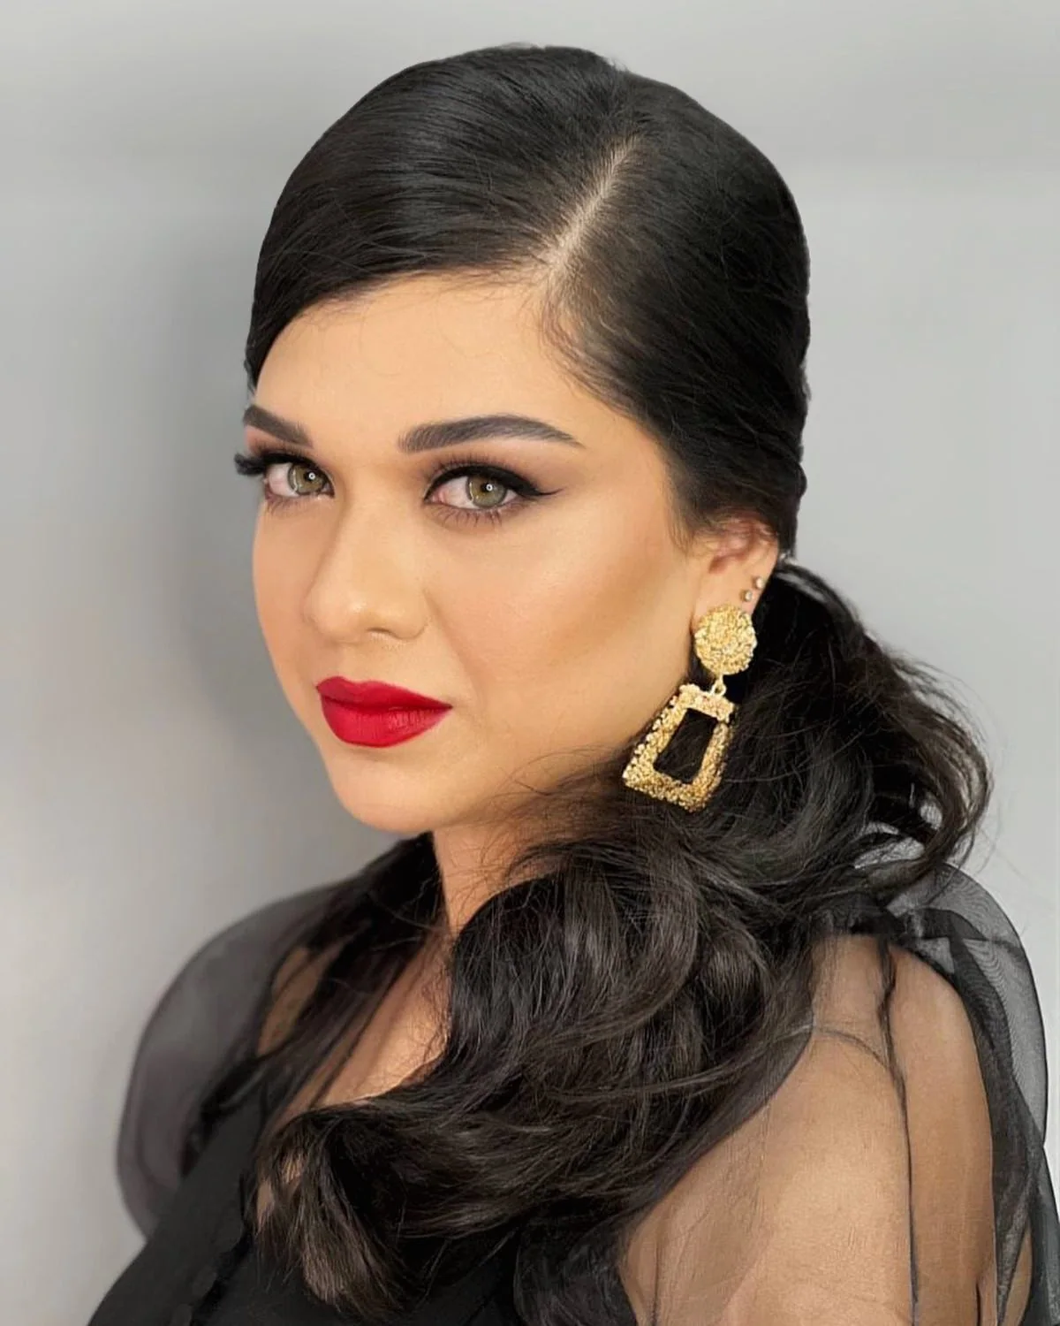
Beauty Me
Salonning
onlayn manzili
Xizmatlarni ko‘rsatish va
mijozga bog‘lanishni osonlashtirish
Veb sayt, CRM va Telegram bot taklifi
Notes:
Beauty Me uchun tayyorlangan mustaqil demo konsepti. Haqiqiy surat salonning Instagram postidan: https://www.instagram.com/beautyme_uz/p/CZya3dgt4T8/ . Sayt: https://beauty-me-tashkent-demo.netlify.app/uz/ .

Slide 2
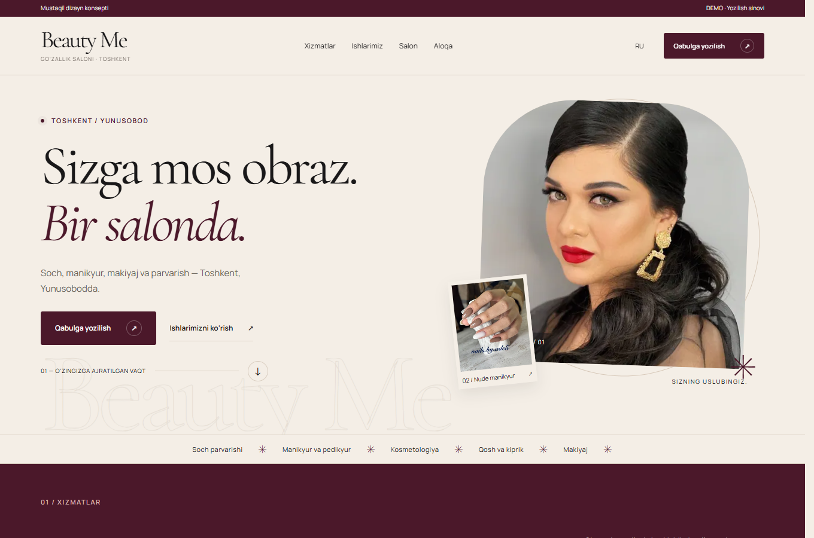
Biznesga foydasi
01
Ko‘proq ishonch
Salonning haqiqiy ishlari va xizmatlari
mijozga tanlashda yordam beradi.
02
Yozilish osonroq
Xizmatni tanlash, yozilish va
telefon orqali aloqa bir joyda.
03
Kamroq takroriy savol
Xizmatlar, manzil va aloqa ma’lumotini
mijoz saytning o‘zida ko‘radi.
04
Reklama uchun bitta havola
Instagram bio, QR va reklama
mijozni bir manzilga olib keladi.
Beauty Me uslubiga mos ranglar,
yirik suratlar va aniq yozilish tugmasi
Notes:
Skrinshot: https://beauty-me-tashkent-demo.netlify.app/uz/ . Ko‘rsatilgan foydalar interfeys vazifalaridan kelib chiqadigan imkoniyatlar, savdo yoki konversiya natijasiga kafolat berilmaydi. Hozirgi yozilish forma rejimi demo.

Slide 3
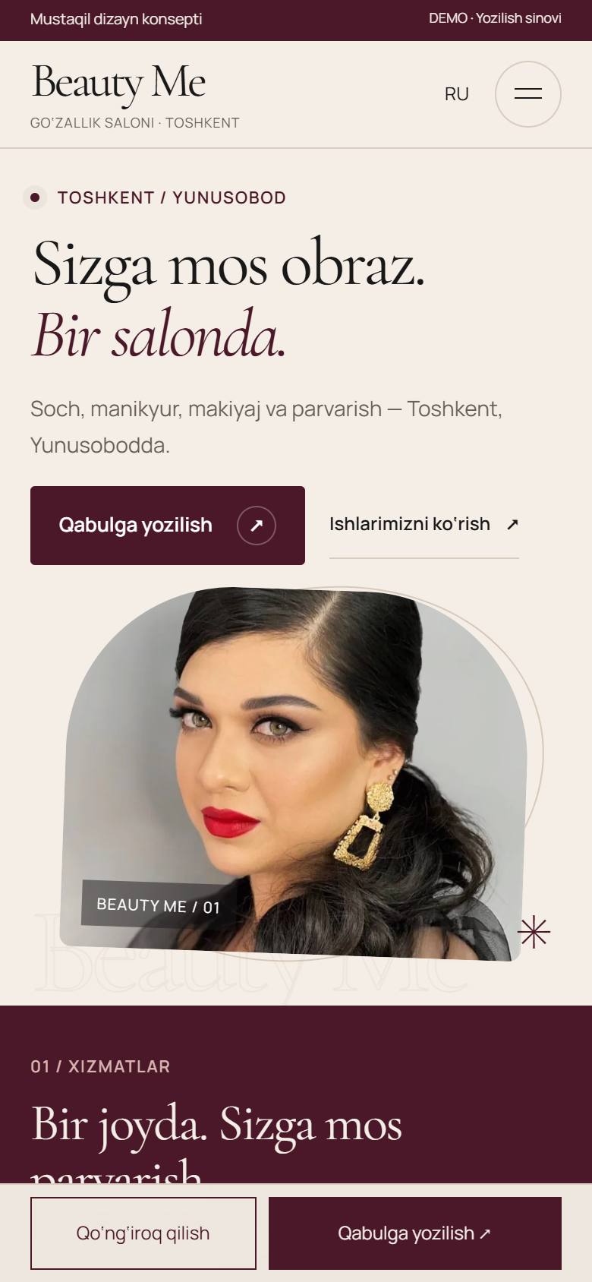

Mijoz uchun qulay ko‘rinish
6 xizmat yo‘nalishi
Soch, tirnoq, kosmetologiya, qosh va
kiprik, makiyaj hamda massaj
Haqiqiy ishlar galereyasi
Filtrlar, kattalashtirish va suratga
mos xizmatga darhol yozilish
Telefon va kompyuter uchun
UZ/RU tillari, ijodiy o‘tishlar,
yozilish formasi va qulay aloqa
Notes:
Haqiqiy mobil skrinshotlar: https://beauty-me-tashkent-demo.netlify.app/uz/ va https://beauty-me-tashkent-demo.netlify.app/uz/gallery/ . Funksiyalar loyiha src/data/content.ts, Gallery va Booking komponentlari orqali tekshirilgan. Yozilish faqat xizmat, sana va vaqt tanlovini shu tabdagi admin namunasiga o‘tkazadi. Ism, telefon va izoh saqlanmaydi; salonga hech narsa yuborilmaydi.

Slide 4
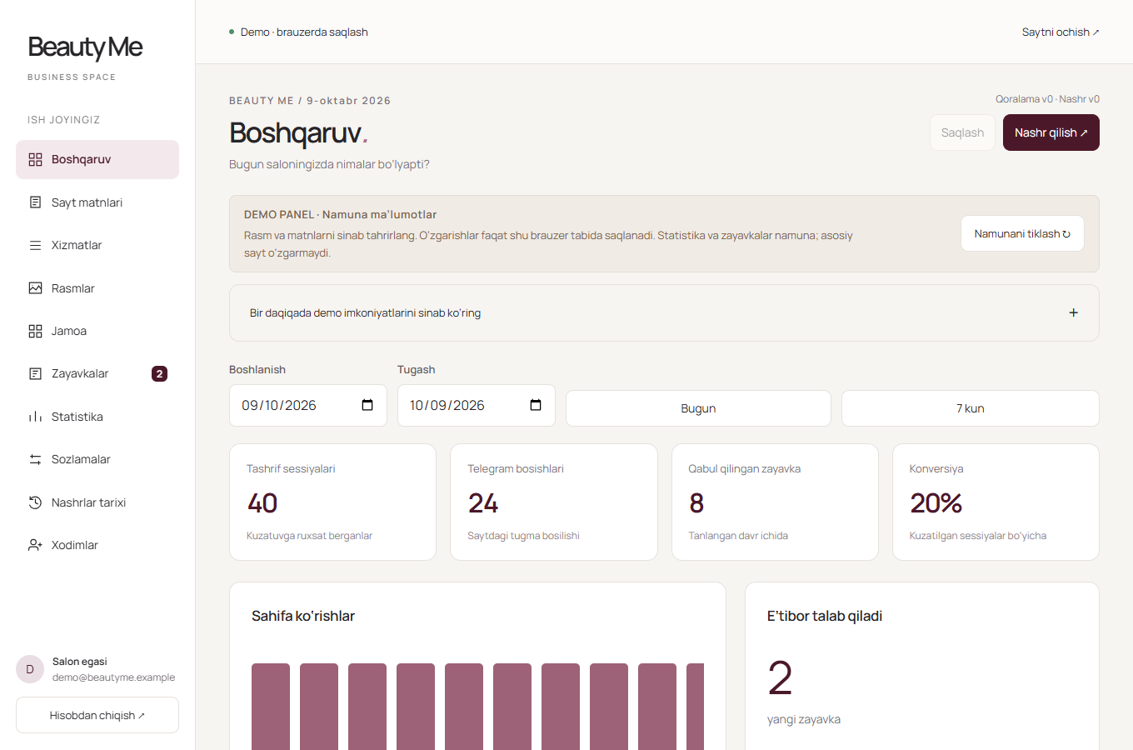
Boshqaruv o‘z qo‘lingizda
Matn va rasmlar
Rasm yuklash, kesimini tanlash,
xizmat va ma’lumotni yangilash
Mijoz so‘rovlari
Demo yozilish so‘rovi, holat,
izoh va mas’ul xodim
Statistika va nazorat
Tashriflar, Telegram bosishlari,
xodimlar va nashrlar tarixi
Demo: raqamlar namuna, tahrirlar brauzerda. Paket doirasida haqiqiy bazani ulab ishga tushiramiz.
Notes:
Admin screenshot and link: https://beauty-me-tashkent-demo.netlify.app/admin/demo/ . Dashboard statistics and leads are synthetic demo data, not salon performance. Demo transport stores only per-tab sessionStorage. Real publishing, customer requests and visit collection require Supabase deployment per ADMIN_SETUP.md. Source: ADMIN_DEMO_QA.md and src/admin/demo.ts.

Slide 5
CRM va Telegram bot
Saytdagi barcha zayavkalar tanlangan mas’ul xodimlarga keladi
01
02
03
04
Saytdagi zayavka
CRM’da saqlash
Telegram xabari
Administrator amali
Ism, telefon,
xizmat va vaqt
So‘rov va holat
bir joyda ko‘rinadi
Barcha zayavkalar
mas’ul xodimlarga
Tasdiqlash yoki
mijozga qo‘ng‘iroq
Bot ichida boshqarish
Holat CRM’da yangilanadi
«Tasdiqlash» va «Bog‘lanildi» amallari.
Telefon orqali mijoz bilan aloqa.
Guruh yoki shaxsiy chatlarga xabar.
Botdagi amal admin panelda ham ko‘rinadi.
Holat, izoh va mas’ul xodimni
kuzatish mumkin.
Paket doirasida ishlab beriladi. Hozirgi demo botga ulanmagan va statistikasi namuna.
Notes:
Commercial scope supplied by the user: develop a CRM-connected Telegram bot, notify all selected responsible administrators about every website request, support confirmation/contact actions, and synchronize status with the admin panel. This is included implementation work, not an existing live feature. Contact means using the submitted phone number; no claim of automatic bot messaging to customers who have not started the bot. Current live admin is a sandbox.

Slide 6


Taklif va ishga tushirish
$250
Demo havolalari
Bir martalik ishlab chiqish narxi
Sayt, admin panel, CRM va Telegram bot
Ishga tushgach 1 oy bepul
Mijoz sayti
Admin demo
Servis, yordam va mas’ul xodimga saytni hamda
admin panelni yuritishni 1 oy davomida o‘rgatish.
Saytni ochish
Panelni ochish
QR yoki havolani bosing.
Admin demo parolsiz ochiladi.
Domen va server / hosting
To‘lov mijoz hisobidan. Hisoblar biznes egasi nomiga
ochiladi. Tanlash, ulash va to‘liq sozlashni biz bajaramiz.
Notes:
User-specified fixed development price: USD 250, including the website, real admin/CRM integration, Telegram bot development, setup and go-live. The client pays domain and server/hosting provider charges separately, accounts and domain are registered under the business owner. Our work covers provider selection, registration assistance, connections and complete setup. First month after go-live includes free service/help and training of the designated person to maintain the website and use admin features. No subsequent monthly service price or provider fee was supplied, so none is invented here. QR payloads: https://beauty-me-tashkent-demo.netlify.app/uz/ and https://beauty-me-tashkent-demo.netlify.app/admin/demo/ .

