Slide 1
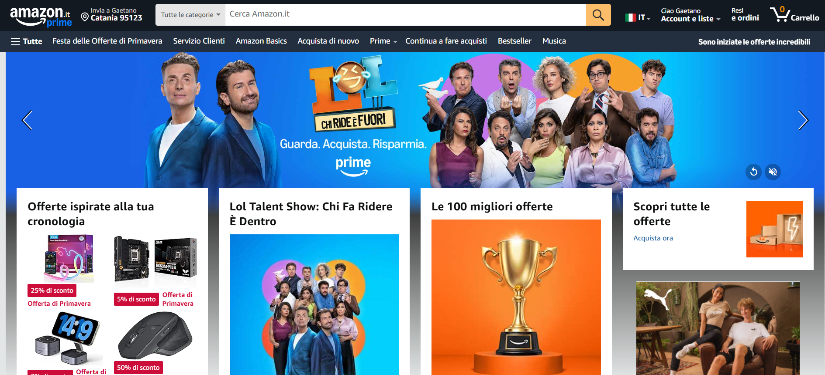
http://127.0.0.1:5500/ecommerce-layout/mhw.html#

