Slide 1
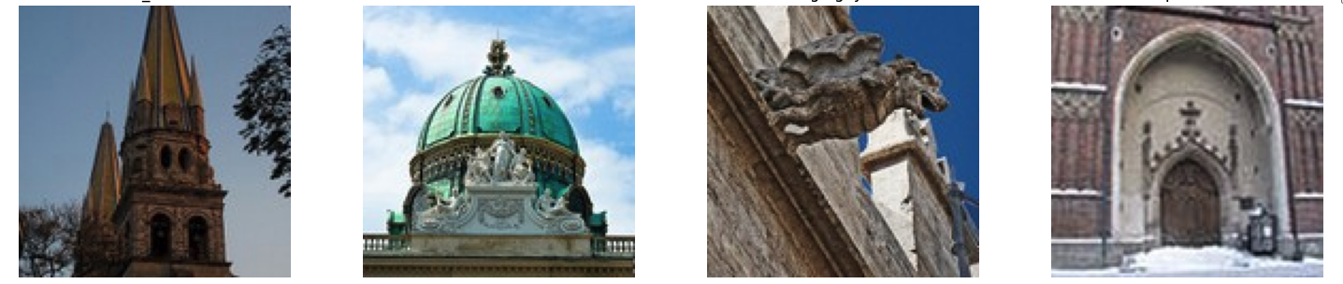
Deep Learning Approach to Identifying Architectural Heritage Structure
Deep Learning - Final Project by Arbind Kumar Singh

Slide 2
Problem Description
In this deep learning project, I will perform
Create a Convolutional Neural Network (CNN) that can classify architectural heritage elements into classes such as altar, apse, bell tower, column, dome (inner), dome (outer), flying buttress, gargoyle, stained glass and vault.
Using various types of neural network architectures and hyper parameter tuning to gain insight into what factors most affect model performance.
Compare all model results that have used the same dataset (training and test).

Slide 3
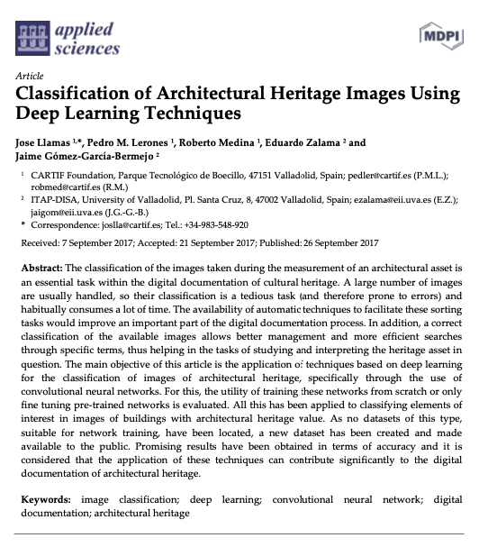
Problem Description
Classify architectural heritage elements is a challenging task in image classification, as it involves not only shape and position but also a symbolic dimension
The project is inspired by the article: Llamas J, M. Lerones P, Medina R, Zalama E, Gómez-García-Bermejo J. Classification of Architectural Heritage Images Using Deep Learning Techniques. Applied Sciences. 2017; 7(10):992. https://doi.org/10.3390/app7100992

Slide 4
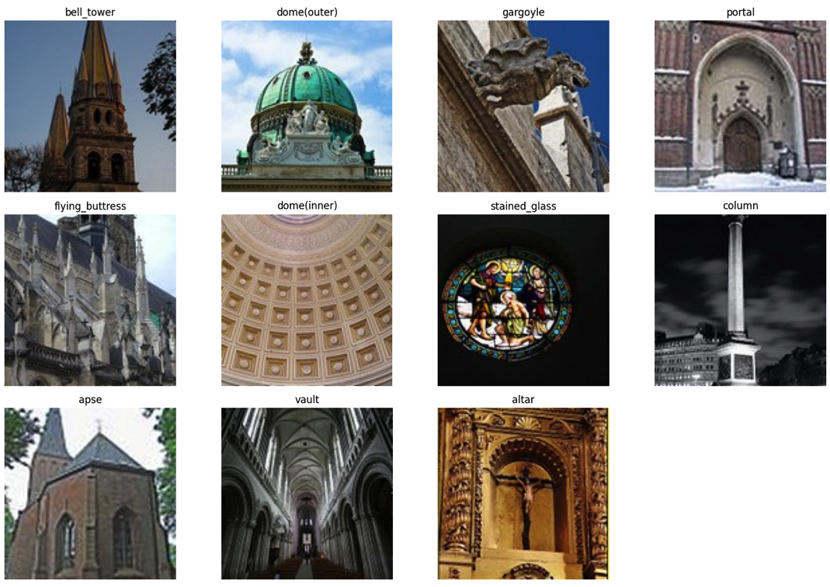
Dataset
The dataset was created and made available as part of the Llamas et al. (2017) article mention before.
The dataset consists of 10543 images classified into 11 categories
The dataset can be found several places and in several versions. This project used https://correo.cartif.es/home/joslla@cartif.es/Briefcase/Architectural_Heritage_Elements_image_Dataset

Slide 5
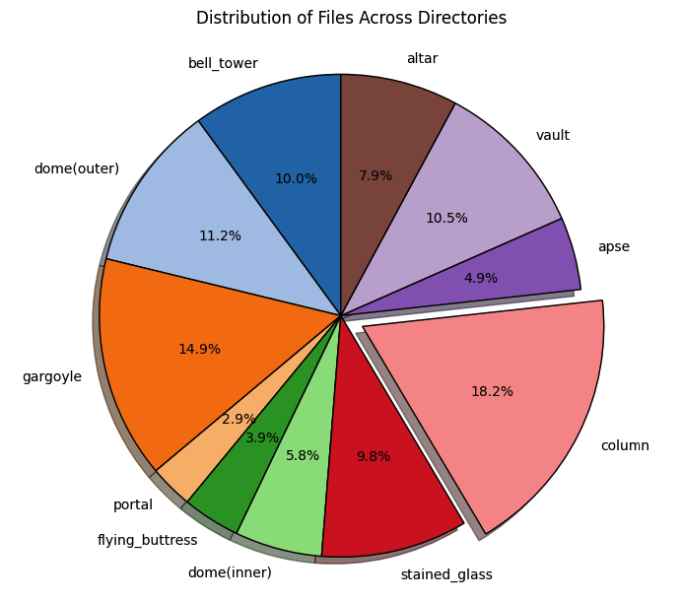
Dataset Analysis
The categories are somewhat unevenly distributed – which can make some categories harder to classify
Since portals are not part of the original study and it is the smallest category, we will remove it from our study

Slide 6
Model Architecture
I will be using Four different convolutional neural network (CNN) architectures: Basic, Deep, Double Conv, and Double Deep. Each architecture is represented as a sequence of layers, with details on layer types, filter sizes, and output shapes.
Basic: This network has a simple structure with convolutional layers, max-pooling layers, a flatten layer, dense layers, and dropout layers. It serves as a baseline model.
Deep: This architecture increases the depth of the network by adding more convolutional and max-pooling layers. This allows the network to learn more complex features.
Double Conv: This model introduces a pattern of two consecutive convolutional layers before each max-pooling layer. This can help the network capture more intricate spatial relationships.
Double Deep: This architecture combines the depth of the "Deep" network with the double convolutional layers of the "Double Conv" network, creating a more complex and potentially more powerful model.
Notes:
Adding more layers to a CCN-model should enhance its capacity to learn more complex features from the data.
And adding double convolution layers should allow the network to perform more complex feature extraction before pooling and enable it to better recognize and combine detailed patterns within the input data.

Slide 7
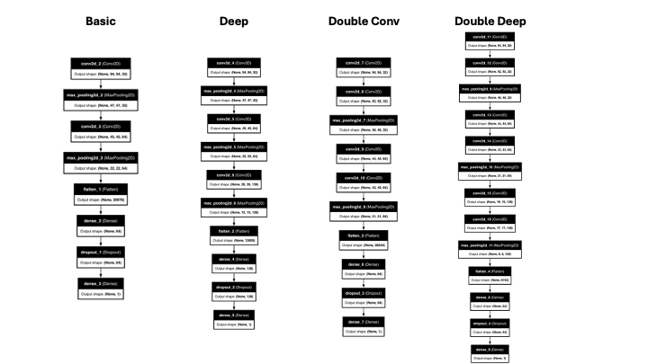
Model Architecture
I will try to improve the accuracy of our prediction by making use of two specific architectural principles – depth and double convolution layer
Notes:
Adding more layers to a CCN-model should enhance its capacity to learn more complex features from the data.
And adding double convolution layers should allow the network to perform more complex feature extraction before pooling and enable it to better recognize and combine detailed patterns within the input data.

Slide 8
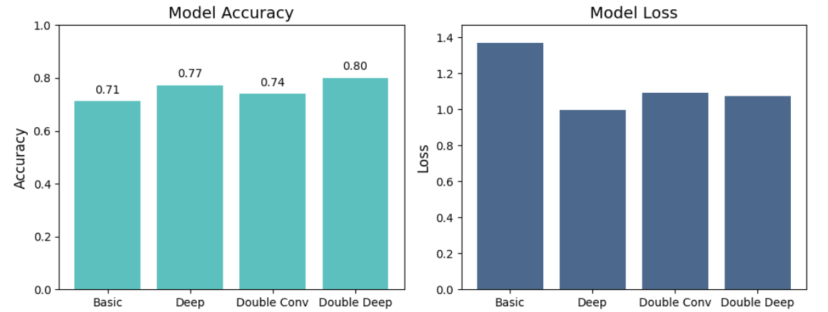
Model Architecture
The Double Deep model outperforms the other three architectures (at least when we look at accuracy).
An even deeper model architecture could perhaps have resulted in even better results.

Slide 9
Results and Analysis
Various methods can be used to improve the performance of a CNN
Using different optimizers
Adding L2 regularization to the neurons in the network
Altering the number of neurons dropped by the dropout layers
Carrying out batch normalization and trying out different learning rates
I will focus on testing the impact of optimizers and L2 regularization
RMSprop
L2 regularization factor of 0.001 and 0.0001

Slide 10
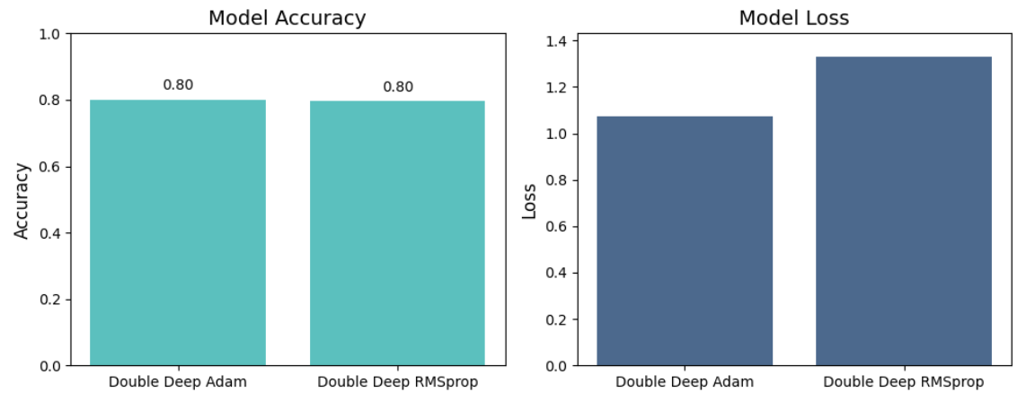
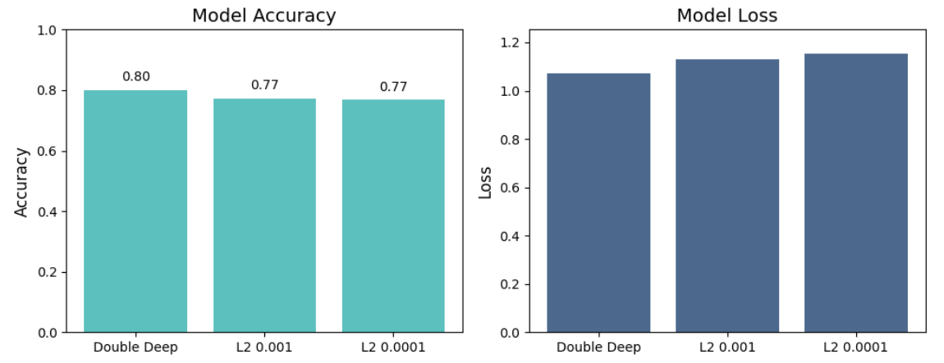
Results and Analysis
Altering the optimizer to RMSprop did not improve model performance. Adam, had the same accuracy, but with a slightly lower loss.
L2 regularization did not lead to any improvement either. The combination of a lot of data, a dropout layer and a l2 regularization seem to have resulted in over-regularization.

Slide 11
Comparison with AlexNet and Inception-ResNet-v2
Comparing my best performing model - the Double Deep - with two of the models used in the paper by Llamas et al. (2017) - Alex net and Inception-Res-v2.
Alex net is a model that among others utilize stacked convolutional layers, ReLU activations and dropout for regularization. It achieved a remarkable performance on the ImageNet dataset in 2012.
Inception-ResNet-v2, on the other hand, is a model that is pre-trained on ImageNet data, which consists of 1000 object classes and contains 1,281,167 training images.

Slide 12
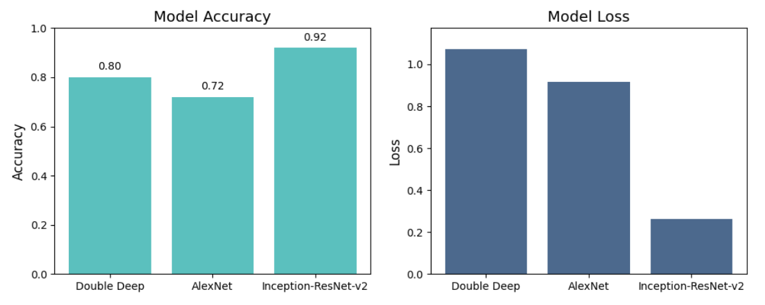
Comparison with AlexNet and Inception-ResNet-v2

Slide 13
Conclusion
It is possible to build a CNN model that can classify architectural heritage elements into classes with a reasonably good accuracy (about for our best model 80%).
Architecture seems to be more important than conventional hyper parameter tuning and regularization.
Both depth and double convolution layers add positively to performance and the combination produces very good results.
Pre-trained models, such as InceptionResNet v2, tend to outperform model which have not been trained in advance. In our case, the InceptionResNet model managed to classify 92% of the elements correctly.

Slide 14
GitHub Repo
https://github.com/getarbind/Deep-Learning-Final-Project/tree/main
It container Jupyter notebook, Dataset, Results and Presentation

