Slide 1
Global Partners End to End Project
Created by Marvin Ziegler

Slide 2
Data Analysis prior to Pipeline Creation
File Integrity (Missing values, duplicates, corrupt values):
csv_data_integrity_report.xlsx
csv_data_integrity_info.txt
Info on schema, relationships & data quality
Key columns for joins & insights
initial_data_analysis.txt

Slide 3
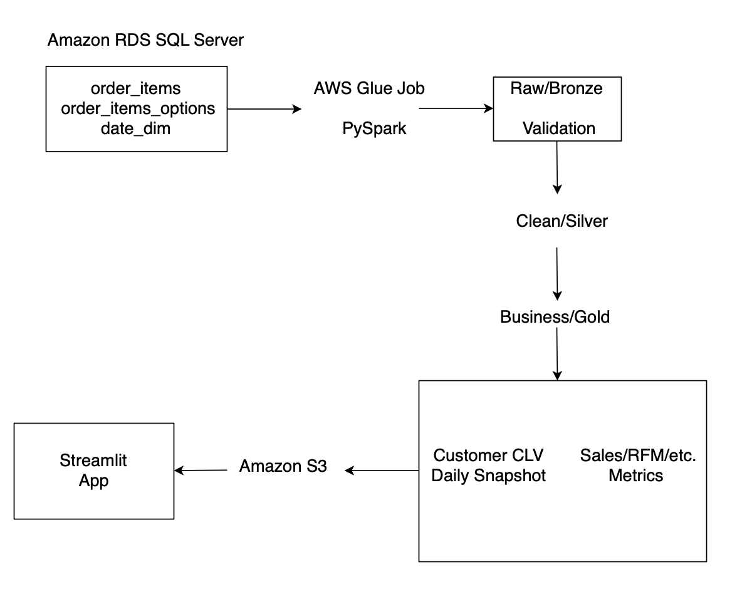
Architecture Pipeline

Slide 4
Definitions
Athena - serverless, interactive query service courtesy of Amazon AWS; allows direct data analysis in S3 using standard SQL
IAM - AWS Identity and Access Management
KMS - AWS Key Management Service, which allows creation of keys and control encryption across AWS and beyond
VPC - Virtual Private Cloud (a secure, isolated private network hosted within a shared public cloud)

Slide 5
Metrics - Measurement of customer activity impacts
Primary - Customer Lifetime Value (Estimation of Total Lifetime Value of Customer Interactions)
Focus - Aggregation to calculate customer behavior, separation customer activity
into tiers based on level of activity
Secondary - Calculations of customer activity levels, at risk customers, sales trends,
loyal program impacts, restaurant performance & discount effectiveness
Primary & Secondary Metrics Calculations:
primary_secondary_metrics.txt

Slide 6
Github
Repository for files for this project
All files are uploaded to Github via CLI at the following location:
https://github.com/getaround2itnow/global_partners

