Slide 1
Health Care End to End Project
Created by Marvin Ziegler

Slide 2
Initial Report on Missing values, duplicates & outliers
Definitions:
Missing values - cells that aren’t populated with data
Duplicates - records (rows) that appear twice in a table
Outliers - values that differ greatly in range from the majority of other values
Example: most numeric values range from 20 to 100; an outlier might be 2
on the lower end or 120 on the upper

Slide 3
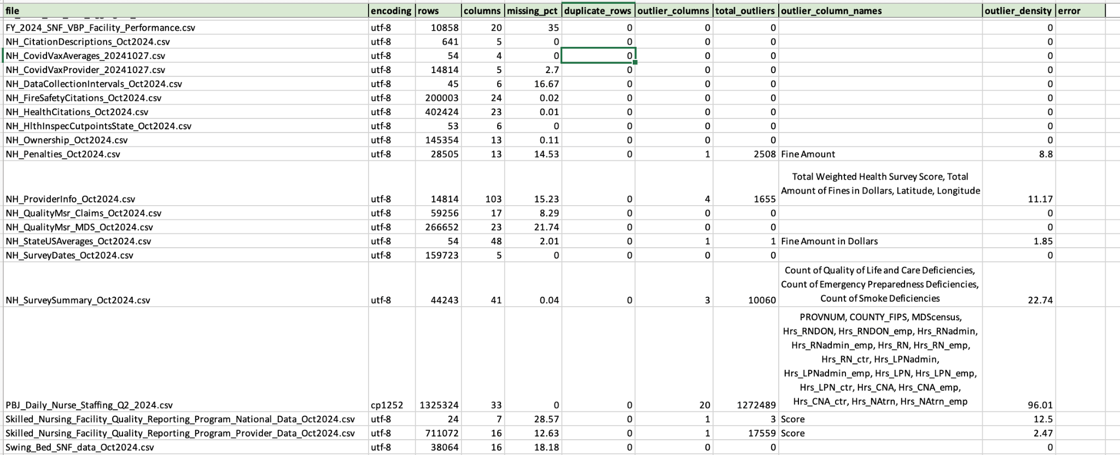
Preliminary spreadsheet for report on missing values, duplicates rows and outliers
The column for missing values is column E; it’s labeled ‘missing_pct’ (for missing percent).

Slide 4
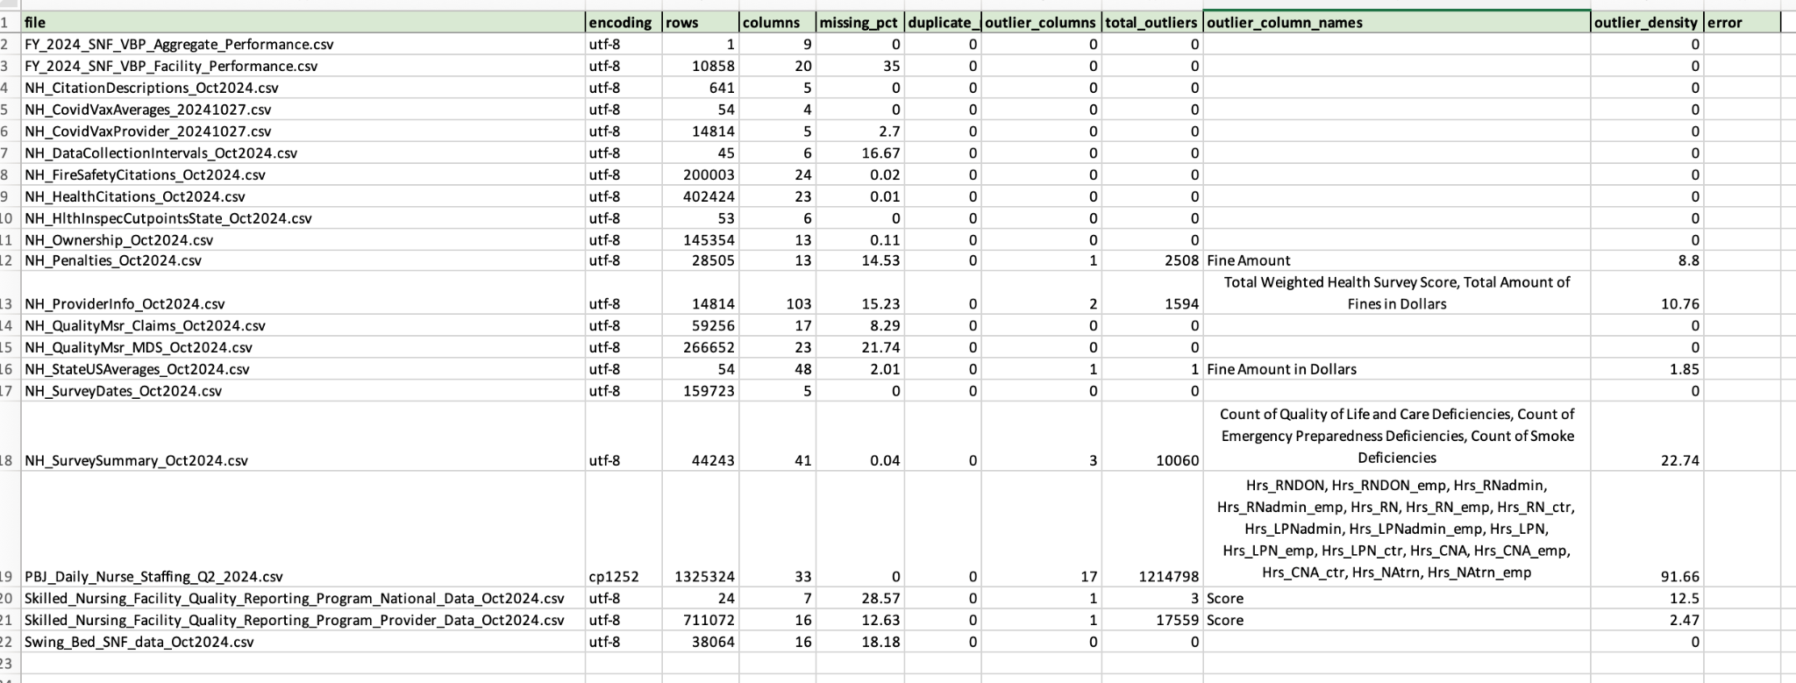
Subsequent spreadsheet for report on missing values, duplicates rows and outliers
The column for missing values is column E; it’s labeled ‘missing_pct’ (for missing percent).

Slide 5
Explanation for difference between reports
For the files named "PBJ_Daily_Nurse_Staffing_Q2_2024.csv", which contained hours worked for various types of nursing personnel, the outlier density was at 91.66% per the findings. This amount remained high, even after adding the necessary words to the list of "exclude keywords” such as "Provnum”, "County_FIPS” and "MDSCensus”. Adding the exclude_keywords caused the outlier density to be reduced from 96.01%.
This indicates that the staffing dataset varies widely as far as hours from one institution (or staff member) to another even after investigating the numbers. Active consideration of the legitimate outliers and eliminating invalids as appropriate indicates true staffing levels vary quite a bit from one place to another.

Slide 6
Missing value report explanation
File name | Purpose | Missing value % | Explanation for missing values
FY_2024_SNF_VBP_Facility_Performance.csv | nursing facility performance | 35 | footnote columns that aren’t data populated
NH_QualityMsr_MDS_Oct2024.csv | quarterly scores for various nursing home measurements | 21.74 | footnote columns that aren’t data populated
NH_DataCollectionIntervals_Oct2024.csv | from & to dates of various measures | 16.67 | a ‘date range’ column that isn’t being used
NH_ProviderInfo_Oct2024.csv | mostly staffing to patient ratios | 15.23 | “special status focus” column that isn’t data populated in most cases, several footnote columns are blank, few instances of numeric values being written in footnote column instead of the numeric value column
NH_QualityMsr_Claims_Oct2024.csv | various measures for different patient types | 8.29 | various score columns aren’t data populated; a footnote column that isn’t used
NH_StateUSAverages_Oct2024.csv | averages for various metrics per state | 2.01 | various numeric values not data populated

Slide 7
Key columns for joins & data exploration
PBJ_Daily_Nurse_Staffing_Q2_2024.csv PROVNUM (equates to CMS Certification
Number (CCN) on other files)
NH_ProviderInfo_Oct2024.csv CMS Certification Number (CCN)
NH_StateUSAverages_Oct2024.csv Nation or State
NH_QualityMsr_MDS_Oct2024.csv CMS Certification Number (CCN),
Measure Code

Slide 8
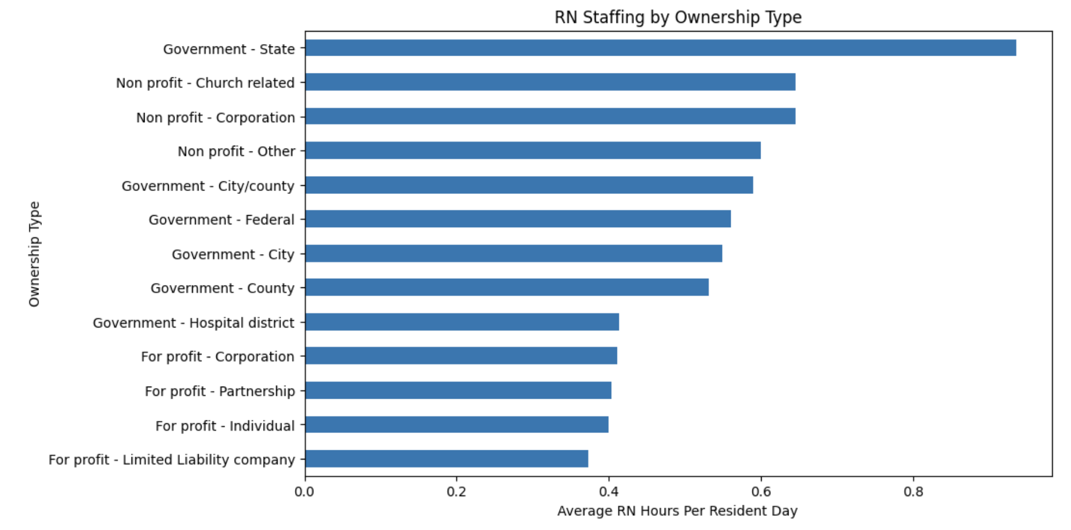
RN Staffing per Ownership Type

Slide 9
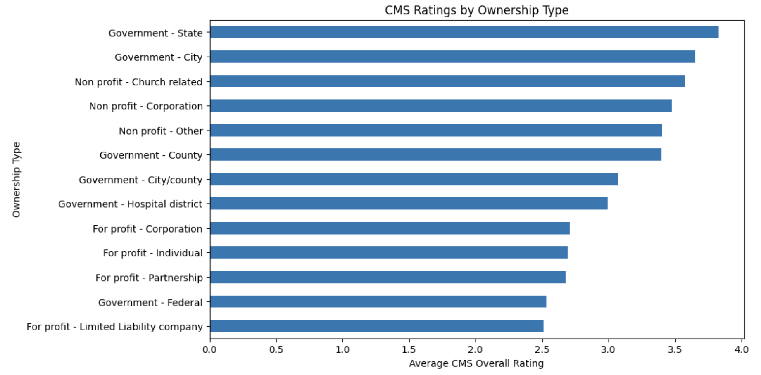
Average Rating per Ownership Type

Slide 10
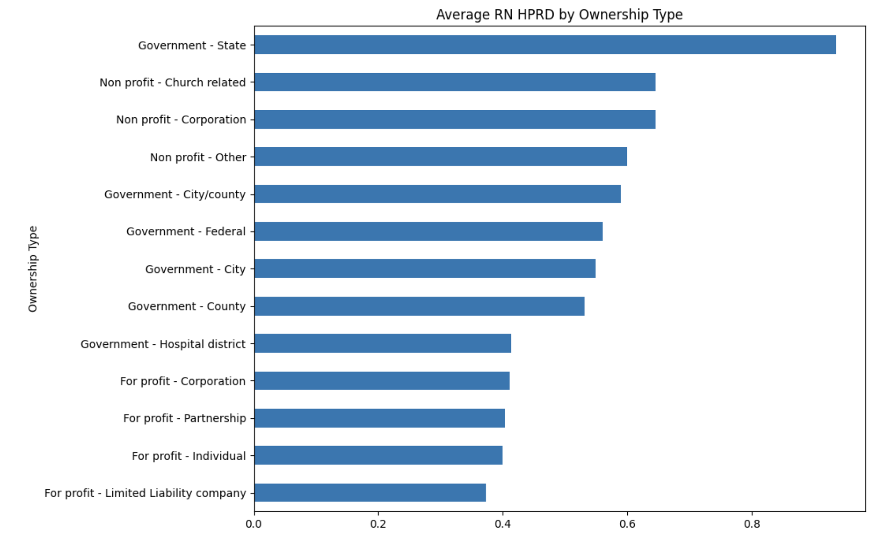
Ownership Type per Average RN Hour per Res per Day

Slide 11
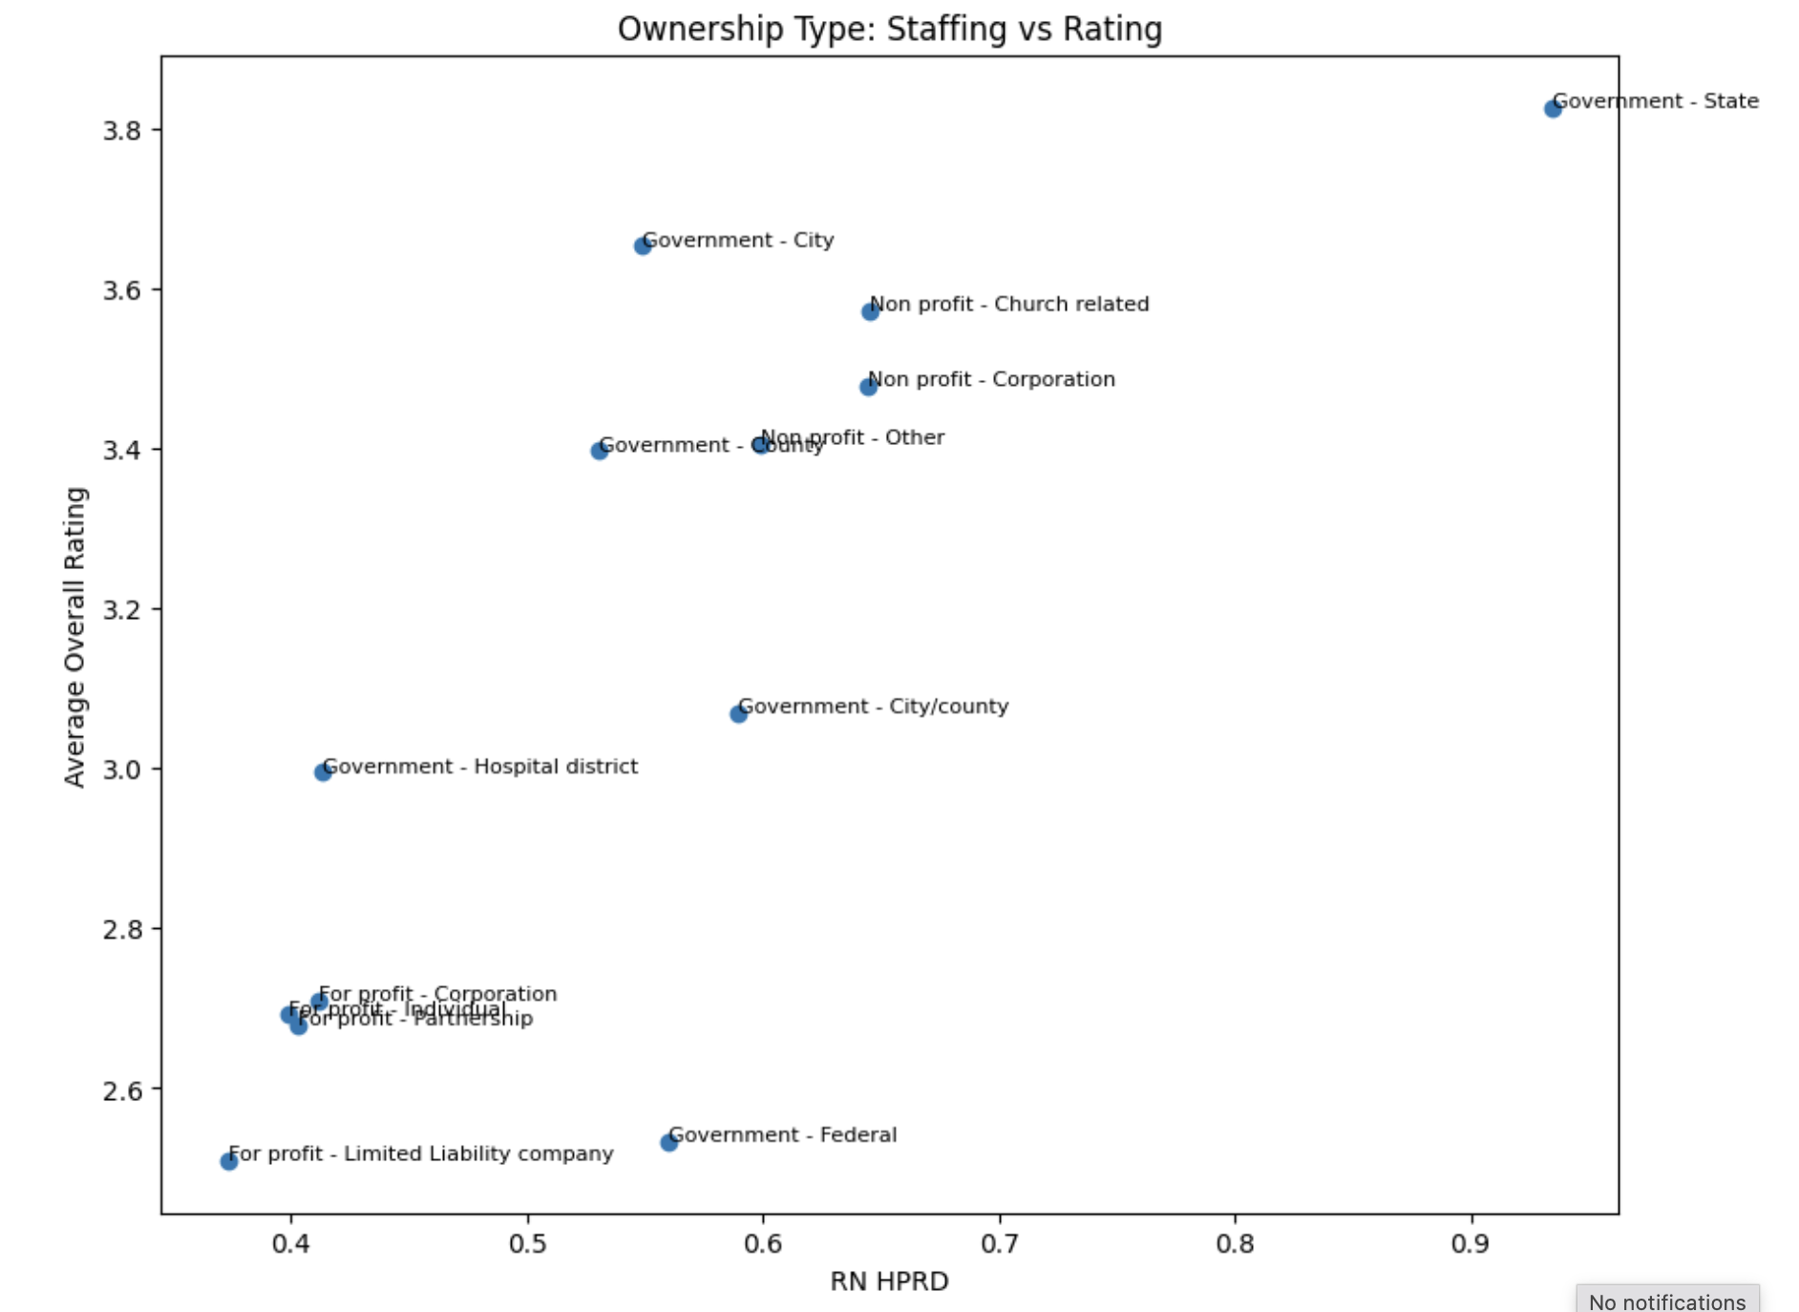
Comparison of Ownership Types vs Staffing & Rating

Slide 12
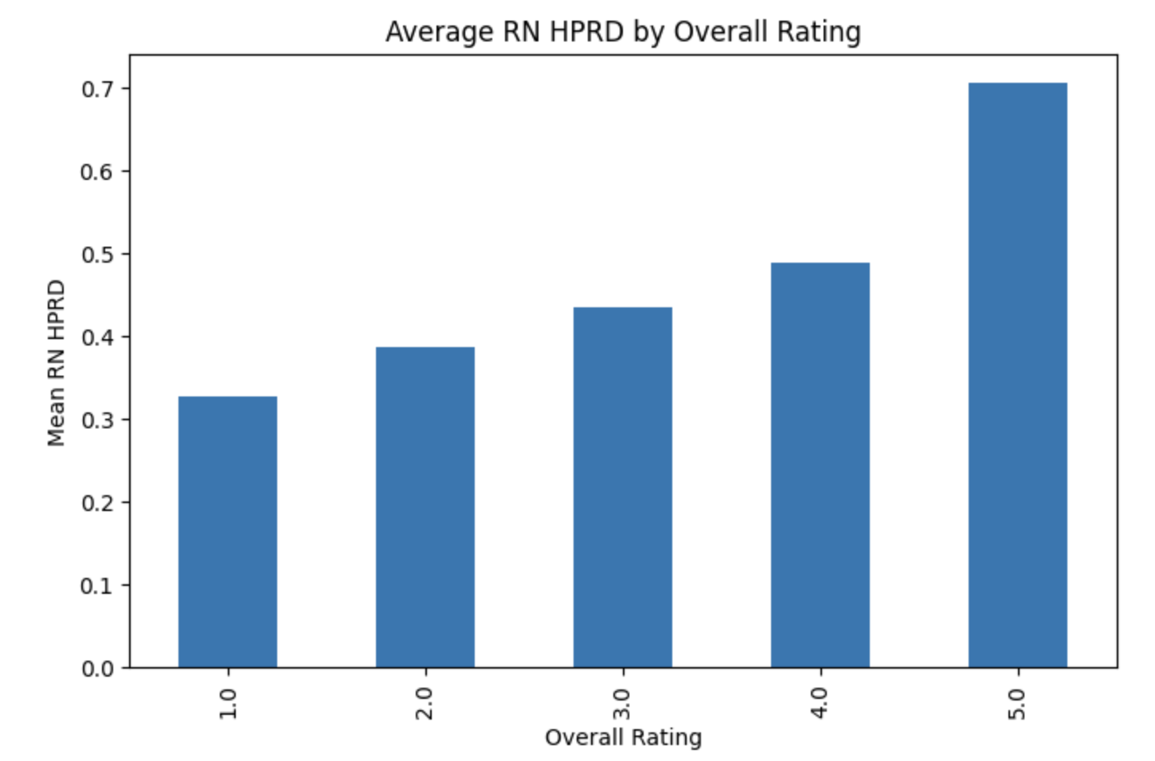
Average RN Hours per Resident Day per Overall Rating

Slide 13
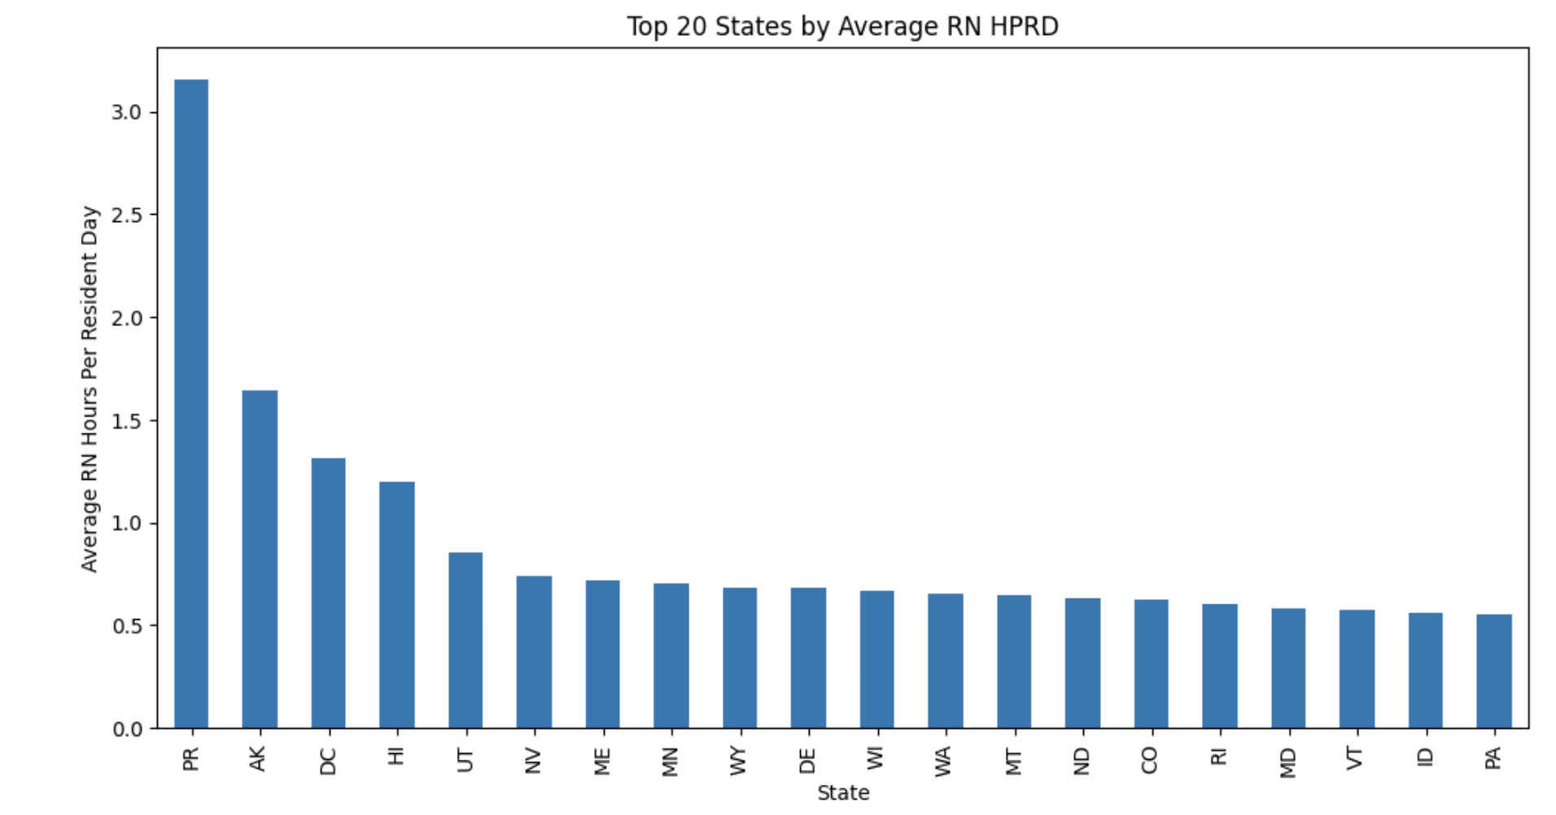
Average RN Hours per Resident Day per State

Slide 14
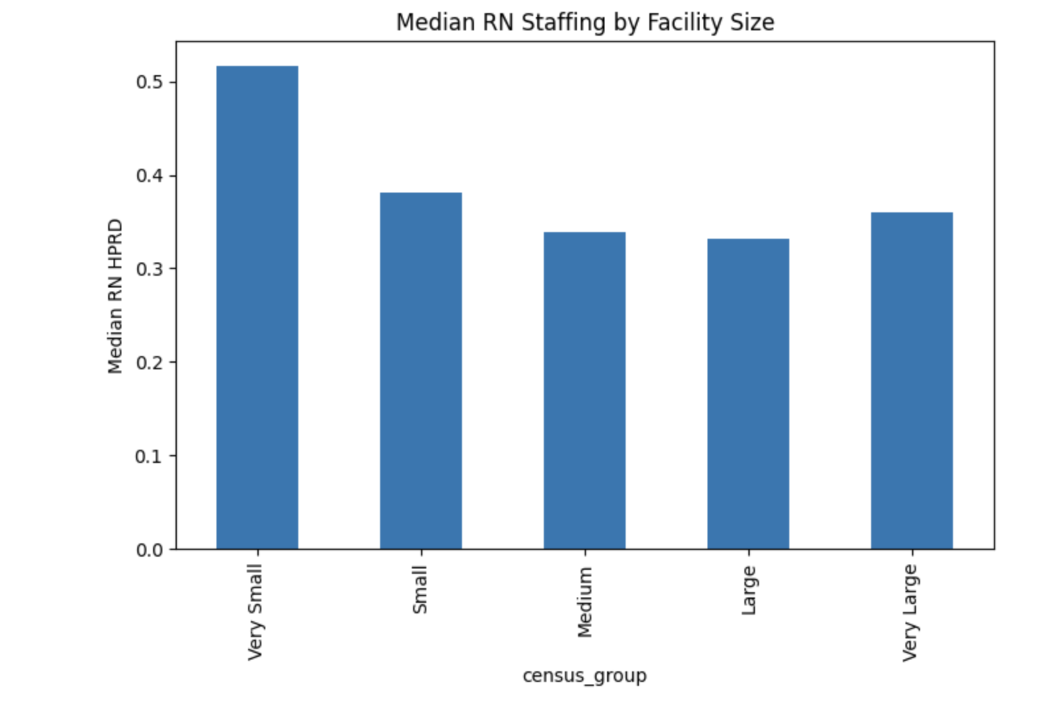
Median RN Staffing per facility size

Slide 15
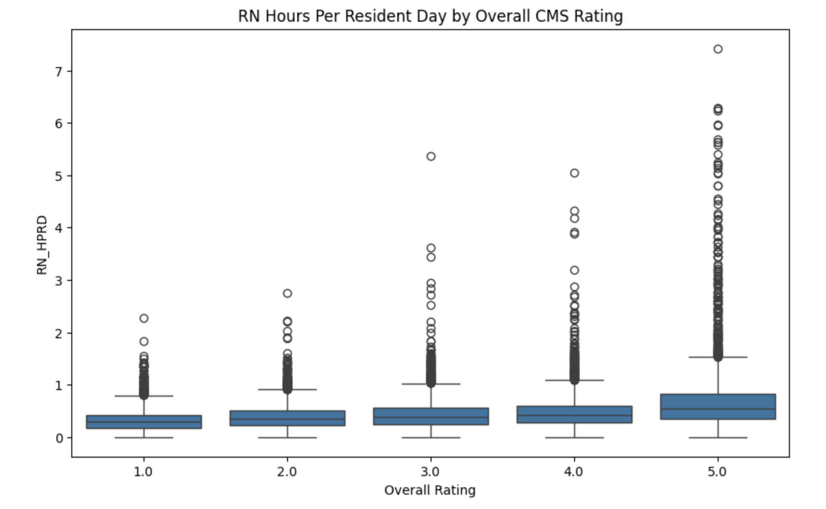
RN Hours per Resident Day per Overall Rating

Slide 16
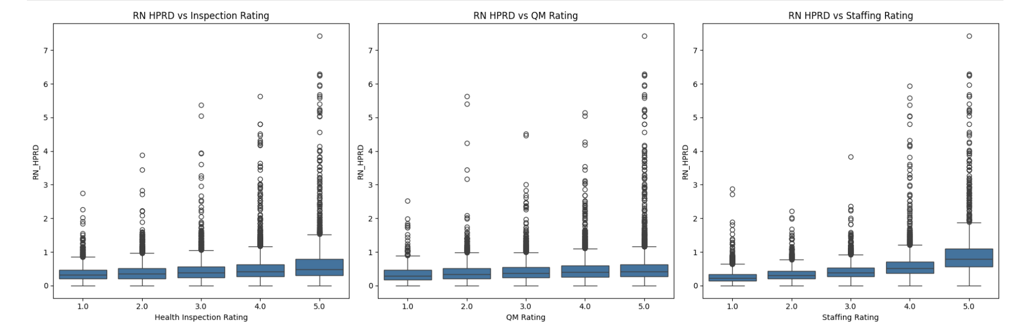
Comparison of Rating Types

Slide 17
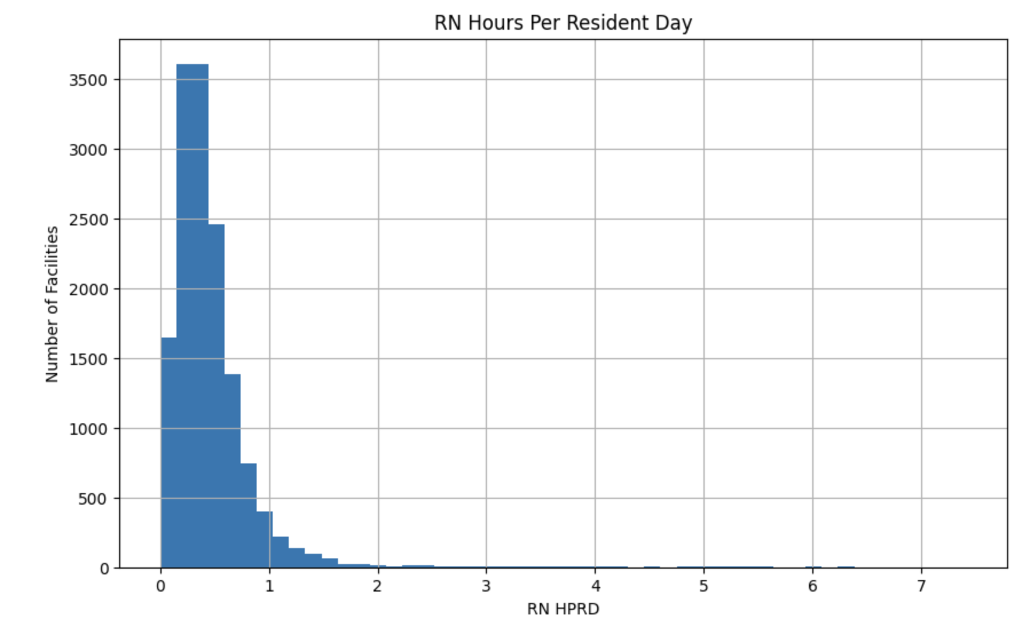
RN Staffing per Resident Day per Number of Facilities

Slide 18
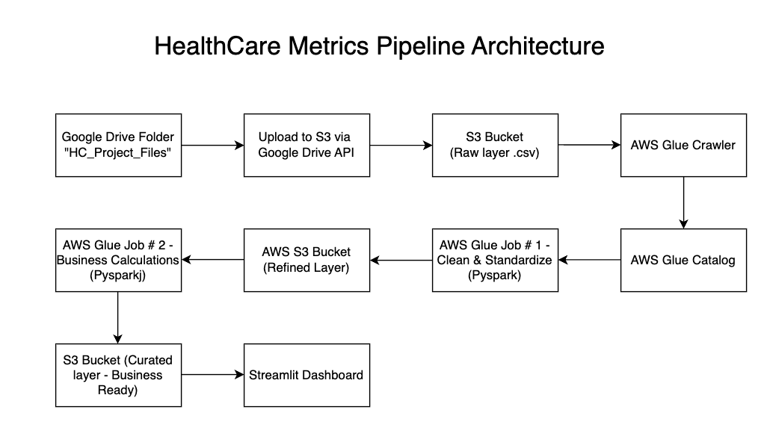

Slide 19
Google Drive API (part 1)
Located at:
https://drive.google.com/file/d/1O2Q6PRTMJ3N4yA2JL2_hvH9audgnMBA1/view?usp=drive_link
Import statements used:
import io (handles input/output operations)
import os (interaction with underlying operating system)
from googleapiclient.discovery import build
from googleapiclient.http import MediaIoBaseDownload
from google_auth_oauthlib.flow import InstalledAppFlow
from google.auth.transport.requests import Request
from google.oauth2.credentials import Credentials
import boto3
Included above are import statements that are specific to the Google APIs Client Library for Python. They’re used for:
handle downloading of binary files
allowing of file operations
grant permissions
boto3 is for interaction with AWS services
Notes:
g

Slide 20
Google Drive API (part 2)
functions:
def get_drive_service()
Verifies user credentials and returns API client
def transfer_drive_to_s3()
Queries google drive folder for files/shortcuts
Processes & streams files/shortcuts to S3
Notifies user of status

Slide 21
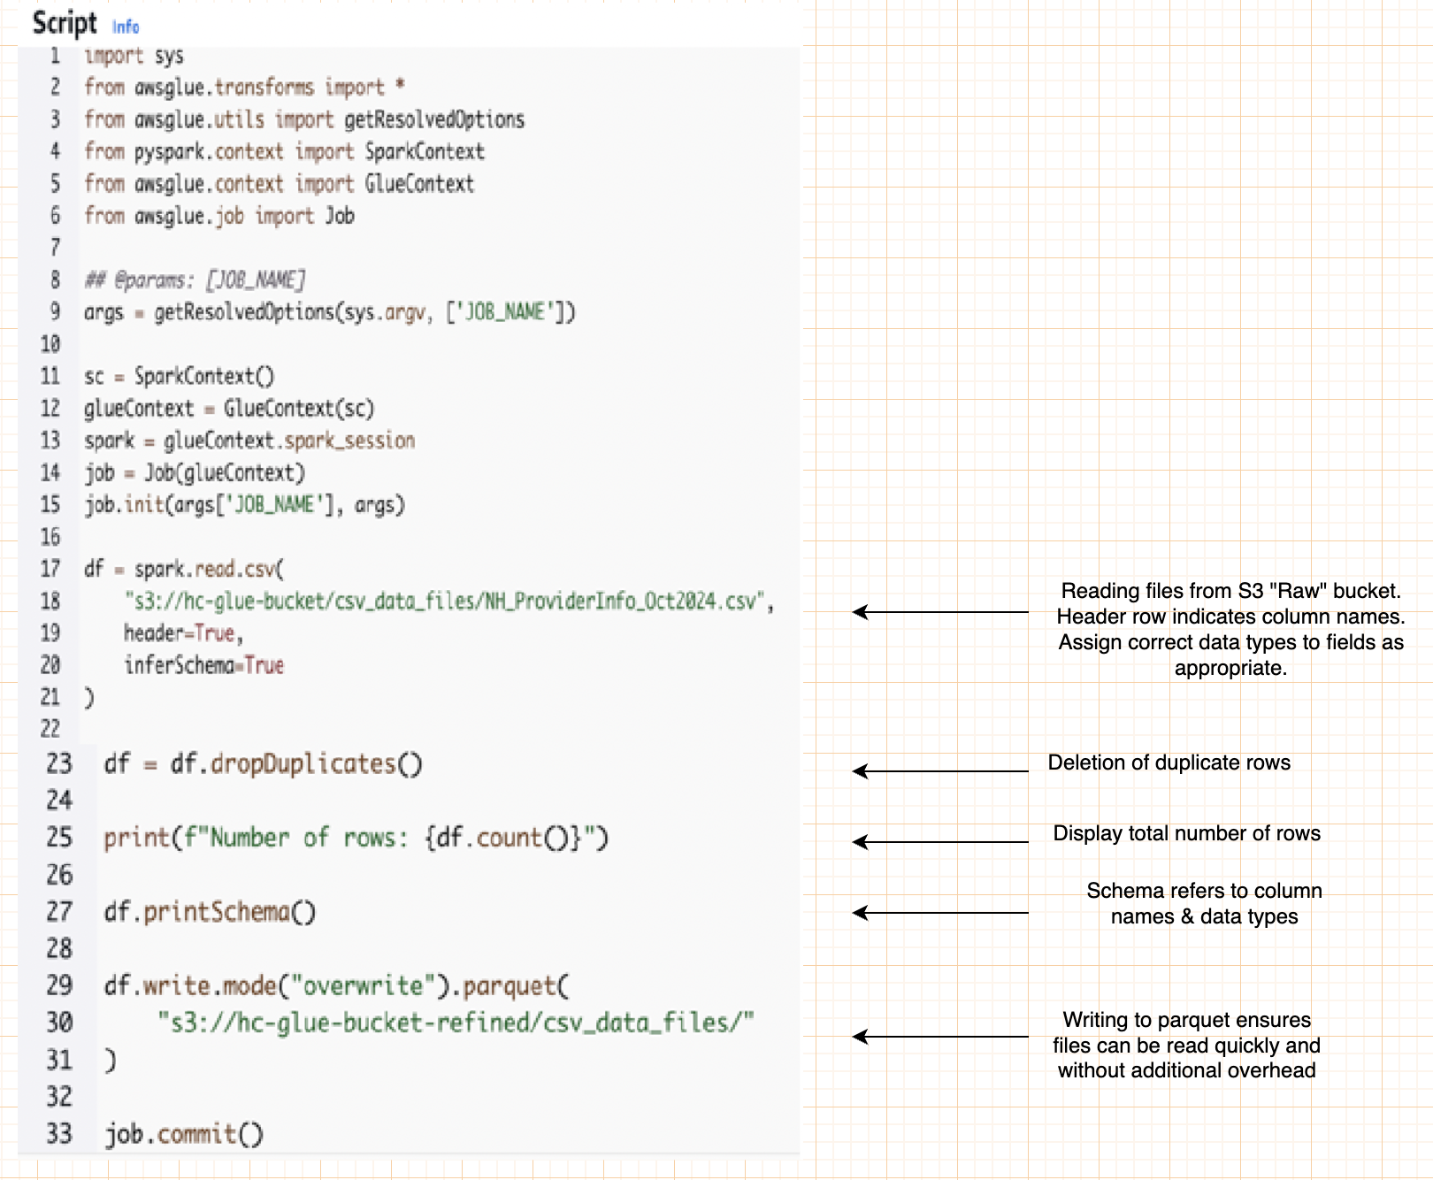
Glue Job # 1 Script -
Raw to refined layers

Slide 22
Staffing metrics Question 2: Total hours worked by nurses per hospital, state, and month (Part 1)
By month:
It peaked in May 2024, yet was lower in April & June of 2024
Month Nurse Hours Worked
2024-04 119,635,201
2024-05 124,319,975
2024-06 120,197,608
By state:
It widely varied; it was highest in CA & NY at 35 & 30 million; lowest in AK & PR at 313
and 48 thousand.

Slide 23
Staffing metrics Question 2: Total hours worked by nurses per hospital, state, and month (Part 2)
By facility:
top 2:
Provider Name State Nurse Hours Worked
MILLER'S MERRY MANOR IN 220,850
ISABELLA GERIATRIC CENTER INC NY 199,145
bottom 2:
Provider Name State Nurse Hours Worked
ST CATHERINE OF SIENA NJ 0
WHITE RIVER HEALTHCARE AR 0

Slide 24
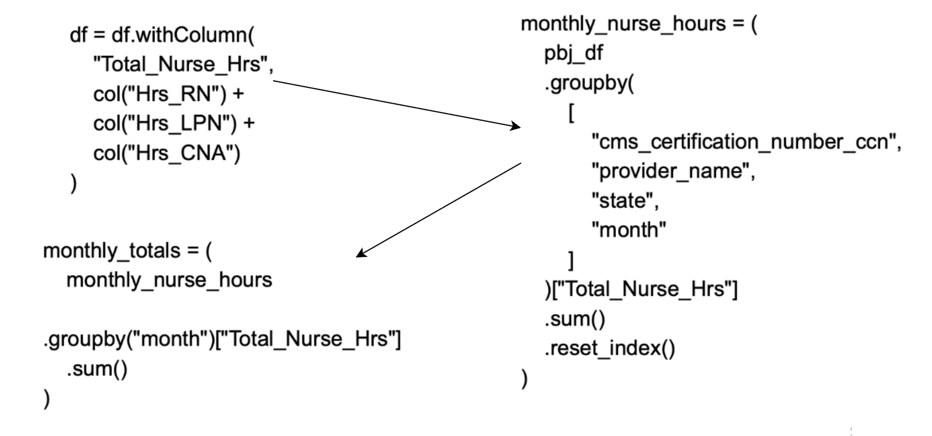
Arriving at answer to staffing metric # 2 (Part 1):
For total nurse hours per month, total nurse hours were calculated when transferring data from refined to curated during the AWS Glue Job. Then in streamlit, hours were summed and grouped for each month.

Slide 25
Arriving at answer to staffing metric # 2 (Part 2):
For total nurse hours per state, total nurse hours were grouped and summed by cms_certification_number. Then they were grouped and summed again by state and populated into a different dataframe.
monthly_nurse_hours = (
pbj_df
.groupby(
[
"cms_certification_number_ccn",
"provider_name",
"state",
"month"
]
)["Total_Nurse_Hrs"]
.sum()
.reset_index()
)
nurse_hours_state = (
monthly_nurse_hours
.groupby("state")["Total_Nurse_Hrs"]
.sum()
.reset_index()
.sort_values("Total_Nurse_Hrs", ascending=True)
)

Slide 26
Arriving at answer to staffing metric # 2 (Part 3):
nurse_hours_provider = (
monthly_nurse_hours
.groupby(
["provider_name", "state"
]
)["Total_Nurse_Hrs"]
.sum()
.reset_index()
.sort_values("Total_Nurse_Hrs", ascending=False)
For total nurse hours per provider, it's the same process as determining total nurse hours per state. Only the grouping is done by provider instead of by state.

Slide 27
Chart creation for total nurse hours by month
monthly_nurse_hours = (
pbj_df
.groupby(
[
"cms_certification_number_ccn",
"provider_name",
"state",
"month"
]
)["Total_Nurse_Hrs"]
.sum()
.reset_index()
)
monthly_totals = (
monthly_nurse_hours
.groupby("month")["Total_Nurse_Hrs"]
.sum()
)
st.subheader("Total Nurse Hours by Month")

Slide 28
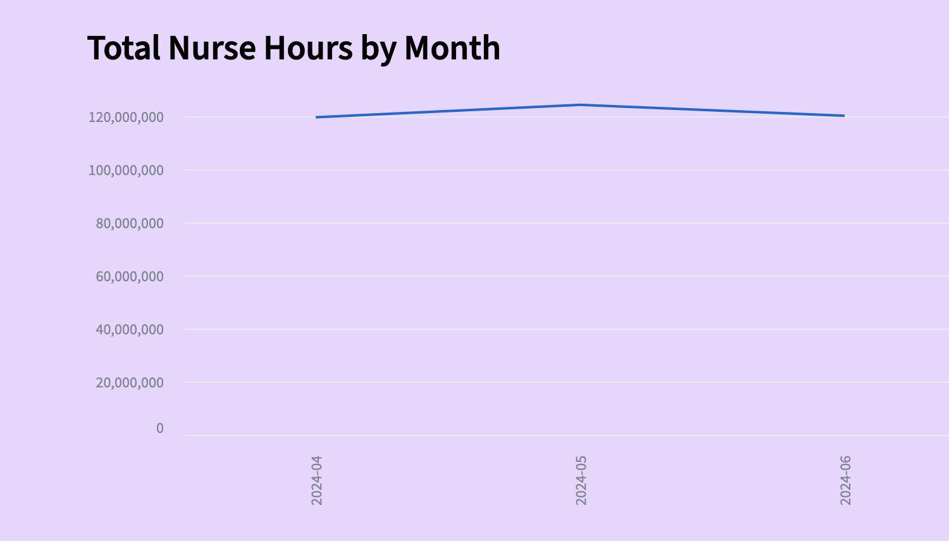
Total Nurse Hours by Month Chart

Slide 29
SQL solution for finding total nurse hours by month
facility level monthly hours:
WITH monthly_nurse_hours AS (
SELECT
cms_certification_number_ccn,
provider_name,
state,
month,
SUM(Total_Nurse_Hrs) AS Total_Nurse_Hrs
FROM
pbj
GROUP BY
cms_certification_number_ccn,
provider_name,
state,
month
)
overall monthly total
SELECT
month,
SUM(Total_Nurse_Hrs) AS monthly_total_nurse_hrs
FROM
monthly_nurse_hours
GROUP BY
month
ORDER BY
month;

Slide 30
Operational Metric # 3
Ratio of permanent staff to temporary/contract staff.
This varies highly from one provider to another one. Some providers might not have any contract nurses at all; others can have more than 40% contract workers.

Slide 31
Arriving at answer to operational metric # 3 (Part 1):
Employee and and contractor hours were added in script that moved data from refined to curated layers in AWS Glue Job.
df = df.withColumn(
"employee_hrs",
col("Hrs_RN_emp") +
col("Hrs_LPN_emp") +
col("Hrs_CNA_emp") +
col("Hrs_NAtrn_emp") +
col("Hrs_MedAide_emp")
)
df = df.withColumn(
"contractor_hrs",
col("Hrs_RN_ctr") +
col("Hrs_LPN_ctr") +
col("Hrs_CNA_ctr") +
col("Hrs_NAtrn_ctr") +
col("Hrs_MedAide_ctr")
)

Slide 32
Arriving at answer to operational metric # 3 (Part 2):
In streamlit, employee to contractor ratio is computed by dividing employee hours by contractor hours.
Percentage of contractor hours is computed by dividing contractor hours by the sum of employee hours and contractor hours.
# Permanent / Contractor hours ratio
if total_contractor_hrs > 0:
employee_contractor_ratio = (
total_employee_hrs / total_contractor_hrs
)
else:
employee_contractor_ratio = None
contractor_hours_pct = (
total_contractor_hrs /
(total_employee_hrs + total_contractor_hrs)
)

Slide 33
Facility metrics question # 2: Bed utilization rates by hospital and department.
There's no data concerning the departments in the facilities, yet the highest rate was Oak Bend, which was occupied by more than 300%. This means that for every 3 people, there is less than 1 bed.
Provider Name State Occupancy Rate
OAK BEND MEDICAL CENTER TX 3.19
PIH HEALTH GOOD SAMARITAN HOSPITAL D/P SNF CA 2.34
PENN NURSING CENTER NC 1.81
SOLARIS HEALTHCARE PARKWAY FL 1.40

Slide 34
Arriving at answer to facility metrics question # 2 (part 1)
Occupancy rate (bed utiilization rate) was calculated in the AWS Glue script by dividing the average residents each day by the number of beds.
df = df.withColumn(
"occupancy_rate",
col("Average Number of Residents per Day") /
col("Number of Certified Beds")
)

Slide 35
Arriving at answer to facility metrics question # 2 (part 2)
From there, providers were sorted according to which one had the highest occupancy.
provider_occupancy = (
filtered_df[
["provider_name", "state", "occupancy_rate"]
]
.sort_values(
"occupancy_rate",
ascending=False
)
)
st.dataframe(
provider_occupancy.style.format({
"occupancy_rate": "{:.2f}"
})
)

Slide 36
SQL solution for finding occupancy rate by provider
Ordering by descending values mean the largest values appear first
SELECT
provider_name,
state,
ROUND(occupancy_rate * 100, 2) AS occupancy_percent
FROM
filtered_df
ORDER BY
occupancy_rate DESC;

Slide 37
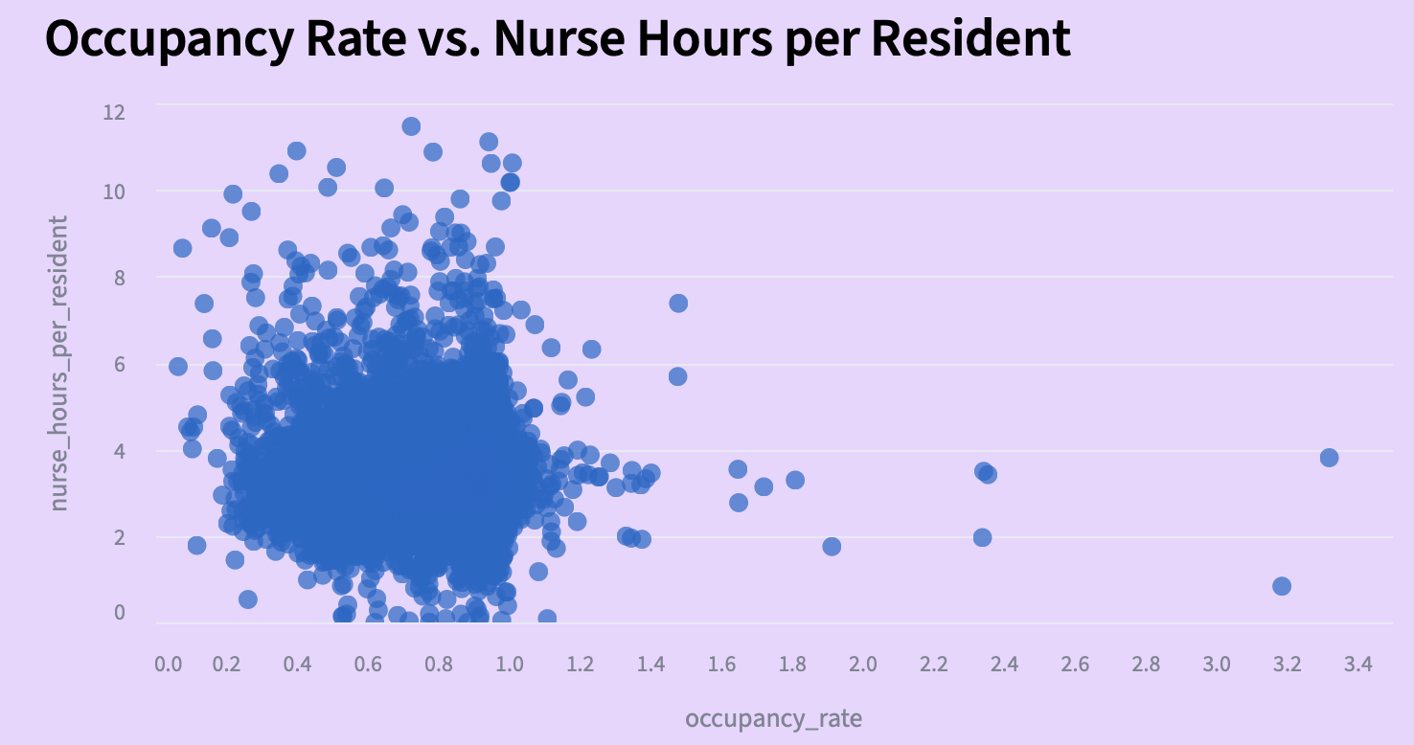
Business Question 1:
What is the relationship between nurse staffing levels and hospital occupancy rates?
Answer:
There’s substantial variation. As can be seen, occupancy rates are from around 20 to 120%;
Nurse staffing hours can go from around 2 to more than 9. Occupancy by itself doesn’t explain the large difference in nurse staffing levels.

Slide 38
Arriving to answer to Business Question 1 (part 1)
In AWS glue job, 'occupancy_rate' column was created by means of a calculation between 2 other columns:
df = df.withColumn(
"occupancy_rate",
col("Average Number of Residents per Day") /
col("Number of Certified Beds")
)
Total_Nurse_Hrs was also created in with an AWS Glue job through addition:
df = df.withColumn(
"Total_Nurse_Hrs",
col("Hrs_RN") +
col("Hrs_LPN") +
col("Hrs_CNA")
)

Slide 39
Arriving to answer to Business Question 1 (part 2)
In Python, avg_total_nurse_hrs was calculated by finding the average of the Total_Nurse_hrs column:
facility_staffing = (
pbj_df
.groupby(
["cms_certification_number_ccn", "provider_name"]
)["Total_Nurse_Hrs"]
.mean()
.reset_index(name="avg_total_nurse_hrs")
)

Slide 40
Here is the Python code to merge datasets for provider & staffing in order to obtain comparison between occupancy rate and staffing levels:
facility_analysis = (
provider_df[
[
"cms_certification_number_ccn",
"provider_name",
"state",
"occupancy_rate"
]
]
.merge(
facility_staffing,
on=["cms_certification_number_ccn", "provider_name"],
how="inner"
)
)
facility_analysis = facility_analysis.rename(
columns={
"Total_Nurse_Hrs": "avg_total_nurse_hours"
}
)
Arriving to answer to Business Question 1 (part 3)

Slide 41
Business Question 2
Which hospitals have the highest overtime hours for nurses?
Answer:
The PBJ dataset has info on (presumably) regular hours for various types of nurses. For this dataset, the RN_Hrs column has info on nurse hours; many rows in this column show more than 40 hours worked for nurses.
There's no clarity as to whether anything above 40 hours count as valid overtime hours for this particular field.

Slide 42
Business Question 3:
What are the average staffing levels by state and hospital type?
Answer:
There's a wide amount of variation of staffing levels among state and types of hospital. On the staffing page, selections show a wide range of nurse hours depending on which state and hospital type is chosen.

Slide 43
Expanding section for Provider details retrieves info from dataframe named "filtered_facility_analysis"
with st.expander("Provider Details", expanded=True):
if not filtered_facility_analysis.empty:
provider = filtered_facility_analysis.iloc[0]
details = {
Particulars for details table
provided on next slide
}
st.table(details)
else:
st.info("No provider is available for the selected filters.")
Arriving at answer to Business Question
# 3 (part 1):
Expanding section for Provider details retrieves info from dataframe named "filtered_facility_analysis"

Slide 44
Arriving at answer to Business Question # 3 (part 2):
Details table consists of variables referred to in the earlier part of the code:
details = {
"Provider Name": provider["provider_name"],
"State": state_names.get(
provider["state"],
provider["state"]
),
"Ownership": provider["ownership_type"],
"Average Nurse Hours": f"{avg_nurse_hours:,.1f}",
"Average Nurse Hours to each Resident":
f"{avg_nurse_hours_per_resident:,.2f}",
"Average Occupancy": f"{avg_occupancy:.1%}"
}

Slide 45
Arriving at answer to Business Question # 3 (part 3):
Variables for metrics were calculated in the earlier part of the code; 'mean' refers to an average.
avg_nurse_hours = (
filtered_facility_analysis["avg_total_nurse_hrs"].mean()
)
avg_nurse_hours_per_resident = (
filtered_facility_analysis["nurse_hours_per_resident"].mean()
)
avg_occupancy = (
filtered_facility_analysis["occupancy_rate"].mean()
)

Slide 46
Business Question # 4:
What trends can you identify in patient length of stay over time?
Answer:
For the 'resident_type' field in the Quality dataset, the two available categories are long stay and short stay. Both short and long are general terms for a length of time, yet they don't address the question of how long the patient will stay.
What's more, the provided info doesn't tell how patient length of stay changes over a longer period of time;.

Slide 47
Deliverables (Part 1)
Google API script for uploading csv files from google drive to S3:
https://drive.google.com/file/d/1O2Q6PRTMJ3N4yA2JL2_hvH9audgnMBA1/view?usp=share_link
Pipeline documentation (HC_Project_pipeline)
https://docs.google.com/document/d/1Z_0f-kfrJN5iwzThNAHLk0U1Ev3-DZ9JXOOheVWzwR0/edit?usp=sharing
Code files (HC_Project_Code_files) contains glue script files for transformation and streamlit code for dashboard creation.
https://docs.google.com/document/d/1goKlSpJA2j1E2Z-RZKvVOsGw_cMz13AE2eJ00LTWSbg/edit?usp=sharing

Slide 48
Deliverables (Part 2)
Health Care Dashboard URL:
https://healthcareproject-mz-deacademy.streamlit.app/
Data dictionary: "HC_Project_Data_Dict"
https://docs.google.com/document/d/1nxLoo1fGAGNq-pUkEqarN6eoAeWetieNRejEF14ovuM/edit?usp=sharing
HealthCare Project on Github
https://github.com/getaround2itnow/healthcare_project

