Slide 1
Kernel Work Queues Arun KS Staff Engineer, Qualcomm

Slide 2
Scope
What is it?
Old implementation
New implementation (CMWQ)
Concurrency
Examples

Slide 3
What is a WQ?
A mechanism for asynchronous process context execution.
A work item describing a work is put on a queue.
An independent thread serves as async execution context.

Slide 4
Old Implementation
At highest level there are worker threads.
One worker per processor of a given type.
By default there are event workers. (event/n)
You can create your own workqueue.
An example,
Create a falcon thread
Assume you have 4 processor cores.
It creates 4 falcon threads.
When your driver queue work, it will be serviced by the worker thread(falcon) on the same cpu.

Slide 5
API
Scheduling work:
schedule_work(&work);
schedule_delayed_work(&work, delay);
Creating a new work queue:
struct workqueue_struct *create_workqueue(const char *name);
Scheduling work on your private work_queues:
queue_work(wq, work)

Slide 6
Drawbacks
One worker thread per cpu for each work queue.
As Numbers of WQ users are increasing in kernel and with number of cores continuously rising, some system saturated the default 32K PID space just booting up.
Although they wasted lot of resources, the level of concurrency was unsatisfactory.
Tasks queued to same WQ on same cpu cannot execute concurrently.
Which means if one work sleeps all the other work has to wait.
Works which may sleep and take long time need a separate work queue.
Dependent works can cause deadlocks by depending on the same execution resources.
Combined, above factors lead to many workqueues with mostly unused workers.

Slide 7
Concurrency Managed WQ – New Implementation
Goals.
Reduce the number of kernel threads running on system.
Use what is necessary and allocate resources lazily on demand.
Wqs no longer need to worry about managing concurrency and in most cases dead locks(unless the deadlock chain involves many works)
Far fewer number of kthreads, hence more efficient kernel.
Also increasing the concurrency of tasks submitted to same WQ.

Slide 8
Concurrency is not Parallelism
Concurrency is about dealing with lots of things at once.
Parallelism is about doing lots of things at once.
Not the same, but related
Concurrency is about structure, parallelism is about execution.
Concurrency is a way to structure a program by breaking into pieces that can (but not necessarily) be parallelizable.
An analogy
Concurrent: Mouse, keyboard, display, and disk drivers.
Parallel: SIMD processors

Slide 9

We got a Problem – trying to explain concurrency.
Move and burn these obsolete manuals

Slide 10

Trying for an optimized solution.
More gopher and more carts.
This will go faster, but there is bottleneck at the pile and burner.
Also need to synchronize the gophers

Slide 11
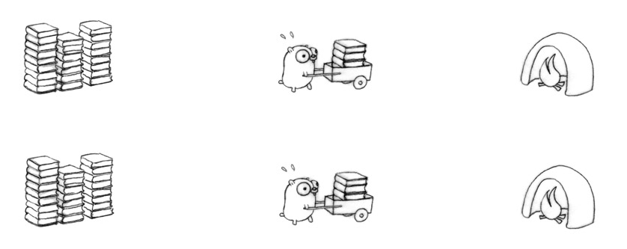
Trying for an optimized solution.
Remove the bottleneck, make them independent.
This will be twice as fast.
The design is not automatically parallel.
What if only one gopher is allowed to move at a time?
Then it’s still concurrent(that’s in design), just not parallel.
However, its automatically parallelizable.

Slide 12
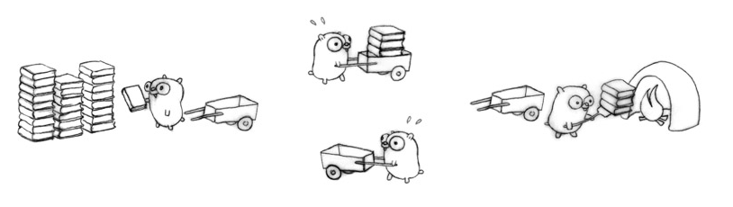
Trying for an optimized solution.
Another approach of fine grained concurrency.
Four gophers in action for better flow, each doing one simple task.
If we arrange everything right, that's four times faster than our original one-gopher design.

Slide 13
Lesson
There are many ways to break the processing down.
That’s concurrent design.
Concurrency is not parallelism.
Concurrency can enables parallelism.

Slide 14
CMWQ - Design
per-workqueue kernel threads are gone, replaced by a central set of threads with names like [kworker/0:0]
There are no threads dedicated to any specific workqueue.
Instead, there is a global pool of threads attached to each CPU in the system.
One interesting implication of this change is that tasks submitted to the same workqueue on the same CPU may now execute concurrently.
There are two worker-pools, one for normal work items and the other for high priority ones, for each possible CPU and some extra worker-pools to serve work items queued on unbound workqueues.

Slide 15
CMWQ – Design cont..
Keeps the number of active workers to minimum but no less.
As long as there is one or more workers running on the cpu, no new worker is scheduled.
For eg kworker0:1 started working and it sleeps, kwoker0:2 will be scheduled to execute next work. But if kowker0:1 finishes a work, same worker will be used for next pending work item.
The work is processed in batch as much as possible.
But when the worker blocks, new worker is scheduled so that the cpu will not be idle with pending works.
Keeps at least single idle work around.
When new worker is necessary as there are no idle workers, creates another worker.
Workers are destroyed if idle for some time(5 minutes), but maintains a ratio 1:4(1/4 of busy can be idle).
Each worker pool bound to an actual cpu implements concurrency management by hooking in to the scheduler.
If a worker went to sleep, scheduler notify and ask workqueue whether it wants to wake up a task to maintain concurrency.(kernel/sched/core.c)

Slide 16
What about Reentrancy?
All the workqueues are now non-reentrant.
If a work item is executing on a different CPU when queuing is requested, it is always queued on that CPU.
Eg: kworker0:0 is executing a work on cpu 0, now when we queue same work from a different cpu(lets say cpu1), the work get queued on cpu0 and not on cpu1.
This may affect some users negatively.
Non-reentrancy overrides affinity specified by queue_work_on.
In the above Eg, even if we use queue_work_on(1, work1), it gets queued in cpu0 to meet the non-reentrant behavior.

Slide 17
New API
alloc_workqueue() takes 3 args. Name, flags and max_active
Flags and max_active control how work items are assigned execution resources and scheduled.
@flags
WQ_UNBOUND:
Wq were designed to run tasks on cpu where there were submitted(for better cache utilization). This flag turns off that behavior.
Work items queued to unbound wq are served by special worker pools, whose workers are not bounded to any cpu.
This make wq behave as a simple execution context provider without concurrency.
Used where task run for a long time.
WQ_HIGHPRI
Use workers from high priority thread pools.
WQ_FREEZABLE
this workqueue will be frozen when the system is suspended.

Slide 18
How concurrency is implemented.
max_active
Maximum number of execution context which can be assigned to the work items of a wq. Per CPU.
max max_active is 512.
Default value when 0 is passed is 256
For users who need strict execution order of ST wq.
max_active=1 and WQ_UNBOUND.

Slide 19
Example - old WQ implementation
Preconditions:
w0, w1, w2 are queued to a bounded wq q0 on the same cpu
w0 burns cpu for 5 ms and sleeps for 10 ms, wakes up and burns another 5 ms before finishing.
w1 and w2 burns cpu for 5 ms then sleep for 10 ms.
Possible sequence of events with old wq:
Time Events
0 w0 start and burns cpu
5 w0 sleeps
15 w0 wakes up and burn cpu
20 w0 finishes
20 w1 starts and burns cpu
25 w1 sleeps
35 w1 wakes up and finishes
35 w2 starts and burns cpu
40 w2 sleeps
50 w2 wakes up and finishes

Slide 20
Example – new WQ implementation
Preconditions:
w0, w1, w2 are queued to a bounded wq q0 on the same cpu
w0 burns cpu for 5 ms and sleeps for 10 ms, wakes up and burns another 5 ms before finishing.
w1 and w2 burns cpu for 5 ms then sleep for 10 ms.
Possible sequence of events with cmwq max_active > 3
Time Events
0 w0 start and burns cpu
5 w0 sleeps
5 w1 starts and burn cpu
10 w1 sleeps
10 w2 starts and burns cpu
15 w2 sleeps
15 w0 wakes up and burn cpu
20 w0 finishes
20 w1 wakes up and finishes
25 w2 wakes up and finishes
New WQ implementation finishes the works in half the time than old implementation.

Slide 21
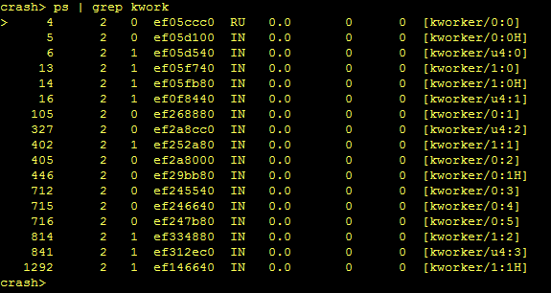
Kworker snapshot on a dual core SMP system
Kworker/1:2H
2nd kworker running on cpu 1. H signifies it’s a high priority pool worker.
Kworker/u4:1
Is an unbounded worker. Here 4 signifies the worker pool number and not the cpu number. How come 4? Each core will have two pools(normal and high priority pools) of kworkers. Since this is a dual core system, 0 – 3 pool ids are used for bounded worker pools. And 4 and 5 will be used by unbounded worker pools.

Slide 22
Let’s Test our Understanding
static void a_bad_work_function(struct work_struct *work)
{
while(1);
}
What all bad things can happen?

Slide 23
Reference
Kernel Documentation
Documentation/workqueue.txt
Concurrency is not parallelism,
http://talks.golang.org/2012/waza.slide#1
LWN.net
Kernel Code
Kernel/workqueue.c
Include/linux/workqueue.h

