Slide 1
Bootrom (Public/Secure) Boot sequence from power-on to Linux

Slide 2
Scope
Startup of system domain.
HW & SW design – boot related functions.

Slide 3
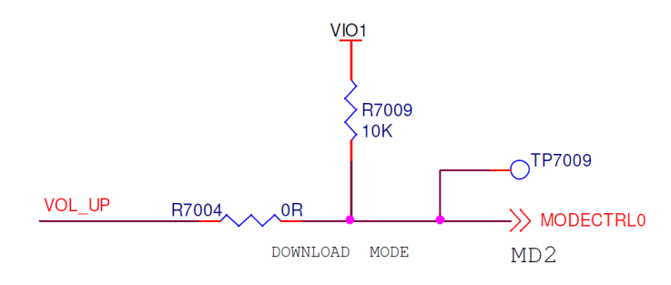
Boot Modes
USB Boot.
eMMC Boot.
Selected by an external pin setting.

Slide 4
Stages
1st Stage: Boot ROM code and Loader Execution.
Starts execution from Mask Secure ROM.
Select bootable interface(USB / eMMC) and initialize it.
Do security checks of the images downloaded.
Flash SW image into eMMC (only for USB mode).
2nd Stage: Domain Setup.
Each domain(System, RT and Modem) starts running from external SDRAM.

Slide 5
Memory Used at Boot Time
Mode | Memory Type | Size in (Kbytes)
Non Secure | Public ROM | 64
Secure | Secure ROM | 96
 | Secure RAM | 256
Non Secure - Secure | Inter connect RAM | 72
Common | L1 I-Cache | 32
 | L1 D-Cache | 32
 | L2 Cache | 256
 | S3Cache (MERAM) | 2048

Slide 6
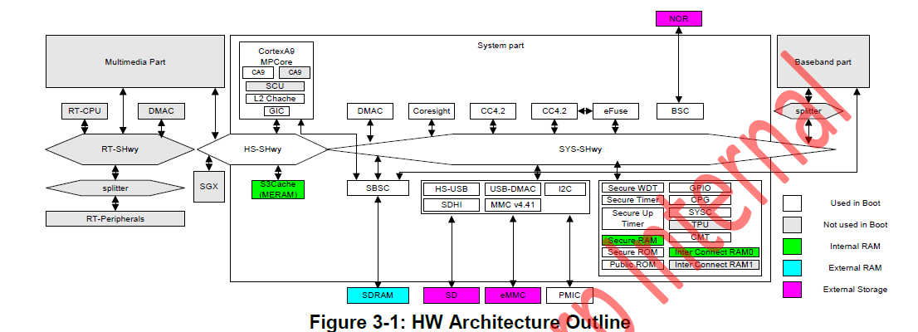
HW Architecture Outline

Slide 7
SW Architecture Outline
- Load verify and execute ISSW.
- Also initialize secure resources.
- Handles entry/exit from/to S/NS modes
- For public ROM internal use
- Provides access for Secure mode, and called only by Public ROM for security reasons.
- Communication btw S & NS mode uses shared memory called Inter connect RAM
- Initial Security Software
- 1st external SW executed in secure mode.
- Initialization of secure peripherals
- Loading/authenticating of 2nd image.
- Used in both boot cases.
- Patch code for Public ROM
- OEMs also use RAMSET in order to some early changes in clk config for example.
- eMMC boot only
- Perform SBSC settings.
- Download OS image to SDRAM.
- USB boot only
- Donwload SW via USB interface and program into eMMC device.
To access HW resources(crypto engines) from Secure ROM service
Public Side
Secure Side
Public ROM Service
Secure ROM Service
Secure RAM
SA
- SA(Secure Application) – loaded by ISSW
- Application SW that is executed in secure mode.
- TC (Testing Certificate)
- Includes bit pattern for enable/disable debug interfaces such as JTAG, STM
- According to this parameter ISSW enables/disables the debug functionality.
ISSW API
S3Cache (MERAM)
ISSW
Test Certificate
RAMSET
Security
Library API
R-loader (eMMC)
Renasas Library
Secure ROM
Libraries
[ NOTE ]
ROM
FW Uploader
Crypto Lib
Device Driver
Loader
Crypto HW
Other HW

Slide 8


High Level Boot Sequence
Public Mode
Secure Mode
Cpu initialization
Secure peripheral init
Cpu initialization
Boot interface selection
eMMC initalization
Load 1st Image
SSA_ISSW_IMPORT
Authenticate ISSW
Import to secure RAM
ISSW_init
As per TC enable debug
Authenticate Ramset
Execute Ramset
Return response
Load 2nd image
Authenticate 2nd image
Import SA to secure RAM
Execute R-loader
Initialize DDR

Slide 9
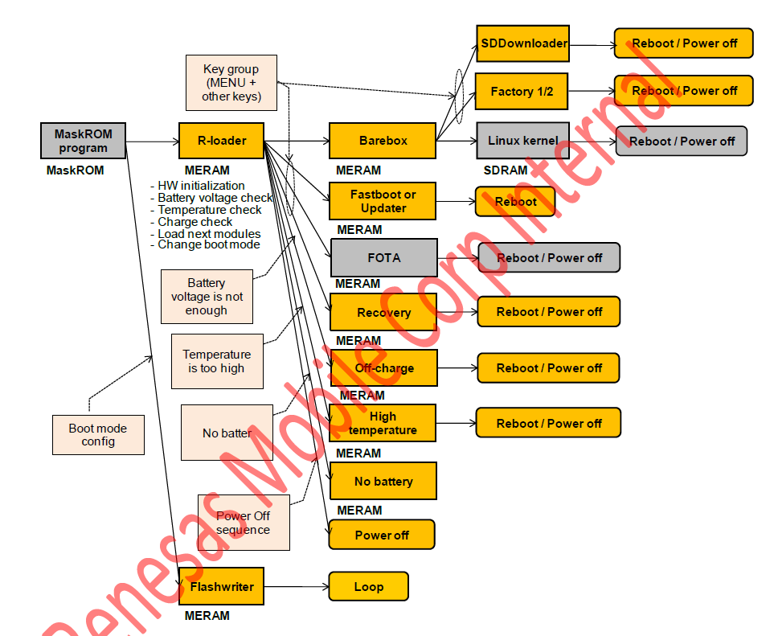

Slide 10
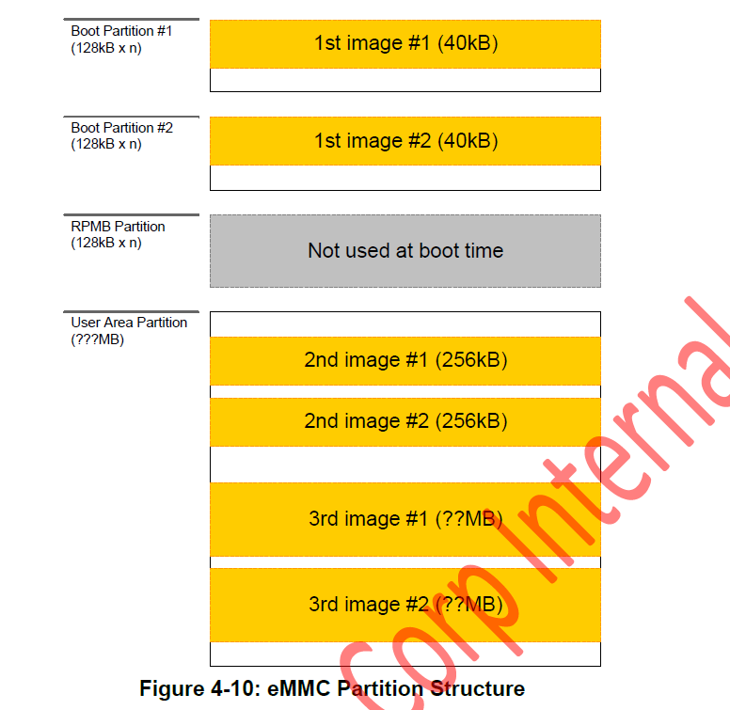
eMMC Partition Structure

Slide 11
Low Battery
Taken care by R-loader
Check current voltage, if enough perform normal boot.
If voltage not enough, but VBUS is not detected, perform poweroff.
If voltage not enough, VBUS detected, load off_charging module.

