Slide 1
Caches and Coherency.
Arun KS
Kernel, BDC

Slide 2
Scope
Cache – How do they help?
Cache Architecture
Direct and Set Associative cahes
Cache Policies
Cache Coherency with ACE

Slide 3
Caches – How do they help?
Program execution is not random.
Code and data have temporal and spatial locality properties.
They sit very close to CPU.

Slide 4
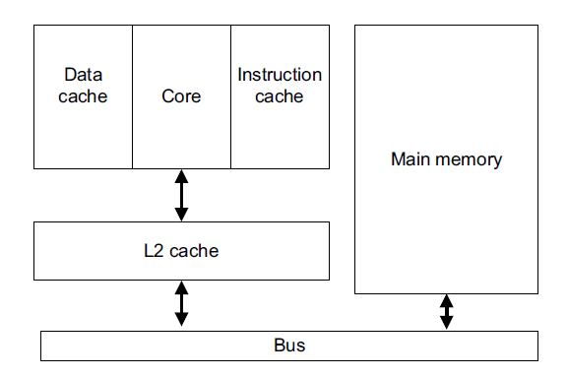
Memory Hierarchy

Slide 5
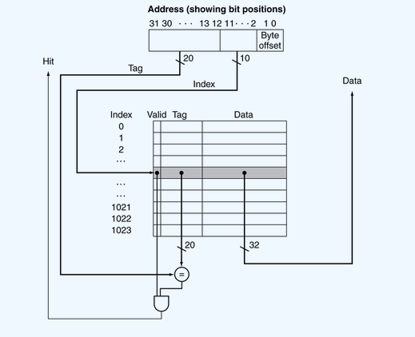
Direct Mapped Caches
Notes:
INTRO: Data flows among the CPUs’ caches and memory in fixed-length blocks called “cache lines”, ranging from 16 to 256 bytes.
When data is first accessed by cpu it will be absent in cpu cache(we call it a cache miss). Now the cpu has to wait(or stall) for hundreds of cycle while it is fetched from memory.
However item will be loaded to cpu cache so that the subsequent accesses will be in cache and we can run in full speed.
After sometime, cpu cache will be filled and subsequent misses need to eject a line from cache to make room for the newly fetched item.
Sometimes eviction in need even before the cache is full.
1 word = 4 bytes
Data flow – fixed length blocks – lines- ranging 16 to 256
Explain about full associative, then go to set associative in next slide.

Slide 6
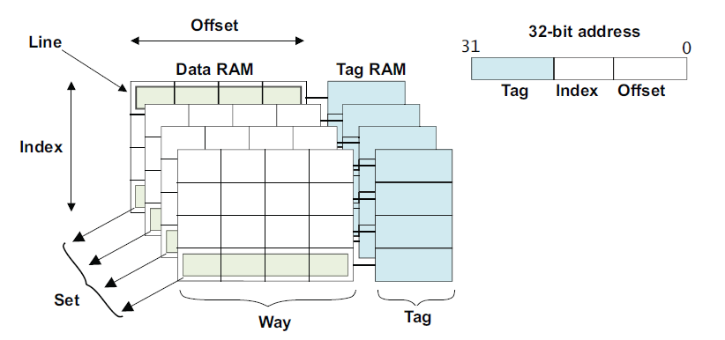
Caches Architecture
Line: smallest loadable unit of a cache from main memory.
Index: part of address that determines the line(s).
Way: subdivision of cache, each way of equal size.
Set: line associated with a particular index from each cache way grouped together forms a set.
Tag: part of address that identifies the main memory address
Notes:
Each line in the cache includes:
Tag bits
Valid bit
Dirty data bit
Fully associative
Only has tag and offset,
Advantage over direct mapped: nothing get “thrown out” of the cache untill it is completely full.
Disadvantage: Full Associate require a complete search through all the tags to see if there is a hit. Direct mapped caches only need to look one place.

Slide 7
8KB cache – 256 bye line size, 2 way, 16 index
Way 0 Way 1
0x0
0x1
0x2
0x3
0x4
0x5
0x6
0x7
0x8
0x9
0xA
0xB
0xC
0xD
0xE
0xF
0x12345000
0x12345100
0x12345200
0x12345300
0x12345400
0x12345500
0x12345600
0x12345700
0x12345800
0x12345900
0x12345A00
0x12345B00
0x12345C00
0x12345D00
0x12345E00
0x12345000 to 0x12345EFF
0x43210E00
0x453210E00
Notes:
INTRO: This is a 8KB cache of 256 bytes cache line size. This cache line size is bigger, but it make the hex arithmetic simpler. Normal size of cache line are 32 and 64 bytes.
Each way has 16 index * 256 = 4096 = 4KB
256 bytes cache line = 8 bytes 2 nibbles to index into the cache line
16 index need = 1 nibble in green. Rest goes to the tag.
Program accessed data sequentially from 0x12345000 through 0x12345EFF

Slide 8
Cache Policies
Allocation Policy: What causes a line from external memory to be placed into the cache.
Replacement Policy: How the controller decides which line within a set associative cache to use for incoming data.
Write Policy: What happens when the core performs a write that hit in the cache.

Slide 9
Allocation Policy
Read Allocate: allocate only on read. If a write misses, write goes to next level of hierarchy.
Write Allocate: allocate for either a read/write that misses.
Notes:
INTRO: When core performs a cache look-up and if it was a MISS. It must determine whether not to perform a cache line fill or not.
Replace allocate with linefill
Write Allocate: For both memory reads that miss in the cache and memory writes that miss in the cache, a cache linefill is performed.

Slide 10
Replacement Policy
Round-robin or cyclic: have a counter(victim counter) that cycles through available ways and cycles to 0
Pseudo-random: randomly select a line in a set. The victim counter still used, but is incremented in a pseudo-random fashion and can point to any line in the set.
Least recently used:
Notes:
INTRO:The replacement policy is what controls the victim selection process.
When there is a cache miss, and if all ways for that particular line is full, the cache controller must select one of the cache lines in the set for the incoming data.
The cache line selected is called the victim. If the victim contains valid, dirty data, the contents of that line must be written to main memory before new data can be written to the victim cache line. This is called eviction.
Where can I configure that? Implementation Defined.

Slide 11
Write Policy
Write through: writes are performed to both the cache and main memory.
Write-back: writes are performed only to the cache, and not to main memory.
Notes:
INTRO:When the core executes a store instruction, a cache lookup on the address to be written is performed.
For a cache hit on a write, there are two choices.

Slide 12
Cortex –A5x CPU specific
Cache lines are 16 words (64 bytes)
Replacement policy is implementation defined
Cortex-A57: L1 caches use LRU, L2 uses random
Cortex-A52: L1 and L2 uses random
Write policy:
Write through is not supported on most Cortex-A5x

Slide 13
Cache Coherency
Cache coherency is an issue when,
Contains one or more cache
Has more than one device sharing data in a cached area.
Example scenarios where coherency must be managed
DMA using cached memory
Self modifying code
Modification to the page tables
Notes:
Cache coherency relates to the consistency of data stored in local caches.
Examples:
1) External memory incoherent with CPU Data cache
2) Data cache contains more recent copy than instruction cache.
3) TLB contents are no longer valid.

Slide 14
SW and HW Coherency
Software based coherency
Cache maintenance and barrier instructions are used by the programmer to force coherency at key points.
As the number of entities in a system increases, managing coherency in SW alone becomes difficult.
Hardware based coherency
Maintaining automatic coherency between caches.
Broadcasting maintenance and barrier operation to other entities in system.
Notes:
Software-based approaches put the coherency problem onto the programmer. You don’t want to do it n SW.
IPC to all processors to do the same. TLB.
LAST:
Hardware-managed coherency can improve system performance and reduce system power by sharing on-chip data. Managing coherency has the following benefits:
• Reducing external memory accesses.
• Reducing the software overhead.
Disadvantage is it takes space and each time you need to broadcast the coherency. Its is better than the alternative, thousands of code and lots of interrupts.

Slide 15
Cortex-A family coherency
Cortex A8 : single core, no HW coherency support.
Cortex A9 : coherency support inside the cluster for up to 4 cores.
Cortex A15/A7/A57/A53 : coherency btw clusters.
Notes:
Cortex A8: pages marked as shareable are implicitly non-cacheable.
Maintenance operation only apply to processor issuing the instruction.
Cortex A9: Data from pages marked as shareable can be cached and kept coherent between caches. SCU
SCU uses TAG ram, copy of tag of individual tags of L1 caches.
Maintenance instructions on one core may be broadcast to other cores. AMBA3 AXI only
SCU maintains coherency btw inner cores. But does not have coherency broadcast in bus.
Cortex A15/A57: still have local snoops to maintain coherency inside the cluster for L1 caches.
What A53 does is to transmit the coherency using external pins. We need the interconnect to utilize that.
When you say coherency between clusters is supported. It need support from the bus interconnect as well. AMBA coherence extensions.
These processors use AMBA4 which has ACE support

Slide 16
ACE system level coherency
AMBA 4 introduced ACE (AXI coherency Extensions)
Supported by cortex-A15/A7, cortex-A53/57, and ARM’s CCI-400(and CCN-504)
Coherency management between cores in a cluster and across clusters.
Notes:
ACE has been designed to enable performance and power optimizations by avoiding wherever possible unnecessary external memory accesses.
ACE facilitates direct master-to-master data transfer. Off-chip accesses are an order of magnitude 10x.
CCI-400 can support only 2 ACE masters, for more like servers we can use CCN-504 interconnect. But this is too heavy weight for mobile devices.

Slide 17
CCI-400
CCI-400 combines interconnect and coherency functions into a single module.
Supports upto two ACE masters and three ACE lite masters.
Two type of coherency
IO coherency. Device can snoop into processor caches(but nobody can snoop into device.)
Full cache coherency. Snooping allowed in both directions.
Notes:
ACE Masters: masters with caches
ACE-Lite Masters: components without caches, snooping other caches
ACE-Lite/AXI Slave: components not initiating snoop transactions.
ACE lite masters: for example, the ARM Mali™-T600, DMA

Slide 18
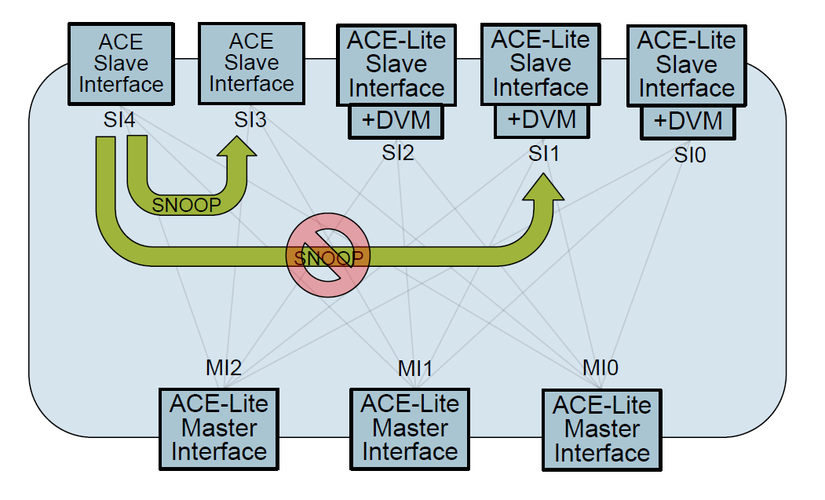
ACE Master snooping transactions
Transactions from ACE masters can snoop other ACE masters.
Transaction from ACE masters cannot snoop other ACE-Lite masters

Slide 19
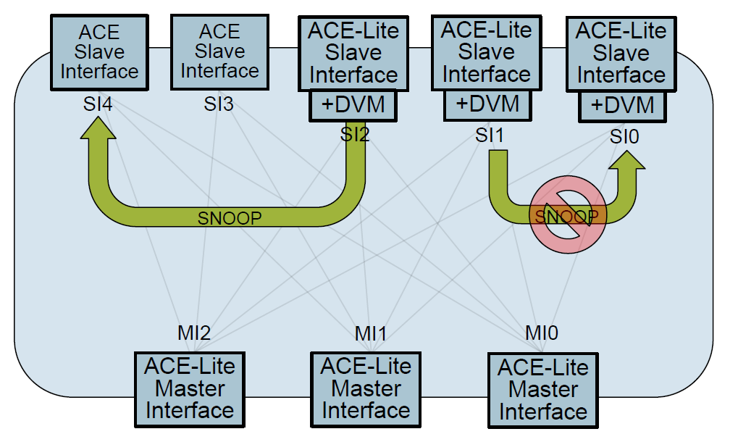
ACE-Lite Master Snooping
Transaction from ACE-Lite masters can snoop other ACE masters’ cache.
Transactions from ACE-Lite masters cannot snoop ACE-Lite master’s cache.
Notes:
ACE Masters: masters with caches
ACE-Lite Masters: components without caches, snooping other caches
ACE-Lite/AXI Slave: components not initiating snoop transactions.
ACE lite masters: for example, the ARM Mali™-T600, DMA

Slide 20
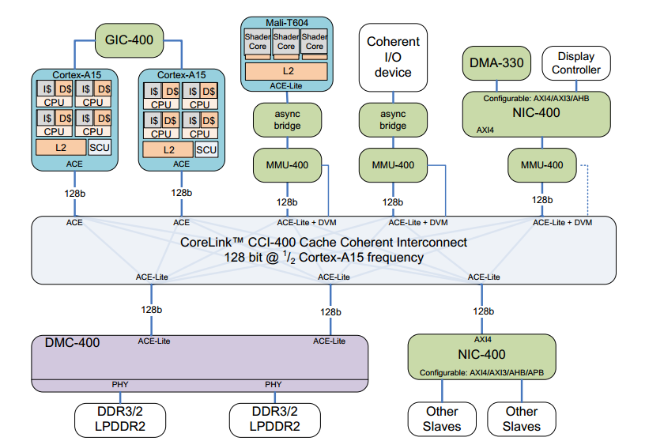
Example system with CCI-400
Notes:
ACE Masters: masters with caches
ACE-Lite Masters: components without caches, snooping other caches
ACE-Lite/AXI Slave: components not initiating snoop transactions.
CCN-504 is required to support full coherency between two outer domains.

Slide 21
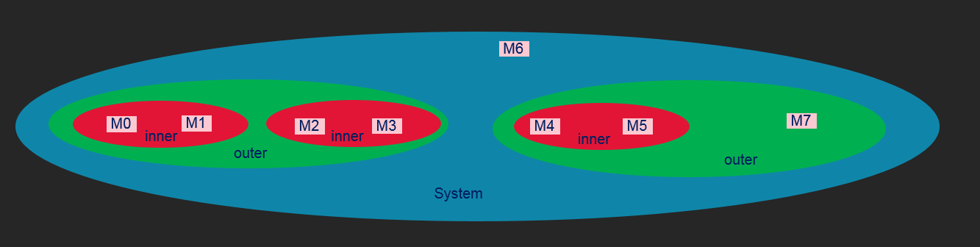
Domains
Used to filter snooping in a system by partitioning memory.
Name | Description
Non – Shareable | Contains just a single master
Inner shareable | The inner domain can include additional masters
Outer Shareable | The outer domain contains at lest all masters in the inner domain and may also include additional masters
System Shareable | The system domain includes all masters in the system.
Notes:
Why can’t we make every thing outer sharable and forget it?
What does this mean when we programming the page tables?
Shareablility attribute: say who else is using this data. Who do we broadcast to.
Muliple type of shareablity: inner, outer.
LATER:
You do a read, you look on your own cache, scu looks in tag ram, ask interconnect to send the cache request to all other masters in the shareablity domain.
You look in your cache, look in your cluster all caches, and you look into caches present in requested domain.
If not anywhere pick it from memory.

Slide 22
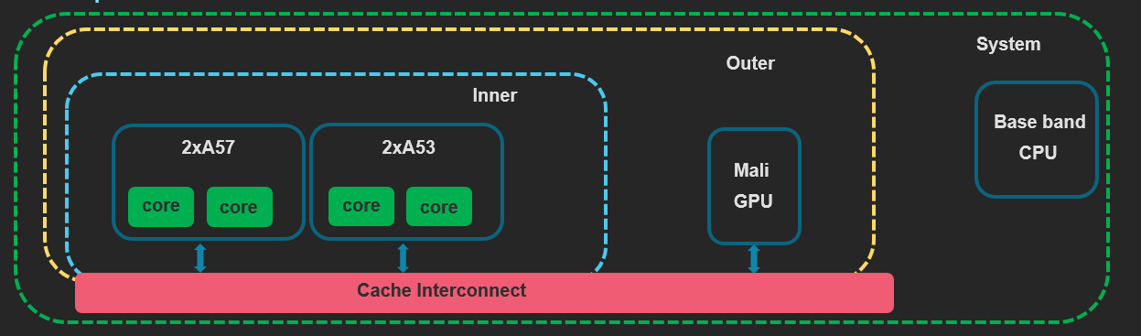
Example: big.LITTLE implementation
big LITTLE system running SMP across both clusters, supported by a Mali GPU
System Layout:
Inner-sharable domain: Multi-core processors A57 & A53
Outer-sharable domain: GPU + inner domain
System: Everything else(eg baseband cpu)
Transition table attributes:
Program memory: Normal cacheable, inner-shareable
Frame & texture buffers: Normal cacheable, outer-shareable
Mailbox for base-band cpu: Normal, non-cacheable
Peripherals: Device.
Notes:
TLB and instruction cache maintenance – inner cache
GPU shares data cache information with cpu clusters. GPU does not care about instruction caches. For each frame, the cpu writes GPU commands and optionally vertices to memory. Without ACE-lite coherency these commands would need to be flushed from cache.
Base band is not connected to the cache coherent.
Inner and outer domains are fixed in SoC.
ACP(Accelerator Coherency Port) is different from this. All the bus traffic goes through A53, which has limited bandwidth.
Going forward, ACE-Lite is the preferred technique for I/O coherency and should be used wherever possible rather than ACP.
Cortex-A15/cortex A7 support ACE coherency protocol, whereas A5/A9 do not – so no big.LITTLE A9A5.
Explain about the effect on barriers w.r.t shareablity

Slide 23
Reference
ARM ARM – v8 and v7
ARM v7 programmers guide.
Introduction to AMBA 4 ACE and big.LITTLE Processing Technology.

