Slide 1

Addis Ababa University Department of Computer Science
Addis Ababa, Ethiopia
Machine Learning (CoSc 6041)
Social Media Addiction Risk Analyzer
A Supervised Learning Solution with AdaBoost Algorithm
NAME ID No.
1. Getaye Fiseha GSE/6132/18
Submitted to: Dr. Yaregal A.
Date: March 14, 2026

Slide 2
Project Overview
📌 What is it?
A web-based ML application that predicts social media addiction risk using behavioral patterns
🎯 Goal
Provide data-driven, personalized risk assessment and recommendations for digital wellness
👥 Target Users
Students & young adults
Researchers in digital wellness
Mental health professionals
General public

Slide 3
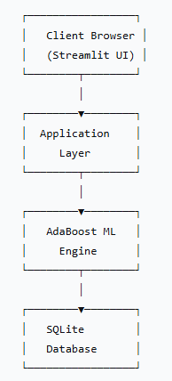
Problem Statement & Motivation
🌍 The Social Media Challenge
📈 4.9 billion social media users worldwide
⏰ Average user spends 2.5 hours/day on social media
🧠 1 in 3 young adults show signs of problematic use
📉 Strong correlation with anxiety, depression, poor sleep
✅ Our Solution
Data-driven ML approach for objective assessment
Real-time analysis with instant results
Historical tracking and trends
Personalized recommendations
Accessible web-based platform

Slide 4
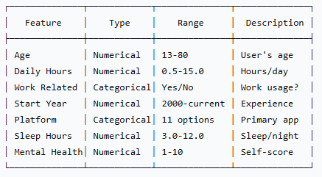
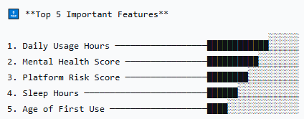
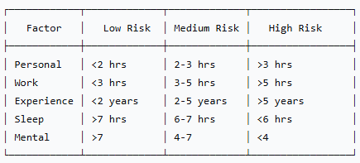
Features
📊 Input Features
🎯 Risk Classification Thresholds

Slide 5

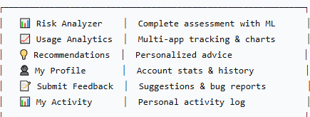
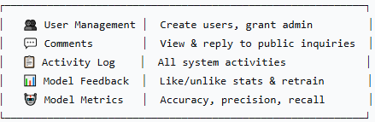
User Interface & Features
🌐 Public Access (No Login)
👤 Registered User Features
👑 Admin Features

Slide 6
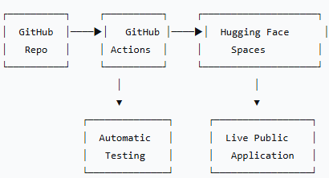
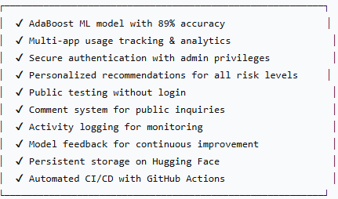
Deployment and Achievements
🚀 Deployment Architecture
✅ Achievements
🌐 Live Demo
https://huggingface.co/spaces/Getaye/social-media-addiction-analyzer

Slide 7
Thank You!

