Slide 1




Hands on
Sara Dickinson
Willem Toorop

Slide 2

Hands on Overview
What is the getdns API
What can the getdns library do for you
Guided tour of the API
Examples uses (code!)
Demo of Stubby (time permitting)
but first...

Slide 3
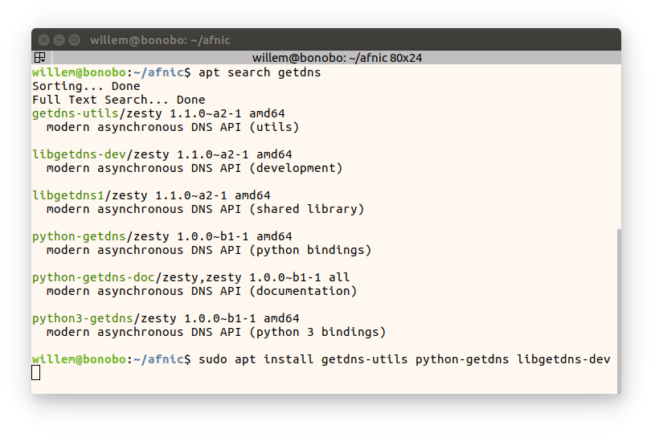
installation on ubuntu

Slide 4
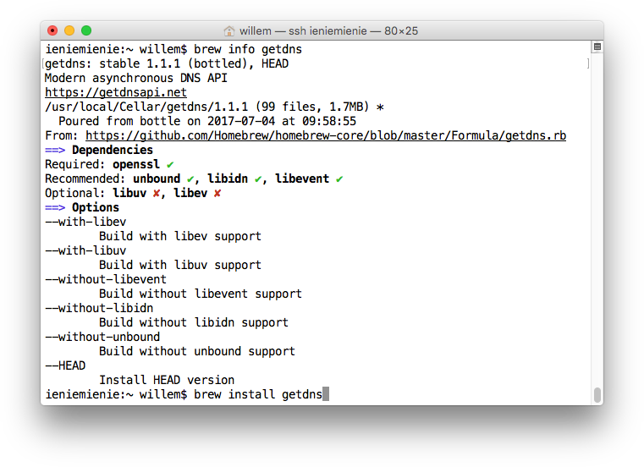
installation on MacOS

Slide 5
installation from tarball
$ wget https://getdnsapi.net/dist/getdns-1.1.2.tar.gz
--2017-07-04 10:20:20-- https://getdnsapi.net/dist/getdns-1.1.2.tar.gz
Resolving getdnsapi.net (getdnsapi.net)... 2a04:b900:0:100::37, 185.49.141.37
Connecting to getdnsapi.net (getdnsapi.net)|2a04:b900:0:100::37|:443... connected.
HTTP request sent, awaiting response... 200 OK
Length: 948941 (927K) [application/x-gzip]
Saving to: 'getdns-1.1.2.tar.gz'
getdns-1.1.2.tar.gz 100%[==================>] 926.70K --.-KB/s in 0.08s
2017-07-04 10:20:20 (11.9 MB/s) - 'getdns-1.1.2.tar.gz' saved [948941/948941]
$ tar xzf getdns-1.1.2.tar.gz
$ cd getdns-1.1.2/
$ ./configure --enable-stub-only --without-libidn
checking for gcc... gcc
checking whether the C compiler works... yes
checking for C compiler default output file name... a.out
checking for suffix of executables...
checking whether we are cross compiling... no
$ make
$ sudo make install

Slide 6
installation from repository
$ git clone https://github.com/getdnsapi/getdns
Cloning into 'getdns'...
remote: Counting objects: 13781, done.
remote: Compressing objects: 100% (165/165), done.
remote: Total 13781 (delta 167), reused 158 (delta 85), pack-reused 13531
Receiving objects: 100% (13781/13781), 8.86 MiB | 7.94 MiB/s, done.
Resolving deltas: 100% (10541/10541), done.
$ cd getdns
$ git checkout features/zeroconf-dnssec
Branch features/zeroconf-dnssec set up to track remote branch features/zeroconf-dnssec from origin.
Switched to a new branch 'features/zeroconf-dnssec'
$ git submodule update --init
Submodule 'src/test/jsmn' (https://github.com/getdnsapi/jsmn.git) registered for path 'src/jsmn'
Submodule 'src/yxml' (git://g.blicky.net/yxml.git) registered for path 'src/yxml'
Cloning into '/home/willem/getdns/getdns/src/jsmn'...
Cloning into '/home/willem/getdns/getdns/src/yxml'...
Submodule path 'src/jsmn': checked out '868c22e35ec223fc26ddefdb9ca83901dc6e2534'
Submodule path 'src/yxml': checked out '10f968b0e78b9aeee357d0de81a46b445c3fb27b'

Slide 7
installation from repository
$ autoreconf -fi
libtoolize: putting auxiliary files in '.'.
libtoolize: copying file './ltmain.sh'
libtoolize: putting macros in AC_CONFIG_MACRO_DIRS, 'm4'.
libtoolize: copying file 'm4/libtool.m4'
libtoolize: copying file 'm4/ltoptions.m4'
libtoolize: copying file 'm4/ltsugar.m4'
libtoolize: copying file 'm4/ltversion.m4'
libtoolize: copying file 'm4/lt~obsolete.m4'
libtoolize: Consider adding '-I m4' to ACLOCAL_AMFLAGS in Makefile.am.
$ glibtoolize -ci
libtoolize: putting auxiliary files in '.'.
libtoolize: copying file './config.guess'
libtoolize: copying file './config.sub'
libtoolize: copying file './install-sh'
libtoolize: Consider adding '-I m4' to ACLOCAL_AMFLAGS in Makefile.am.
$ ./configure --enable-stub-only --without-libidn
$ make
$ sudo make install

Slide 8
installation try out getdns_query
$ getdns_query -h
usage: getdns_query [<option> ...] \
[@<upstream> ...] [+<extension> ...] ['{ <settings> }'] [<name>] [<type>]
default mode: recursive, synchronous resolution of NS record
using UDP with TCP fallback
upstreams: @<ip>[%<scope_id>][@<port>][#<tls port>][~<tls name>][^<tsig spec>]
<ip>@<port> may be given as <IPv4>:<port>
or '['<IPv6>[%<scope_id>]']':<port> too
tsig spec: [<algorithm>:]<name>:<secret in Base64>
extensions:
+add_warning_for_bad_dns
+dnssec_return_status
+dnssec_return_only_secure
+dnssec_return_all_statuses
+dnssec_return_validation_chain
+dnssec_return_full_validation_chain
+dnssec_roadblock_avoidance
+edns_cookies
+return_both_v4_and_v6
+return_call_reporting
+sit=<cookie> Send along cookie OPT
with value <cookie>
+specify_class=<class>
+0 Clear all extensions

Slide 9
installation try out getdns_query
$ getdns_query -i
$ getdns_query -k
$ getdns_query -s . DNSKEY +dnssec_return_status
$ getdns_query -k
$ ls -l $HOME/.getdns
$ getdns_query -s @185.49.141.37~getdnsapi.net \
-l LTU +return_call_reporting
$ getdns_query -s _443._tcp.www.afnic.fr TLSA \
+dnssec_return_validation_chain

Slide 10
The API is:
A DNS API specification (for resolving)
by and for application developers (for application)
getaddrinfo() does not fit standards* any more
  Protocol signalling in non-address records:
  SSHFP, TLSA, OPENPGPKEY, SMIMEA,
  URI, CAA, HIP, CDS, CDNSKEY, CSYNC, etc.
  Asynchronous standards (Happy Eyeballs)
  App. level DNSSEC validation (for DANE)
  DNS Privacy
motivation

Slide 11
The API is:
A DNS API specification (for resolving)
by and for application developers (for application)
From API design considerations:
… There are other DNS APIs available,
but there has been very little uptake …
… talking to application developers
… the APIs were developed by and for DNS people,
not application developers …
... create a natural follow-on to gettadrinfo() ...
motivation

Slide 12
The API is:
A DNS API specification (for resolving)
by and for application developers (for application)
First edited by Paul Hoffman
First published in April 2013
Currently published at
https://getdnsapi.net/documentation/spec/
Maintained by the getdns team

Slide 13


The library is:
An implementation of the getdns API
A DNS API specification (for resolving)
by and for application developers (for application)
First implementation initiative by Allison Mankin
Initially a collaboration of LABS, ,
Melinda Shore and

Slide 14
The library is:
26 February 2014: getdns-0.1.0 release
23 July 2015: took over editor role
of the API specification
22 October 2015: New API specification release
introducing JSON-pointers
2016: 2 getdns-1.0.0 beta releases
2 getdns-1.1.0 alpha releases
17 January 2017: getdns-1.0.0 released
100% specification complete
3 July 2017: getdns-1.1.2 released (latest)
many non-API functions
non-API doc: https://getdnsapi.net/doxygen/modules.html

Slide 15
The library is:
An implementation of the getdns API
Weekly meetings with the getdns core team
Claus Assman, Theogene Bucuti, Andrew Cathrow, Neil Cook, Saúl Ibarra Corretgé, Craig Despeaux, John Dickinson, Sara Dickinson, Robert Edmonds, Angelique Finan, Simson Garfinkel, Daniel Kahn Gillmor, Neel Goyal, Bryan Graham, Robert Groenenberg, Jim Hague, Paul Hoffman, Scott Hollenbeck, Christian Huitema, Shumon Huque, Jelte Janssen, Guillem Jover, Shane Kerr, Anthony Kirby,
Olaf Kolkman, Sanjay Mahurpawar, Allison Mankin, Sai Mogali, Linus Nordberg, Benno Overeinder, Joel Purra, Tom Pusateri, Prithvi Ranganath,
Hoda Rohani, Rushi Shah, Vinay Soni, Melinda Shore, Bob Steagall, Andrew Sullivan, Ondřej Surý, Willem Toorop, Gowri Visweswaran,
Wouter Wijngaards, Glen Wiley, Paul Wouters

Slide 16
The library
Core team active in IETF and at IETF hackathons:
  “Best in Show” prize at IETF93
  DNSSEC roadblock detection, start of DNS over TLS
  “Best internet security” at IETF94
  edns0-client-subnet privacy election, start of padding
  IETF95 – start of TLS DNSSEC auth. chain ext.
  IETF96 – start of DNS64 work
  IETF97 – Stubby interoperability testing
  IETF98 – Start of Zero Configuration DNSSEC
  and...

Slide 17
The library
Core team active in IETF and at IETF hackathons:
  IETF98 – DNS over TLS monitoring plugin by
  Stephane Bortzmeyer
  Blog : https://www.bortzmeyer.org/monitor-dns-over-tls.html
  Git : https://github.com/bortzmeyer/monitor-dns-over-tls
  In use at dnsprivacy.org: https://dnsprivacy.org/jenkins/job/dnsprivacy-monitoring/

Slide 18
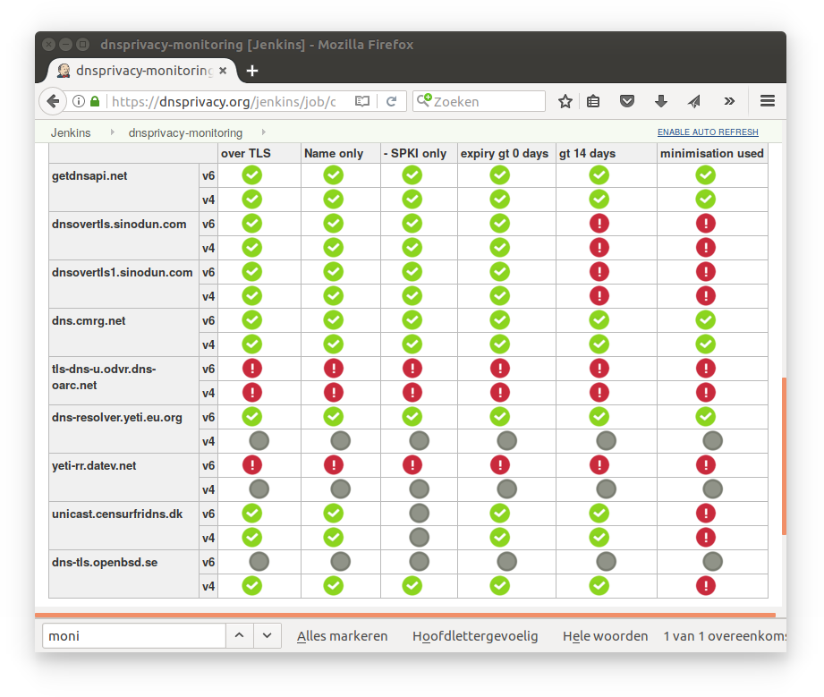
The library
Core team active in IETF and at IETF hackathons:
  IETF98 – DNS over TLS monitoring plugin by
  Stephane Bortzmeyer
  Blog : https://www.bortzmeyer.org/monitor-dns-over-tls.html
  Git : https://github.com/bortzmeyer/monitor-dns-over-tls
  Used at dnsprivacy.org: https://dnsprivacy.org/jenkins/job/dnsprivacy-monitoring/

Slide 19
The library
motivation
From the README.md:
… DNSSEC offers a unique global infrastructure
for establishing cryptographic trust relations …
… offer application developers a modern and
flexible way that enables end-to-end trust in the
DNS architecture …
… inspire application developers towards
innovative security solutions …

Slide 20
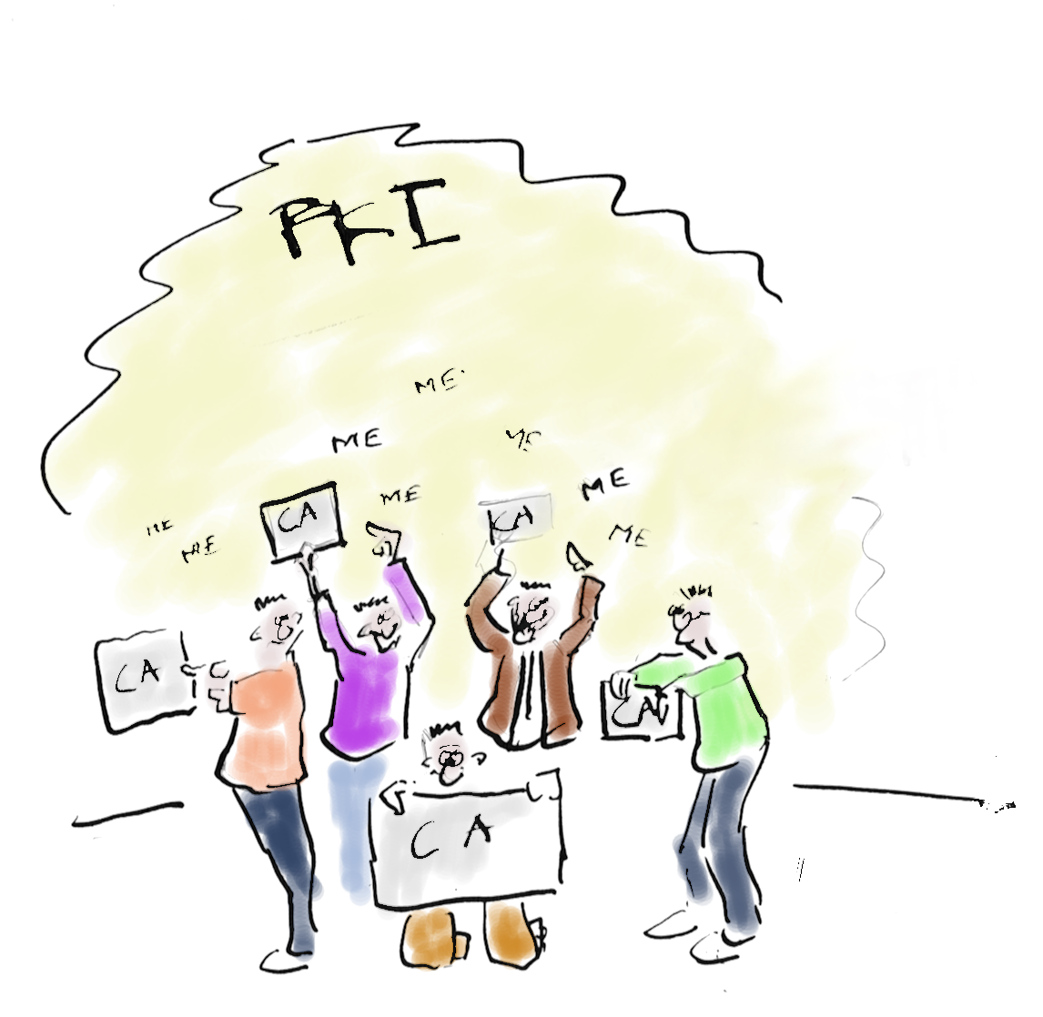
The library
motivation
Regular PKI is flawed
Any Certificate Authority (3000+)
Can vouch for any name

Slide 21
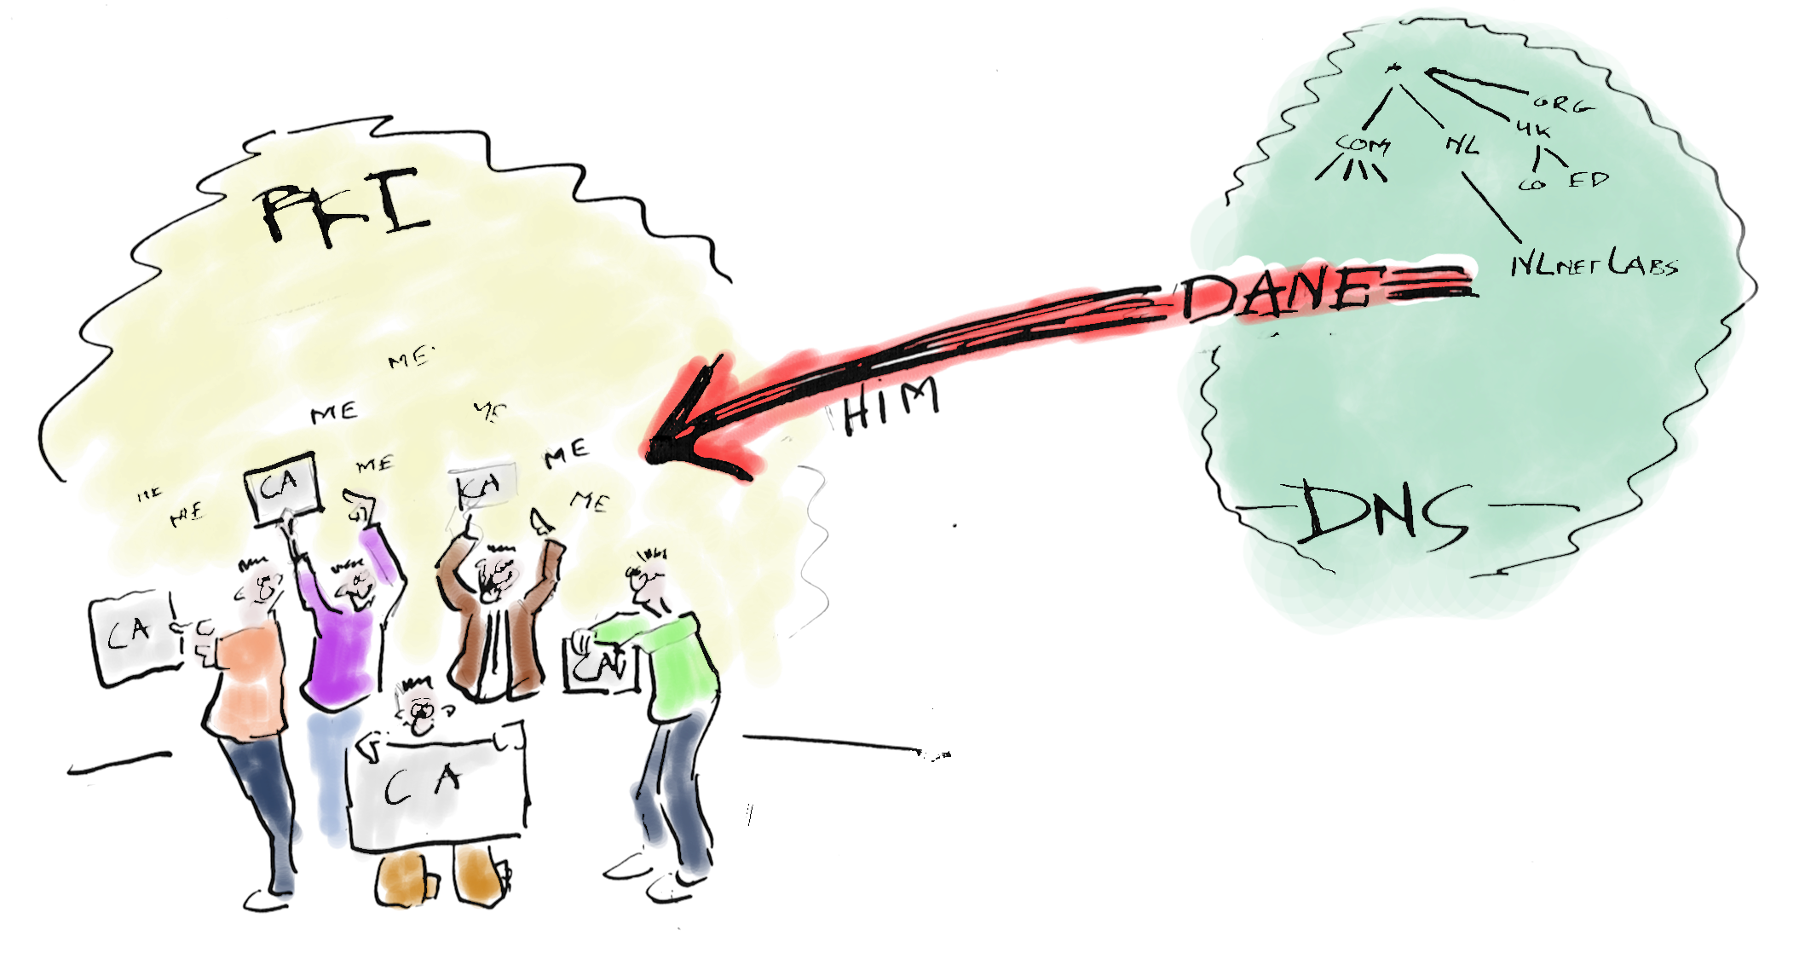
The library
motivation
DNS-Enabled
Authentication of
Named
Entities

Slide 22
The library
motivation
Do you just trust your resolver?

Slide 23
The library
motivation
Do you just trust your resolver?
Who’s to blame

Slide 24
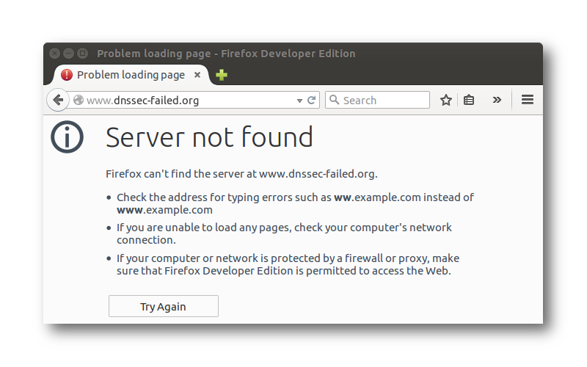
The library
motivation
Do you just trust your resolver?
Who’s to blame

Slide 25
The library
features
Do you just trust your resolver?
Who’s to blame
DNSSEC resolution as Stub

Slide 26
The library
features
Do you just trust your resolver?
DNSSEC resolution as Stub
DNSSEC Roadblock avoidance

Slide 27
The library
features
Privacy with DNS over TLS

Slide 28
The library
features
Browser
(application)
A
DNS-over-TLS
Privacy
stub
resolver
A
OS
Browser
(application)
B
DNS-over-TLS
Privacy
stub
resolver
B
OS
TCP fastopen (optional) RFC7413
Connection reuse RFC7766
EDNS0 keepalive RFC7828
EDNS0 padding RFC7830

Slide 29
The library
features
Connection reuse (A_{Q}/A_{R}, B_{Q}/B_{R}, C_{Q}/C_{R})
Pipe-lining of queries (A_{Q},B_{Q},C_{Q},A_{R},B_{R},C_{R})

Slide 30
The library
features
Connection reuse (A_{Q}/A_{R}, B_{Q}/B_{R}, C_{Q}/C_{R})
Pipe-lining of queries (A_{Q},B_{Q},C_{Q},A_{R},B_{R},C_{R})
Process Out-Of-Order-Responses (A_{Q},B_{Q},C_{Q},B_{R},C_{R},A_{R})

Slide 31

The library
on the
roadmap
For 1.2.0 (during IETF99)
Zero configuration DNSSEC
(built in unbound-anchor)
KSK tracking (RFC5011 like)
Taking the “user space library” setting into account
  Running with user permissions
  Not running as a daemon

Slide 32
The library
on the
roadmap
DNS64 prefix discovery (RFC7050)

Slide 33
The library
on the
roadmap
DANE authenticated DNS over TLS

Slide 34
The library
on the
roadmap
DANE authenticated DNS over TLS
DNSSEC authentication chain in TLS extension

Slide 35
related research and projects
The role of a versatile stub in
from the ground up privacy (and security)
DNSSEC for legacy applications
(i.e. a dnssec-trigger follow up, with signalling)
How can getdns benefit from a system component
  i.e. share stateful connections to upstreams
  have feedback on level of privacy

Slide 36

related research and projects
Stubby

Slide 37
look & feel data structures
getdns is not your typical C library
Script like data structures are used to represent:
  DNS responses
  Resource Records
  Rdata fields
Formatted as JSON-like strings by
char *getdns_pretty_print_dict(getdns dict *dict);
char *getdns_pretty_print_list(getdns_list *list);
typedef struct getdns_dict getdns_dict;
typedef struct getdns_list getdns_list;
typedef struct getdns_bindata { size_t size;
uint8_t *data; } getdns_bindata;

Slide 38
look & feel data structures
getdns is not your typical C library
response dict
{ "answer_type": GETDNS_NAMETYPE_DNS,
"status": GETDNS_RESPSTATUS_GOOD
"canonical_name": <bindata for afnic.fr.>,
"just_address_answers": [
{ "address_data": <bindata for 192.134.5.25>,
"address_type": <bindata of "IPv4"> },
{ "address_data": <bindata for 2001:67c:2218:30::5>,
"address_type": <bindata of "IPv6"> }
],
"replies_full": [
<bindata of 0x7a2f81b000010002000400010561666e...>,
<bindata of 0xa40581b000010002000400010561666e...>
],
"replies_tree": [{ … first reply … }, { … second reply … }]
}

Slide 39
look & feel data structures
getdns is not your typical C library
reply
{ "answer_type": GETDNS_NAMETYPE_DNS,
"canonical_name": <bindata for afnic.fr.>,
"dnssec_status": GETDNS_DNSSEC_SECURE,
"header": { "id": 50407,
"qr": 1, "opcode": GETDNS_OPCODE_QUERY,
"aa": 0, "tc": 0, "rd": 1, "ra": 1,
"z" : 0, "ad": 1, "cd": 1,
"rcode": GETDNS_RCODE_NOERROR,
"qdcount": 1, "ancount": 2,
"nscount": 4, "arcount": 1
},
"question": { "qclass": GETDNS_RRCLASS_IN,
"qname" : <bindata for afnic.fr.>,
"qtype" : GETDNS_RRTYPE_A
},

Slide 40
look & feel data structures
getdns is not your typical C library
reply
"answer": [
{ "name" : <bindata for afnic.fr.>,
"type" : GETDNS_RRTYPE_A,
"class": GETDNS_RRCLASS_IN,
"ttl" : 31,
"rdata": { "ipv4_address": <bindata for 192.134.5.25>,
"rdata_raw": <bindata of 0xc0860519>
}
},
{ "name" : <bindata for afnic.fr.>,
"type" : GETDNS_RRTYPE_RRSIG,
"rdata": { "type_covered": GETDNS_RRTYPE_A,
"algorithm": 8, "labels": 2,
"original_ttl": 600,
"signature_expiration": 1500960505,
"signature_inception": 1498356836,
"key_tag": 16774,
"signers_name": <bindata for afnic.fr.>,

Slide 41
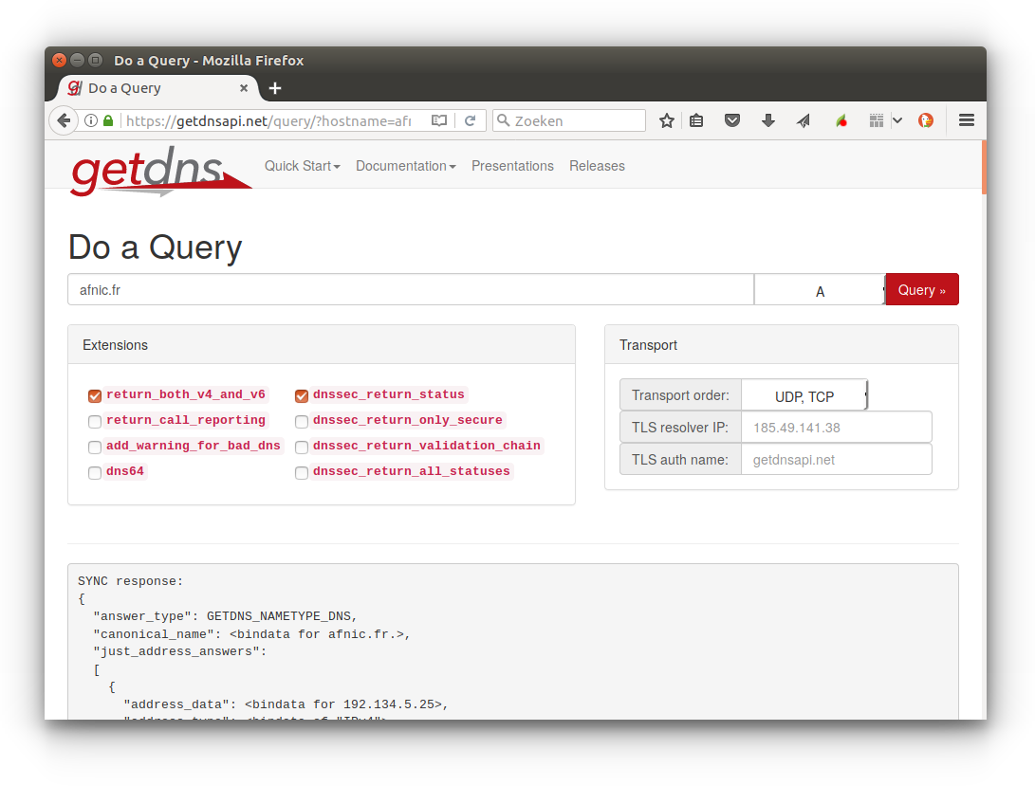
look & feel

Slide 42
look & feel data structures
reading getdns_dicts:
getdns_return_t getdns_dict_get_dict(
const getdns_dict *dict, const char *name, getdns_dict **answer);
getdns_return_t getdns_dict_get_list(
const getdns_dict *dict, const char *name, getdns_list **answer);
getdns_return_t getdns_dict_get_bindata(
const getdns_dict *dict, const char *name, getdns_bindata **answer);
getdns_return_t getdns_dict_get_int(
const getdns_dict *dict, const char *name, uint32_t *answer)
getdns_return_t getdns_dict_get_data_type(
const getdns_dict *dict, const char *name, getdns_data_type *answer);
getdns_return_t getdns_dict_get_names(
const getdns_dict *dict, getdns_list **answer);

Slide 43
look & feel data structures
reading getdns_lists:
getdns_return_t getdns_list_get_dict(
const getdns_list *list, size_t index, getdns_dict **answer);
getdns_return_t getdns_list_get_list(
const getdns_list *list, size_t index, getdns_list **answer);
getdns_return_t getdns_list_get_bindata(
const getdns_list *list, size_t index, getdns_bindata **answer);
getdns_return_t getdns_list_get_int(
const getdns_list *list, size_t index, uint32_t *answer);
getdns_return_t getdns_list_get_data_type(
const getdns_list *list, size_t index, getdns_data_type *answer);
getdns_return_t getdns_list_get_length(
const getdns_list *this_list, size_t *answer);

Slide 44
look & feel data structures
Creating/writing to getdns_dicts:
getdns_dict * getdns_dict_create();
getdns_return_t getdns_dict_set_dict(
getdns_dict *dict, const char *name, const getdns_dict *child_dict);
getdns_return_t getdns_dict_set_list(
getdns_dict *dict, const char *name, const getdns_list *child_list);
getdns_return_t getdns_dict_set_bindata(
getdns_dict *dict, const char *name, const getdns_bindata *child_bindata);
getdns_return_t getdns_dict_set_int(
getdns_dict *dict, const char *name, uint32_t child_uint32)
void getdns_dict_destroy(getdns_dict *dict);

Slide 45
look & feel data structures
{
"answer_type": GETDNS_NAMETYPE_DNS,
"status": GETDNS_RESPSTATUS_GOOD,
"canonical_name": <bindata of "www.getdnsapi.net.">,
"just_address_answers":
[ { "address_data": <bindata for 185.49.141.37>,
"address_type": <bindata of "IPv4">
}
],
"replies_full": [ <bindata of 0x00008180000100020004...> ],
"replies_tree": [ { … first reply … } ],
Response object dict
if ((r = getdns_address_sync(ctx, "getdnsapi.net", ext, &resp)))
return r;
else if ((r = getdns_list_get_bindata(
addr_dict, "/just_address_answers/0/address_data", &addr)))
return r;
Notes:
Suppose we want to get to address of first response in dict
(cumbersome?)

Slide 46
look & feel data structures
if ((r = getdns_address_sync(ctx, "getdnsapi.net", ext, &resp)))
return r;
else if ((r = getdns_list_get_bindata(
addr_dict, "/just_address_answers/0/address_data", &addr)))
return r;
Natural in script languages
Python
resp = ctx.address('getdnsapi.net')
addr = resp.just_address_answers[0]['address_data']
Nodejs
function callback(err, resp) {
var addr = resp.just_address_answers[0].address_data;
}
ctx.getAddress('getdnsapi.net', callback);

Slide 47
look & feel data structures
The alternative would introduce a lot of new types:
  Python:
  addr = resp.replies_tree[0]['answer'][0]['rdata']['ipv6_address']
  C now
  r = getdns_dict_get_bindata(
  resp, "/replies_tree/0/answer/rdata/ipv6_address", &addr)))
  C otherwise (ldns like)
  getdns_response *resp; getdns_reply *reply;
  getdns_rrs *rrs; getdns_rr *rrs;
  getdns_rdata *rdata; struct sockaddr_storage addr;
  if ((r = getdns_response_get_reply(resp, 0, &reply)))
  return r;
  else if ((r = getdns_reply_get_answer_section(reply, &rrs)))
  return r;
  else if ((r = getdns_rrs_get_rr(rrs, &rr)))
  return r;
  else if ((r = getdns_rr_get_rdata(rr, &rdata)))
  return r;
  else if ((r = getdns_rdata_get_rdatafield_address(rdata, 0, &addr)))
  return r;
Notes:
This is what ldns looks like

Slide 48
look & feel data structures
getdns is not your typical C library
Natural in script languages
The alternative would introduce a lot of new types.
With current approach, the library can easily grow
New rdata fields or new extensions without a new API
(dns cookies, roadblock avoidance, client subnet, etc.)
Just in time parsing of wireformat data on the roadmap
( internally already iterator like accessor types for wireformat data)
Still… “C bindings” on the roadmap
Notes:
Currently still constructed of little pieces of memory
Accessors to wireformat data

Slide 49
look & feel lookup functions
getdns_return_t getdns_general(
getdns_context *context,
const char *name,
uint16_t request_type,
getdns_dict *extensions,
void *userarg,
getdns_transaction_t *transaction_id,
getdns_callback_t callbackfn
);
context contains configuration parameters
  Stub or recursive modus operandi, timeout values, root-hints, forwarders, trust anchor, search path etc.)
context contains the resolver cache
getdns_return_t getdns_context_create(
getdns_context **context, int set_from_os)

Slide 50
look & feel lookup functions
getdns_return_t getdns_general(
getdns_context *context,
const char *name,
uint16_t request_type,
getdns_dict *extensions,
void *userarg,
getdns_transaction_t *transaction_id,
getdns_callback_t callbackfn
);
context contains configuration parameters
name and request_type the name and type to lookup

Slide 51
look & feel lookup functions
getdns_return_t getdns_general(
getdns_context *context,
const char *name,
uint16_t request_type,
getdns_dict *extensions,
void *userarg,
getdns_transaction_t *transaction_id,
getdns_callback_t callbackfn
);
context contains configuration parameters
name and request_type the name and type to lookup
extensions additional parameters specific for this lookup
  return_both_v4_and_v6, dnssec_return_status, specify_class, add_opt_parameter

Slide 52
look & feel extensions
dnssec_return_validation_chain
  { # Response object
  "validation_chain":
  [ { "name" : <bindata for .>, "type": GETDNS_RRTYPE_DNSKEY, ... },
  { "name" : <bindata for .>, "type": GETDNS_RRTYPE_DNSKEY, ... },
  { "name" : <bindata for .>, "type": GETDNS_RRTYPE_RRSIG,
  "rdata": { "signers_name": <bindata for .>,
  "type_covered": GETDNS_RRTYPE_DNSKEY, ... }, ... },
  { "name" : <bindata for net.>, "type": GETDNS_RRTYPE_DS, ... },
  { "name" : <bindata for net.>, "type": GETDNS_RRTYPE_RRSIG,
  "rdata": { "signers_name": <bindata for .>,
  "type_covered": GETDNS_RRTYPE_DS, ... }, ... },
Can be fed as support_records with companion function:
  getdns_return_t
  getdns_validate_dnssec( getdns_list *to_validate
  , getdns_list *support_records
  , getdns_list *trust_anchors);
Notes:
dnssec_return_all_statusses?

Slide 53
look & feel lookup functions
getdns_return_t getdns_general(
getdns_context *context,
const char *name,
uint16_t request_type,
getdns_dict *extensions,
void *userarg,
getdns_transaction_t *transaction_id,
getdns_callback_t callbackfn
);
context contains configuration parameters
name and request_type the name and type to lookup
extensions additional parameters specific for this lookup
userarg is passed in on the call to callbackfn
transaction_id is set to a unique value that is also
passed in on the call to callbackfn

Slide 54
look & feel lookup functions
getdns_return_t getdns_general(
getdns_context *context,
const char *name,
uint16_t request_type,
getdns_dict *extensions,
void *userarg,
getdns_transaction_t *transaction_id,
getdns_callback_t callbackfn
);
typedef void (*getdns_callback_t)(
getdns_context *context,
getdns_callback_type_t callback_type,
getdns_dict *response,
void *userarg,
getdns_transaction_t transaction_id
);
// callback_type = complete, cancel, timeout or error

Slide 55
look & feel lookup functions
getdns_return_t getdns_general(
getdns_context *context,
const char *name,
uint16_t request_type,
getdns_dict *extensions,
void *userarg,
getdns_transaction_t *transaction_id,
getdns_callback_t callbackfn
);
getdns_return_t getdns_general_sync(
getdns_context *context,
const char *name,
uint16_t request_type,
getdns_dict *extensions,
getdns_dict **response
);

Slide 56
look & feel lookup functions
getdns_return_t getdns_address(
getdns_context *context,
const char *name,
getdns_dict *extensions,
void *userarg,
getdns_transaction_t *transaction_id,
getdns_callback_t callbackfn
);
getdns_address also lookups in other name systems
  local files, mDNS (not implemented yet)
When name is found in the DNS, getdns_address returns both IPv4 and IPv6

Slide 57
look & feel lookup functions
getdns_return_t getdns_hostname(
getdns_context *context,
getdns_dict *address,
getdns_dict *extensions,
void *userarg,
getdns_transaction_t *transaction_id,
getdns_callback_t callbackfn
);
With address: { "address_type": <bindata of "IPv4">,
"address_data": <bindata for 185.49.141.37>
}
will lookup 37.141.49.185.in-addr.arpa PTR

Slide 58
look & feel lookup functions
getdns_return_t getdns_service(
getdns_context *context,
getdns_dict *name,
getdns_dict *extensions,
void *userarg,
getdns_transaction_t *transaction_id,
getdns_callback_t callbackfn
);
Provides a partly randomly sorted list (by weight and priority) of service addresses and ports (RFC2782)
"canonical_name": <bindata for _jabber._tcp.nlnetlabs.nl.>
"srv_addresses":
[ { "address_data": <bindata for 2a04:b900::1:0:0:10>,
"domain_name": <bindata for open.nlnetlabs.nl.>,
"port": 5269 },
{ "address_data": <bindata for 185.49.140.10>,
"domain_name": <bindata for open.nlnetlabs.nl.>,
"port": 5269 }
],

Slide 59
look & feel event libraries
libevent
Include : #include <getdns/getdns_ext_libevent.h>
Use : getdns_extension_set_libevent_base(context, base);
Link : -lgetdns -lgetdns_ext_event
libev
Include : #include <getdns/getdns_ext_libev.h>
Use : getdns_extension_set_libev_loop(context, loop);
Link : -lgetdns -lgetdns_ext_ev
libuv
Include : #include <getdns/getdns_ext_libuv.h>
Use : getdns_extension_set_libuv_loop(context, loop);
Link : -lgetdns -lgetdns_ext_uv

Slide 60
look & feel example query
from getdns import *
ctx = Context()
ext = { "dnssec_return_only_secure": EXTENSION_TRUE }
res = ctx.general( ’_443._tcp.getdnsapi.net’, RRTYPE_TLSA, ext)
if res[’status’] == RESPSTATUS_GOOD:
# Process TLSA RRs
Notes:
Lookup DANE record
Default is recursive (pitty but safe)

Slide 61
look & feel example query
from getdns import *
ctx = Context()
ctx.resolution_type = RESOLUTION_STUB
ext = { "dnssec_return_only_secure": EXTENSION_TRUE }
res = ctx.general( ’_443._tcp.getdnsapi.net’, RRTYPE_TLSA, ext)
if res[’status’] == RESPSTATUS_GOOD:
# Process TLSA RRs

Slide 62
look & feel example query
from getdns import *
ctx = Context()
ctx.resolution_type = RESOLUTION_STUB
ext = { "dnssec_return_only_secure" : EXTENSION_TRUE
, "dnssec_roadblock_avoidance": EXTENSION_TRUE}
res = ctx.general( ’_443._tcp.getdnsapi.net’, RRTYPE_TLSA, ext)
if res[’status’] == RESPSTATUS_GOOD:
# Process TLSA RRs

Slide 63
look & feel example query
from getdns import *
def process_tlsa_rrs( ttype, result, userarg, tid ):
ctx = userarg
if ttype == CALLBACK_COMPLETE:
# Process TLSA RRs
pass
elif ttype == CALLBACK_TIMEOUT:
# Handle timeout
pass
ctx = Context()
ctx.resolution_type = RESOLUTION_STUB
ext = { "dnssec_return_only_secure" : EXTENSION_TRUE
, "dnssec_roadblock_avoidance": EXTENSION_TRUE}
tid = ctx.general( '_443._tcp.getdnsapi.net', RRTYPE_TLSA, ext
, userarg = ctx, callback = process_tlsa_rrs )
ctx.run()

Slide 64
look & feel example query
var getdns = require('getdns');
function process_tlsa_rrs(err, res)
{
if (err) {
console.log( err )
} else {
// Process TLSA RRs
}
}
ctx = getdns.createContext();
ctx.general( ' _443._tcp.getdnsapi.net', getdns.RRTYPE_TLSA
, { dnssec_return_only_secure : true
, dnssec_roadblock_avoidance: true }
, function(err, res) { process_tlsa_rrs(ctx, err, res); });

Slide 65
Hands on
DANE authenticated
TLS connect (python)
from getdns import *
from M2Crypto import SSL, X509
import sys
from socket import *
import hashlib
if len(sys.argv) > 1:
hostname = sys.argv[1]
port = int(sys.argv[2]) if len(sys.argv) > 2 else 443
else:
print('%s <hostname> [ <port> ]' % sys.argv[0])
sys.exit(0)
ctx = Context()
ctx.resolution_type = RESOLUTION_STUB
ext = { "dnssec_return_only_secure" : EXTENSION_TRUE }
# , "dnssec_roadblock_avoidance": EXTENSION_TRUE }
# Correctly query and process DANE records
res = ctx.general('_%d._tcp.%s' % (port, hostname), RRTYPE_TLSA, ext)

Slide 66
Hands on
DANE authenticated
TLS connect (python)
if res.status == RESPSTATUS_GOOD:
# Process TLSA Rrs
tlsas = [ answer for reply in res.replies_tree
for answer in reply['answer']
if answer['type'] == RRTYPE_TLSA ]
elif res.status == RESPSTATUS_ALL_TIMEOUT:
print('Network error trying to get DANE records for %s' % hostname)
sys.exit(-1);
elif res.status == RESPSTATUS_ALL_BOGUS_ANSWERS:
print('DANE records for %s were BOGUS' % hostname)
sys.exit(-1);
else:
tlsas = None
# Conventional PKIX without DANE processing

Slide 67
Hands on
DANE authenticated
TLS connect (python)
Find the CA vouching for the connection for PKIX-TA and DANE-TA usages.
ca_cert = None
def get_ca(ok, store):
global ca_cert
if store.get_current_cert().check_ca():
ca_cert = store.get_current_cert()
return ok
# Now TLS connect to each address and verify the cert (or CA)
for address in ctx.address(hostname).just_address_answers:
sock = socket(AF_INET if address['address_type'] == 'IPv4'
else AF_INET6, SOCK_STREAM)
socket.setsockopt(sock, SOL_SOCKET, SO_REUSEADDR, 1)
print('Connecting to %s' % address['address_data']);
ssl_ctx = SSL.Context()
ssl_ctx.load_verify_locations(capath = '/etc/ssl/certs')
ssl_ctx.set_verify(SSL.verify_none, 10, get_ca)
connection = SSL.Connection(ssl_ctx, sock=sock)

Slide 68
Hands on
DANE authenticated
TLS connect (python)
Just two more household affairs...
# set TLS SNI extension
connection.set_tlsext_host_name(hostname)
# Per RFC7671, for DANE-EE usage, certificate identity checks are
# based solely on the TLSA record, so we ignore name mismatch
# conditions in the certificate.
try:
connection.connect((address['address_data'], port))
except SSL.Checker.WrongHost:
pass

Slide 69
Hands on
DANE authenticated
TLS connect (python)
Without TLSA RRs, fall back to old fashioned PKIX
if not tlsas:
print( 'No TLSAS. Regular PKIX validation '
+ ('succeeded' if connection.verify_ok() else 'failed'))
continue # next address
But with TLSA RRs, try each TLSA RR in turn.
First one matching makes the day!
Note that for PKIX-TA (0) and DANE-TA (2) we set cert to the CA.
cert = connection.get_peer_cert()
TLSA_matched = False
for tlsa in tlsas:
rdata = tlsa['rdata']
if rdata['certificate_usage'] in (0, 2):
cert = ca_cert

Slide 70
Hands on
DANE authenticated
TLS connect (python)
Put certdata into selector and the matching_type shape
if rdata['selector'] == 0:
certdata = cert.as_der()
elif rdata['selector'] == 1:
certdata = cert.get_pubkey().as_der()
else:
raise ValueError('Unkown selector')
if rdata['matching_type'] == 1:
certdata = hashlib.sha256(certdata).digest()
elif rdata['matching_type'] == 2:
certdata = hashlib.sha512(certdata).digest()
else:
raise ValueError('Unkown matching type')

Slide 71
Hands on
DANE authenticated
TLS connect (python)
And see if certdata matches TLSA certificate association data
With usages PKIX-TA (0) and PKIX-EE (1)
we need to PKIX validate too (i.e. connection.verify_ok())
if str(certdata) == str(rdata['certificate_association_data'])\
and (rdata['certificate_usage'] > 1 or connection.verify_ok()):
TLSA_matched = True
print('DANE validated successfully')
break # from "for tlsa in tlsas:" (first one wins!)
if not TLSA_matched:
print('DANE validation failed')

Slide 72
Hands on
DANE authenticated
TLS connect (python)
Our DANE example in action:
willem@bonobo:~/jcsa17$ ./dane-connect.py www.afnic.fr
Connecting to 2001:67c:2218:30::24
DANE validated successfully
Connecting to 192.134.5.24
DANE validated successfully
willem@bonobo:~/jcsa17$ ./dane-connect.py www.sidn.nl
Connecting to 2001:7b8:606:294::3
DANE validated successfully
Connecting to 212.114.98.233
DANE validated successfully
willem@bonobo:~/jcsa17$ ./dane-connect.py www.nominet.uk
Connecting to 2400:cb00:2048:1::6814:e3d
No TLSAS. Regular PKIX validation succeeded
Connecting to 104.20.14.61
No TLSAS. Regular PKIX validation succeeded

Slide 73
Hands on
C API – How to do a simple query
Use API and non-API functions
Do a synchronous request (one at a time).
Extract data from the response dict
Do asynchronously requests
Use an event loop libraries
Use extension dictionaries
https://getdnsapi.net/blog/simple-lookup/
https://getdnsapi.net/static/getdns-jcsa17-examples-0.1.0.tar.gz
https://github.com/getdnsapi/getdns-jcsa17

Slide 74
Hands on
C API – How to do a simple query
setup context
#include <getdns/getdns_extra.h>
#include <stdio.h>
int main()
{
getdns_return_t r;
getdns_context *ctxt = NULL;
if ((r = getdns_context_create(&ctxt, 1)))
fprintf( stderr, "Could not create context: %s\n"
, getdns_get_errorstr_by_id(r));
if (ctxt)
getdns_context_destroy(ctxt);
return r ? EXIT_FAILURE : EXIT_SUCCESS;
}
GETDNS_RETURN_SUCCESS == 0
getdns_get_errorstr_by_id() is a non-API function
getdns_conext_create() does not touch ctxt on failure

Slide 75
Hands on
C API – How to do a simple query
do query
#include <getdns/getdns_extra.h>
#include <stdio.h>
int main()
{
getdns_return_t r;
getdns_context *ctxt = NULL;
getdns_dict *resp = NULL;
if ((r = getdns_context_create(&ctxt, 1)))
fprintf( stderr, "Could not create context: %s\n"
, getdns_get_errorstr_by_id(r));
else if ((r = getdns_address_sync(ctxt, "getdnsapi.net.", NULL, &resp)))
fprintf( stderr, "Unable to do an address lookup: %s\n"
, getdns_get_errorstr_by_id(r));
if (resp)
getdns_dict_destroy(resp);
if (ctxt)
getdns_context_destroy(ctxt);
return r ? EXIT_FAILURE : EXIT_SUCCESS;
}

Slide 76
Hands on
C API – How to do a simple query
do query
#include <getdns/getdns_extra.h>
#include <stdio.h>
int main()
{
getdns_return_t r;
getdns_context *ctxt = NULL;
getdns_dict *resp = NULL;
if ((r = getdns_context_create(&ctxt, 1)))
fprintf( stderr, "Could not create context: %s\n"
, getdns_get_errorstr_by_id(r));
else if ((r = getdns_address_sync(ctxt, "getdnsapi.net.", NULL, &resp)))
fprintf( stderr, "Unable to do an address lookup: %s\n"
, getdns_get_errorstr_by_id(r));
if (resp)
getdns_dict_destroy(resp);
if (ctxt)
getdns_context_destroy(ctxt);
return r ? EXIT_FAILURE : EXIT_SUCCESS;
}
if (!(r = getdns_context_create(&ctxt))) {
if (!(r = getdns_address_sync(ctxt, ..., &resp))) {
getdns_dict_destroy(resp);
}
else
; /* error handling */
getdns_context_destroy(ctxt);
} else
; /* error handling */

Slide 77
Hands on
C API – How to do a simple query
do query
#include <getdns/getdns_extra.h>
#include <stdio.h>
int main()
{
getdns_return_t r;
getdns_context *ctxt = NULL;
getdns_dict *resp = NULL;
if ((r = getdns_context_create(&ctxt, 1)))
fprintf( stderr, "Could not create context: %s\n"
, getdns_get_errorstr_by_id(r));
else if ((r = getdns_address_sync(ctxt, "getdnsapi.net.", NULL, &resp)))
fprintf( stderr, "Unable to do an address lookup: %s\n"
, getdns_get_errorstr_by_id(r));
if (resp)
getdns_dict_destroy(resp);
if (ctxt)
getdns_context_destroy(ctxt);
return r ? EXIT_FAILURE : EXIT_SUCCESS;
}
if ((r = getdns_context_create(&ctxt, 1)))
goto escape;
if ((r = getdns_address_sync(ctxt, ..., &resp)))
goto escape_destroy_context;
if ((r = getdns_something(...)))
goto escape_destroy_resp;
escape_destroy_resp:
getdns_dict_destroy(resp);
escape_destroy_context:
getdns_context_destroy(ctxt);
escape:
return r ? EXIT_FAILURE : EXIT_SUCCESS;

Slide 78
Hands on
C API – How to do a simple query
do query
#include <getdns/getdns_extra.h>
#include <stdio.h>
int main()
{
getdns_return_t r;
getdns_context *ctxt = NULL;
getdns_dict *resp = NULL;
if ((r = getdns_context_create(&ctxt, 1)))
fprintf( stderr, "Could not create context: %s\n"
, getdns_get_errorstr_by_id(r));
else if ((r = getdns_address_sync(ctxt, "getdnsapi.net.", NULL, &resp)))
fprintf( stderr, "Unable to do an address lookup: %s\n"
, getdns_get_errorstr_by_id(r));
if (resp)
getdns_dict_destroy(resp);
if (ctxt)
getdns_context_destroy(ctxt);
return r ? EXIT_FAILURE : EXIT_SUCCESS;
}
if (!(r = getdns_context_create(&ctxt, 1))
&& !(r = getdns_address_sync(ctxt, ..., &resp))
&& !(r = getdns_something(...))
&& !(r = getdns_something_else(...))) {
/* The happy path */
} else
fprintf( stderr, "Something went wrong somewhere: %s\n"
, getdns_get_errorstr_by_id(r));
if (resp) getdns_dict_destroy(resp);
if (ctxt) getdns_dict_destroy(ctxt);

Slide 79
Hands on
C API – How to do a simple query
get data
getdns_bindata *address;
char address_str[1024];
if ((r = getdns_context_create(&ctxt, 1)))
fprintf( stderr, "Could not create context: %s\n"
, getdns_get_errorstr_by_id(r));
else if ((r = getdns_address_sync(ctxt, "getdnsapi.net.", NULL, &resp)))
fprintf( stderr, "Unable to do an address lookup: %s\n"
, getdns_get_errorstr_by_id(r));
else if ((r = getdns_dict_get_bindata( resp,
"/just_address_answers/0/address_data", &address)))
fprintf( stderr, "Unable to get an address from the response: %s\n"
, getdns_get_errorstr_by_id(r));
else if (address->size != 4 && address->size != 16)
fprintf(stderr, "Unable to determine type of this address\n");
else if (! inet_ntop( address->size == 4 ? AF_INET : AF_INET6
, address->data, address_str, sizeof(address_str)))
fprintf(stderr, "Could not convert address to string\n");
else
printf("An address of getdnsapi.net is: %s\n", address_str);

Slide 80
Hands on
C API – How to do a simple query
get data
getdns_bindata *address;
char address_str[1024];
if ((r = getdns_context_create(&ctxt, 1)))
fprintf( stderr, "Could not create context: %s\n"
, getdns_get_errorstr_by_id(r));
else if ((r = getdns_address_sync(ctxt, "getdnsapi.net.", NULL, &resp)))
fprintf( stderr, "Unable to do an address lookup: %s\n"
, getdns_get_errorstr_by_id(r));
else if ((r = getdns_dict_get_bindata( resp,
"/just_address_answers/0/address_data", &address)))
fprintf( stderr, "Unable to get an address from the response: %s\n"
, getdns_get_errorstr_by_id(r));
else if (address->size != 4 && address->size != 16)
fprintf(stderr, "Unable to determine type of this address\n");
else if (! inet_ntop( address->size == 4 ? AF_INET : AF_INET6
, address->data, address_str, sizeof(address_str)))
fprintf(stderr, "Could not convert address to string\n");
else
printf("An address of getdnsapi.net is: %s\n", address_str);
JSON-pointer introduced into the API by us
getdns returns "network" format IPv4 and IPv6 addresses
No data is converted, response dicts brings you to the spot

Slide 81
Hands on
C API – How to do a simple query
asynchronous
#include <getdns/getdns_extra.h>
#include <stdio.h>
void callback(getdns_context *ctxt, getdns_callback_type_t cb_type,
getdns_dict *resp, void *userarg, getdns_transaction_t trans_id) {}
int main()
{
getdns_return_t r;
getdns_context *ctxt = NULL;
if ((r = getdns_context_create(&ctxt, 1)))
fprintf( stderr, "Could not create context: %s\n"
, getdns_get_errorstr_by_id(r));
else if ((r = getdns_address(ctxt, "getdnsapi.net.", 0, 0, 0, callback)))
fprintf( stderr, "Unable to schedule an address lookup: %s\n"
, getdns_get_errorstr_by_id(r));
else
getdns_context_run(ctxt);
if (ctxt)
getdns_context_destroy(ctxt);
return r ? EXIT_FAILURE : EXIT_SUCCESS;
}

Slide 82
Hands on
C API – How to do a simple query
asynchronous
#include <getdns/getdns_extra.h>
#include <stdio.h>
void callback(getdns_context *ctxt, getdns_callback_type_t cb_type,
getdns_dict *resp, void *userarg, getdns_transaction_t trans_id) {}
int main()
{
getdns_return_t r;
getdns_context *ctxt = NULL;
if ((r = getdns_context_create(&ctxt, 1)))
fprintf( stderr, "Could not create context: %s\n"
, getdns_get_errorstr_by_id(r));
else if ((r = getdns_address(ctxt, "getdnsapi.net.", 0, 0, 0, callback)))
fprintf( stderr, "Unable to schedule an address lookup: %s\n"
, getdns_get_errorstr_by_id(r));
else
getdns_context_run(ctxt);
if (ctxt)
getdns_context_destroy(ctxt);
return r ? EXIT_FAILURE : EXIT_SUCCESS;
}
A request is scheduled
A callback function is registered
getdns_context_run() is not an API function

Slide 83
Hands on
C API – How to do a simple query
async libuv
int main() {
getdns_return_t r;
getdns_context *ctxt = NULL;
uv_loop_t loop;
if (uv_loop_init(&loop)) {
fprintf( stderr, "Could not initialize event loop\n");
return EXIT_FAILURE;
}
else if ((r = getdns_context_create(&ctxt, 1)))
fprintf( stderr, "Could not create context: %s\n"
, getdns_get_errorstr_by_id(r));
else if ((r = getdns_extension_set_libuv_loop(ctxt, &loop)))
fprintf( stderr, "Unable to set the event loop: %s\n"
, getdns_get_errorstr_by_id(r));
else if ((r = getdns_address(ctxt, "getdnsapi.net.", 0, 0, 0, callback)))
fprintf( stderr, "Unable to schedule an address lookup: %s\n"
, getdns_get_errorstr_by_id(r));
else
uv_run(&loop, UV_RUN_DEFAULT);
if (ctxt) getdns_context_destroy(ctxt);
return r ? EXIT_FAILURE : EXIT_SUCCESS;
}

Slide 84
Hands on
C API – How to do a simple query
#include <uv.h>
cc -o 05-libuv-query -lgetdns -lgetdns_ext_libuv -luv
asynchronous
int main() {
getdns_return_t r;
getdns_context *ctxt = NULL;
uv_loop_t loop;
if (uv_loop_init(&loop)) {
fprintf( stderr, "Could not initialize event loop\n");
return EXIT_FAILURE;
}
else if ((r = getdns_context_create(&ctxt, 1)))
fprintf( stderr, "Could not create context: %s\n"
, getdns_get_errorstr_by_id(r));
else if ((r = getdns_extension_set_libuv_loop(ctxt, &loop)))
fprintf( stderr, "Unable to set the event loop: %s\n"
, getdns_get_errorstr_by_id(r));
else if ((r = getdns_address(ctxt, "getdnsapi.net.", 0, 0, 0, callback)))
fprintf( stderr, "Unable to schedule an address lookup: %s\n"
, getdns_get_errorstr_by_id(r));
else
uv_run(&loop, UV_RUN_DEFAULT);
if (ctxt) getdns_context_destroy(ctxt);
return r ? EXIT_FAILURE : EXIT_SUCCESS;
}

Slide 85
Hands on
C API – How to do a simple query
get data 2
void callback(getdns_context *ctxt, getdns_callback_type_t cb_type,
getdns_dict *resp, void *userarg, getdns_transaction_t trans_id)
{
getdns_return_t r;
getdns_list *jaa; /* The just_address_answers list */
size_t i; /* Variable to iterate over the jaa list */
getdns_dict *ad; /* A dictionary containing an address */
if (cb_type != GETDNS_CALLBACK_COMPLETE)
fprintf( stderr, "Something went wrong with this query: %s\n"
, getdns_get_errorstr_by_id(cb_type));
else if ((r = getdns_dict_get_list(resp, "just_address_answers", &jaa)))
fprintf( stderr, "No addresses in the response dict: %s\n"
, getdns_get_errorstr_by_id(r));
else for (i = 0; !getdns_list_get_dict(jaa, i, &ad); i++) {
getdns_bindata *address;
char address_str[1024];
if ((r = getdns_dict_get_bindata(ad, "address_data", &address)))
fprintf( stderr, "Could not get address_data: %s\n"
, getdns_get_errorstr_by_id(r));

Slide 86
Hands on
C API – How to do a simple query
get data 2
void callback(getdns_context *ctxt, getdns_callback_type_t cb_type,
getdns_dict *resp, void *userarg, getdns_transaction_t trans_id)
{
getdns_return_t r;
getdns_list *jaa; /* The just_address_answers list */
size_t i; /* Variable to iterate over the jaa list */
getdns_dict *ad; /* A dictionary containing an address */
if (cb_type != GETDNS_CALLBACK_COMPLETE)
fprintf( stderr, "Something went wrong with this query: %s\n"
, getdns_get_errorstr_by_id(cb_type));
else if ((r = getdns_dict_get_list(resp, "just_address_answers", &jaa)))
fprintf( stderr, "No addresses in the response dict: %s\n"
, getdns_get_errorstr_by_id(r));
else for (i = 0; !getdns_list_get_dict(jaa, i, &ad); i++) {
getdns_bindata *address;
char address_str[1024];
if ((r = getdns_dict_get_bindata(ad, "address_data", &address)))
fprintf( stderr, "Could not get address_data: %s\n"
, getdns_get_errorstr_by_id(r));
works with
all constants
stop for
when != 0

Slide 87
Hands on
C API – How to do a simple query
size_t i; /* Variable to iterate over the jaa list */
getdns_dict *ad; /* A dictionary containing an address */
if (cb_type != GETDNS_CALLBACK_COMPLETE)
fprintf( stderr, "Something went wrong with this query: %s\n"
, getdns_get_errorstr_by_id(cb_type));
else if ((r = getdns_dict_get_list(resp, "just_address_answers", &jaa)))
fprintf( stderr, "No addresses in the response dict: %s\n"
, getdns_get_errorstr_by_id(r));
else for (i = 0; !getdns_list_get_dict(jaa, i, &ad); i++) {
getdns_bindata *address;
char address_str[1024];
if ((r = getdns_dict_get_bindata(ad, "address_data", &address)))
fprintf( stderr, "Could not get address_data: %s\n"
, getdns_get_errorstr_by_id(r));
else if (address->size != 4 && address->size != 16)
fprintf(stderr, "Unable to determine address type\n");
else if (! inet_ntop( address->size == 4 ? AF_INET : AF_INET6,
address->data, address_str, sizeof(address_str)))
fprintf(stderr, "Could not convert address to string\n");
else
printf("An address of getdnsapi.net is: %s\n", address_str);
}
getdns_dict_destroy(resp); /* Safe, because resp is NULL on error */
}
get data 2

Slide 88
Hands on
C API – How to do a simple query
multiple queries
struct dane_query_st {
getdns_dict *addrs_response;
getdns_transaction_t addrs_transaction_id;
getdns_dict *tlsas_response;
getdns_transaction_t tlsas_transaction_id;
};
int main()
{
getdns_return_t r;
getdns_context *ctxt = NULL;
uv_loop_t loop;
getdns_dict *ext;
struct dane_query_st state = { NULL, 0, NULL, 0 };
else if ((r = getdns_context_set_resolution_type(
ctxt, GETDNS_RESOLUTION_STUB)))
fprintf( stderr, "Could not set stub resolution modus: %s\n"
, getdns_get_errorstr_by_id(r));
else if ((r = getdns_address( ctxt, "getdnsapi.net.", NULL
, &state
, &state.addrs_transaction_id
, addresses_callback)))
fprintf( stderr, "Unable to schedule an address lookup: %s\n"
, getdns_get_errorstr_by_id(r));
void *
userarg

Slide 89
Hands on
C API – How to do a simple query
multiple queries
else if (!(ext = getdns_dict_create())) {
fprintf( stderr, "Could not allocate extensions dict\n");
r = GETDNS_RETURN_MEMORY_ERROR;
}
else if ((r = getdns_dict_set_int(ext, "dnssec_return_only_secure"
, GETDNS_EXTENSION_TRUE))
|| (r = getdns_dict_set_int(ext, "dnssec_roadblock_avoidance"
, GETDNS_EXTENSION_TRUE)))
fprintf( stderr, "Could not populate extensions dict: %s\n"
, getdns_get_errorstr_by_id(r));
else if ((r = getdns_general( ctxt, "_443._tcp.getdnsapi.net."
, GETDNS_RRTYPE_TLSA, ext
, &state
, &state.tlsas_transaction_id
, tlsas_callback)))
fprintf( stderr, "Unable to schedule a TLSA lookup: %s\n"
, getdns_get_errorstr_by_id(r));
else
uv_run(&loop, UV_RUN_DEFAULT);
void *
userarg
Create & populate extensions the API way

Slide 90
Hands on
C API – How to do a simple query
multiple queries
else if ((r = getdns_str2dict(
"{ dnssec_return_only_secure : GETDNS_EXTENSION_TRUE "
", dnssec_roadblock_avoidance: GETDNS_EXTENSION_TRUE }", &ext)))
fprintf( stderr, "Could not create/populate extensions dict: %s\n"
, getdns_get_errorstr_by_id(r));
else if ((r = getdns_general( ctxt, "_443._tcp.getdnsapi.net."
, GETDNS_RRTYPE_TLSA, ext
, &state
, &state.tlsas_transaction_id
, tlsas_callback)))
fprintf( stderr, "Unable to schedule a TLSA lookup: %s\n"
, getdns_get_errorstr_by_id(r));
else
uv_run(&loop, UV_RUN_DEFAULT);
void *
userarg
Create & populate extensions the unofficial non-API way

Slide 91
Hands on
C API – How to do a simple query
multiple queries
void addresses_callback(getdns_context *ctxt, getdns_callback_type_t cb_type,
getdns_dict *resp, void *userarg, getdns_transaction_t trans_id)
{
struct dane_query_st *state = (struct dane_query_st *)userarg;
if (cb_type != GETDNS_CALLBACK_COMPLETE) {
/* Something went wrong,
* Cancel the TLSA query if it hasn't finished yet.
* Then abort the connection.
*/
if (! state->tlsas_response)
(void) getdns_cancel_callback(
ctxt, state->tlsas_transaction_id);
abort_connection(state);
return;
}
state->addrs_response = resp;
if (state->tlsas_response)
setup_connection(state);
else
; /* Wait for TLSA lookup to complete */
}

Slide 92
Hands on
C API – How to do a simple query
multiple queries
void tlsas_callback(getdns_context *ctxt, getdns_callback_type_t cb_type,
getdns_dict *resp, void *userarg, getdns_transaction_t trans_id)
{
struct dane_query_st *state = (struct dane_query_st *)userarg;
if (cb_type != GETDNS_CALLBACK_COMPLETE) {
/* Something went wrong,
* Cancel the TLSA query if it hasn't finished yet.
* Then abort the connection.
*/
if (! state->addrs_response)
(void) getdns_cancel_callback(
ctxt, state->addrs_transaction_id);
abort_connection(state);
return;
}
state->tlsas_response = resp;
if (state->addrs_response)
setup_connection(state);
else
; /* Wait for address lookup to complete */
}

Slide 93
Hands on
C API – How to do a simple query
multiple queries
void abort_connection(struct dane_query_st *state)
{
getdns_dict_destroy(state->addrs_response);
getdns_dict_destroy(state->tlsas_response);
fprintf(stderr, "DNS failure\n");
}
void setup_connection(struct dane_query_st *state)
{
uint32_t status;
if (getdns_dict_get_int(state->tlsas_response, "status", &status)
|| status == GETDNS_RESPSTATUS_ALL_BOGUS_ANSWERS) {
abort_connection(state);
return;
}
printf("DNS lookups were successful!\n");
/* Schedule opening the TLS connection to the addresses (if any)
* and verification with the received TLSAs (if any)
* i.e. uv_tcp_connect(connect, socket, dest, callback);
*/
}

