Slide 1
How to get a trustworthy
DNS Privacy enabling recursive resolver an analysis of authentication mechanisms for
DNS Privacy enabling recursive resolvers
Willem Toorop
NLnet Labs
(presenter)
Melinda Shore
Fastly
Benno Overeinder
NLnet Labs

Slide 2

DNS over TLS
What are the actors, and what are their relationships?
Current Spec (RFC7858) focuses on securing stub to recursive traffic
TLS from the system stub client to a privacy enabling recursive resolver can withstand he power and capabilities of a passive pervasive monitor (i.e. an eavesdropper)
The user entrusts her queries with the Privacy enabling recursive resolver
How did the stub resolver learn the recursive resolver? (traditionally via DHCP)
local network
(DHCP) (wifi)
Authoritative
Stub resolver
Privacy enabling
Authoritative
recursive resolver
Authoritative

Slide 3

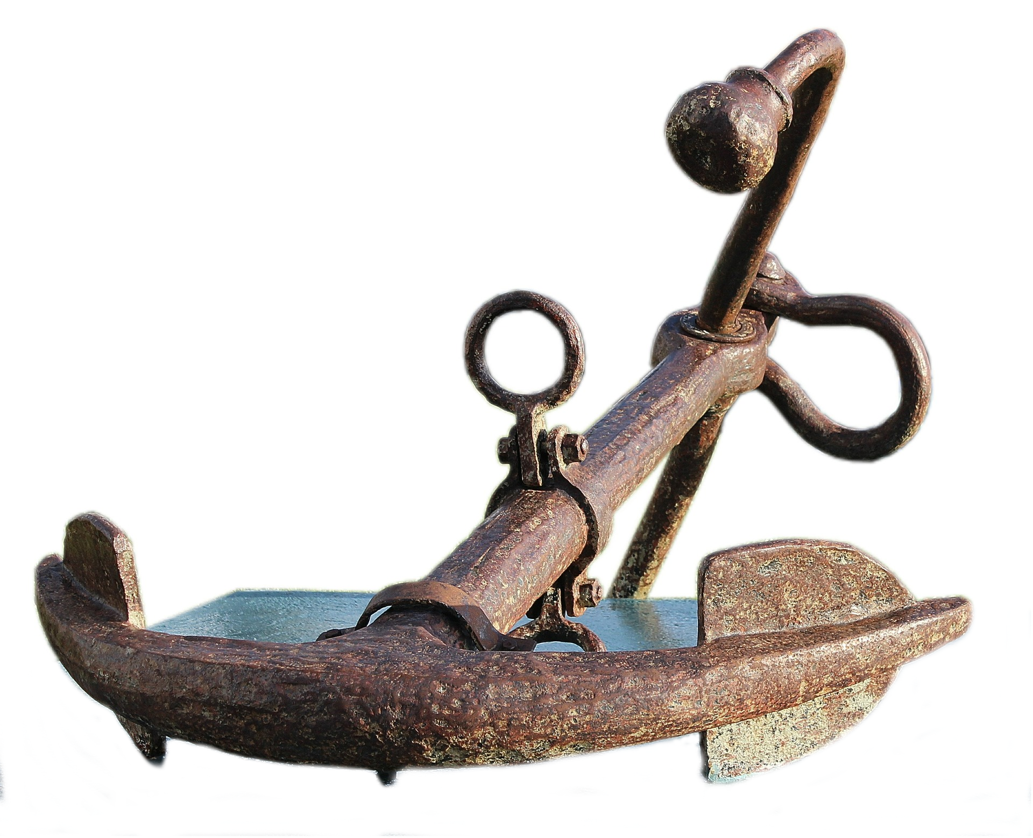
DNS over TLS
What are the actors, and what are their relationships?
Current Spec (RFC7858) focuses on securing stub to recursive traffic
User trusts the channel (Verbally? Website?) over which the connection end-point
(IP-address? Name?) was communicated (what is most reliable to get right, name or IP?)
How to get the IP-address for a name securely, and privately (what is acceptable to leak?)
Trust the DNSSEC root trust-anchor + provisioning channel + TLD of the name ?
dnsovertls.sinodun.com
Authoritative
Stub resolver
Privacy enabling
Gateway
recursive resolver
Authoritative
DNSSEC
Authoritative

Slide 4
Authentication
TLS from stub to resolver cat withstand the power and capabilities of an eavesdropper,
it does not withstand an attacker that plugs itself into the path
Trust in the network can be replaced with authentication
In RFC7858 and draft-ietf-dtls-and-tls-profiles authenticated TLS is called Strict.
Oppertunistic is the best you can get modus operandi
local network
(wifi)
Authoritative
Stub resolver
Privacy enabling
Gateway
recursive resolver
Authoritative
malicious
Authoritative
Gateway/
resolver

Slide 5
Analysis of authentication mechanisms
Analyzed mechanisms: (from draft-ietf-dprive-dtls-and-tls-profiles)
  SubjectPublicKeyInfo pinning … SPKI
  Traditional Public Key Infrastructure for X.509 Certificates
    Statically configured Authentication Domain Name and IP address … PKIX ADN + IP
    Statically configured Authentication Domain Name + dynamically obtained IP … PKIX ADN only
  DNS Based Authentication of Named Entities … DANE
  TLS DNSSEC Authentication Chain Extension
There are key trade-offs between
  Usability & provision flexibility (important for adoption and correct usage)
  meta queries leaking information in these mechanisms
  Requirements on additional dependencies (fewer deps, less can break; i.e. Robustness)
    Availability of unhampered DNSSEC and DNSSEC capable stub resolver
    Third parties (Trust anchor/CA store) that do the authentication

Slide 6
Analysis of authentication mechanisms
 | 1 | 2 | 3 | 4 | 5
SPKI
PKIX ADN + IP
PKIX ADN only
DANE
Chain Extension
We did an analysis on the basis of these considerations:
  Ease of configuration … Least possible config to identify the trusted recursive resolver
  Key management … Can it handle updated, rolled or withdrawn keys
  Information leakage … Leaks info about the trusted recursive resolver, via DNS or SNI
  DNSSEC dependency … Needs DNSSEC availability and capability for bootstrapping
  Trust requirements … Dependencies and maintainability on Trust Anchor and/or CA store

Slide 7
SubjectPublicKeyInfo (SPKI) pinning
IP address: 2001:610:1:40ba:145:100:185:15
SPKI pinset: 62lKu9HsDVbyiPenApnc4sfmSYTHOVfFgL3pyB+cBL4=
Authoritative
Stub resolver
Privacy enabling
recursive resolver
Authoritative
? IP address
? hash of Public Key
+ direct and simple
+ nothing is leaked
+ no additional network activity
Authoritative

Slide 8
SubjectPublicKeyInfo (SPKI) pinning
IP address: 2001:610:1:40ba:145:100:185:15
SPKI pinset: 62lKu9HsDVbyiPenApnc4sfmSYTHOVfFgL3pyB+cBL4=
SPKI pinset
Authoritative
updates
Stub resolver
Privacy enabling
recursive resolver
Authoritative
? IP address
? hash of Public Key
+ direct and simple
+ nothing is leaked
+ no additional network activity
Authoritative
- IP-address and pinset are easy to get wrong
- Lacks provisioning
- Lacks compromised and updated keys signaling
Tip! Backup pinsets

Slide 9
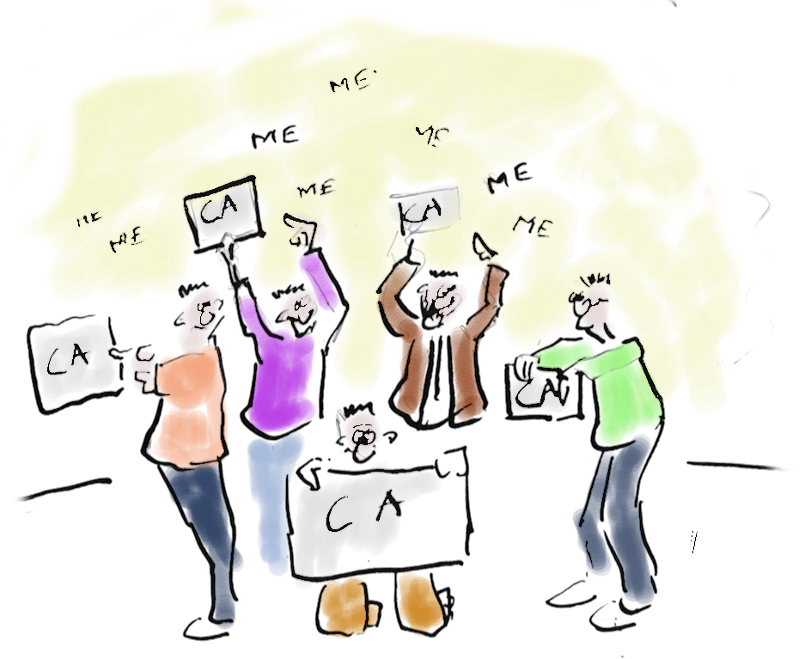
Traditional Public Key Infrastructure for X.509 Certificates (PKIX)
name: dns.cmrg.net
? name
? IP address
- static, DHCP or DNS
+ traditional, well-known
OS managed
+ keys can be rolled
- All CA’s in the store can vouch for any name
?
IP
Authoritative
Stub resolver
Privacy enabling
recursive resolver
Authoritative
Authoritative

Slide 10
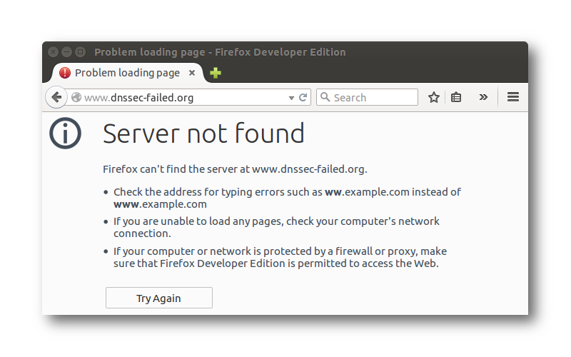

Traditional Public Key Infrastructure for X.509 Certificates (PKIX)
name: dns.cmrg.net
? name
? IP address
- static, DHCP or DNS
+ traditional, well-known
OS managed
- All CA’s in the store can vouch for any name
- no signaling of unknown CA (reason for opportunistic encryption with SMTPS)
- network access + DNS is already needed for OCSP etc.
Authoritative
Stub resolver
Privacy enabling
recursive resolver
Authoritative
SNI
: dns.cmrg.net
Authoritative
OCSP etc.

Slide 11
PKIX - statically configured IP address
name: dnsovertls.sinodun.com
? name
? static IP address
- IP easy to get wrong
- no IP change signalling
ip
:
2001:610:1:40ba:145:100:185:15
Authoritative
Stub resolver
Privacy enabling
recursive resolver
Authoritative
SNI
: dns.cmrg.net
Authoritative
OCSP etc.

Slide 12
PKIX – Both name and IP address came from DHCP
+ Dynamically configured Authentication Domain Name
- Needs secure DHCP (does not exist) + extension to convey the ADN
- Shifts problem to bootstrapping secure DHCP (how is that statically configured?)
Authoritative
name: dns.cmrg.net
ip: 199..58.81.218
Stub resolver
Privacy enabling
recursive resolver
Authoritative
SNI
: dns.cmrg.net
Authoritative
DHCP
OCSP etc.

Slide 13
PKIX – statically configured name, IP address from DNS
Lookup the privacy resolver with DNS
_domain-s._tcp.dns.cmrg.net SRV
name: dns.cmrg.net
unhampered
+ IP change provisioning
199.58.81.218
DNSSEC
Authoritative
DNSSEC
Privacy enabling
Stub resolver
recursive resolver
Authoritative
SNI
: dns.cmrg.net
DNSSEC
Authoritative
OCSP etc.
draft-ietf-dprive-dtls-and-tls-profiles requires DNSSEC for lookup
- Needs unhampered DNSSEC - DNSSEC capable stub resolver needed
- Additional trust in DNSSEC trust anchor + In protocol trust anchor rollover (RFC5011)

Slide 14
DNS Based Authentication of Named Entities (DANE)
Lookup the privacy resolver with DNS
_domain-s._tcp.dns.cmrg.net SRV
_853._tcp.dns.cmrg.net TLSA
+ IP change provisioning
+ No more dependency on
CA infrastructure
Not concerning the option with provided IP,
because that has no additional benefits
- Needs unhampered DNSSEC - DNSSEC capable stub resolver needed
- Additional trust in DNSSEC trust anchor + In protocol trust anchor rollover (RFC5011)

Slide 15
TLS DNSSEC Authentication Chain Extension
draft-ietf-tls-
dnssec-chain-extension
+ Smallest setup latency (same as SPKI)
– No IP change provisioning
+ No more dependency on CA infrastructure
Not concerning the option with resolved IP,
because that has no additional benefits
compared to the pure DANE option
+ No need for unhampered DNSSEC – DNSSEC capable stub resolver needed
– Additional trust in DNSSEC trust anchor + In protocol trust anchor rollover (RFC5011)

Slide 16
Comparison of the different considerations per mechanism
 | Ease of configuration
SPKI | --
PKIX ADN + IP | -
PKIX ADN only | ++
DANE | ++
Chain extension | -
++) | PKIX ADN only, DANE | need only the name
-) | PKIX ADN + IP, Chain ext. | need name + IP (IPv6 addresses are hard to communicate)
--) | SPKI | needs IP + pinset (Base64 pinset is impossible to communicate)

Slide 17
Comparison of the different considerations per mechanism
 | Ease of configuration | Key management
SPKI | -- | --
PKIX ADN + IP | - | -
PKIX ADN only | ++ | -
DANE | ++ | +
Chain extension | - | +
+ ) | DANE, Chain extension | DNSSEC has single trust anchor in protocol key management (RFC5011) bootstrap problem when of for long period?
- ) | PKIX ADN’s | Traditional, well known, managed by OS, but weakest link problem lack of unknown CA signaling
--) | SPKI | Complete manual provisioning with long Base64 string

Slide 18
Comparison of the different considerations per mechanism
 | Ease of configuration | Key management | Information leakage
SPKI | -- | -- | ++
PKIX ADN + IP | - | - | -
PKIX ADN only | ++ | - | --
DANE | ++ | + | --
Chain extension | - | + | +
++) | SPKI | No non-TLS communications, no SNI
+ ) | Chain extension | No non-TLS communications, leaks name by SNI
- ) | PKIX ADN + IP | No non-TLS communications, leaks name by SNI , leaks CRL checking
--) | PKIX ADN only, DANE | DNS communication before TLS setup, leaks SNI PKIX also leaks CRL

Slide 19
Comparison of the different considerations per mechanism
 | Ease of configuration | Key management | Information leakage | DNSSEC dependency
SPKI | -- | -- | ++ | ++
PKIX ADN + IP | - | - | - | ++
PKIX ADN only | ++ | - | -- | --
DANE | ++ | + | -- | --
Chain extension | - | + | + | +
++) | SPKI, PKIX ADN + IP | No DNSSEC dependency
+) | Chain extension | Not affected by DNSSEC hampering middle boxes Requires DNSSEC capable stub resolver
--) | PKIX ADN only, DANE | Requires unhampered DNSSEC availability Requires DNSSEC capable stub resolver

Slide 20
Comparison of the different considerations per mechanism
 | Ease of configuration | Key management | Information leakage | DNSSEC dependency | Trust requirements
SPKI | -- | -- | ++ | ++ | ++
PKIX ADN + IP | - | - | - | ++ | -
PKIX ADN only | ++ | - | -- | -- | --
DANE | ++ | + | -- | -- | +
Chain extension | - | + | + | + | +
++) | SPKI | trust the outbound communication channel connection endpoint details
+ ) | DANE, Chain extension | Additional trust on DNSSEC trust anchor + TLD
- ) | PKIX ADN + IP | Additional trust on all CA’s in the trust store
--) | PKIX ADN only | Additional trust on DNSSEC trust anchor + TLD Additional trust on all CA’s in the trust store

Slide 21
Comparison of the different considerations per mechanism
 | Ease of configuration | Key management | Information leakage | DNSSEC dependency | Trust requirements
SPKI | -- | -- | ++ | ++ | ++
PKIX ADN + IP | - | - | - | ++ | --
PKIX ADN only | ++ | - | -- | -- | --
DANE | ++ | + | -- | -- | -
Chain extension | - | + | + | + | +
How would you weigh the considerations?

