Slide 1
The Importance of Being an Earnest stub
Challenges and solution for the versatile stub
Willem Toorop
13 May 2017
OARC 26 (Madrid)
Notes:
For both DANE and DNS Privacy, stub resolvers need to be able to reliably establish the authenticity of data and the remote end. This alone already involves DNSSEC and/or PKIX validation, and might also involve DNSSEC roadblocks avoidance, discovery and anticipating IPv6-only networks (DNS64/NAT64), and reliable trust requirements maintenance (i.e. the KSK rollover). Furthermore, to correctly perform DANE, applications need to learn from the stub resolver the status of the authentication result.
In this course of the presentation the following topics will be covered:
- the current techniques stub resolvers have to reliably do DNSSEC,
- the changing architectural role of the stub-resolver system-component (Stub as daemon, as library, as both, dbus interface, nsswitch module),
- the stub resolver specific challenges with the KSK rollover, and
- the implementation status of different stub software with respect to the bullet points above.
Many transactions that need to be trustworthy, and possibly encrypted, start with a DNS query. If we consider security from the ground-up, we need to include end users DNS transactions with resolvers in the security realm. The minimal step is DNSSEC where the received data can be verified and validated to be correct and authentic. But if we want to take security and privacy a step further, also the recursive resolver needs to be authenticated and communication with it encrypted.
These requirements put higher demands, on the capabilities and also on the role and responsibilities of stub resolvers, and changes the relationship with and the requirements on the recursive resolvers they use. The first/last mile is changing.
In this presentation we discuss the idea of security from the ground-up, focussing on the versatile stub resolver as designed in the getdns project. Current challenges and solutions to DNSSEC roadblocks are presented, and ideas/design of future developments are outlined.

Slide 2
From the ground-up security
Every “secure” connection is preceded by a DNS lookup
The stub does the lookup at the request of the application
The recursive resolver does all the heavy lifting
Notes:
Every secure connections, for example a https session, starts with a DNS query.
The role of a stub resolver in the DNS eco-system is very simple,
It just forwards the lookup request from the application to the recursive resolver which does all the heavy lifting.

Slide 3
From the ground-up security
DNSSEC protects against cache poisoning
Notes:
To make sure your https connect is to the right server, the recursive resolver validates the answer with DNSSEC

Slide 4
From the ground-up security
DNSSEC protects against cache poisoning
But not against resolver hijacking
( i.e. ARP or DHCP hijacking or routing tricks )
Notes:
But stubs traditionally do not validate the answer, and therefore are susceptible for domain hijacking by resolver hijacking attacks.

Slide 5
From the ground-up security
DNSSEC protects against cache poisoning
But not against resolver hijacking
One possibility: DNSSEC on the stub
Notes:
One way to overcome this is to validate the “DNSSEC” responses on the stub resolver itself.

Slide 6
From the ground-up security/privacy
DNSSEC protects against cache poisoning
But not against resolver hijacking
Another possibility: DNS over TLS
Notes:
Another way, could be to use an authenticated/secure communications channel with the validating recursive resolver. Then the stub doesn’t have to do DNSSEC itself, which is quite hard for a stub, but I’ll come to that later...
This not only deals with the first mile, but introduces privacy too.

Slide 7
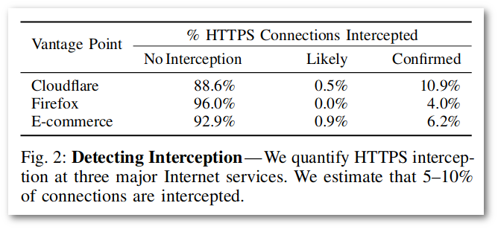
From the ground-up security/privacy
Applies to DNS over TLS too
TLS hijacking? Is That Possible?!
Durumeric, Zakir, et al. "The Security Impact of HTTPS Interception." Network and Distributed Systems Symposium (NDSS’17). 2017.
https://www.internetsociety.org/doc/security-impact-https-interception
Notes:
But, the security of a TLS connection depends heavily on how it is authenticated!
Regular PKIX has the Too many CA’s problem.
This collaboration of Michigan, Illinois, Mozilla, Cloudflare, Google, Berkeley and ICSI
To be honest, the report speaks about intentional hijacks by anti-virus software and enterprise middle-boxes, and states that nearly all reduce connection security and many introduce severe vulnerabilities.
Note that they would also hamper DANE

Slide 8
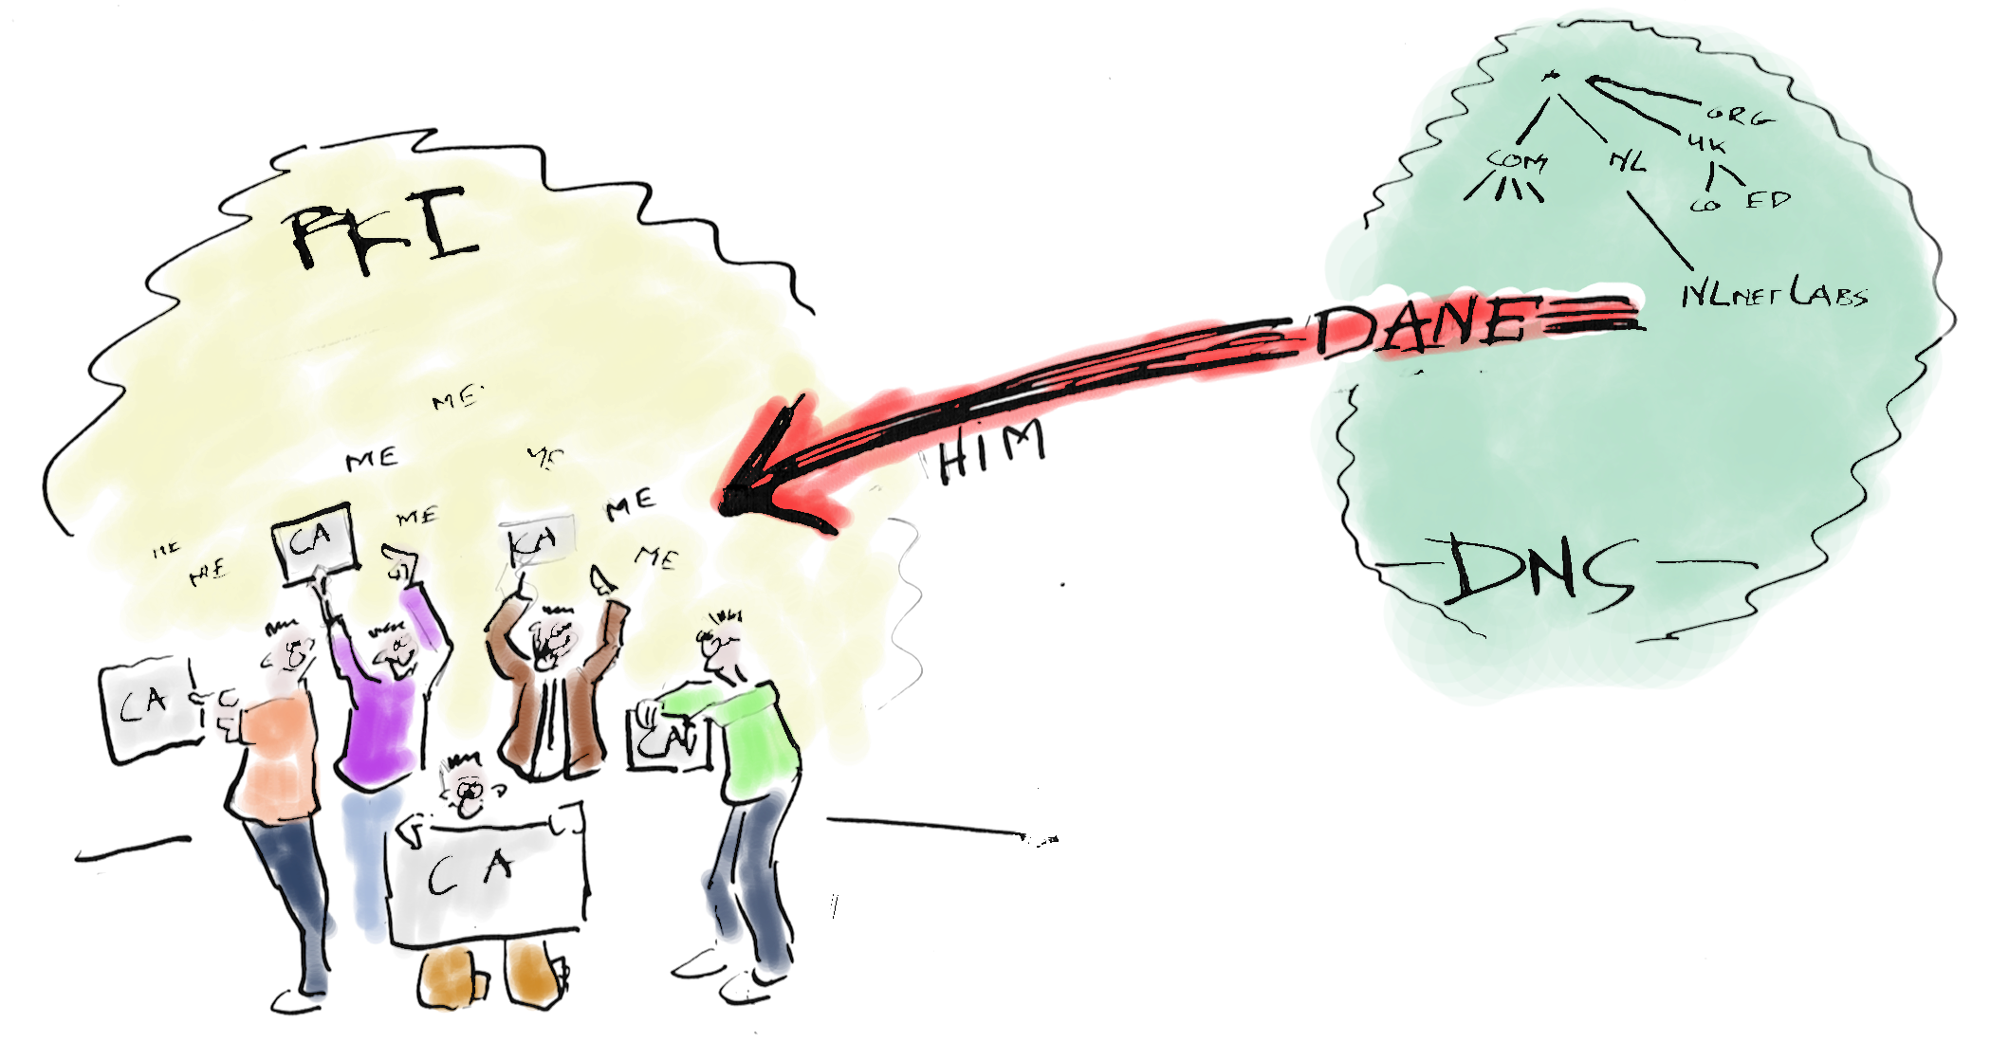
From the ground-up security/privacy
Strengthen TLS security with the stub: DANE
( DNS-based Authentication of Named Entities )
Also signalling system for TLS support
( For application without user interaction )
Notes:
A more capable and versatile stub can help out, by strengthening the authentication with DANE.
Signalling like with the opportunistic encryption offered with DANE enabled SMTP:
- Try STARTTLS, fallback to unencrypted when it is not available
- Try to authenticate, but fallback to unauthenticated encryption when it is not available
- Except when a secure TLSA RRset was found! Then authenticated TLS is required!

Slide 9
From the ground-up security/privacy
Authenticate DNS-over-TLS with DANE?
Bootstrap the TLSA lookup with regular DNS?
Notes:
Can we use this to strengthen security of the TLS channel to the validation recursive resolver. Maybe, but then...

Slide 10
From the ground-up security/privacy
Authenticate DNS-over-TLS with DANE?
Bootstrap the TLSA lookup with regular DNS?
  Chicken and Egg problem
Notes:
… the stub has to cover the first mile anyway by doing DNSSEC.
B.t.w. This option is still perfectly valid for privacy reasons only

Slide 11
From the ground-up security/privacy
Bootstrap the TLSA lookup with regular DNS?
Have the TLSA record + the complete DNSSEC authentication chain embedded in a TLS extension
https://tools.ietf.org/html/draft-ietf-tls-dnssec-chain-extension
Notes:
A workaround could be to embed the complete authentication chain in a TLS extension.
.

Slide 12

From the ground-up security/privacy
TLS DNSSEC
authentication chain extension must be obligatory, to prevent the “Too many CA’s” problem
Bootstrap the TLSA lookup with regular DNS?
Have the TLSA record + the complete DNSSEC authentication chain embedded in a TLS extension
https://tools.ietf.org/html/draft-ietf-tls-dnssec-chain-extension
Notes:
Note that semantically this option only adds the DNSSEC root trust-anchor as another CA and that the stub must be told to expect and accept only DNSSEC validation for this to be a strengthened authentication mechanism.

Slide 13
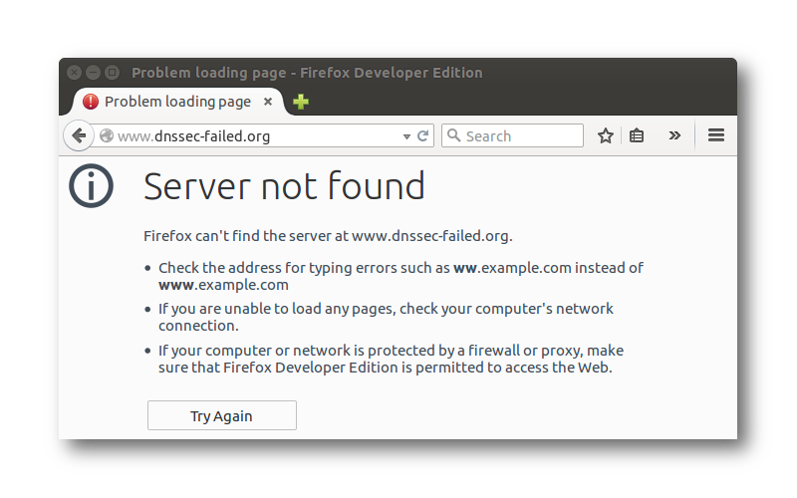



From the ground-up security/privacy
DNSSEC Availability
DNS Privacy status
X Clear text DNS
X Private DNS
X Authenticated
X Private DNS
The stub is close to the application
Inform status of DNSSEC and DNS Privacy
Notes:
Here is yet another thing where the versatile stub could help.

Slide 14


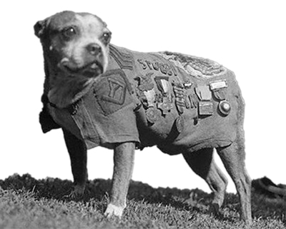

From the ground-up security/privacy
Authoritative
.
Round-robin
Authoritative
net
Validation
Recursive
Authoritative
Validation
resolver
dns-oarc.net
Recursive
Browser
Validation
resolver
Recursive
(application)
Validation
resolver
WebSrv
Recursive
stub
Validation
resolver
Recursive
resolver
OS
Enhanced privacy by round-robining upstreams
Bonus Feature
Notes:
There could be more in the realm of security and privacy too.
Current stubby has round-robining upstreams feature to enhace privacy.

Slide 15
From the ground-up security/privacy
DNSSEC
DNS over TLS
Non address lookups
Requirements for the
versatile stub
API
Cross the first DNSSEC mile | X
From the ground up Privacy |  | X
Strengthened TLS authentication (DANE) | X |  | X
Strengthened opportunistic TLS (DANE) | X |  | X
Provide status of DNSSEC & DNS over TLS |  |  |  | X
Notes:
Here is a summary of potential versatile stub features and what that implies for the capabilities

Slide 16
From the ground-up security/privacy
DNSSEC
DNS over TLS
Non address lookups
Requirements for the
versatile stub
API
Cross the first DNSSEC mile | X
From the ground up Privacy |  | X
Strengthened TLS authentication (DANE) | X |  | X
Strengthened opportunistic TLS (DANE) | X |  | X
Provide status of DNSSEC & DNS over TLS |  |  |  | X
Notes:
In the next slides I’ll zoom into the complications and work-arounds for some of those capabilities starting with DNSSEC

Slide 17
DNSSEC Roadblocks
Resolving DNSSEC (to cross the first mile)
needs DNSSEC Aware recursive resolver
Notes:
DNSSEC validating stub does not need a validating recursive resolver, but is does need a DNSSEC aware upstream.

Slide 18
DNSSEC Roadblocks
Resolving DNSSEC (to cross the first mile)
needs DNSSEC Aware recursive resolver
DNSSEC Roadblock Avoidance https://tools.ietf.org/html/rfc8027
+Full recursion capability
Notes:
Versatile DNSSEC stubs should do full recursion themselves to overcome DNSSEC unaware and/or hampering middle-boxes

Slide 19

DNSSEC Roadblocks
Does not apply to first-mile crossed by DNS-over-TLS
Resolving DNSSEC (to cross the first mile)
needs DNSSEC Aware recursive resolver
DNSSEC Roadblock Avoidance https://tools.ietf.org/html/rfc8027
+Full recursion capability
Notes:
This doesn’t apply to DNS-over-TLS, because you either trust your authenticated upstream to do DNSSEC and otherwise you do not want to bypass the upstream because you will lose the privacy it offers

Slide 20

DNSSEC Roadblocks
Authoritative
.
IPv6 Only
Authoritative
com
Browser
twitter.com AAAA
(application)
←
DNS64
Authoritative
stub
→
twitter.com
64:ff9b::68e0:2ac1
NAT64
IPv4 only
OS
https
https
104.244.42.193
DNSSEC Roadblock Avoidance https://tools.ietf.org/html/rfc8027
IPv6 Address Synthesis Prefix Discovery
https://tools.ietf.org/html/rfc7050
+DNS64 capability https://tools.ietf.org/html/rfc6147
Notes:
DNS64 and NAT64 is also hampering stub DNSSEC validation because of synthesized answers by the DNS64 server. The versatile stub should detect DNS64, ask for the real A answers and synthesize the AAAA answers itself; a reasonable secure technique for this is described in RFC7050.

Slide 21
DNSSEC Roadblocks
Authoritative
.
IPv6 Only
Authoritative
com
Browser
(application)
DNS64
Authoritative
twitter.com
stub
NAT64
Privacy
OS
resolver
DNSSEC Roadblock Avoidance https://tools.ietf.org/html/rfc8027
IPv6 Address Synthesis Prefix Discovery
https://tools.ietf.org/html/rfc7050
+DNS64 capability https://tools.ietf.org/html/rfc6147
Notes:
Note that if you pick a specific DNS privacy enabling resolver outside your network, and you are in an IPv6 only DNS64/NAT64 network, your stub has to do IPv6 address synthesis itself too! We’re looking into if the same technique described in RFC7050 can be reused for this scenario.

Slide 22

DNSSEC Roadblocks
Root
KSK
Rollover
DNSSEC validating stubs must do RFC5011
Notes:
DNSSEC validating stubs must do RFC5011

Slide 23
DNSSEC Roadblocks
Root
KSK
Rollover
In-band RFC5011 tracking
with DNSSEC auth chain TLS extension
DNSSEC validating stubs must do RFC5011
Notes:
Note that this is also perfectly possible with the TLS authentication chain extension.

Slide 24
DNSSEC Roadblocks
Root
KSK
Rollover
DNSSEC validating stubs must do RFC5011
A stub library for DANE has no system config
+bootstrap DNSSEC capability: https://tools.ietf.org/html/rfc7958
A stub library for DANE runs with user's privileges
Notes:
Trust anchor management with stub resolvers is different from trust anchor management with system software (i.e. regular recursive resolver).
A stub resolver in an external library linked with the application can not rely on a system component to do the trust anchor management. It might have to do RFC7958 (unbound-anchor) itself, and store that trust-anchor with the S/MIME signature because it is stored with user privileges, like the other user space programs.

Slide 25
DNSSEC Roadblocks
DNSSEC stubs capability requirements
DNSSEC validation | (various)
DNSSEC Roadblock Avoidance | RFC8027
IPv6 Prefix Discovery | RFC7050
IPv6 Address Synthesis | RFC6147
Automated Trust Anchor Updates | RFC5011
Automated Initial Trust Anchor retrieval | RFC7958
Notes:
To summarize, to properly do DNSSEC for covering the first mile, or for doing DANE, it has to have all these (relatively new) standards.

Slide 26
From the ground-up security/privacy
Non address lookups
DNSSEC
DNS over TLS
Requirements for the
versatile stub
API
Cross the first DNSSEC mile | X
From the ground up Privacy |  | X
Strengthened TLS authentication (DANE) | X |  | X
Strengthened opportunistic TLS (DANE) | X |  | X
Provide status of DNSSEC & DNS over TLS |  |  |  | X
Notes:
What is required for DNS-over-TLS?

Slide 27
Requirements for
DNS-over-TLS
Browser
(application)
A
DNS-over-TLS
Privacy
stub
resolver
A
OS
Browser
(application)
B
DNS-over-TLS
Privacy
stub
resolver
B
OS
TCP fastopen (optional) https://tools.ietf.org/html/rfc7413
Connection reuse https://tools.ietf.org/html/rfc7766
EDNS0 keepalive https://tools.ietf.org/html/rfc7828
EDNS0 padding https://tools.ietf.org/html/rfc7830
Notes:
RFC7766 has a whole list of requirements for DNS over stateful transports in general
- Connection reuse: reuse an already established TLS connection for further queries

Slide 28
Requirements for
DNS-over-TLS
Connection reuse (Q/R, Q/R, Q/R)
Pipe-lining of queries (Q,Q,Q,R,R,R)
Notes:
- pipe-lining

Slide 29
Requirements for
DNS-over-TLS
Connection reuse (Q/R, Q/R, Q/R)
Pipe-lining of queries (Q,Q,Q,R,R,R)
Process Out-Of-Order-Responses (Q₁,Q₂, R₂, R₁)
Notes:
- Out-Of-Order processing

Slide 30
Requirements for
DNS-over-TLS
Authoritative
.
Authoritative
net
dns-oarc.net A
Privacy
Authoritative
←
resolver
dns-oarc.net
Browser
→
(application)
WebSrv
64.191.0.198
https
stub
OS
Strict or Opportunistic usage profiles?
https://tools.ietf.org/html/draft-ietf-dprive-dtls-and-tls-profiles-09
  Authenticated Private DNS
  Private DNS
  Clear text DNS
Notes:
- Draft that describes two usage profile for DNS-over-TLS, strict and oppertunistic
- Strict means authenticated DNS-over-TLS, and opportunistic means give me the best you have. Ideally authenticated DNS-over-TLS, just TLS otherwise and if nothing else: unauthenticated DNS
- The draft also describes different authentication mechanisms for DNS-over-TLS.
Those authentication mechanisms influences the requirements on the capabilities for the stub resolver.

Slide 31
Requirements for
DNS-over-TLS
Authoritative
.
Authoritative
net
dns-oarc.net A
Privacy
Authoritative
←
resolver
dns-oarc.net
Browser
→
(application)
WebSrv
64.191.0.198
https
stub
OS
Strict or Opportunistic usage profiles?
https://tools.ietf.org/html/draft-ietf-dprive-dtls-and-tls-profiles-09
  Authenticated Private DNS
  Private DNS
  Clear text DNS
RFC7858 (DNS-over-TLS)
defined direct SPKI authentication only
Notes:
The original RFC had only matching a hash of the SubjectPublicKeyInformation as the authentication mechanism, which is not very useful for trust-anchor management.
The privacy resolver could never roll it’s key!

Slide 32

Requirements for
DNS-over-TLS
Authoritative
.
Authoritative
DNSSEC
net
getdnsapi.net A/AAAA
Resolver
Authoritative
Authoritative
dns-oarc.net
getdnsapi.net
Browser
→
(application)
dns-oarc.net A
Privacy
WebSrv
stub
resolver
←
64.191.0.198
OS
https
Regular PKIX authentication
(bootstrap address lookup with regular DNS(SEC))
Notes:
Regular PKIX has a dependency on regular PKIX CA store management
Which is not very strong, we have DANE
( The draft has a requirement on DNSSEC for the bootstrapping address lookup
, which makes sense from a “from the ground up security/privacy” perspective )

Slide 33
Requirements for
DNS-over-TLS
Authoritative
.
DNSKEY DS A
getdnsapi.net
Authoritative
DNSSEC
Aware
Recursive
net
resolver
Authoritative
getdnsapi.net
Browser
→
(application)
dns-oarc.net A
Privacy
WebSrv
stub
resolver
←
64.191.0.198
DNSSEC
https
OS
Regular PKIX authentication
Authenticate with DANE
(stricter opportunistic with TLSA signalling)
Notes:
Regular DANE would add an additional requirement on DNSSEC including everything which is needed for that (i.e. roadblock avoidance etc.)
Interesting opportunity for the stricter version of opportunistic

Slide 34
Requirements for
DNS-over-TLS
Authoritative
.
_853._
tcp.getdnsapi.net TLSA
getdnsapi.net DNSKEY DS
net DNSKEY DS
Authoritative
RRSIGs
. DNSKEY
net
Authoritative
Authoritative
dns-oarc.net
getdnsapi.net
Browser
→
(application)
dns-oarc.net A
Privacy
WebSrv
_853._
tcp.getdnsapi.net TLSA
getdnsapi.net DNSKEY DS
resolver
net DNSKEY DS
stub
RRSIGs
. DNSKEY
←
64.191.0.198
DNSSEC
https
OS
Regular PKIX authentication
Authenticate with DANE
DNSSEC authentication chain TLS extension
Notes:
I think DNSSEC authentication chain TLS extension would be the best fit for authenticating privacy resolvers, but it does need support and capability from the privacy resolver too.

Slide 35
Requirements for
DNS Privacy
DNS-over-TLS | RFC7858
Reuse / Pipelining / OOOR | RFC7766
TCP Fastopen | RFC7413
ENDS0 keepalive | RFC7828
ENDS0 padding | RFC7830
PKIX support for authentication | (various)
DNSSEC support (for address lookup and authentication) | (various)
Notes:
Summarizing: here is the list of capability requirements for a DNS-over-TLS stub

Slide 36
From the ground-up security/privacy
DNSSEC
DNS over TLS
Non address lookups
Requirements for the
versatile stub
API
Cross the first DNSSEC mile | X
From the ground up Privacy |  | X
Strengthened TLS authentication (DANE) | X |  | X
Strengthened opportunistic TLS (DANE) | X |  | X
Provide status of DNSSEC & DNS over TLS |  |  |  | X
Notes:
Here is the least standardized part: The interface with the application, i.e.

Slide 37
Non address lookups -
Application Interface
Application
getaddrinfo() and getnameinfo()
(POSIX standard extended by RFC3493 for IPv6)
stub
OS
Notes:
Traditionally applications use the getaddrinfo() and getnameinfo() functions,
They don’t allow for other then address lookups and don’t convey DNSSEC and/or DNS Privacy status information.

Slide 38
Non address lookups -
Application Interface
Application
getaddrinfo() and getnameinfo()
(POSIX standard extended by RFC3493 for IPv6)
stub
OS
Application
Talk to upstreams directly with a library:
libresolv, libval, ldns, libunbound, libgetdns
stub
library
OS
Learn upstreams from OS
/etc/resolv.conf, NetworkManager, registry...
Notes:
Traditionally, for doing non-address lookups, applications use a DNS library.
Libresolv is sufficient for MX lookups, but not for TLSA lookups because of missing DNSSEC (and everything that comes with that) capability.

Slide 39

Non address lookups -
Application Interface
Applications using getaddrinfo() API
will not get the versatile stub features
(first DNSSEC mile coverage, DNS privacy)
Application
getaddrinfo() and getnameinfo()
(POSIX standard extended by RFC3493 for IPv6)
stub
OS
Application
Talk to upstreams directly with a library:
libresolv, libval, ldns, libunbound, libgetdns
stub
library
OS
Learn upstreams from OS
/etc/resolv.conf, NetworkManager, registry...
Notes:
But other application do not benefit from the versatile stub capabilities (i.e. first-DNSSEC-mile or privacy)

Slide 40


Non address lookups -
Application Interface
Stub server listening on 127.0.0.1:53
getaddrinfo() and getnameinfo()
use system stub which uses stub server
Application
stub
server
stub
OS
Stubby
Dnssec-Trigger
Dnsmasq
Notes:
These systems try to resolve this with a local server process. The system stub accessed by getaddrinfo() and getnameinfo() learns the address of the server stub process and will target that as its upstream.

Slide 41
Non address lookups -
Application Interface
getaddrinfo() and getnameinfo()
use systemd-resolved via nsswitch module
Stub server listening on 127.0.0.53:53
Application
stub
server
OS
systemd-resolved.service
systemd-resolved
Notes:
Systemd-resolved is a DNSSEC stub resolver which has a slightly different method. They usa a nsswitch module that talks to the server process via a dbus API.
A DNS interface is provided anyway for applications that need to do non-address lookups , but...

Slide 42
Non address lookups -
Application Interface
App
Application
Talk to stub server via a library:
libresolv, libval, ldns, libunbound, libgetdns
stub
library
stub
stub
server
OS
systemd-resolved.service
systemd-resolved
127.0.0.53:53
Stubby
Dnssec-Trigger
Dnsmasq
Notes:
… here is a picture of how that works, ldns or libval or libunbound use the stub server address on localhost to do the special lookups...

Slide 43


Non address lookups -
Application Interface
App
Application
Talk to stub server via a library:
libresolv, libval, ldns, libunbound, libgetdns
stub
library
stub
stub
server
OS
systemd-resolved.service
systemd-resolved
127.0.0.53:53
Stubby
Dnssec-Trigger
Dnsmasq
Notes:
… and this doesn’t work for systemd-resolved. It gives answers without signatures. I have a github issue describing the issue. But I could not find a requirement that validating resolvers should convey the signatures and other DNSSEC proof downstream, it just seems that everybody does.
I have submitted an issue for this with the systemd github repo:
https://github.com/systemd/systemd/issues/4621

Slide 44
Non address lookups -
Application Interface
App
Application
Talk to stub server via the dbus API
https://www.freedesktop.org/wiki/Software/systemd/resolved/
dbus API
stub server
OS
systemd-resolved.service
systemd-resolved
Notes:
Systemd-resolved does provide an interface to do non address lookups, get DNSSEC status etc, but it is the dbus API that the nsswitch module uses too.

Slide 45
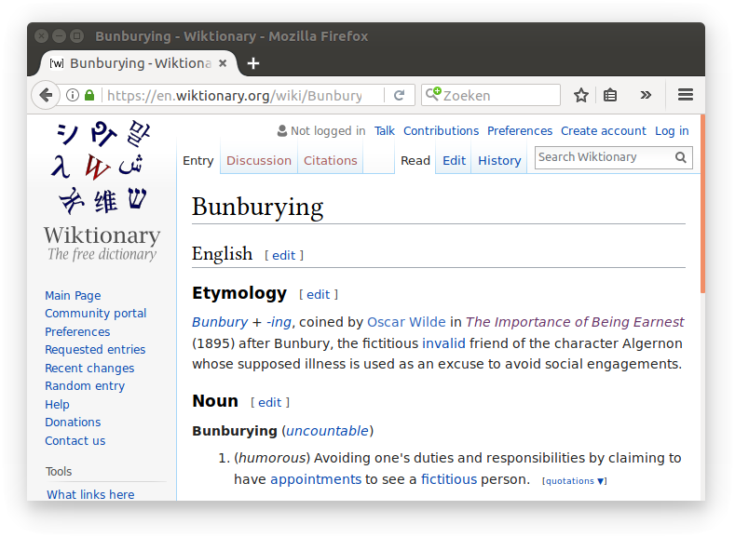
The Importance of Being an Earnest stub
Notes:
Stub implementation seems to diverge a bit. Especially on the API side.
Maybe stub developers have been bunburying, trying to avoid complicating standardization efforts.
I have not even mentioned the dnscrypt project which has many (120) privacy enabling recursive resolvers, but on a different transport than DNS-over-TLS: https://github.com/jedisct1/dnscrypt-proxy/blob/master/dnscrypt-resolvers.csv
Maybe stub resolvers need a bit more love from the IETF?

Slide 46


