Slide 1
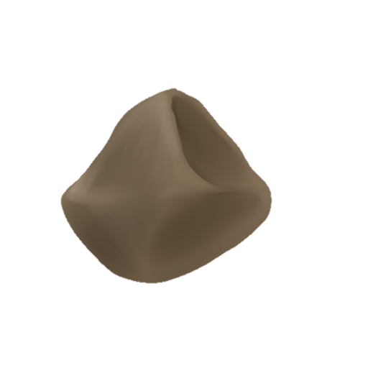
Home
3D Advent Calendar
About Me
Projects

Slide 3
Home
3D Advent Calendar
About Me
Projects

Slide 4
Home
3D Advent Calendar
About Me
Projects

Slide 5
Home
3D Advent Calendar
About Me
Projects

Slide 6
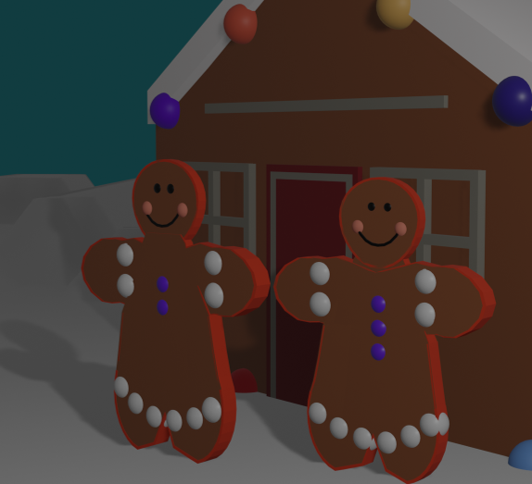
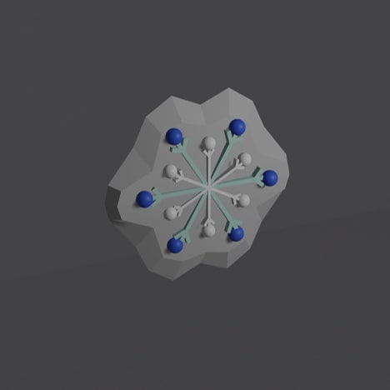
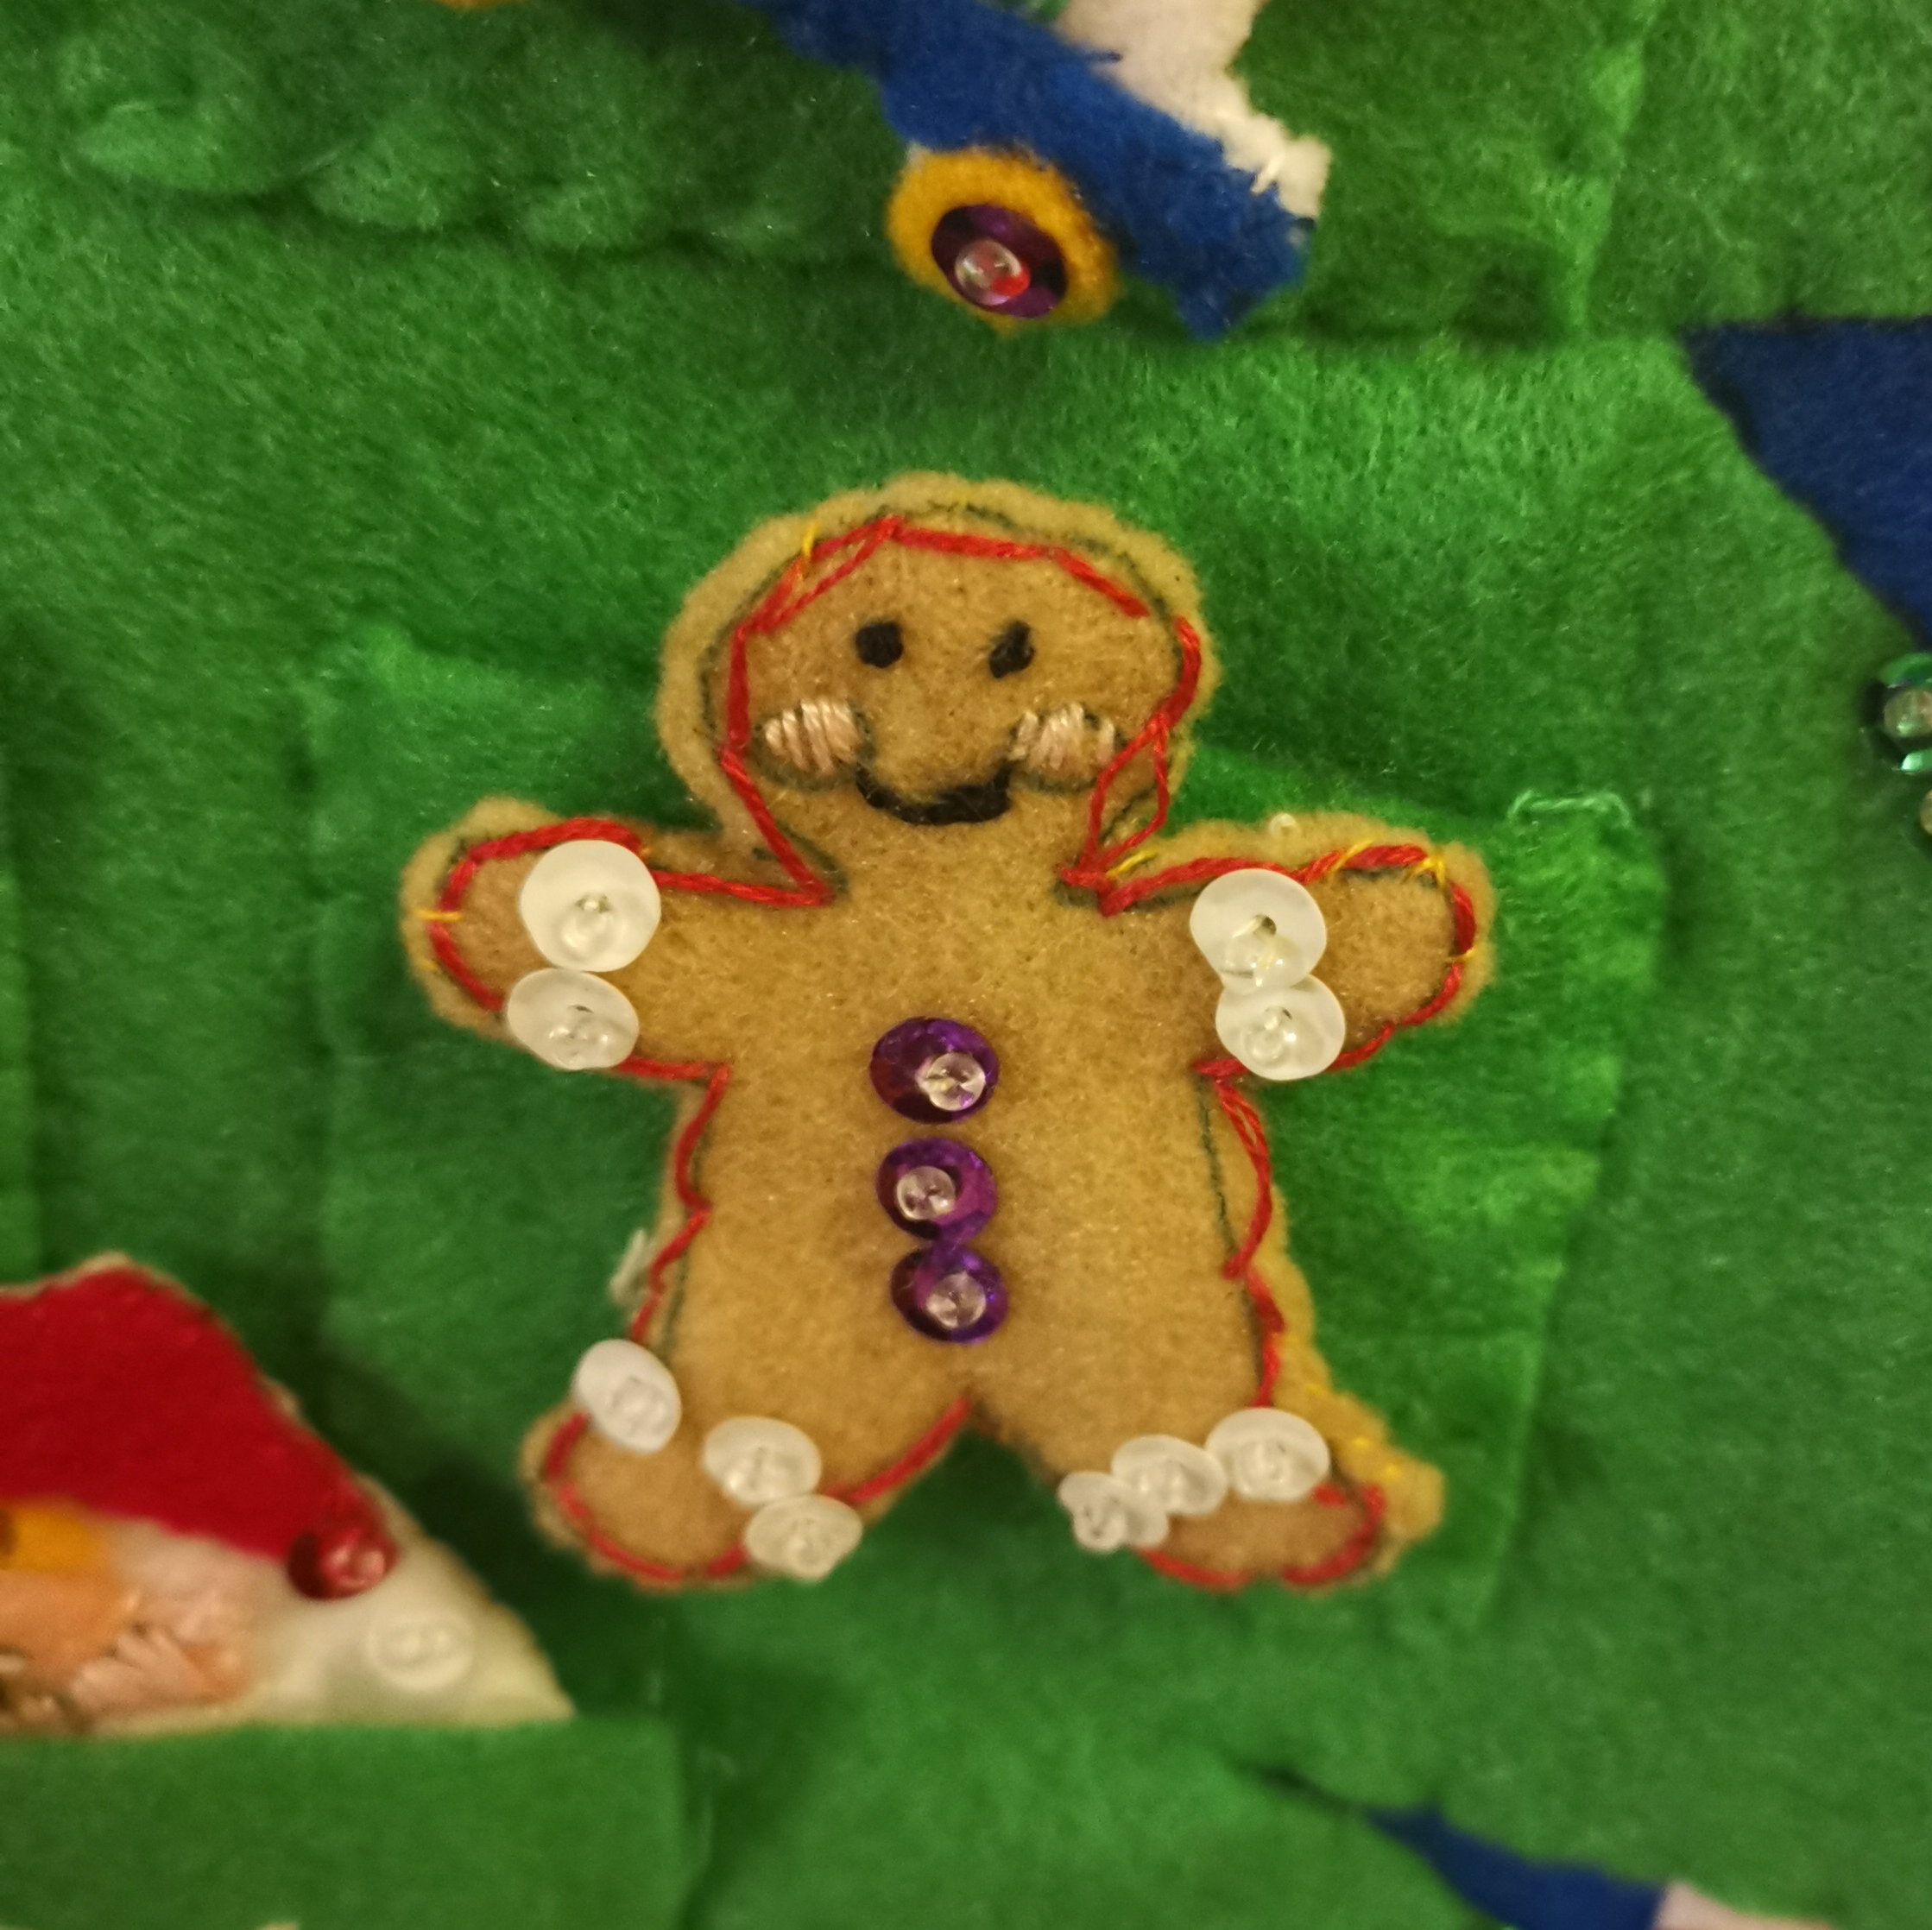
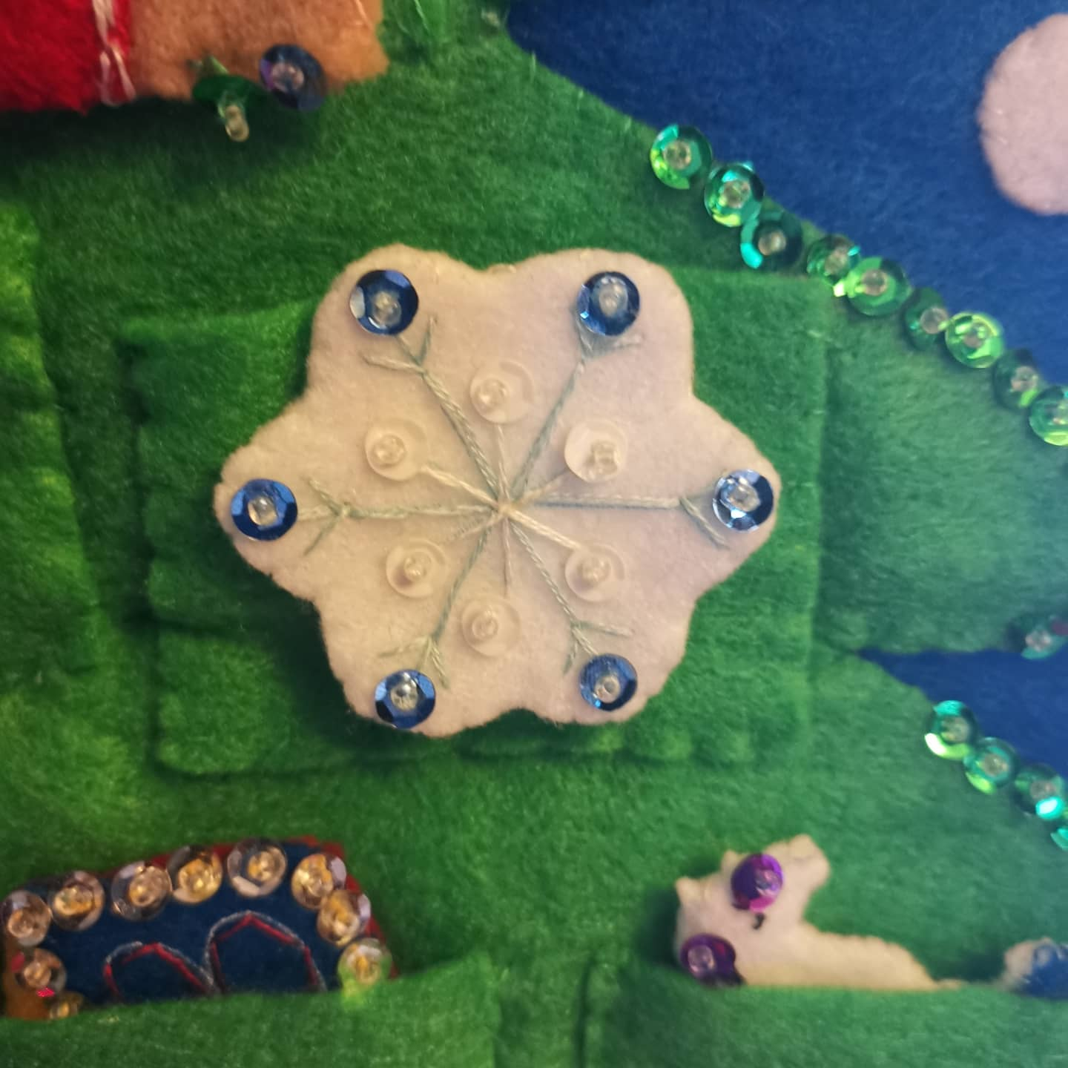
Home
3D Advent Calendar
About Me
Projects

Slide 7

01
02
03
04
05
06
07
08
09
10
11
12
13
14
15
16
17
18
19
20
21
22
23
24

