Slide 1
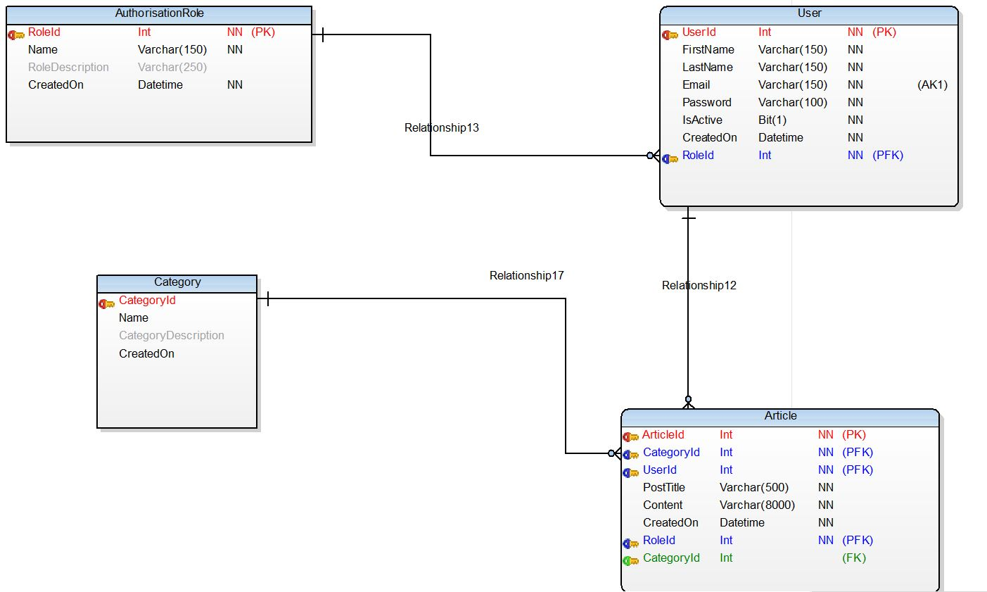

Database Design

Slide 2
Project Prototype
Before starting our project , we designed a prototype to
Understand the requirements
Technically understand the problem
Find design issues early
Set our design priorities
Site Navigation

Slide 3
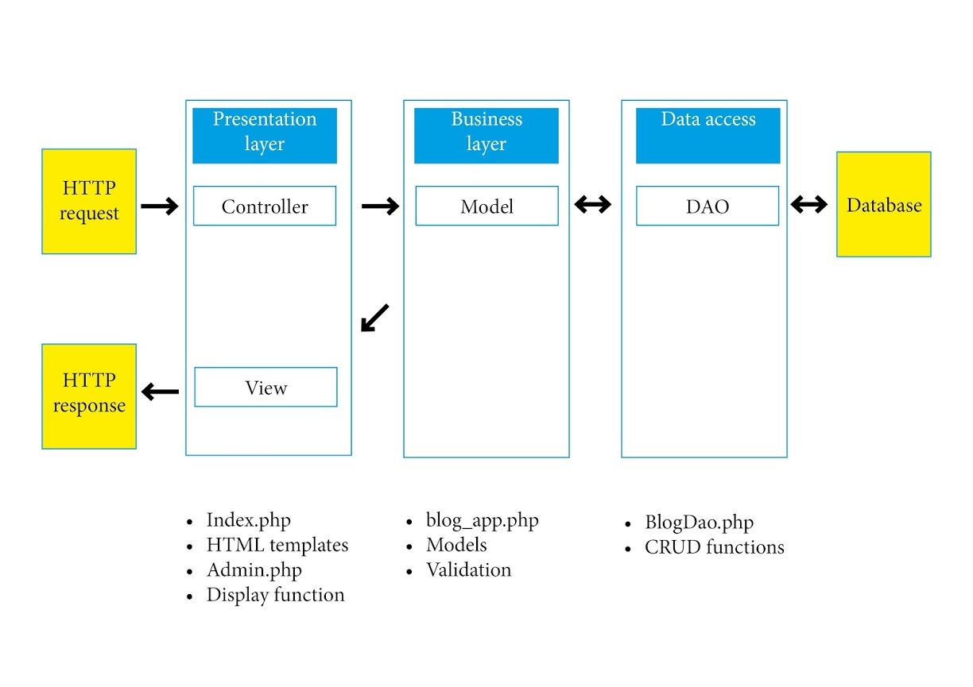
Application Architecture

Slide 4
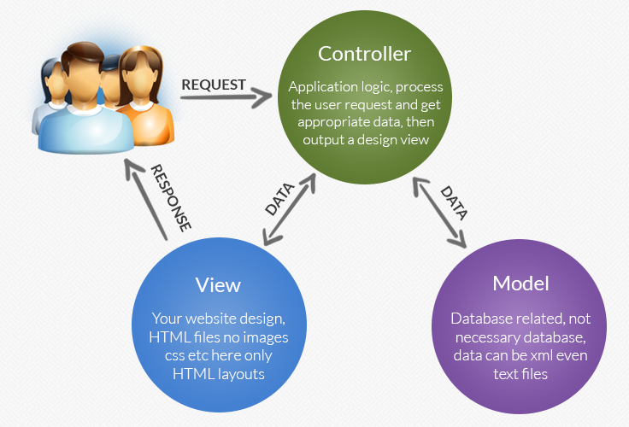
MVC

Slide 5
Challenges
I am new to PHP, so I had to learn a lot from various sources like sky course materials, forums, books etc
I had lot of ideas but due time constraints couldn’t implement all

Slide 6
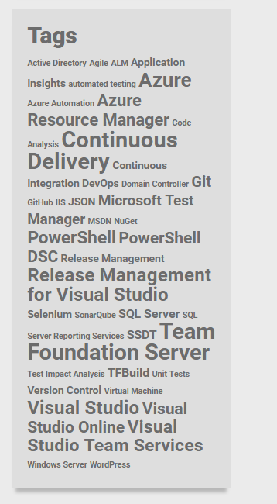
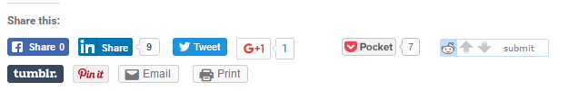
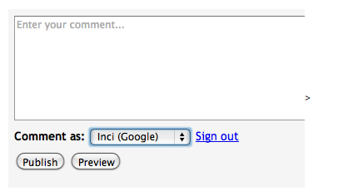
Coming soon…
* Widgets showing popular categories
* Sharing post in social media
* Enable adding comments to posts

