Slide 1

DevelopHers
Group Project

Slide 2
Group Task
Create a blog from scratch using MVC Framework and PHP

Slide 3
Teamwork Makes the Dream Work
Google Hangouts
JoinMe
Meeting up in person
Notes:
Blog Demonstration

Slide 4



Software
PHP, HTML, & CSS
mySQL
Version control system
& repository

Slide 5
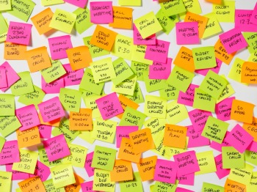
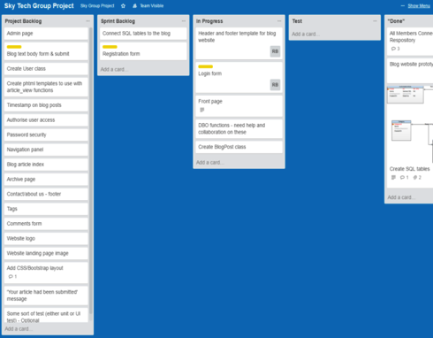
Project Management: Methodology
Adapted Agile SCRUM methodology
Initial planning session to create Project Backlog
3 sprints + sprint review meetings
Daily contact
For task management during sprints, we used Trello:
Project backlog
Sprint backlog
In Progress
Test
“Done”

Slide 6
Project Prototype
Before starting our project , we designed a prototype to
Understand the requirements
Technically understand the problem
Find design issues early
Set our design priorities
Site Navigation

Slide 7
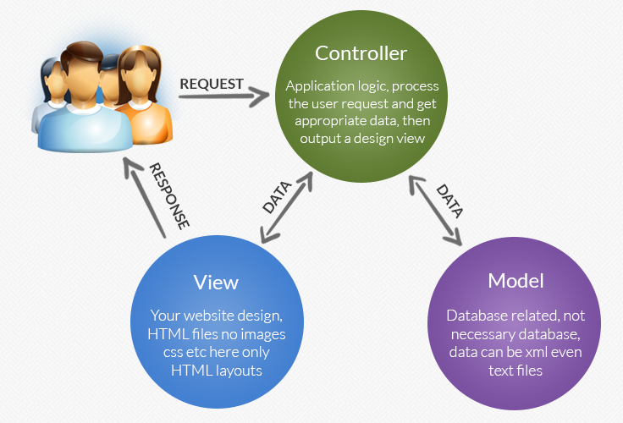
MVC

Slide 8
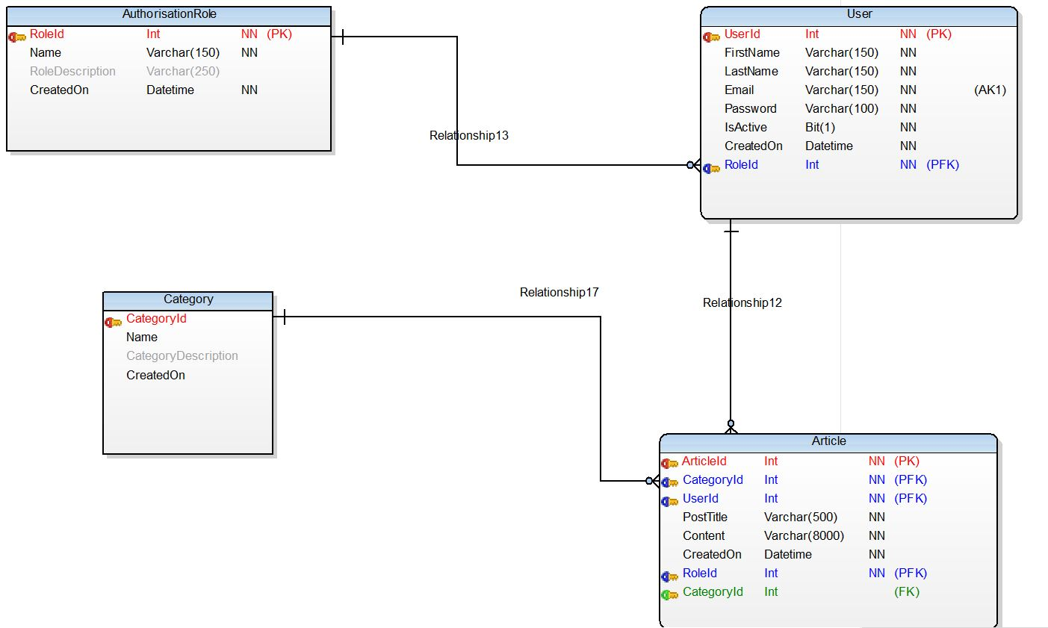
Database Design

Slide 9
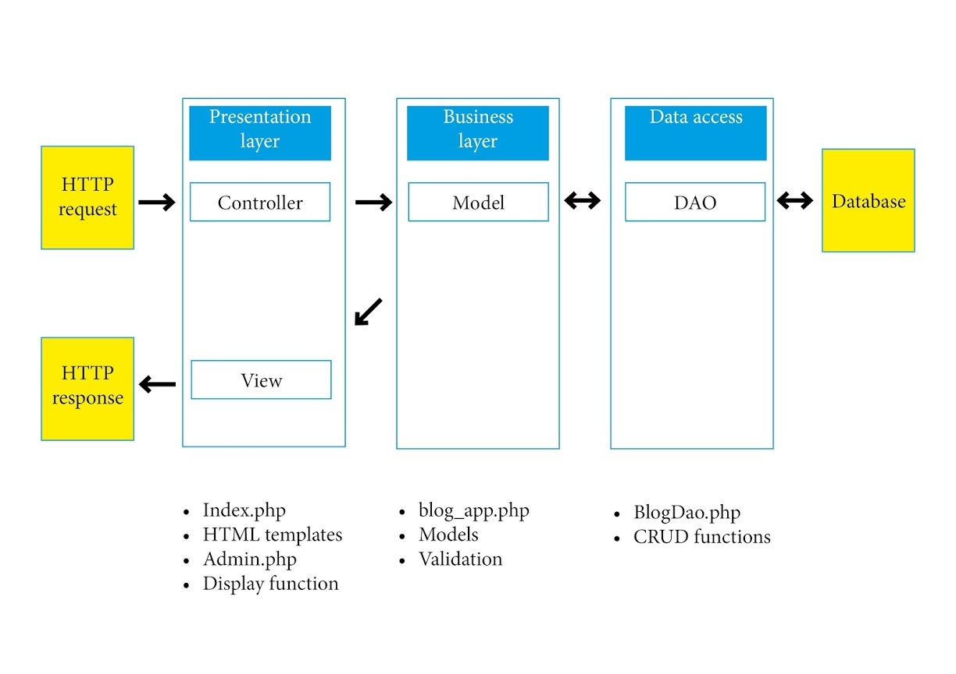
Application Architecture

Slide 10
Authentication & Security
Currently:
Validation and sanitisation of user input for login capability using trim(), stripslashes() and htmlspecialchars() – prevent injection
Passwords are hashed using PASSWORD_DEFAULT, i.e. Blowfish algorithm. Allows for additional algorithms in future. Random salt so each password has to be brute forced individually.
Login authenticated using password_verify, current cost parameter is 10, i.e. 2¹⁰ iterations of hashing algorithm.

Slide 11
Authentication & Security
Going forward:
Password_needs_rehash for best practice.
Increase cost parameter: more iterations but compromise on time (+1 cost = x2 time).
Secure contact us and subscribe forms – user input is not sanitised or validated.
Use different function than mail() as this is outdated and can be adapted to add recipients – used for simplicity.
Active conditions on password creation, i.e. number requirement, case etc.

Slide 12
Challenges & Overcoming
Connie Time constraints, letting people down, how much done in a time period. Taking apart other people’s code in order to add in other features e.g. data access object nad password hashing. | Katrina Lack of technical knowledge Zero previous experience of coding, website design, SCRUM… Utilised a variety of sources: course materials, tutorials, forum posts, and other sources of information on the web Trial and error! Communication Division of labour Keeping each other updated and involved. Primarily solved by using Hangouts and meeting weekly in person
Revathy I am new to PHP, so I had to learn a lot from various sources like sky course materials, forums, books etc. I had lot of ideas but due time constraints couldn’t implement all | Tisha Lack of coding experience, trawling the internet and referring back to course materials for solutions and learning along the way Windows Vs Mac issues Time constraints and worrying about not being able to figure problems out quick enough Communication is the key

Slide 13

Our Blog
The idea behind our blog was to create a dedicated platform where people can read and post blogs about the wonderful, useful, or fun things people do on their lunch break in and around Sky.
A place to voice opinions
A place of discovery
A place to make recommendations

Slide 14
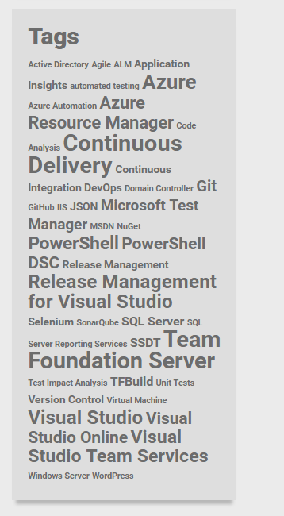
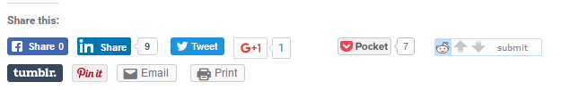

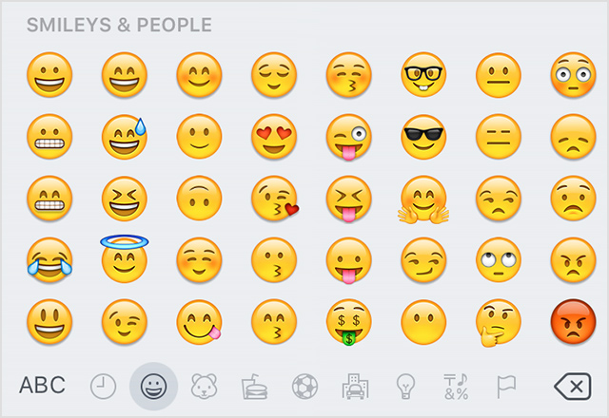


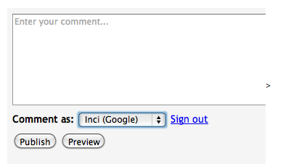

Coming Soon…

Slide 15
…If only we had the the time!
Adding video content to the site
Authorised users can embed video content with their blog posts using an upload form
Can contain tours, reviews, and travel segments to bring the content to life
Will be created using HTML5 and have JavaScript properties
Widgets showing popular categories
Sharing post in social media
Enable adding comments to posts
Linking to Google Maps for directions
Filtering by radius from your location
Calendar / functionality to schedule future events
The ability to rate/ like blog posts
Emoji (emoticons)

Slide 16
Thank you

