Slide 1

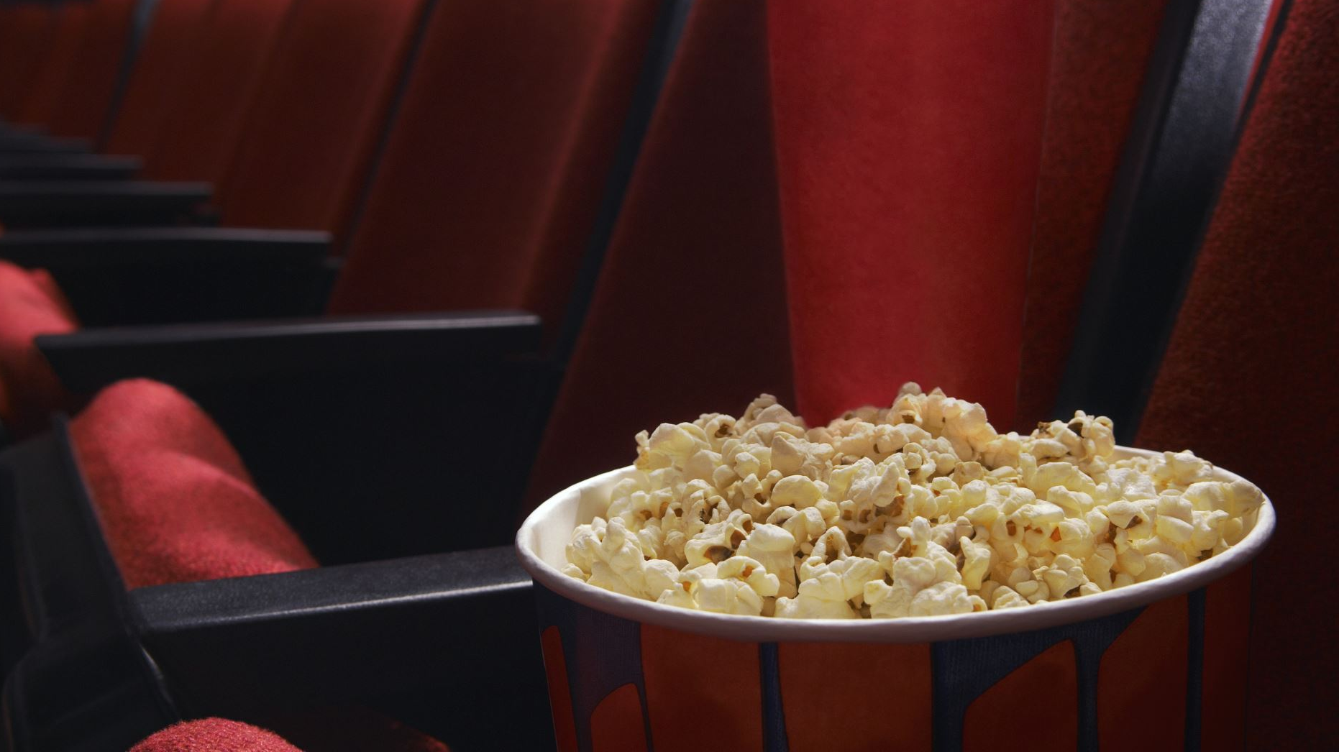
Pop N Watch
By Denmar Ermitano & alvin Alagos

Slide 2

Description
Combining Movies & Snacks
Movie selection
Snack selection & Delivery (API)
Recipe book
Suggestions
Ratings & Reviews

Slide 3
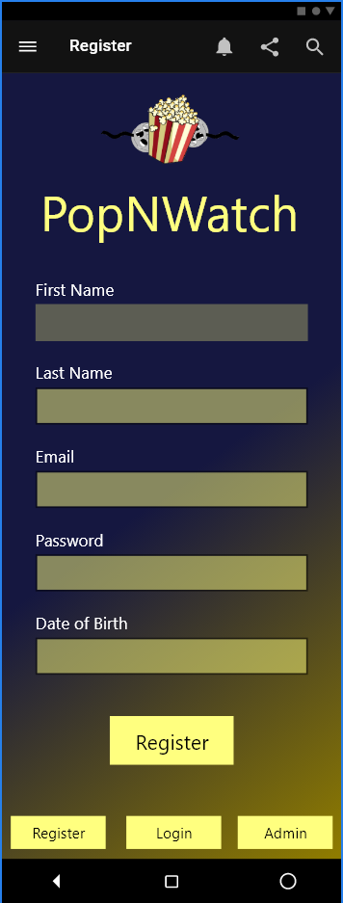
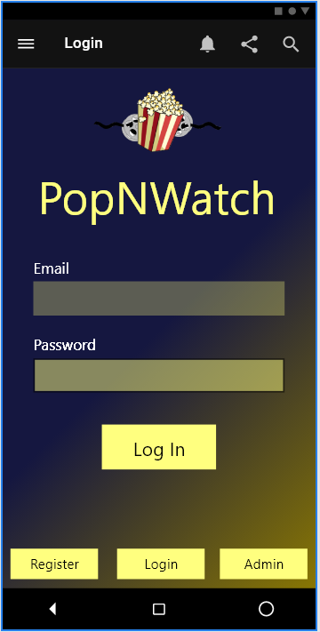
Prototype (login)

Slide 4
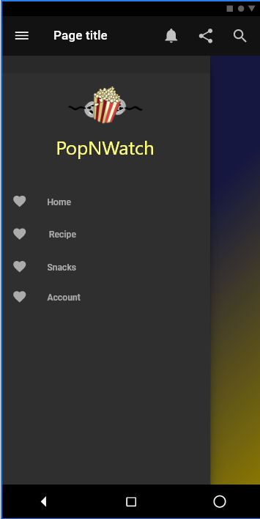
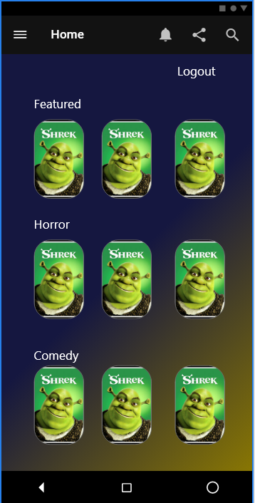
Prototype (home)

Slide 5
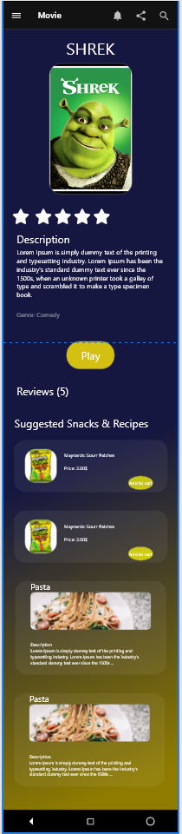
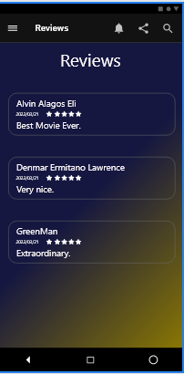
Prototype Movie

Slide 6
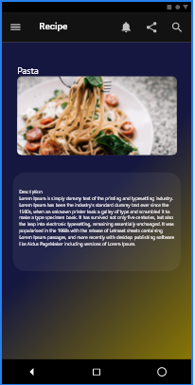
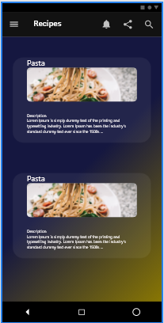
Prototype (recipe & snack)

Slide 7
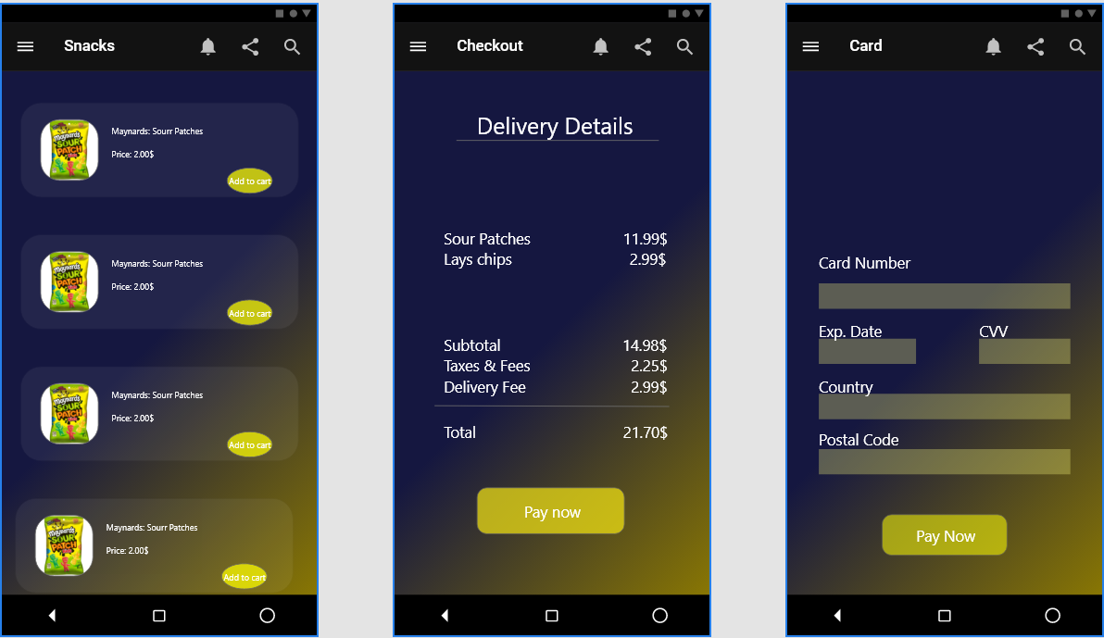
PROTOTYPE (RECIPE & SNACK)

Slide 8
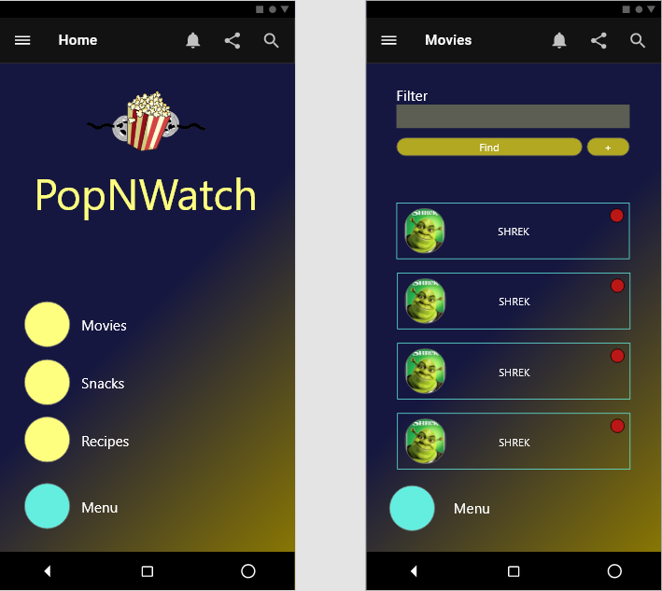
Prototype (Admin)

Slide 9
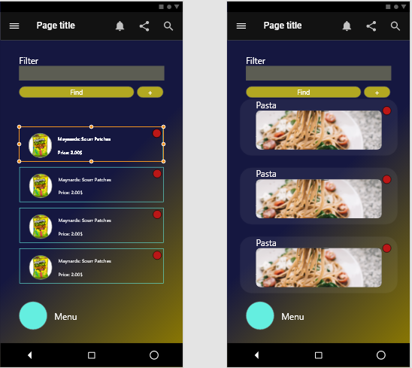
PROTOTYPE (ADMIN) Continue

Slide 10
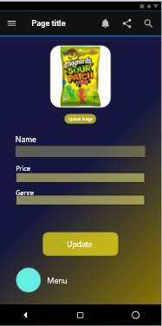
PROTOTYPE (ADMIN) CONTINUE

Slide 11
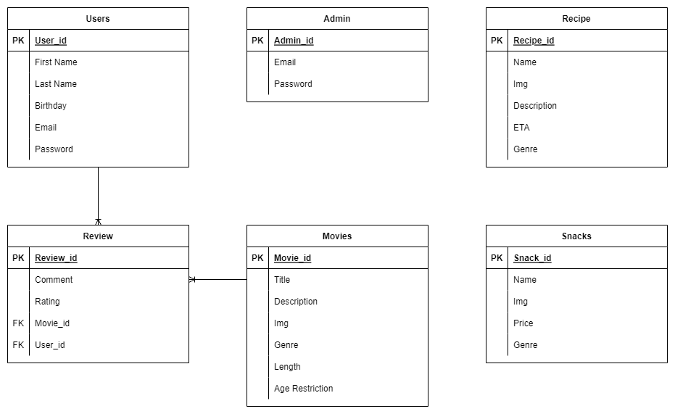
Database

Slide 12
Github
https://github.com/getll/PopNWatch

