Slide 1
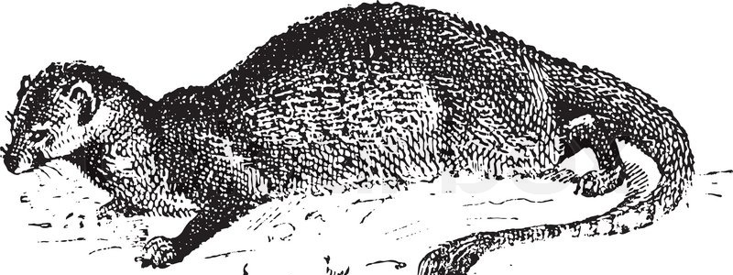
Messing With Mongoose
Michael A. Nowiszewski
3/10/2018

Slide 2
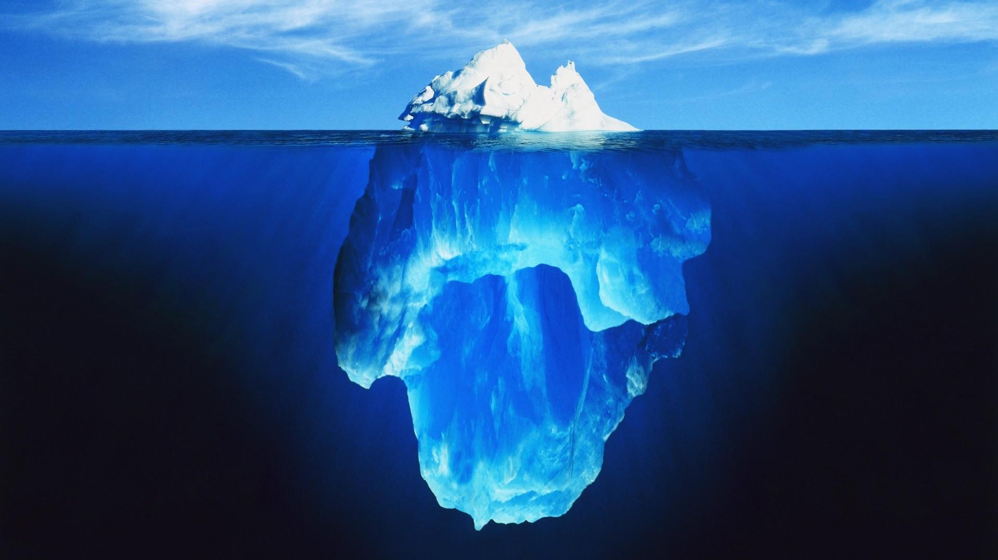

Slide 3
What this presentation will cover…
What Mongoose is
Why Mongoose is useful
How to install Mongoose
Where Mongoose Lives
How Mongoose Interacts w/ App
Setting up connections in M
Monitoring connections in M
Discuss dancing w/ MongoDB
What is a Schema
Overview of Data Types
Close w/ some examples of use cases from most recent project!

Slide 4
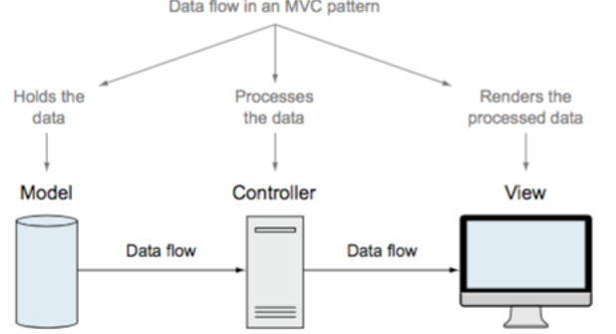
What Is Mongoose?
“elegant mongoDB object modeling for node.js”
Part of our MVC Model! Goals?
Simultaneous development, code reuse
Mongoose is an ODM. What’s that?
A MongoDB object modeling tool
Designed for use in an asynchronous environment
Notes:
There are two approaches for interacting with a database:
Using the databases' native query language (e.g. SQL)
Using an Object Data Model ("ODM") / Object Relational Model ("ORM"). An ODM/ORM represents the website's data as JavaScript objects, which are then mapped to the underlying database. Some ORMs are tied to a specific database, while others provide a database-agnostic backend.

Slide 5


Why Use It, Anyway?
Mongo DB Native Driver
Mongoose
Not easy to work with without customization, add-ons
No way to define and maintain data structures out of the box – requires Mongoose and more
Less Convenient For Users
Ease of Use
Allows us to Manage Data In-App
Solutions for a Range of Datatypes
Uses core Functionality of MongoDB Efficiently
Allows to define/maintain models
Allows us to decide how we’d like our new data models/structures to interact with our DB of choice!

Slide 6
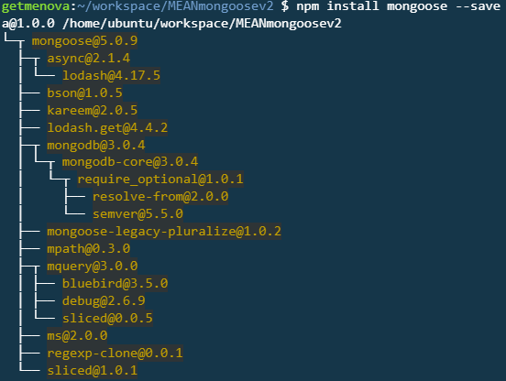
Installing Mongoose:
$ npm install mongoose --save

Slide 7
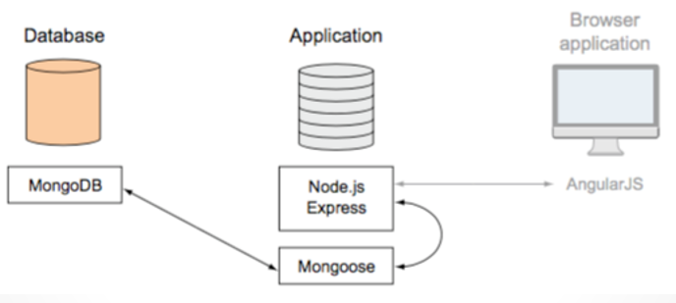
Where Does Mongoose Live?

Slide 8
Mongoose Connections : Interaction with App
Mongoose will open a connection pool
Remember: connection pool is shared between all requests
Also consider the following:
Opening the connection when you spin up app
Keep connection open as long as your app continues to run

Slide 9
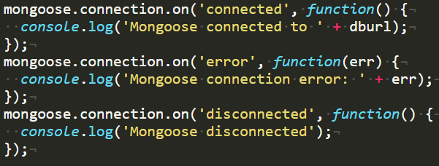
Mongoose: Setup & Monitoring Connections
Simple Steps to Setup App Connection
Monitoring Connections In-App
Create db.js
Use this file in app.js or route it
Remember ‘require’ it!
*appears in db.js in hotel due to routing
What info are we interested in?
On connect
When we encounter an error
When we disconnect
In meanhotel, we did it this way:

Slide 10

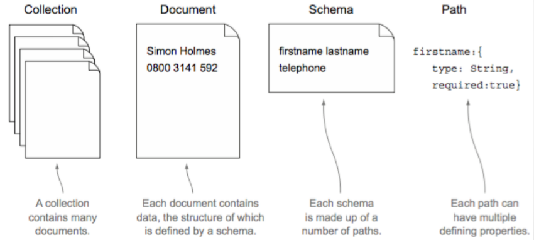

Slide 11
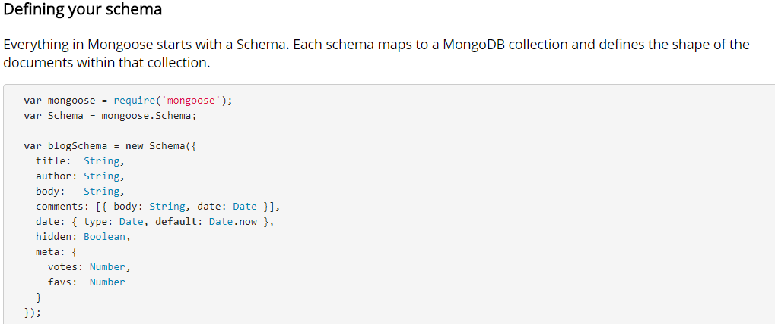
What’s in a Schema?

Slide 12
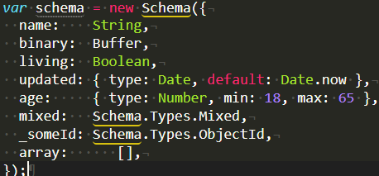
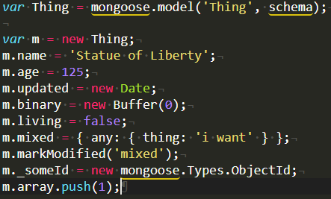
SchemaTypes Supported: Common Examples
String
Number
Date
Buffer
Boolean
Mixed
ObjectId
Array

Slide 13
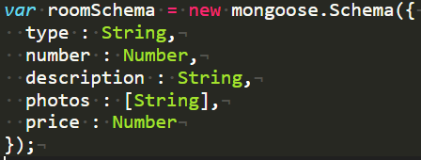
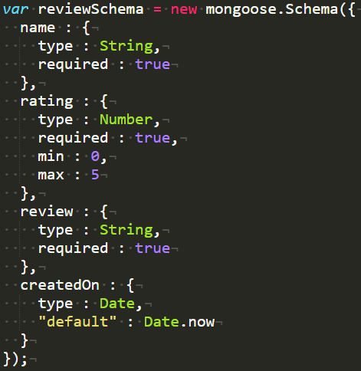
Examples from recent project @/meanhotel/data/hotel.models.js
Simple ‘Room’ Schema
Adding Parameters in ‘Review’ Schema

Slide 15
What this presentation covered…
What Mongoose is
What an ODM is
Why Mongoose is useful
How to install Mongoose
Where Mongoose Lives
How Mongoose Interacts w/ App
Setting up connections in M
Monitoring connections in M
Discuss dancing w/ MongoDB
What is a Schema
Overview of Data Types
Close w/ some examples of use cases from most recent project!

Slide 16
Additional Resources
http://mongoosejs.com/
https://github.com/Automattic/mongoose
https://developer.mozilla.org/en-US/docs/Learn/Server-side/Express_Nodejs/mongoose
https://code.tutsplus.com/articles/an-introduction-to-mongoose-for-mongodb-and-nodejs--cms-29527
https://www.mongodb.com/blog/post/introducing-version-40-mongoose-nodejs-odm
http://mongodb-tools.com/ to compare other ODM, ORM tools.

Slide 17
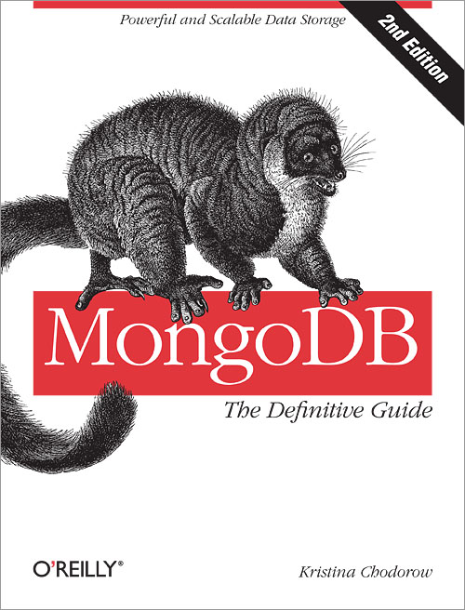

The animal on the cover of MongoDB: The Definitive Guide, Second Edition is a mongoose lemur, a member of a highly diverse group of primates endemic to Madagascar. Ancestral lemurs are believed to have inadvertently traveled to Madagascar from Africa (a trip of at least 350 miles) by raft some 65 million years ago. Freed from competition with other African species (such as monkeys and squirrels), lemurs adapted to fill a wide variety of ecological niches, branching into the almost 100 species known today. These animals’ otherworldly calls, nocturnal activity, and glowing eyes earned them their name, which comes from the lemures (specters) of Roman myth. Malagasy culture also associates lemurs with the supernatural, variously considering them the souls of ancestors, the source of taboo, or spirits bent on revenge. Some villages identify a particular species of lemur as the ancestor of their group.
Thank you kindly for your attention and participation.
Please forward any questions to micski@gmail.com.
Have a nice day!
MN

Slide 18
FIN

