Slide 1

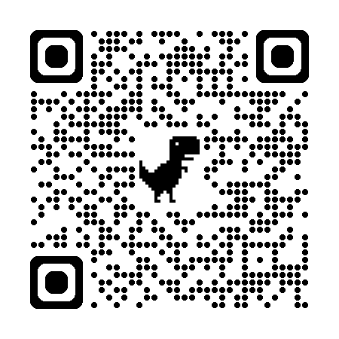
Neight
சொல்வெளி — the open field of words.
NotepadEnhanced → NotepadE → N8 → Neight · pronounced "nate"
A calm, distraction-free text editor for writers.
Tamil + English · Mac & Windows · .txt and .md files
Free forever
Open source · MIT
No accounts
No AI inside
No telemetry
Mac (Apple Silicon) · Windows 10/11 · ~50 MB

Slide 2
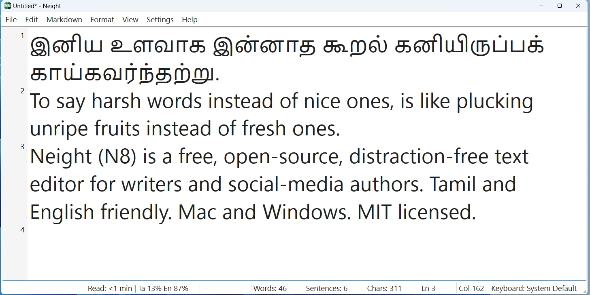
WHAT IS IT?
A notepad built for writing. Nothing else.
Most text editors are built for coders. Most word processors feel like they were built for large offices — full of toolbars and settings most people never touch. Neight is for everyone in between — the blog post, the Twitter thread, the short story, the column, the lecture notes. Plain text. One window. Late at night.
Platforms
macOS · Windows
File types
.txt · .md
Price
$0 — forever
Network use
Zero — fully offline
License
MIT open source
Windows · the blank page

Slide 3
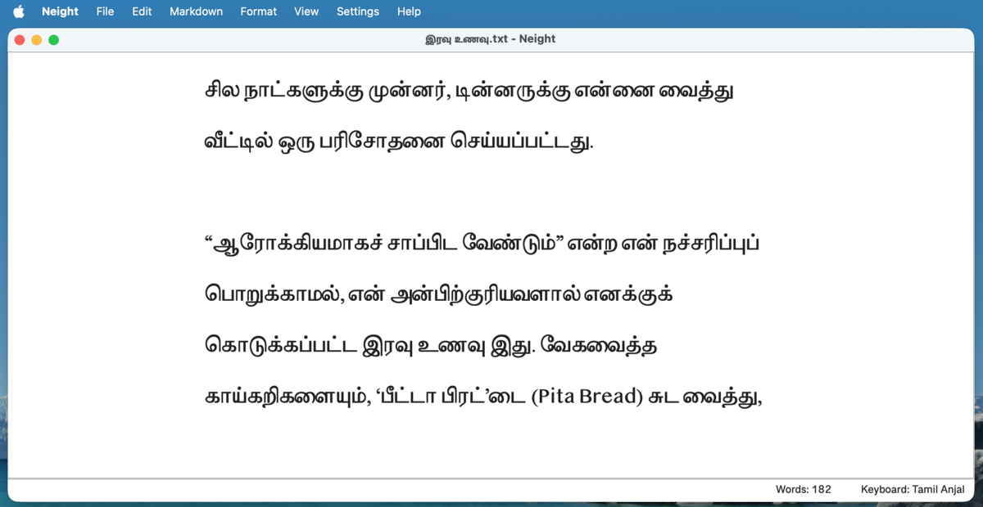
WHY I BUILT IT
Built to scratch an itch.
The spark
The gap
Vibe-coded
Tamil text wasn't rendering correctly in newer Windows Notepad. No clean alternative for bilingual writers.
Word → too heavy. VS Code → built for coders. Notepad → too bare. Needed something in between.
Built evenings & weekends with AI assistance. AI helped build it — zero AI runs inside the app.
How it differs from the alternatives
vs Word / Google Docs
No toolbars, no formatting ribbons, no cloud. Just text.
vs VS Code / Sublime
Not for coders — for writers. No plugins, no complexity.
vs Notepad (Windows)
Proper Tamil text, two writing modes, Markdown, auto-save, PDF.
macOS · Writer Mode (சொல்வெளி)

Slide 4
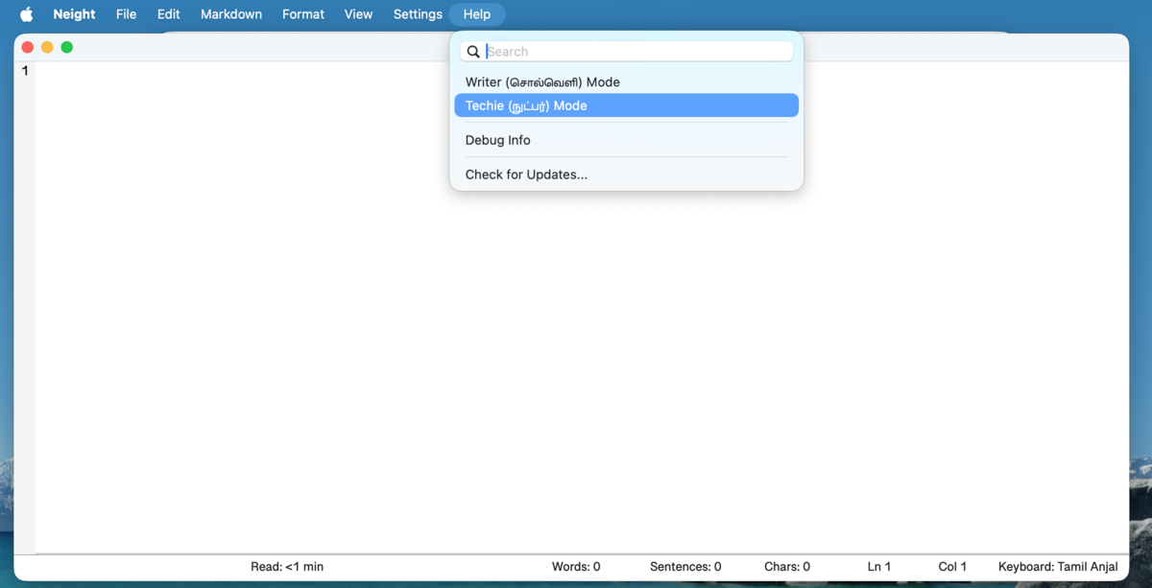
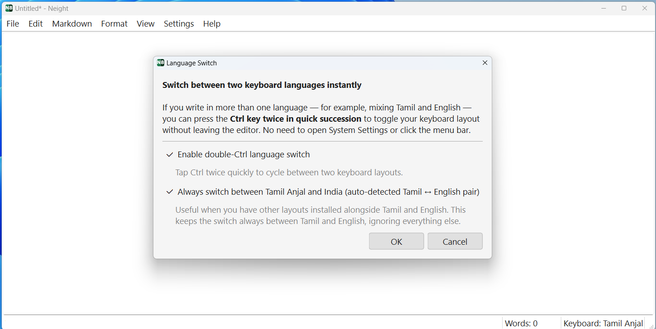
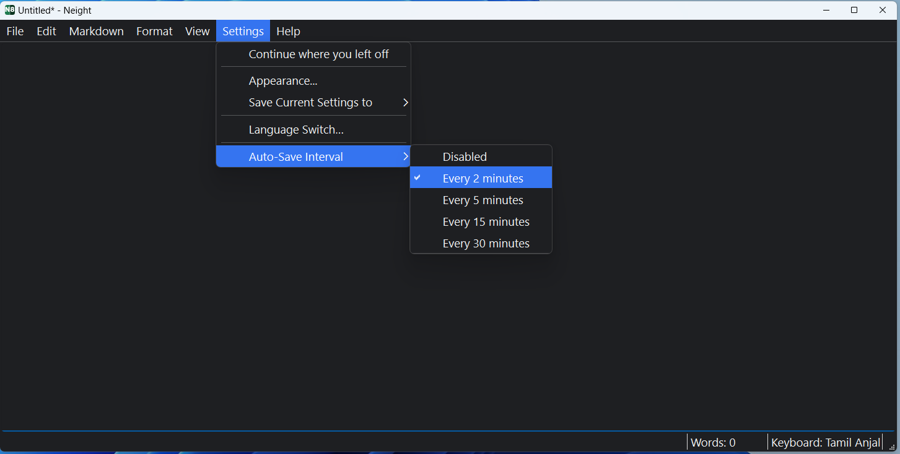
KEY FEATURES
Small features. Sharp ones.
01
02
03
Two writing modes
Double Ctrl keyboard
Markdown menu
Writer (large Tamil serif) Techie (gutter numbers, full status bar)
Flip Tamil ↔ English instantly — no System Settings hunting
Headings, bold, lists, tables, links — Ctrl+1…6 shortcuts
macOS · Writer / Techie mode toggle
04
05
06
Auto-save & recovery
Export to PDF
Sorkuvai lookup
Every 2–30 min. Silent recovery copies kept in ~/Documents/Neight/
A4, proper margins, your font. Markdown tables & headings render too
Right-click a Tamil word to look it up in the Tamil dictionary
Windows · keyboard layout settings
+ Smart filenames · Triple-click to Google · Word index overlay · Find/Replace with escape sequences · Plain-text paste
Windows · Markdown mode

Slide 5
$0
Totally free. Forever.
No tiers · No upgrades · No subscription · No ads · MIT licensed
yours to use, copy, fork, and ship inside your own work.
0 data collected
0 accounts
0 network calls
0 AI in app
0 ads ever
↓ neight.app
With deep gratitude to
Presented at
Thiru Pa. Raghavan
MadrasPaper.com 5th Year Anniversary
Editor
His years-long search for the perfect distraction-free writing app on macOS was the seed that became this project.
That level of care for the craft of writing was reason enough to build something.
Thank you for the space to share this. 🙏
github.com/venkatarangan/neight

