Slide 1
InSAR + DL
IEEE GRSS Data Fusion Contest 2026

Slide 2
Two Main Lines of Work considering InSAR+DL
InSAR pipeline Improvement:
e.g. Improve coherence, interferogram, phase unwrapping, phase filtering to improve the results of downstream tasks e.g. DEM quality. (gathered 26 papers (classic + DL based InSAR))
InSAR Applications:
e.g. Time series analysis of a region of region of interest for change detection, land deformation, canopy height estimation etc.
(gathered 15 papers (Time series InSAR analysis with DL + other apps))

Slide 3
Key Steps – InSAR Pipeline w.r.t Data Fusion Contest
Data selection: Suitable SLIC pairs only w.r.t to specified areas (geographic and temporal distribution)
SLIC files: 791/1582
Have to check the areas with sufficient elevation variation.
check sensor name, orbit types, inclination angle, temporal and perpendicular baseline.
Finalize image pairs to be used in the study. Suggestion Pick 3 locations (next slide)

Slide 4
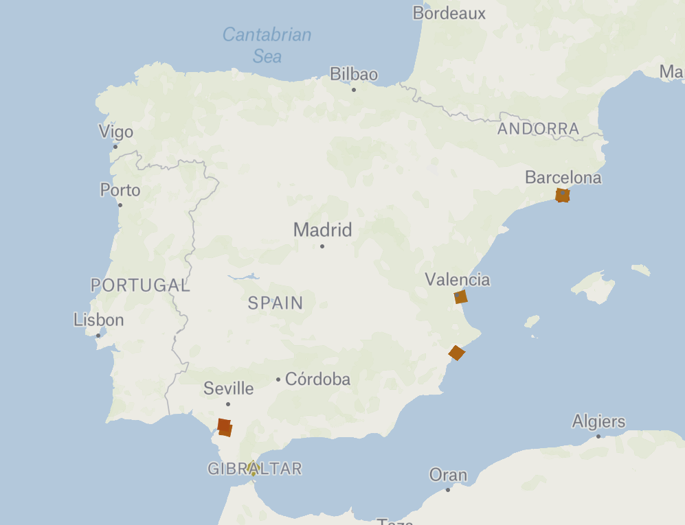
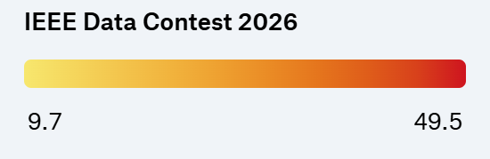
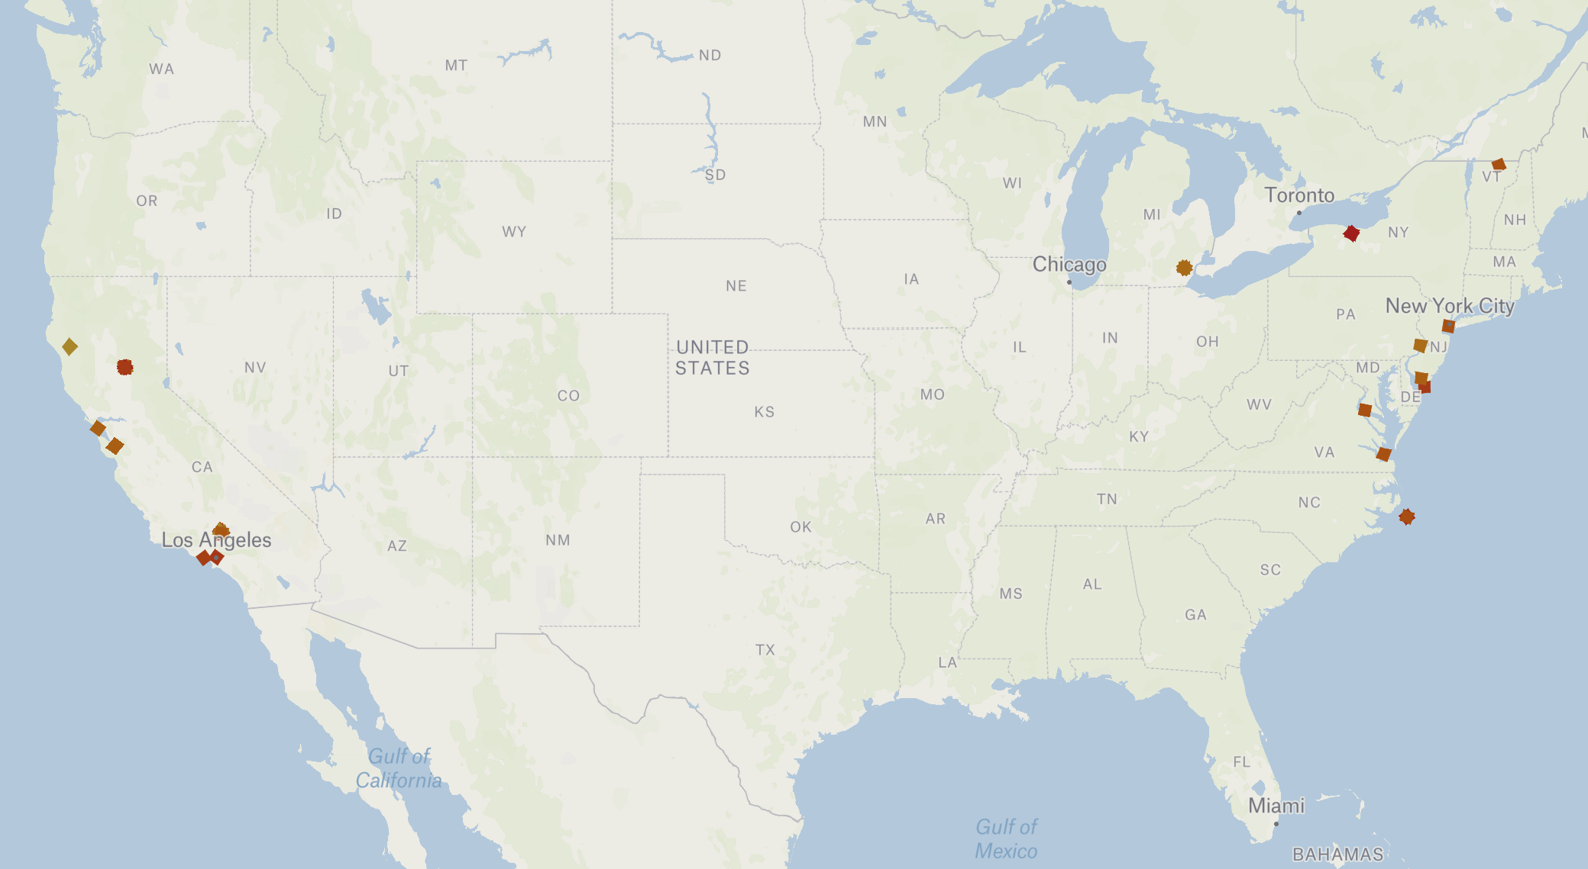
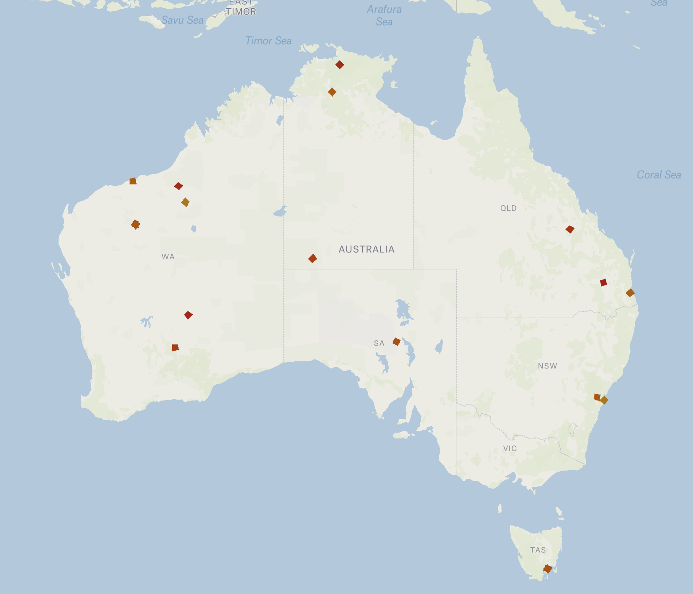
Geographic Distribution of Dataset

Slide 5
No. of Acquisitions per site
Latitude | Longitude | Number of SLC Files
19.4 | -155.3 | 221
34.8 | -118.1 | 119
-23.2 | 118.8 | 100
37.3 | -121.9 | 88
-21.8 | 122.2 | 62
39.5 | -121.5 | 36
-12.7 | 132.9 | 20
-30.4 | 136.8 | 19
-43.0 | 147.3 | 15
38.4 | -0.4 | 10
42.2 | -83.5 | 10
41.3 | 2.2 | 10
43.1 | -77.5 | 5
-20.4 | 118.6 | 5
-33.9 | 151.2 | 4
38.3 | -77.0 | 4
35.3 | -75.5 | 4
-23.5 | 148.8 | 4
-27.5 | 153.0 | 4
-14.5 | 132.4 | 4
Overall Temporal Coverage
(SLC only)
Total SLC scenes: 791
Earliest acquisition: 2020-12-31
Latest acquisition: 2025-11-12
Time span: ~ 4.9 years

Slide 6
Key Steps – InSAR Pipeline w.r.t Data Fusion Contest
Key Steps – InSAR Pipeline w.r.t Data Fusion Contest
2. Geometry and meta data sanity checks
3. Coregistration: Master-Slave pixel level alignment
4. Coherence Estimation and Interferogram formation
5. Adaptive Masking for low coherence areas
6. DL based phase filtering compared to e.g., Goldstein filtering
7. DL assisted phase unwrapping instead of using SNAPHU
8. Generation of uncertainty/confidence maps
9. Estimate Closure Errors for multiple SLIC pairs of same area
10. DEM generation OR Time series analysis
11. Geocoding/terrain correction for visualization
12. Calculation of Error / Quality metrics e.g., RMSE, NMAD etc.

Slide 7
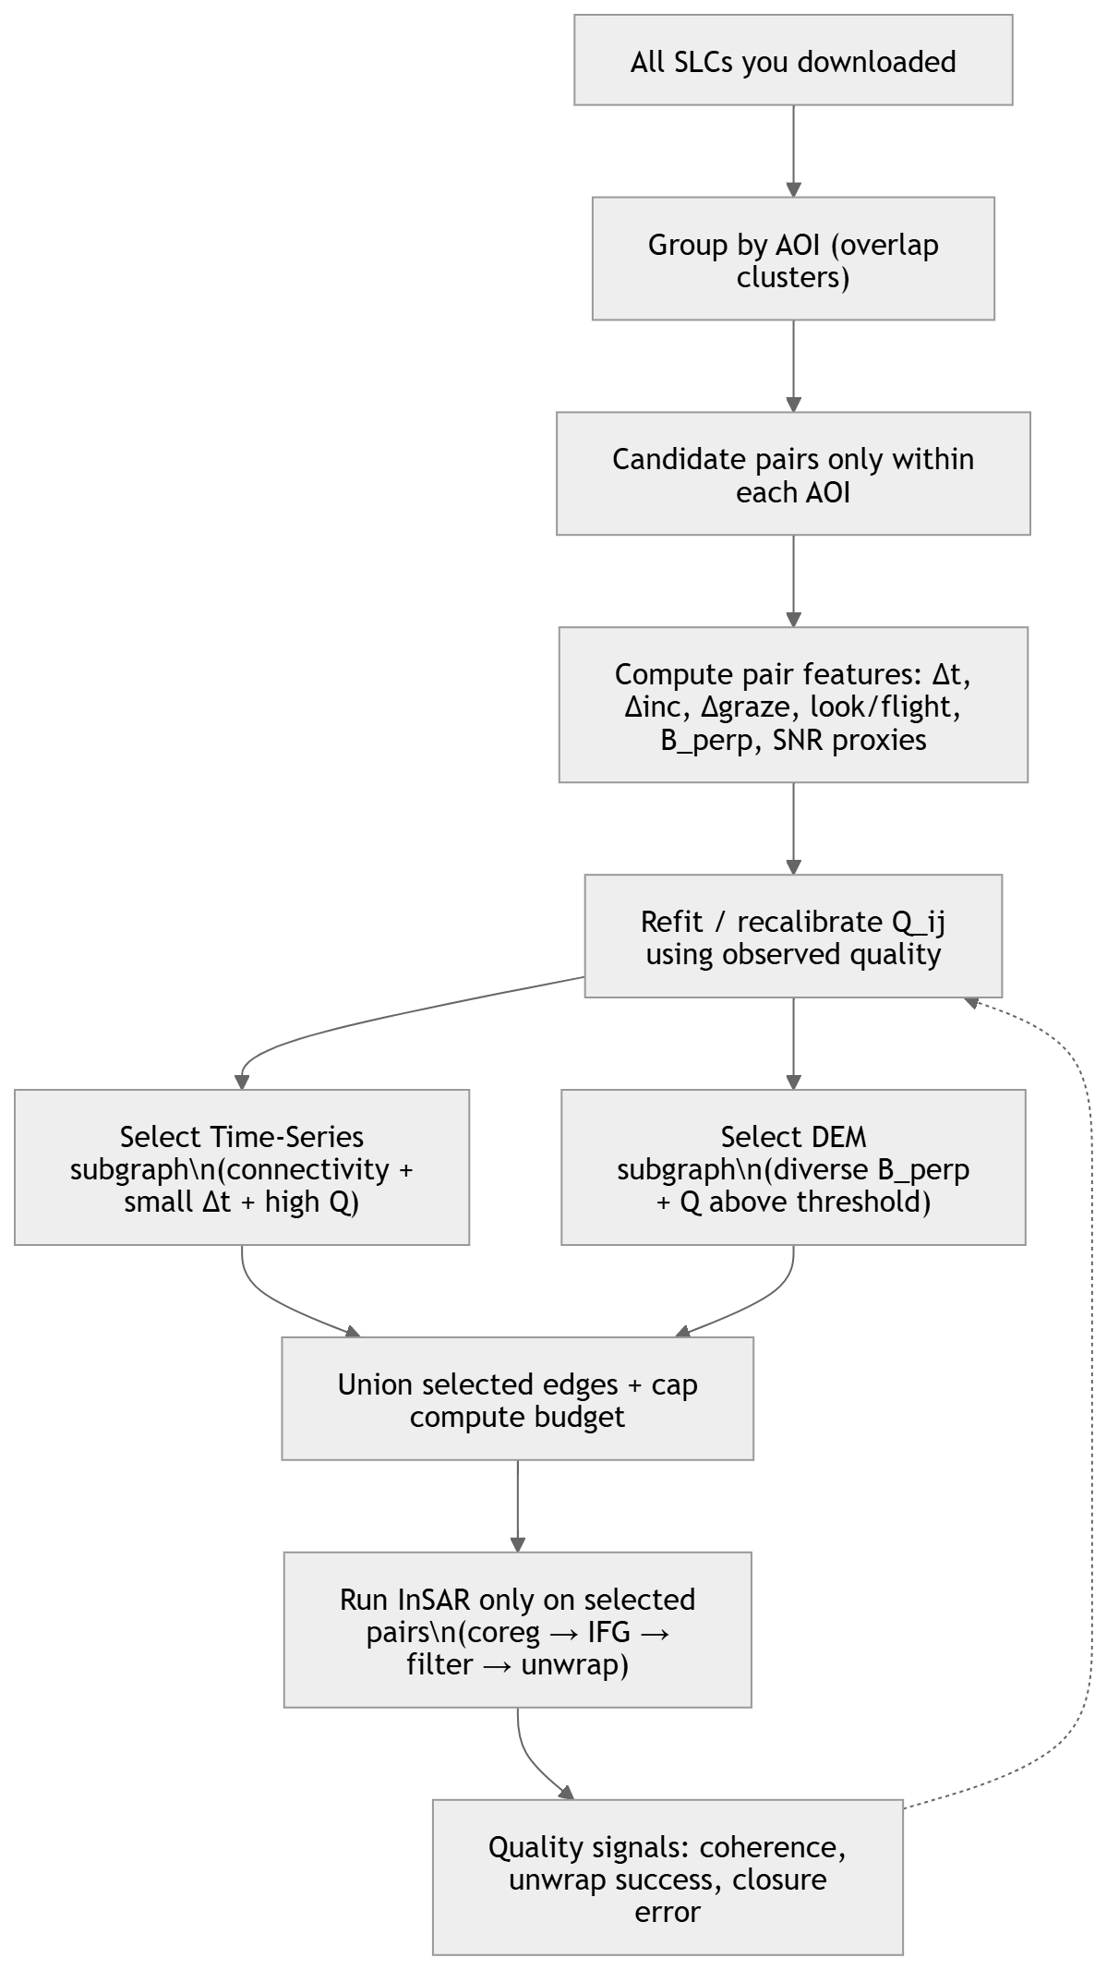
Pair Selection using Conditional Graph based approach

