Slide 1
GPA1-B
Jameson Dorough
January 12, 2026

Slide 2
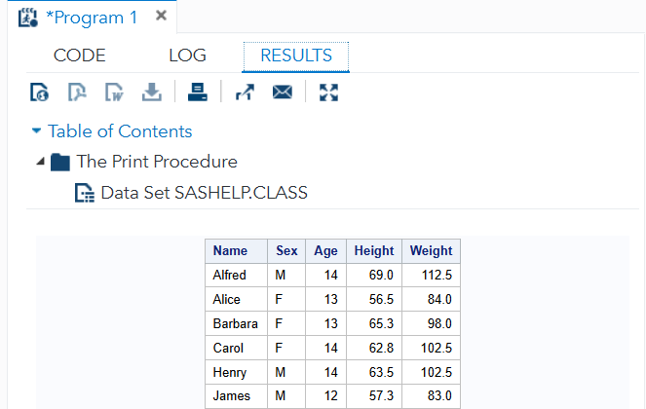

Slide 3
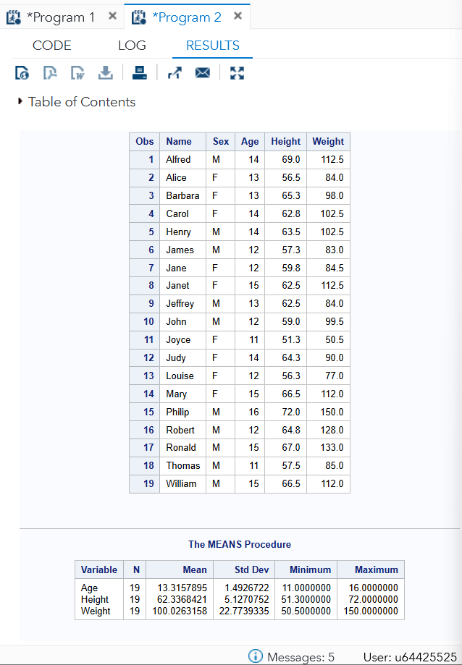

Slide 4
