Slide 1

DAPC, EDM Artist, or Useful Data Analysis Tool?
INFO 523 – Summer 2024 Riley Mawson
Ben Morgan

Slide 2
Background Information

Slide 3
What is DAPC?
Discriminant Analysis of Principal Components (DAPC)
Multivariate method of classifying large datasets
Other multivariate methods of classification are too computer intensive (e.g. Bayesian clustering algorithms)
Focuses on describing clusters of related observations
Takes advantage of the benefits of:
Principal Component Analysis (PCA)
Discriminant Analysis (DA)

Slide 4
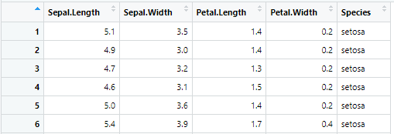
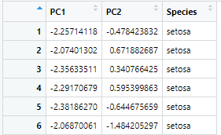
Principal Component Analysis (PCA)
Method to reduce dimensionality in datasets while maintaining variability
Does not consider different in class
Isolates uncorrelated features
Reducing feature size lowers computational intensity

Slide 5
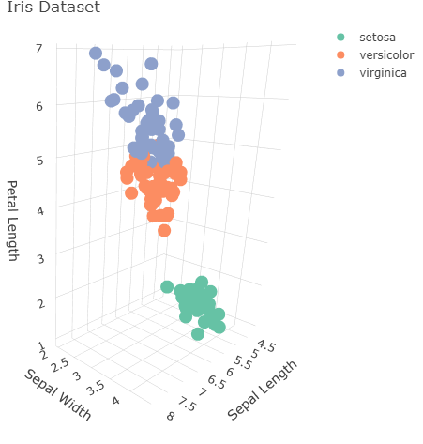
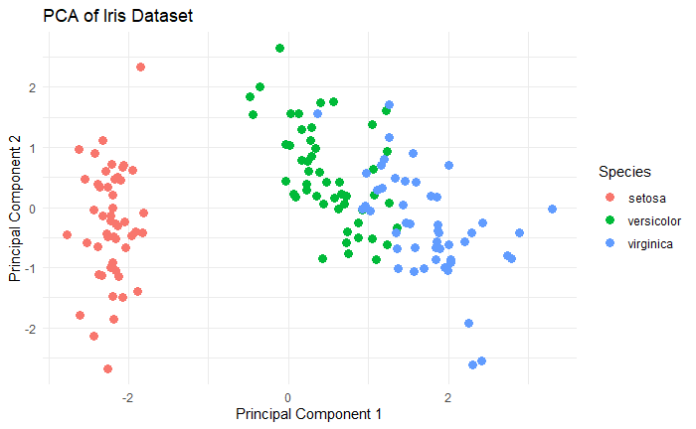
Principal Component Analysis (PCA)
Graphical representation of data 3D -> 2D

Slide 6
Discriminant Analysis (DA)
A method for classifying observations into predefined classes
Works by finding linear combinations of features that best separate classes
Can also be used for dimensionality reduction
Types:
Linear Discriminant Analysis (LDA)
Quadratic Discriminant Analysis (QDA)

Slide 7
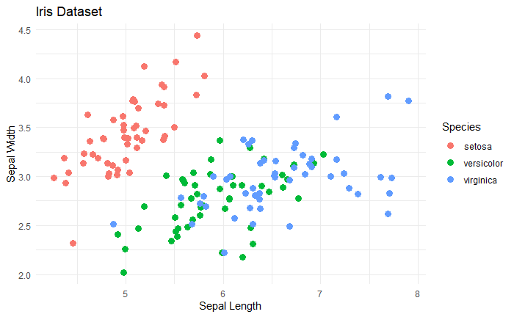
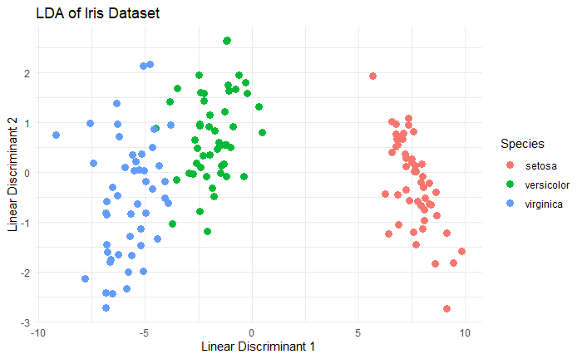
Discriminant Analysis (DA)
Graphical representation of data

Slide 8
Steps in DAPC
Apply PCA to the dataset
Reduce dimensionality of dataset
Select principal components for analysis
Apply DA to the reduced dataset for classification
Identify linear combinations in PCA components to separate groups
Interpret and validate results

Slide 9
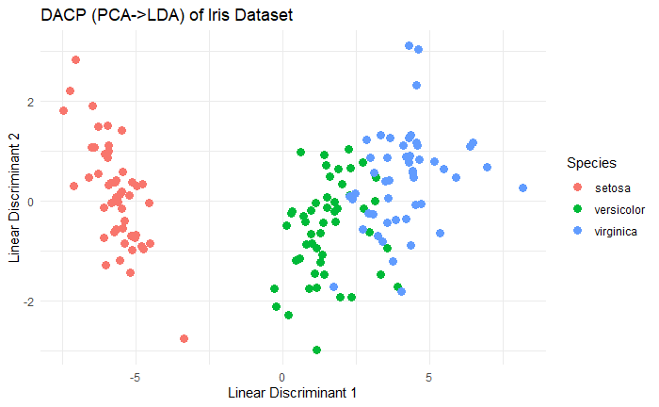
DAPC
Benefits
Current multivariate methods of classification are too computer intensive
Datasets growing at a faster rate than processing power
Can handle more features than samples
PCA step reduces feature size to be less than number of samples
Avoids overfitting by removing correlated features
Apply PCA then LDA

Slide 10
Relation to Course Materials

Slide 11
Clustering Methods
Builds on clustering methods studied in class
Uses K-means to establish ideal number of clusters prior to running DACP
Run successive K-means with increasing number of clusters to determine K.

Slide 12
Real-World
Applications

Slide 13
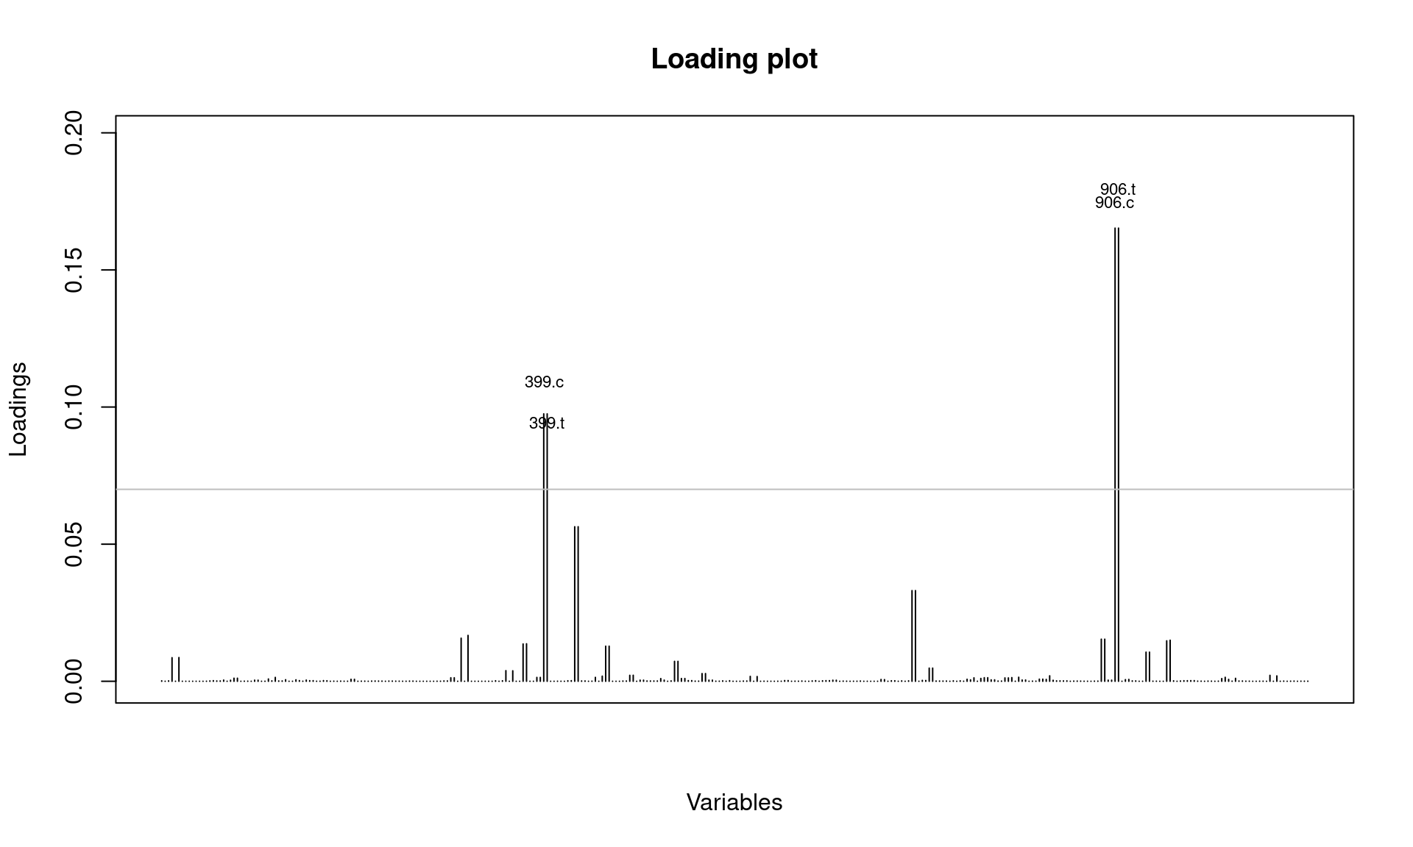
Detecting virus strains
In an analysis performed by Grünwald, Kamvar, and Everhart, they used the H3N2 dataset and DACP to study genetic variations in the virus. They found that from the years 2001-2005 the virus varied slightly but not to a significant degree. In 2006, however, the virus appeared to undergo a large mutation to the point where it became genetically distinct (see graph).
Using DACP they were able to isolate two new alleles that appeared in 2004 and 2005 that were the cause of the observed mutation.

Slide 14
Example

Slide 15
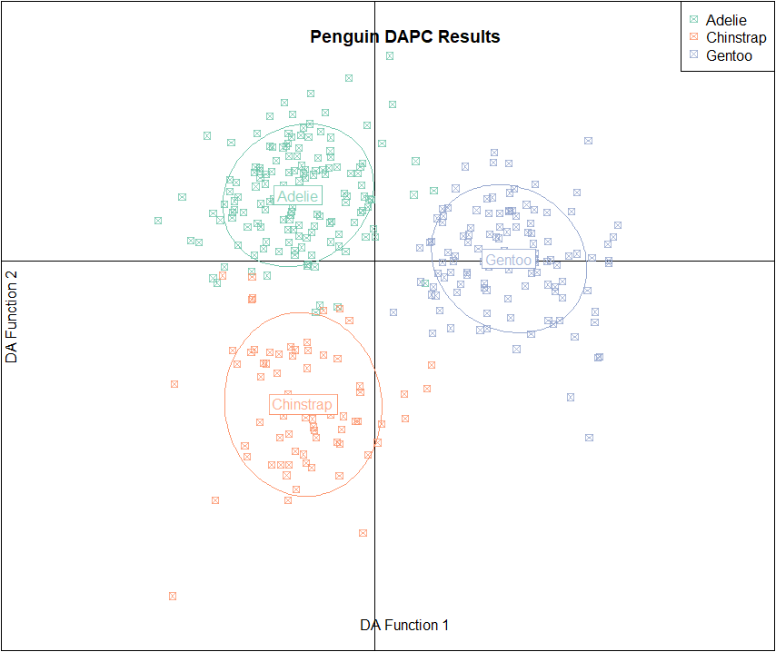
Case Study Example
Implemented DAPC on “Penguins” dataset from “palmerpenguins”
dapc_output <- dapc(features_matrix_for_PCA, factors_for_DA, n.pca = 3, n.da = 2)
DA Function 1-axis is discriminant function with the largest variance, which means it is the most useful for categorizing the data
DA Function 2-axis is the second-most useful DA function for categorizing
When analyzing the results, it is desirable to see clusters distinctly separated from each other with little or no overlap. This demonstrates that the analysis is effective for categorizing the data.
In this case, it successfully groups the three penguin species with almost no overlap.

Slide 16
Conclusion

Slide 17
Conclusion
DACP is built on running PCA followed by DA
Handles larger datasets while increasing performance
Excellent resource for studying genetic data

Slide 18

Thank you
Contact Information:
rileymawson@arizona.edu
benmorgan@arizona.edu

Slide 19
References
Jombart, T., Devillard, S. & Balloux, F. Discriminant analysis of principal components: a new method for the analysis of genetically structured populations. BMC Genet 11, 94 (2010). https://doi.org/10.1186/1471-2156-11-94
NJ Grünwald, ZN Kamvar, and SE Everhart, Discriminant analysis of principal components (DAPC), Available at: https://grunwaldlab.github.io/Population_Genetics_in_R/DAPC.html

