Slide 1
QUARTERLY BUSINESS REVIEW · CEREALS SOUTH
Crunchwell Louisiana Share Decline
Q1 2026 root-cause read-out and three-leg recovery plan
Maya Chen, Senior Insights Analyst · Prepared for Diane Halverson, VP Sales NA · May 13, 2026

Slide 2
THE HEADLINE
Executive summary
Crunchwell's brand share in the Louisiana DMA fell 340 basis points in the 12 weeks ending March 29, 2026 vs. the same period prior year — the largest single-DMA decline in the cereal core in six fiscal years.
The decline is not random. It is the compounding effect of five root causes — concentrated in Original Mega and Honey Nut Mega, in New Orleans–Metairie and Baton Rouge, in the Mass and Grocery channels.
Three of the five causes were addressable earlier than they were addressed. No single tool synthesized the signals until six weeks after the worst of the damage.
−340 bps
LA share loss, Q1 2026 YoY
−$4.2M
Annualized revenue impact
5.7%
Crunchwell US avg (LA −270 bps)
7 mo
Lag on the earliest signal
Mass channel −470 bps; Grocery −380 bps
Original Mega −560 bps; Honey Nut Mega −490 bps
Walmart = 38% of LA cereal volume (vs 31% national)
Internal · Confidential — Acme Corp synthetic demo data
1

Slide 3
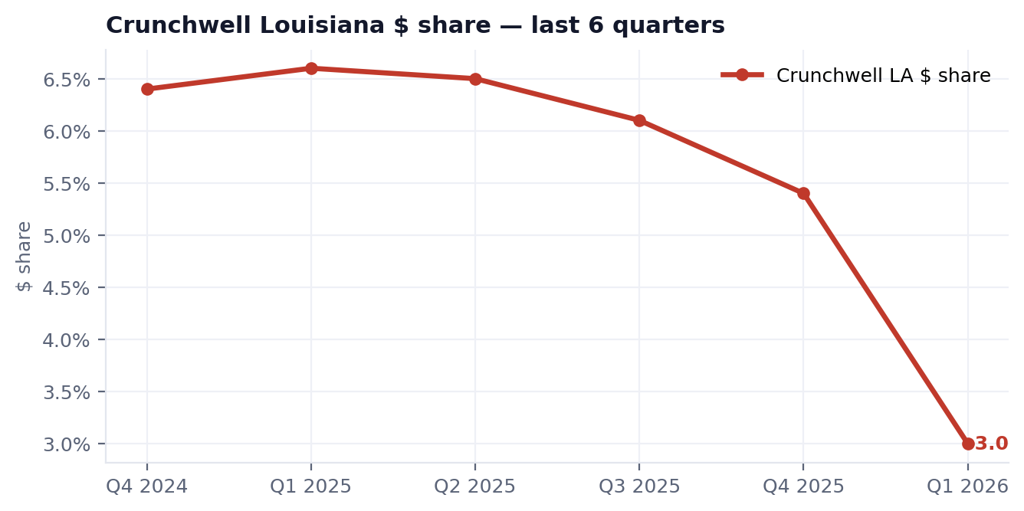
THE NUMBERS
The six-quarter slide into Q1 2026
Quarter | Share | YoY
Q4 2024 | 6.4% | +20
Q1 2025 | 6.6% | +30
Q2 2025 | 6.5% | +10
Q3 2025 | 6.1% | -40
Q4 2025 | 5.4% | -110
Q1 2026 | 3.0% | -340
Q4 2025 was the early warning — down 110 bps. It read three months before the Q1 alarm. The signal existed; nobody acted on it.
Internal · Confidential — Acme Corp synthetic demo data
2

Slide 4
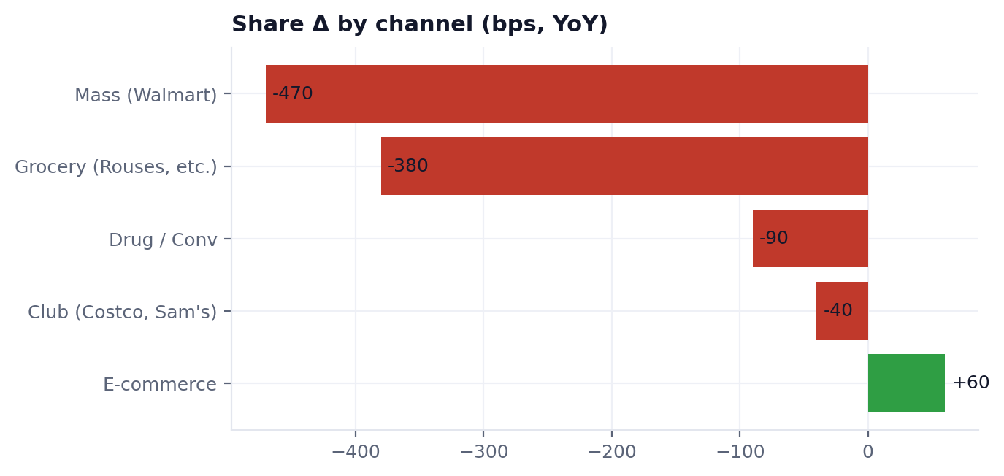
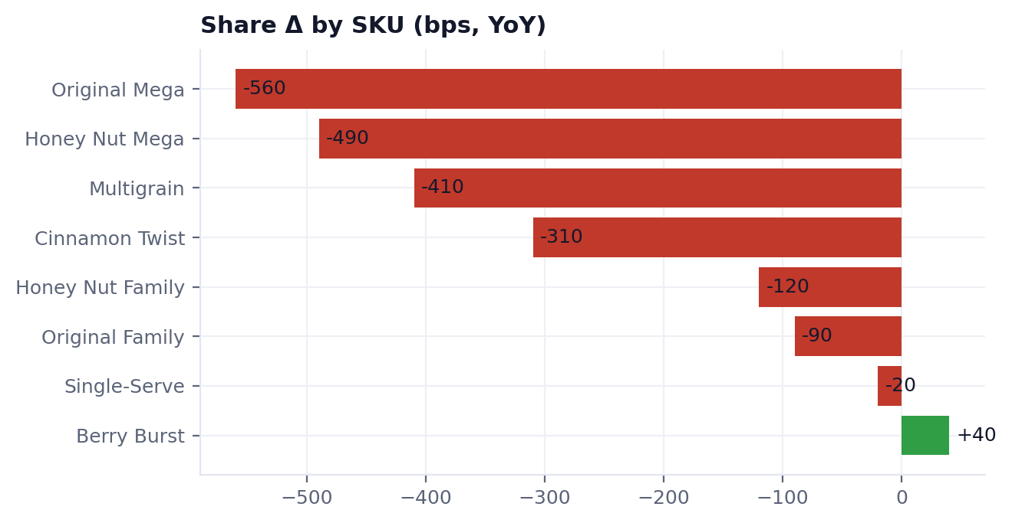
CHANNEL AND SKU
Where the loss concentrates
The Mega and Multigrain SKUs that lost facings in the September 2025 Walmart modular reset are exactly the SKUs taking the largest share losses. This is a distribution problem compounded by competitive promo and a supply disruption — not a brand-health problem.
Internal · Confidential — Acme Corp synthetic demo data
3

Slide 5
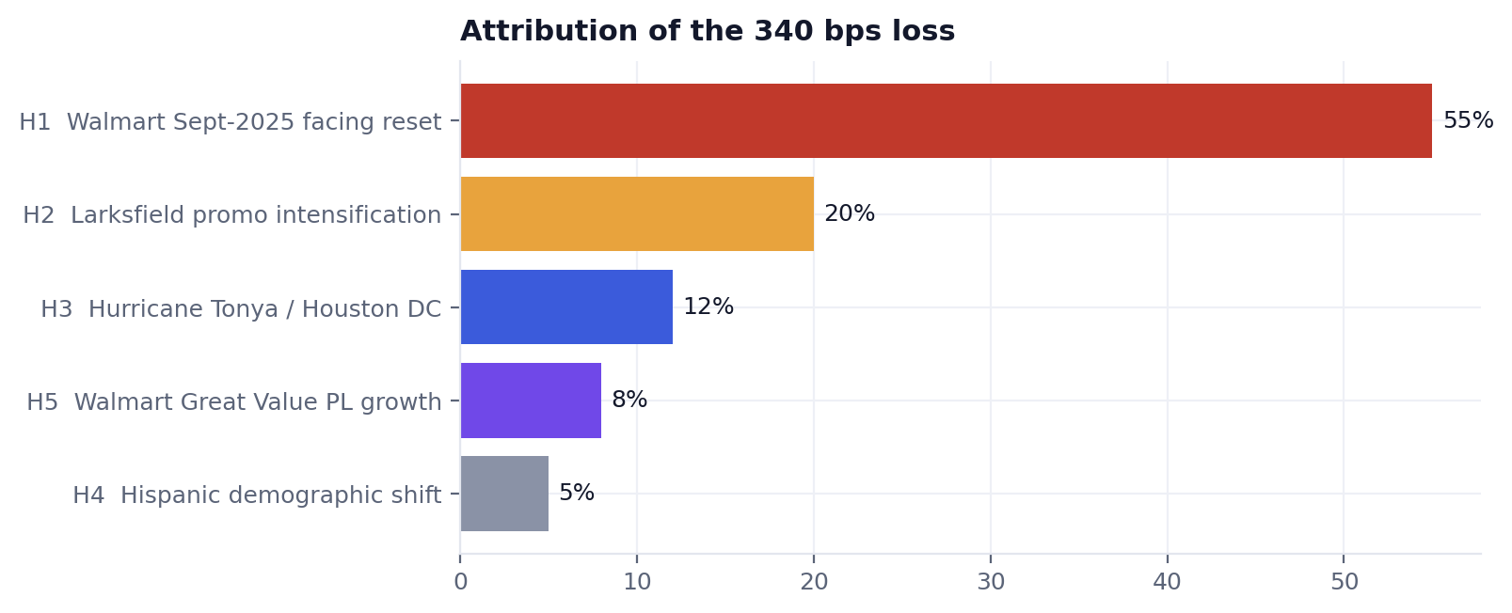
ROOT CAUSE
Five hypotheses, one attribution
Hypothesis | Contribution
H1 · Walmart Sept-2025 facing reset | 55% (-187 bps)
H2 · Larksfield promo intensification | 20% (-68 bps)
H3 · Hurricane Tonya / Houston DC | 12% (-41 bps)
H5 · Walmart Great Value PL growth | 8% (-27 bps)
H4 · Hispanic demographic shift | 5% (-17 bps)
H1 (Walmart facing reset) is the primary driver at ~55%. H2–H5 compound it. H4 and H5 are contextual — real but slow, and cannot account for a 12-week move.
Internal · Confidential — Acme Corp synthetic demo data
4

Slide 6
PRIMARY DRIVER · ~55% OF IMPACT
H1 — Walmart Sept-2025 modular reset
8 → 6
Crunchwell facings cut at 84% of LA Walmart
+4%
Velocity per facing (demand outran shelf)
4.1% → 11.8%
Crunchwell Mega OOS rate, LA Walmart
FY24 → Q1 2026
38%
Walmart share of LA cereal volume
vs 31% national
Walmart's South division applied a 'regional sweetened-cereal demand index' that under-weighted Crunchwell's actual velocities — the four affected SKUs were Original Mega, Honey Nut Mega, Multigrain and Cinnamon Twist.
A 2-facing cut is proportionally more painful in the South, where Walmart runs a smaller Crunchwell modular than the national average.
Field audit (May 11): 0 Acme endcaps and 23 of 41 LA Walmart Supercenters carrying three Larksfield endcaps. We are losing real estate, not consumers.
Owner of fix: Tom Reilly (NAM Walmart) — August 2026 line review. Asking for 2 facings back, anchored on velocity-per-facing data.
Internal · Confidential — Acme Corp synthetic demo data
5

Slide 7
SECONDARY & TERTIARY DRIVERS
H2 & H3 — competitor promo and the storm
H2 · Larksfield promo intensification
~20% of impact (−68 bps)
14-week cadence at Rouses & Brookshire's from late Oct 2025; $0.50 off Field & Honey 14oz vs Acme's $0.40.
Field & Honey LA household reach +11% Q4'25 → Q1'26 (Numerator).
14% of LA Crunchwell lapsed buyers went to Field & Honey at next purchase, vs 6% baseline.
Acme's trade pullback (26% → 22%) coincided exactly with Larksfield's push. We blinked first.
H3 · Hurricane Tonya / Houston DC
~12% of impact (−41 bps)
Landfall near Beaumont TX, Nov 8 2025. Houston DC offline 9 days, then 60% capacity for 18 more.
Crunchwell Mega volume to LA stores down 47% in the Nov 9 – Dec 10 window.
23 OOS escalations logged from LA stores; Walmart.com served Cheerios and Field & Honey as substitutes.
Supply restored mid-January. The residual is long-tail repeat behavior — shoppers who stuck with F&H.
Internal · Confidential — Acme Corp synthetic demo data
6

Slide 8
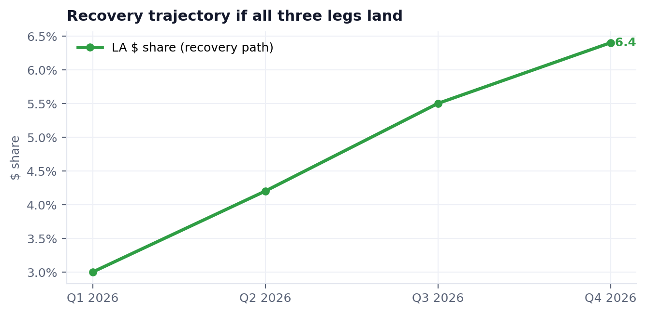
THE PLAN
Three-leg recovery plan
Leg 1 · Tactical trade
Immediate — 4 weeks
$0.55 off Mega + Honey Nut Mega at Rouses from May 25. ~$280K. +120 bps by end June. Owner: Marcus Boudreaux.
Leg 2 · Walmart facings
Medium — Aug line review
Recover 2 facings on Mega + Honey Nut Mega. +150–180 bps if both approved (+70–90 if one). Owner: Tom Reilly + Priya Raman.
Leg 3 · Supply + equity
Ongoing
Memphis 3PL pre-positioning for hurricane season; $1.4M LA media behind the pack refresh in Q3. +50–80 bps by Q4. Owner: Devraj + Hugo Lin.
Land all three legs → flat by Q3, growing by Q4. If the Walmart line review fails, recovery extends into mid-2027.
Internal · Confidential — Acme Corp synthetic demo data
7

Slide 9
THE ASK
Recommendation to the board — May 28
Approve the three-leg recovery plan as outlined.
Approve the $280K tactical trade injection at Rouses (Q2 only, hard end date).
Affirm support for the August Walmart line-review facing push.
Note the systemic gap: Acme's intelligence stack does not synthesize signals across tools fast enough to catch a Louisiana-style decline early. Sponsor the platform-consolidation effort with a mandate to close time-to-insight on regional shifts to under 30 days.
“The first time a single human had all five signals on one page was May 12, 2026 — six weeks after the worst of the damage was done.”
— Maya Chen, Q1 2026 Louisiana root-cause report
Internal · Confidential — Acme Corp synthetic demo data
8

