Slide 1
LAUNCH TRACKER · WELLNESS HERO
ProteinPeak Q2 Launch — Week-4 Read
Cinnamon Crunch (PP005) + Cocoa Almond (PP006) · on shelf April 20, 2026
Maya Chen, Senior Insights Analyst · For Sage Park, Brand Director · Business review · May 26, 2026

Slide 2
EXECUTIVE SUMMARY
The launch is landing — with a bounded watch-out
Cinnamon Crunch and Cocoa Almond are landing — strong at Target, soft at the Walmart pilot, cannibalization bounded.
Recommended action: hold Amazon spend, lean into the Target endcap renewal, and deprioritize Walmart-pilot expansion until it gets an endcap signal.
Net of cannibalization, the launch is +$22M incremental on plan for FY26 — above the $24M combined plan. ProteinPeak's FY26 mandate is $48M → $80M (+66.7%); the two new flavors carry most of that.
110
Trial index, Target (plan = 100)
77
Trial index, Walmart-pilot
1.2×
W2 repeat vs Berry Crunch
~6%
PP001 cannibalization (steady)
$1.2M / $4.2M
Q2 retail-media spent through Week 4 — pacing on plan
Internal · Confidential — Acme Corp synthetic demo data
1

Slide 3
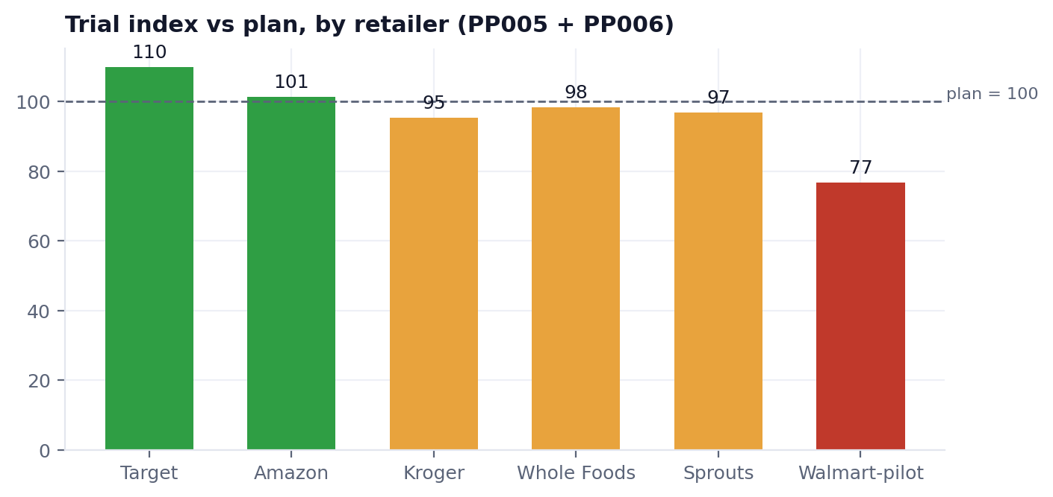
QUESTION 1 · TRIAL
Trial vs plan — Target is the engine
Target endcap drives +10% over plan — the launch motion that works.
Amazon and the premium grocers (WFM, Sprouts) land at or near plan.
Walmart pilot is 23% under plan: premium-protein cereal needs an endcap signal at Walmart, and the pilot had none.
Confidence: ±4% on Target (n=270 store-weeks); ±9% on Walmart (n=110).
Source: plan_vs_actual × perfect_store, post-2026-04-20, PP005 + PP006 combined.
Internal · Confidential — Acme Corp synthetic demo data
2

Slide 4
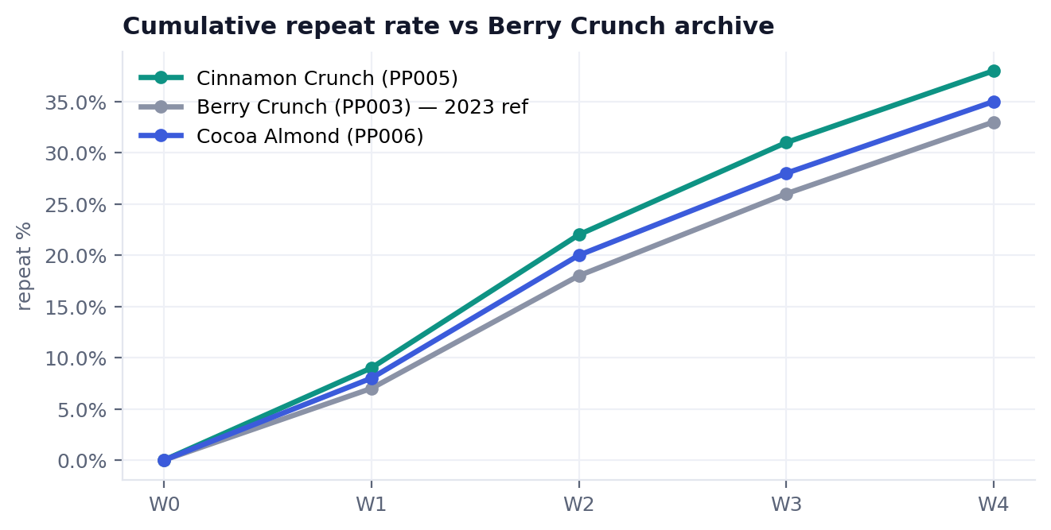
QUESTION 2 · REPEAT
Repeat curve beats the Berry Crunch benchmark
At Week 2, Cinnamon Crunch repeat sits at 1.2× Berry Crunch (PP003) at the same week-since-launch.
Cocoa Almond tracks slightly below at 1.05× — still positive.
The historical-archive comparison is the unlock: Berry Crunch's W2 number was buried across three quarters of Numerator exports nobody had stitched.
Shaded band = ±1 SD on each line.
Internal · Confidential — Acme Corp synthetic demo data
3

Slide 5
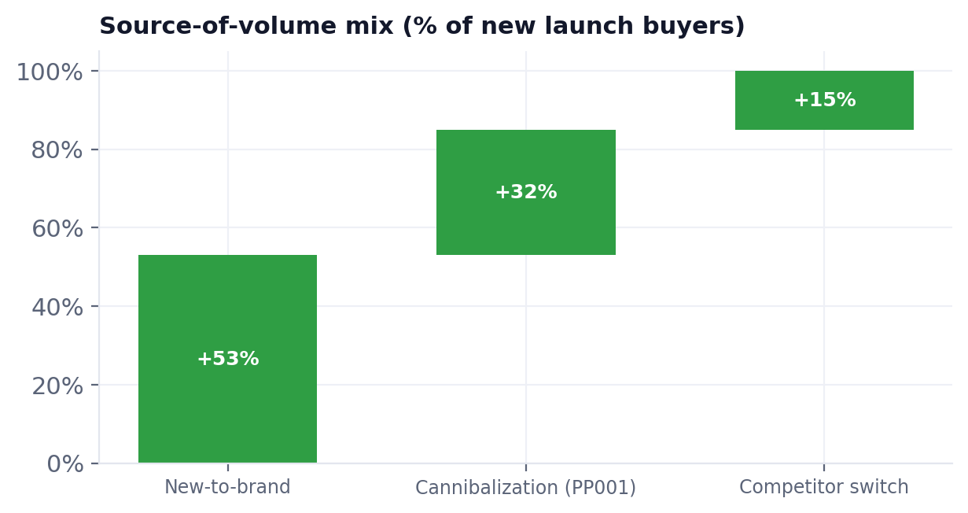
QUESTION 3 · CANNIBALIZATION
Source of volume — mostly net-new, cannibalization bounded
~53% of buyers are net-new to ProteinPeak — the launch is doing what it should.
32% comes from PP001 Vanilla Almond Original; bounded at ~6% steady-state cannibalization (~$1.5M pulled-forward on a $25M SKU).
PP001 velocity dip: −11% Week 1, −6% Weeks 2–4 at launch retailers.
15% is competitor switch (Magic Spoon, Three Wishes, Catalina).
Risk note
If cannibalization widens past 12% by Week 8 — the historical pattern for protein launches lacking flavor differentiation — revisit the stage-gate on the next two flavors.
Internal · Confidential — Acme Corp synthetic demo data
4

Slide 6
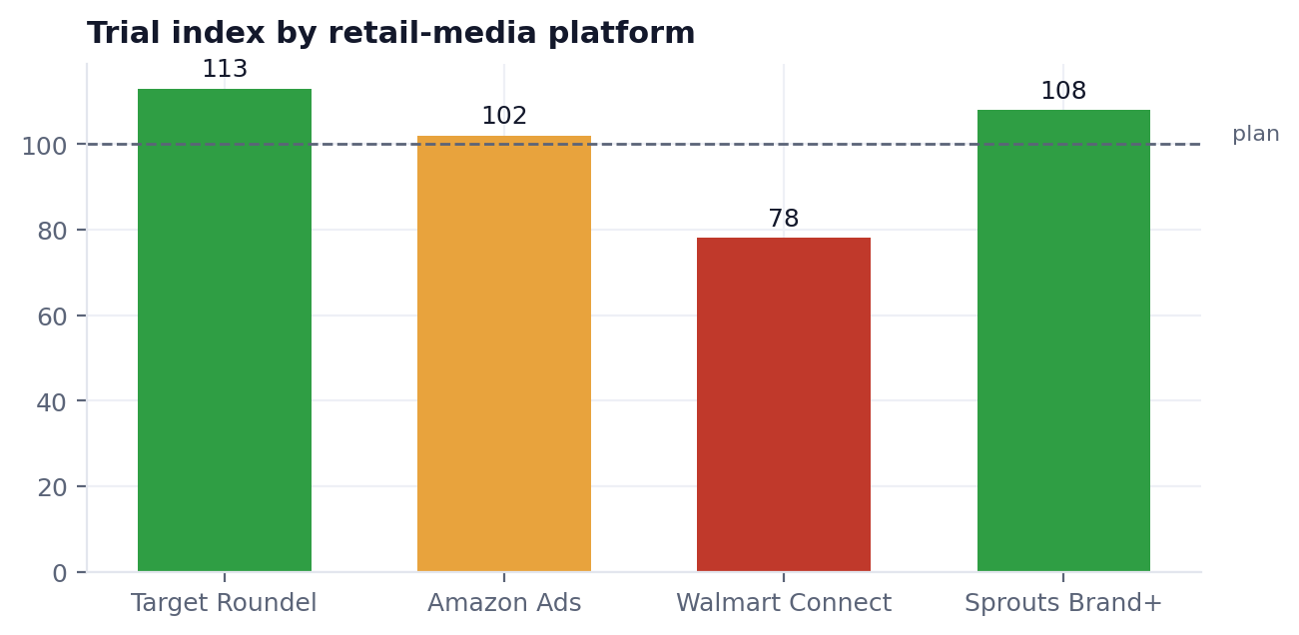
QUESTION 4 · CHANNEL SPLIT
Channel mix + retail-media response
Platform | Spend | Trial | Action
Target Roundel | $1.80M | 113 | GO
Amazon Ads | $1.40M | 102 | HOLD
Walmart Connect | $0.50M | 78 | PAUSE
Sprouts Brand+ | $0.25M | 108 | GO
Re-route the $700K Walmart Connect plan toward the Target Roundel renewal and a small Whole Foods endcap test. Sage-cohort creator sentiment is +0.47 (Brandwatch). Hugo to confirm Tasha Brooks' Pacvue pacing supports the move.
Internal · Confidential — Acme Corp synthetic demo data
5

Slide 7
RECOMMENDED ACTIONS
So what — three decisions for Tuesday
Renew the Target endcap
Target is the proven engine at +10% trial. Lock the Q3 endcap and extend Roundel support.
GO
Hold Amazon spend
Already at plan (102). No incremental return to chasing it; keep the always-on coupon.
HOLD
Pause Walmart-pilot expansion
Without an endcap signal the pilot underdelivers. Re-time to a supported window, reallocate the $700K.
PAUSE
Internal · Confidential — Acme Corp synthetic demo data
6

