Slide 1
JOINT BUSINESS REVIEW · PRE-READ
Kroger Q3 2026 JBR Pre-Read
Category state-of-the-business and the case for a protein-forward captaincy play
Priya Raman, Category Manager · JBR July 8, 2026 · pre-read due June 24 · Cereals & Adjacent

Slide 2
SITUATION
Where Crunchwell stands at Kroger
Crunchwell is flat at Kroger nationally — holding, not winning. Meanwhile the shelf is moving underneath us: Larksfield Field & Honey and Kroger's own Simple Truth are taking the growth, and three premium segments are pulling steadily from traditional family cereal.
This is a captaincy moment. We can either defend a flat line or bring Kroger a protein-forward category plan that grows the total basket — and positions Crunchwell + ProteinPeak as the branded engine of that growth.
Flat
Crunchwell at Kroger vs last JBR
+1.4 pts
Larksfield F&H, national
+2.1 pts
Larksfield F&H, South
+0.8 pts
Simple Truth, protein segment
14%
of Crunchwell lapsed Kroger buyers went to Simple Truth in Q1 2026
Internal · Confidential — Acme Corp synthetic demo data
1

Slide 3
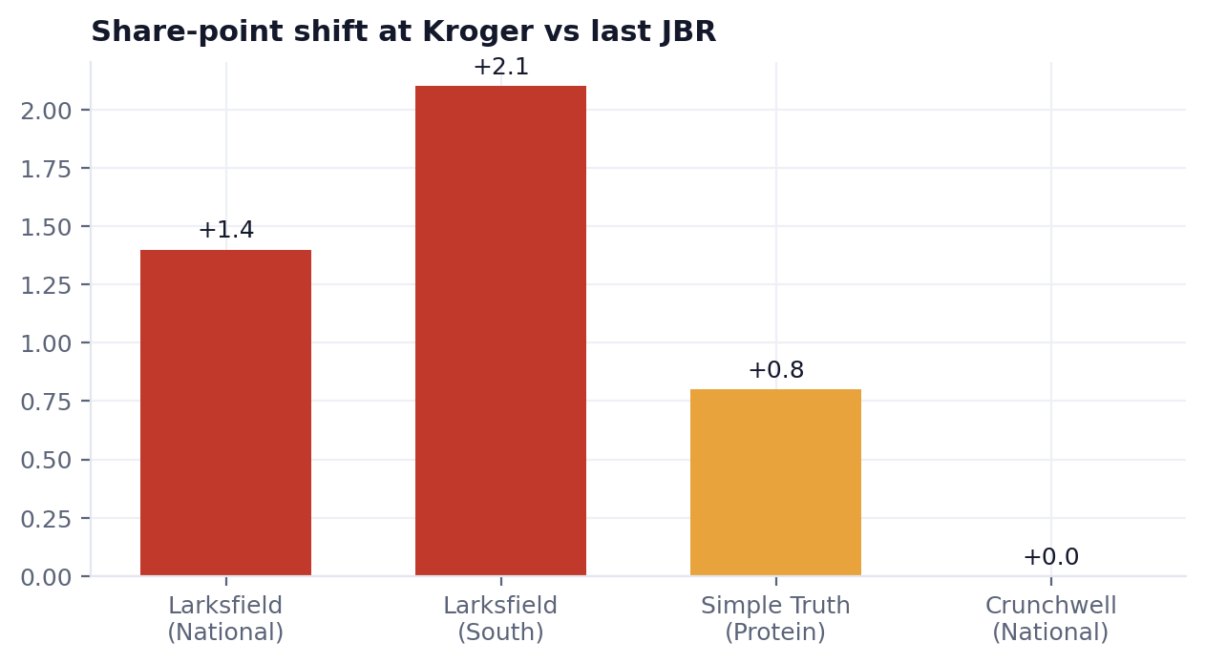
THE SHELF IS MOVING
Who is taking the growth
Larksfield Field & Honey gained 1.4 pts nationally and 2.1 pts in the South vs last JBR — the South over-indexes, mirroring the Louisiana decline.
Simple Truth (Kroger's own PL) gained 0.8 pts across the protein segment.
Crunchwell held flat — neither winning nor leaking at the banner level, but losing relative ground.
Source: kroger_simple_truth_switching, Numerator HH panel, Q1 2026.
Internal · Confidential — Acme Corp synthetic demo data
2

Slide 4
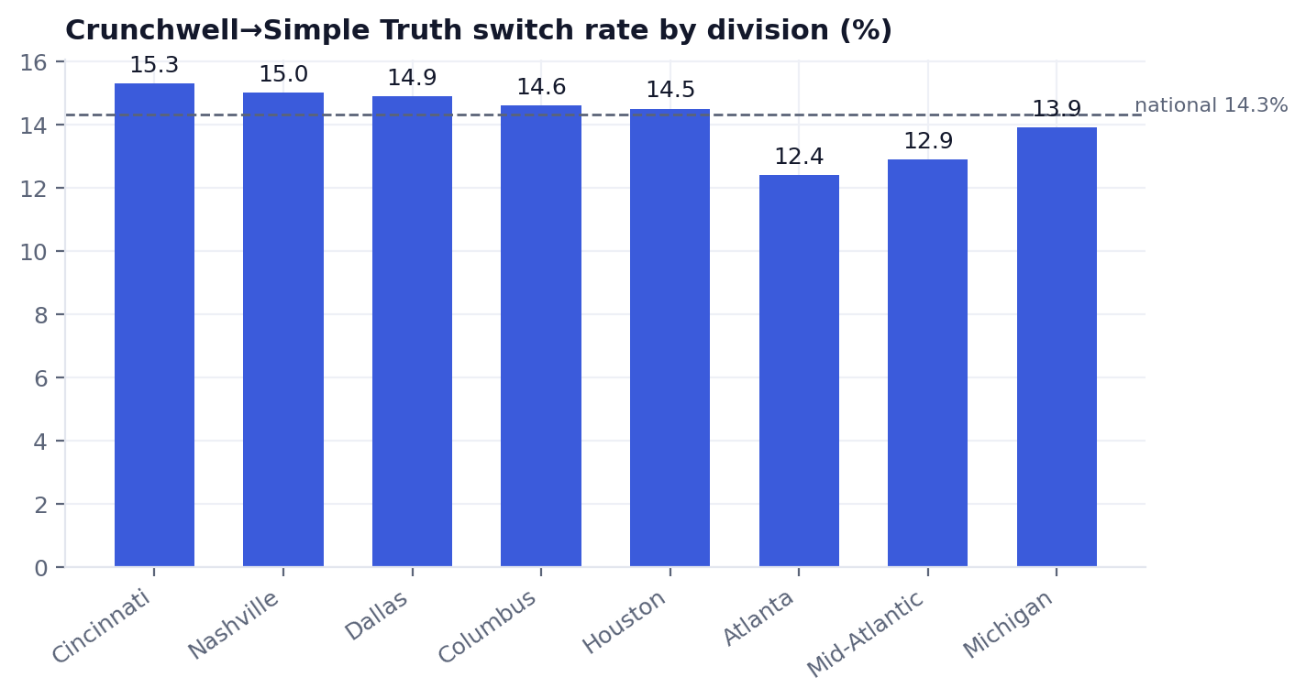
THE LEAK
Crunchwell→Simple Truth switching, by division
National switch rate is 14.3% of lapsed Crunchwell buyers moving to Simple Truth.
Cincinnati, Nashville and Dallas run hottest (15%+).
Houston carries LA-DMA overlap and some hurricane-disrupted households.
Wholegrain and sugar-reduced segments show the highest PL pull (16–18%).
Internal · Confidential — Acme Corp synthetic demo data
3

Slide 5
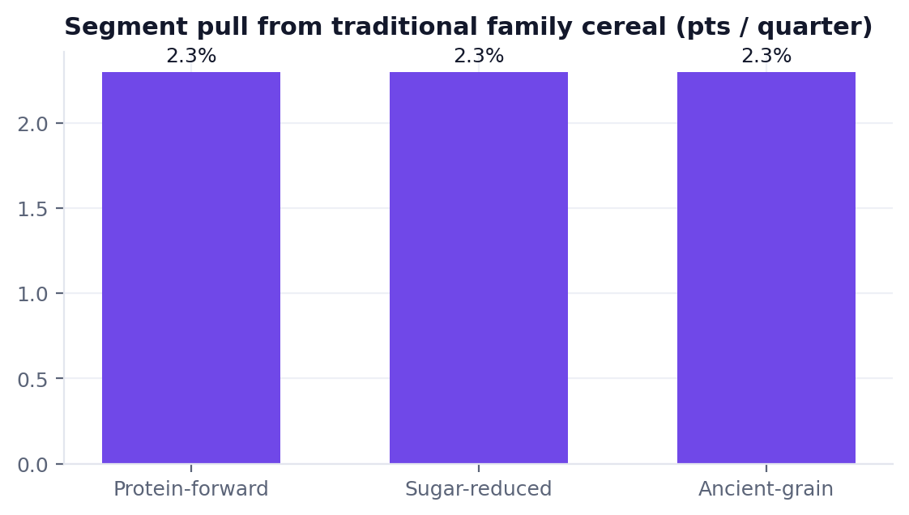
CATEGORY DYNAMICS
The structural story: segments pulling from family cereal
Protein-forward, sugar-reduced and ancient-grain segments are each pulling ~2.3 pts per quarter from traditional family cereal.
Traditional family cereal — Crunchwell's core — is structurally ceding share to wellness formats.
The branded answer already exists in our portfolio: ProteinPeak. The JBR play is to merchandise the wellness migration with our brands, not Simple Truth.
Internal · Confidential — Acme Corp synthetic demo data
4

Slide 6
THE ASK
Recommendation framework for the JBR
1 · Defend the core
Targeted Crunchwell trade + Kroger Precision defense in the eight hottest-switching divisions, anchored on the 14% leak.
2 · Lead the migration
Bring a protein-forward shelf reset that features ProteinPeak as captain's branded answer to Simple Truth's PL gains.
3 · Grow the basket
Position the plan as total-category growth, not brand defense — the captaincy framing Kroger rewards.
Deliverable: 12-page JBR deck with the recommendation framework on the final three slides. Shipped June 20; pre-read due June 24.
Internal · Confidential — Acme Corp synthetic demo data
5

