Slide 1
QUARTERLY BUSINESS REVIEW
Acme Corp — Q2 FY2026 Company Business Review
Enterprise performance through May, the ProteinPeak launch read, and what it means for the back half
Diane Halverson, VP Sales NA (sponsor) · Finance & Insights (prep) · July 2026
Internal management presentation · Internal · Confidential — synthetic demo data

Slide 2
AGENDA
What this deck covers
01
Where the quarter landed
06
Spend efficiency — trade and retail media
02
Brand-by-brand read
07
Supply and service
03
Share and category context
08
Risks into H2
04
The ProteinPeak launch, four weeks in
09
The ask
05
Louisiana: is the recovery working?
Internal · Confidential — Acme Corp synthetic demo data. Fictional; not for real decision-making.
Q2 2026 Company BR · 1

Slide 3
THE HEADLINE
Executive summary
Q2 FY2026 through May ran $123.1M against $127.5M of plan (-3.4%) — a two-point improvement on Q1's -5.3%, and the first quarter since the Louisiana break where the trend line moves the right way. The improvement is almost entirely ProteinPeak coming out of its pre-launch trough. Crunchwell has not yet turned.
-3.4%
-5.3%
Q2 QTD REVENUE VS PLAN
Q1 REVENUE VS PLAN
— Revenue: $123.1M vs $127.5M plan QTD. April $61.5M (-3.5%), May $61.6M (-3.4%) — the gap narrows month on month.
— ProteinPeak moved from −25.4% (Q1, pre-launch) to −6.1% in May on the back of the April 20 Cinnamon Crunch and Cocoa Almond launch. Trial is running 110–113% of plan at Target.
— Crunchwell is still −5.7 to −6.0% every month. Louisiana has recovered ~35 bps off the trough but is nowhere near the 6.4% starting point. The Pack Refresh (Aug 15) is the next lever.
— Efficiency, not demand, is the CFO's issue: retail media returns $0.65 per $1 with Amazon Ads at 0.40, and trade incrementality sits at 0.52.
8.09%
$0.65
ACME NATIONAL RTE SHARE
RETAIL-MEDIA INCREMENTAL PER $1
Internal · Confidential — Acme Corp synthetic demo data. Fictional; not for real decision-making.
Q2 2026 Company BR · 2

Slide 4
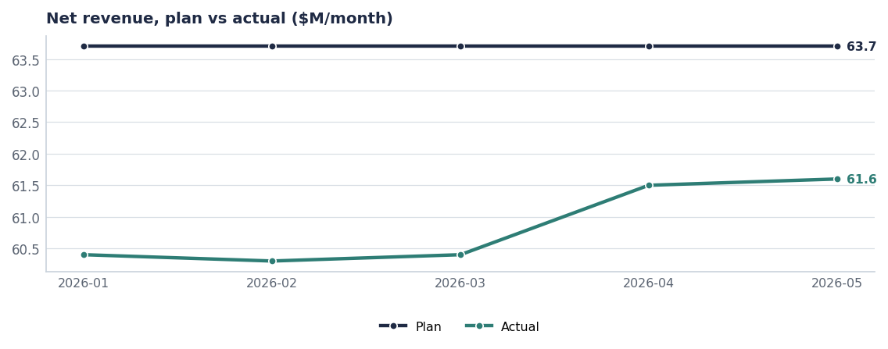
THE NUMBER
Five months of a closing gap
— Plan is flat at $63.7M/month — the FY26 operating plan was built straight-lined.
— Actuals ran $60.3–60.4M through Q1, then stepped up to $61.5M and $61.6M in April and May as launch volume shipped.
— The gap halves from −5.4% at the February low to −3.4% in May.
— Read: the H2 reforecast (Report 44) should assume the improvement holds, not that it accelerates.
Source: plan_vs_actual, periods 2026-01 to 2026-05.
Internal · Confidential — Acme Corp synthetic demo data. Fictional; not for real decision-making.
Q2 2026 Company BR · 3

Slide 5
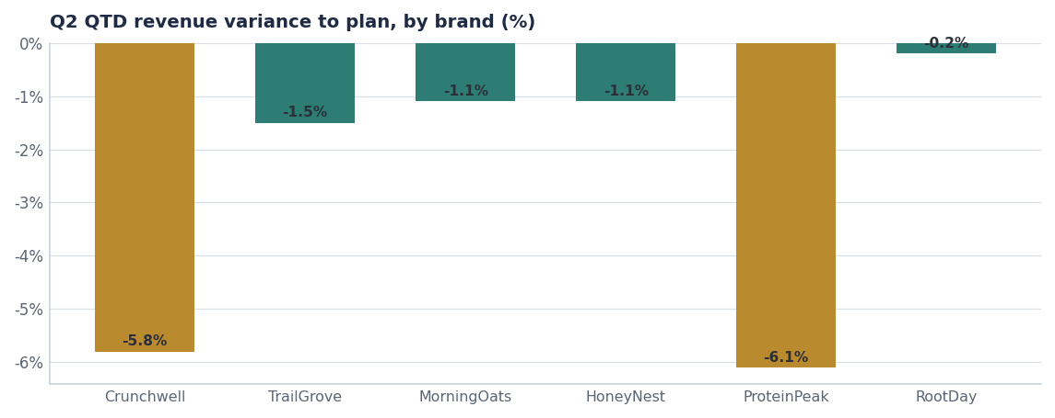
BRAND READ
Four of six brands inside two points of plan
Brand | Plan | Actual | Var | Status
Crunchwell | $50.4M | $47.5M | -5.8% | Watch
TrailGrove | $25.4M | $25.0M | -1.5% | On track
MorningOats | $15.5M | $15.4M | -1.1% | On track
HoneyNest | $13.6M | $13.5M | -1.1% | On track
ProteinPeak | $11.6M | $10.9M | -6.1% | Watch
RootDay | $10.9M | $10.9M | -0.2% | On track
Total Acme | $127.5M | $123.1M | -3.4% | Watch
Source: plan_vs_actual, 2026-04 and 2026-05.
Internal · Confidential — Acme Corp synthetic demo data. Fictional; not for real decision-making.
Q2 2026 Company BR · 4

Slide 6
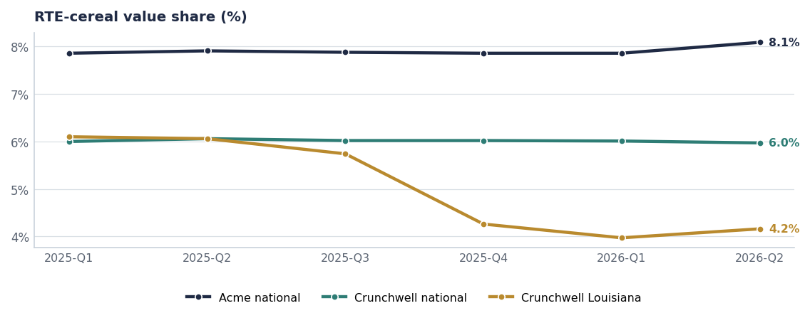
SHARE
National share holds; Louisiana is the hole in the floor
Acme all-brand share is flat-to-up nationally. The share problem is one DMA deep.
Source: syndicated_weekly, RTE Cereal. Canonical LA headline (Mass/Grocery, peak-to-trough) is 6.4% → 3.0%, −340 bps; the all-channel value-weighted cut shown here is milder in the same direction.
Internal · Confidential — Acme Corp synthetic demo data. Fictional; not for real decision-making.
Q2 2026 Company BR · 5

Slide 7
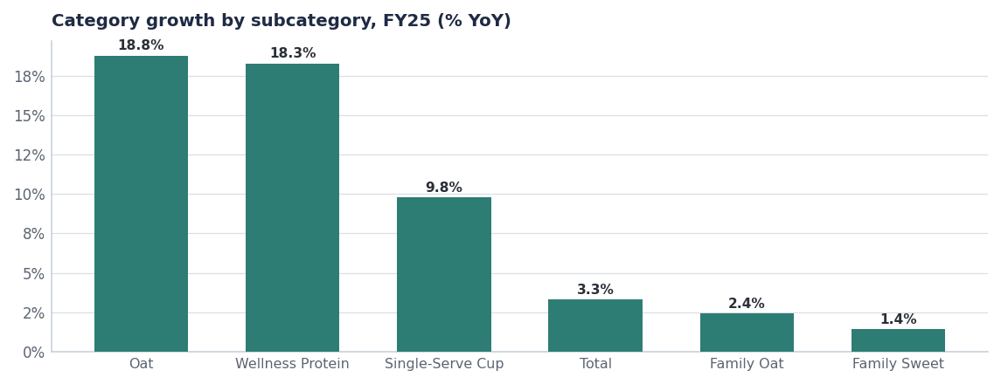
CATEGORY
Where we play decides how hard we have to run
— Wellness Protein grew +18.3% to $840M and is +18.6% again in Q2 QTD. Acme share there moved 7.6% → 8.4%.
— Family Sweet — Crunchwell's home — grew +1.4%. A flat brand in a flat segment is a share-neutral, growth-negative position.
— Kids Sweet is −2.8%. HoneyNest is executing well inside a shrinking pocket (see the portfolio decision, Report 50).
— Oat milk +18.8% is RootDay's tailwind and the most under-funded upside in the portfolio.
Source: seed_category_market_size, FY2025 US National.
Internal · Confidential — Acme Corp synthetic demo data. Fictional; not for real decision-making.
Q2 2026 Company BR · 6

Slide 8
LAUNCH READ
ProteinPeak, four weeks in
110–113
53%
1.2×
+0.44
17.5
TRIAL INDEX AT TARGET
NEW-TO-BRAND VOLUME
WEEK-2 REPEAT
SOCIAL SENTIMENT
TARGET VELOCITY
vs plan; Walmart pilot 77–78
32% cannibalization, 15% competitive
vs Berry Crunch archive
~496 mentions in 2026
units/store/week vs 9.2 Walmart
The launch is working where it was designed to work. Target over-indexes for Wellness Protein (18.4% Acme share vs 5.2% at Walmart), and the endcap plus Roundel package converted. The Walmart pilot is the underperformer and needs a distribution fix, not a media fix.
Source: seed_proteinpeak_q2_launch, household_transactions PP005/PP006, social_mentions, seed_category_market_size.
Internal · Confidential — Acme Corp synthetic demo data. Fictional; not for real decision-making.
Q2 2026 Company BR · 7

Slide 9
EFFICIENCY
Retail media: one platform is carrying the ratio
Platform | Spend | Incremental | Incr. ratio | Call
Amazon Ads | $2.4M | $0.98M | 0.40 | Reallocate
Walmart Connect | $1.0M | $1.21M | 1.20 | Reinvest
Kroger Precision Marketing | $0.4M | $0.32M | 0.77 | Reallocate
Target Roundel | $0.4M | $0.22M | 0.50 | Reallocate
Total | $4.2M | $2.73M | 0.65 | Rebalance
The $700K question
Moving ~$700K out of Amazon Ads into Walmart Connect, Kroger Precision and a Louisiana injection converts $0.40-per-dollar spend into $1.20-per-dollar spend. It is the cheapest incremental revenue available to us in H2.
Source: seed_retail_media_spend_q1_2026, modelled incrementality (not platform ROAS).
Internal · Confidential — Acme Corp synthetic demo data. Fictional; not for real decision-making.
Q2 2026 Company BR · 8

Slide 10
RISKS
What we are watching into H2
Risk | Impact if it lands | Mitigation | Owner
Larksfield's 14g protein line (LCH00032, May 12) | Slows ProteinPeak's share build in its best pocket | Accelerate Chocolate Almond to the Q4 line reviews; hold Target endcap through Q3 | Sage Park
Crunchwell Pack Refresh slips past Aug 15 | Louisiana recovery loses its anchor and Q4 shipment build | Weekly stage-gate with R&D and packaging; pre-build hero SKUs | Cory Whitman
Amazon Ads spend not reallocated | ≈$0.6M of avoidable H2 inefficiency at current ratios | Reallocation decision at the July commercial review | Tasha Brooks
GLP-1 volume drag (trend strength 0.81) | Structural pressure on family-size cereal volume | Pack-architecture work in the RGM plan (Report 45) | RGM Lead
Source: seed_competitor_launches, seed_innovation_pipeline, seed_macro_trends.
Internal · Confidential — Acme Corp synthetic demo data. Fictional; not for real decision-making.
Q2 2026 Company BR · 9

Slide 11
THE ASK
Four decisions out of this review
# | Action | Owner | When
1 | Approve the $700K retail-media reallocation out of Amazon Ads into Walmart Connect, Kroger Precision and Louisiana | Tasha Brooks / CFO | By Aug 1
2 | Hold the FY26 revenue commitment on the protein build; reforecast H2 on May's run-rate, not on Q1's | Finance | H2 reforecast, July
3 | Fix Walmart ProteinPeak distribution at the August line review rather than adding media | Marcus Boudreaux | Aug line review
4 | Confirm Pack Refresh on-shelf for Aug 15 with a weekly stage-gate | Cory Whitman | From July 15
Internal · Confidential — Acme Corp synthetic demo data. Fictional; not for real decision-making.
Q2 2026 Company BR · 10

Slide 12
THE ONE THING
The trend turned. The base has not.
Q2 QTD -3.4% vs plan, improving from -5.3% in Q1.
ProteinPeak is doing its job — 53% of launch volume is new to Acme.
Crunchwell is still −6% a month, and that is the FY27 problem.
Today's decision is the $700K reallocation.
Internal · Confidential — Acme Corp synthetic demo data. Fictional; not for real decision-making.

