Slide 1
ANNUAL OPERATING PLAN · BOARD PRE-READ
Acme Corp FY2027 Annual Operating Plan
The revenue build, the margin path to 16%, and the four bets the plan rests on
Finance & FP&A, reviewed with the CFO · for the October board meeting · July 2026
Internal management presentation · Internal · Confidential — synthetic demo data

Slide 2
AGENDA
What this deck covers
01
FY26 landing zone
05
Where the growth money goes
02
The FY27 revenue build
06
Capacity and supply assumptions
03
Brand-level plan
07
Risks and sensitivities
04
Margin path to 16% EBITDA
08
The approval ask
Internal · Confidential — Acme Corp synthetic demo data. Fictional; not for real decision-making.
FY27 AOP pre-read · 1

Slide 3
THE HEADLINE
What the board is being asked to approve
The FY2027 plan targets $880M of net revenue — roughly +8% on the $812M FY25 base — and starts the margin climb from 14.2% to the 16%-by-FY28 commitment. Growth is loaded onto Wellness Protein and oat milk, not onto pricing, and the FY26 variance to plan is carried as an explicit risk overlay rather than absorbed into productivity.
$880M
+8%
FY27 NET REVENUE TARGET
GROWTH ON THE FY25 BASE
— The number: $880M net revenue and ~15.0% EBITDA margin, consistent with the FY27 AOP (Report 14) and the long-range plan (Report 15).
— FY26 is the risk overlay, not the base. Q1 landed $181.1M against $191.2M of plan (-5.3%); every FY27 initiative carries a named owner who reports deviation monthly.
— The build is bottom-up: ProteinPeak $48M → $100M carries 61% of the gross brand growth; the Pack Refresh anchors Crunchwell stabilisation.
— Margin comes out of trade, not A&P: the ~$150M envelope holds while incrementality moves 0.52 → 0.60.
— All FY27 figures are plan targets, not measured results.
~15.0%
~$150M
FY27 EBITDA MARGIN TARGET
FY27 TRADE ENVELOPE
Internal · Confidential — Acme Corp synthetic demo data. Fictional; not for real decision-making.
FY27 AOP pre-read · 2

Slide 4
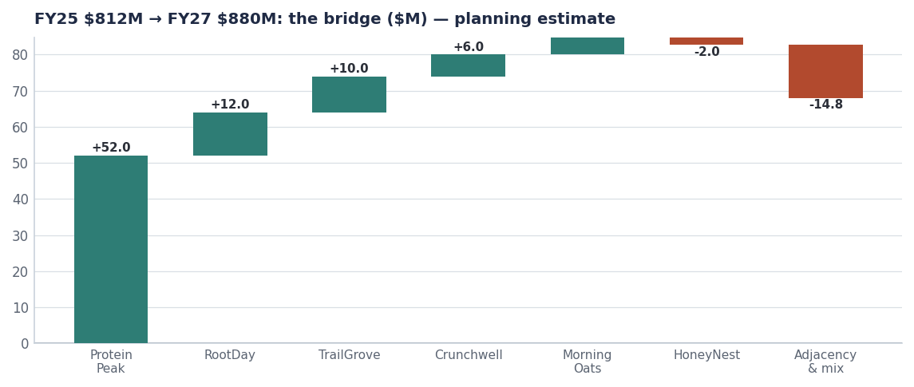
THE BUILD
$880M is one big bet and five small ones
Bars are movements off the $812M FY25 base. Every block is a named, owned initiative — nothing in the build is unallocated growth.
Planning estimate. FY25 brand base from seeds/skus.csv; FY27 brand targets per the FY27 AOP (Report 14); adjacency and mix is the derived residual to $880M.
Internal · Confidential — Acme Corp synthetic demo data. Fictional; not for real decision-making.
FY27 AOP pre-read · 3

Slide 5
BRAND PLAN
FY2027 by brand — the drag is deliberate
Brand | FY25 actual | FY27 target | Growth | What carries it
Crunchwell | $312M | $318M | +2% | Pack Refresh + Louisiana recovery
TrailGrove | $152M | $162M | +7% | Granola and bar distribution build
ProteinPeak | $48M | $100M | +108% | Full-year PP005/PP006 + Chocolate Almond
MorningOats | $87M | $92M | +6% | Single-serve cups (+9.8% segment)
HoneyNest | $94M | $92M | -2% | Managed decline, Kids Sweet −2.8%
RootDay | $62M | $74M | +19% | Oat milk segment +18.8%
Six brands | $755M | $838M | +11% | + adjacency to $880M
FY25 from seeds/skus.csv; FY27 targets are the AOP brand build (Report 14). Brand total reconciles to $880M with non-brand and adjacency revenue.
Internal · Confidential — Acme Corp synthetic demo data. Fictional; not for real decision-making.
FY27 AOP pre-read · 4

Slide 6
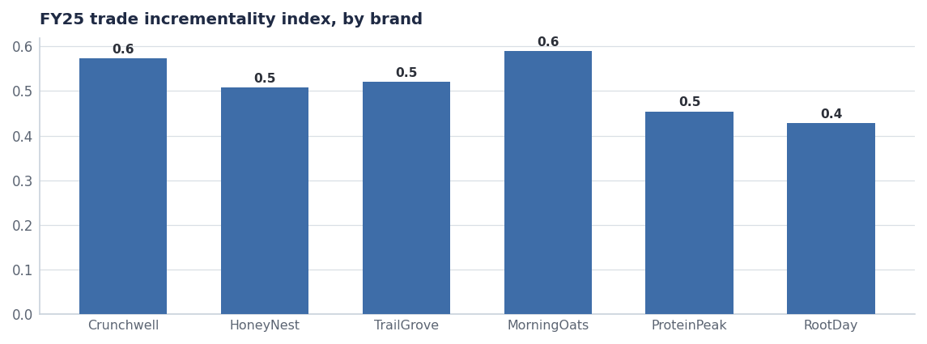
MARGIN
The margin comes out of trade, not out of A&P
— $147M of trade spend in FY25 at a portfolio incrementality index of 0.51. Every 0.01 of index is real money.
— Crunchwell alone is $92.4M at 24.4% average depth — the heaviest promoted line in the house.
— FY27 assumption: portfolio index 0.52 → 0.60 through fewer, deeper, better-timed events. Worth roughly 60 bps of EBITDA.
— A&P holds in absolute dollars and shifts mix toward retail media and creator, per the media effectiveness read (Report 55).
Source: seed_trade_spend_fy25, seed_trade_promo_events_q1_2026.
Internal · Confidential — Acme Corp synthetic demo data. Fictional; not for real decision-making.
FY27 AOP pre-read · 5

Slide 7
ASSUMPTIONS
What has to be true
OPERATING ASSUMPTIONS
SENSITIVITIES (FY27 REVENUE)
— Fill rate holds at ~95% and OTIF at ~90% — no repeat of the Nov 2025 storm impact.
— Pack Refresh ships Aug 15 2026 and is fully distributed by Q4.
— Wellness Protein segment growth stays in the mid-teens.
— No incremental list-price increase in FY27; mix and pack architecture only.
— Trade calendar rebuilt to 0.60 incrementality without volume loss.
— Pack Refresh slips one quarter: −$7M.
— Wellness Protein growth halves to +9%: −$12M on ProteinPeak.
— Louisiana stays at 3.0% share rather than recovering to 4.5%: −$3M.
— Trade index stalls at 0.52: no revenue effect, −60 bps EBITDA.
— GLP-1 volume drag one point worse than assumed: −$5M.
Sensitivities are planning estimates, not modelled forecasts.
Internal · Confidential — Acme Corp synthetic demo data. Fictional; not for real decision-making.
FY27 AOP pre-read · 6

Slide 8
THE ASK
What we need from the board
# | Action | Owner | When
1 | Approve the $880M FY27 revenue plan and the ~15.0% EBITDA target | Board | October 2026
2 | Approve the trade-efficiency programme as the primary margin lever (0.52 → 0.60) | CFO / RGM Lead | October 2026
3 | Note the FY27–FY29 long-range plan (Report 43) as the frame for this AOP | CEO / Strategy | October 2026
4 | Approve capex for Pack Refresh changeover and protein line capacity | CFO / VP Supply Chain | October 2026
Internal · Confidential — Acme Corp synthetic demo data. Fictional; not for real decision-making.
FY27 AOP pre-read · 7

Slide 9
THE ONE THING
Fund the protein, stabilise the core, take the margin out of trade.
$880M and ~15.0% — the AOP the long-range plan implies.
ProteinPeak carries $52M of the $85M of gross brand growth.
The 16% FY28 margin commitment stays intact.
Internal · Confidential — Acme Corp synthetic demo data. Fictional; not for real decision-making.

