Slide 1
LONG-RANGE PLAN · FY27–FY29
Acme Corp Three-Year Strategic Plan
From a flat cereal franchise to a portfolio weighted toward where the category is actually growing
CEO Gregory Whitfield & Strategy · executive committee review · July 2026
Internal management presentation · Internal · Confidential — synthetic demo data

Slide 2
AGENDA
What this deck covers
01
The strategic problem in one page
06
Bet 3 — better-for-you adjacency
02
Three-year financial frame
07
Bet 4 — commercial efficiency
03
Portfolio: where we play by FY29
08
What we stop doing
04
Bet 1 — win Wellness Protein
09
Milestones and gates
05
Bet 2 — stabilise the Crunchwell core
Internal · Confidential — Acme Corp synthetic demo data. Fictional; not for real decision-making.
FY27–FY29 LRP · 1

Slide 3
THE HEADLINE
The three-year thesis
Acme is the #4 US RTE cereal player with a $812M FY25 base growing ~5% and a portfolio weighted three-quarters into segments growing 1% or less. The three-year job is not to grow the existing mix faster — it is to change the mix. The plan takes net revenue to $880M in FY27, $950M in FY28 and ~$1.02B in FY29, with nearly a third of that revenue in double-digit-growth segments.
$1.02B
16%
FY29 REVENUE TARGET
EBITDA MARGIN BY FY28
29%
$150M
— The category is not the problem. RTE Cereal total US grew +1.3% to $8.35B; Wellness Protein grew +18.3% to $3M. We are under-weight in the only pockets that compound.
— Crunchwell is 38% of revenue and flat for six quarters. Stabilising it — not reviving it to growth — is the realistic FY27–FY29 commitment (Report 47).
— Protein is the engine: ProteinPeak $48M FY25 → $100M FY27 → $150M FY29 target, taking Acme's Wellness Protein share from 7.6% toward the mid-teens.
— Efficiency funds the transition: trade incrementality 0.52 → 0.65 and retail-media ratio 0.65 → 1.00 over three years release the money for it.
— All FY27–FY29 figures are targets and commitments, not forecasts.
FY29 REVENUE IN HIGH-GROWTH SEGMENTS
PROTEINPEAK FY29 TARGET
Internal · Confidential — Acme Corp synthetic demo data. Fictional; not for real decision-making.
FY27–FY29 LRP · 2

Slide 4
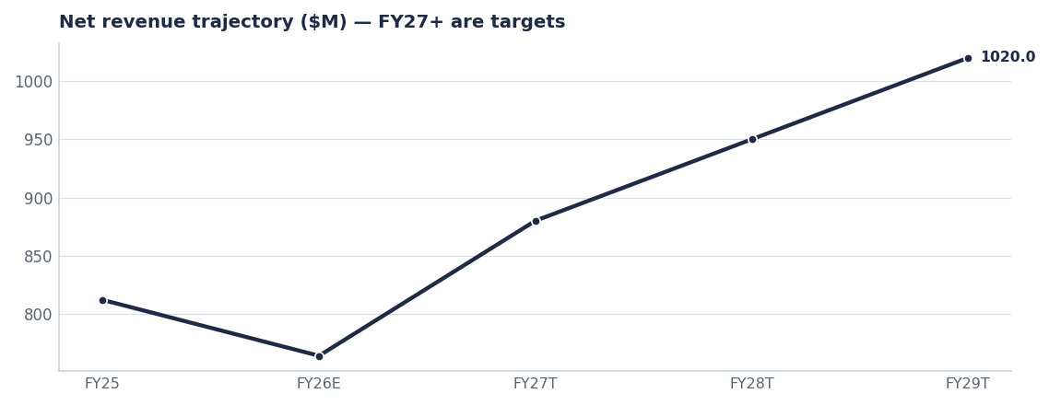
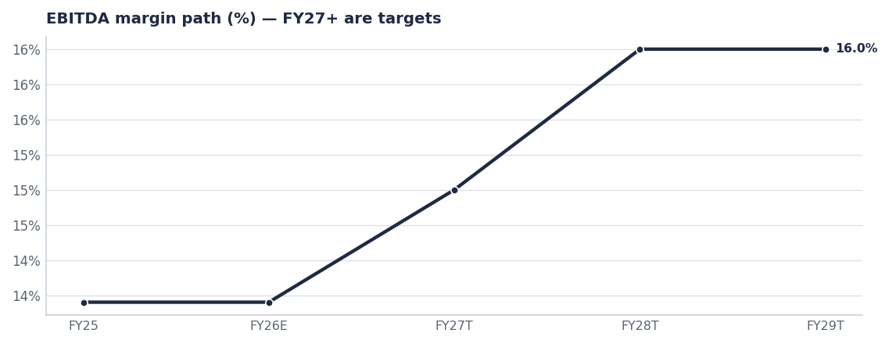
FINANCIAL FRAME
Growth reaccelerates as mix shifts; margin steps to 16% in FY28
FY26 is the transition year on the $63.7M/month plan basis. The step-up comes with a full year of protein plus the Pack Refresh.
The 16% FY28 commitment is unchanged from the board plan; FY29 holds it while revenue grows.
FY25 actual and the FY26 plan basis per FACTS.md; FY27–FY29 are the targets set in the FY27 AOP (Report 14) and the long-range plan (Report 15).
Internal · Confidential — Acme Corp synthetic demo data. Fictional; not for real decision-making.
FY27–FY29 LRP · 3

Slide 5
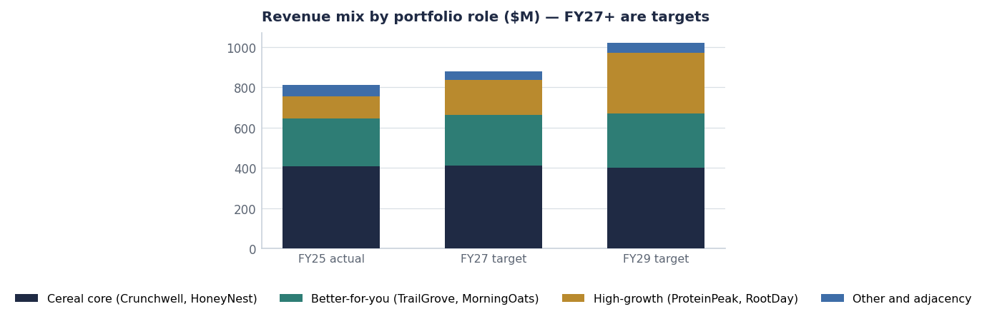
PORTFOLIO
The mix shift is the strategy
— Cereal core holds flat then drifts down — deliberately, from $406M to $400M. We stop funding volume in Kids Sweet (−2.8% segment) and reinvest.
— High-growth nearly triples from $110M to $300M, driven by ProteinPeak and RootDay in segments growing +18%.
— Better-for-you grows modestly on distribution, not innovation spend.
— By FY29, 29% of revenue sits in double-digit-growth segments against 14% today.
Planning estimate. FY25 base from seeds/skus.csv brand revenue.
Internal · Confidential — Acme Corp synthetic demo data. Fictional; not for real decision-making.
FY27–FY29 LRP · 4

Slide 6
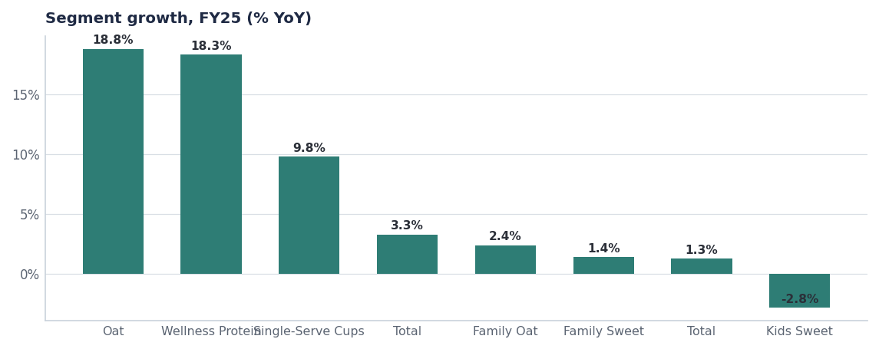
BET 1 · PROTEIN
Win the segment that compounds
Metric | FY25 | FY29 target
Wellness Protein segment size | $3M | $1.45B
Acme share of segment | 7.6% | ≈14%
ProteinPeak revenue | $48M | $150M
SKUs in market | 6 | 12–14
Retailers with full line | Target, Amazon, WFM | +Walmart, Kroger, Costco
Source: seed_category_market_size, seeds/skus.csv. FY29 column is a target.
Internal · Confidential — Acme Corp synthetic demo data. Fictional; not for real decision-making.
FY27–FY29 LRP · 5

Slide 7
BETS 2 & 3
Hold the core, extend the adjacency
BET 2 — STABILISE CRUNCHWELL
BET 3 — BETTER-FOR-YOU ADJACENCY
— Relevance, not Trust: equity work targets Relevance 62.7 → 67 by FY29 (Report 46).
— Pack Refresh (Aug 2026, $28M year-1) then Mega Family Pack and Maiz Crunch.
— Louisiana back to 4.5%+ share; Birmingham and Memphis defended before they break.
— Trade rate down from 25.6% of gross toward 22% without losing base volume.
— RootDay rides oat milk +18.8%: single-serve carton and coffee creamer concepts.
— TrailGrove granola/bars distribution build — the cheapest volume in the portfolio.
— MorningOats single-serve cups (+9.8% segment) as the convenience play.
— No new categories outside cereal, oats, granola and plant-based milk through FY29.
Source: brand_equity_quarterly, seed_innovation_pipeline, seed_category_market_size.
Internal · Confidential — Acme Corp synthetic demo data. Fictional; not for real decision-making.
FY27–FY29 LRP · 6

Slide 8
WHAT WE STOP
Three years of discipline means a stop list
Stop / exit | Why | When | Freed resource
RootDay Coconut Blend, HoneyNest Granola Crunch, HoneyNest Cookie Dough | Sub-scale, low velocity, negative contribution | Q3 FY26 | ≈$1.5M trade + shelf
Linear TV as Crunchwell's dominant channel ($24M/yr) | Reach without relevance; CTV and retail media out-perform on modelled incrementality | FY27 planning | ≈$8M to reallocate
Amazon Ads at current weight (ratio 0.40) | Lowest incremental return of the four retail-media platforms | H2 FY26 | ≈$0.7M immediately, more in FY27
Kids Sweet innovation beyond LTOs | Segment is −2.8% and structurally pressured by mom-guilt trend (0.68) | FY27 plan | R&D capacity to protein
Source: seed_innovation_pipeline (Discontinue), seed_marketing_spend, seed_retail_media_spend_q1_2026, seed_macro_trends.
Internal · Confidential — Acme Corp synthetic demo data. Fictional; not for real decision-making.
FY27–FY29 LRP · 7

Slide 9
GATES
How the executive committee holds this plan to account
# | Action | Owner | When
1 | Approve the FY27–FY29 frame: $880M FY27 → ~$1.02B FY29 at 16% margin, and the mix-shift target | Executive committee | July 2026
2 | Gate 1 — Pack Refresh in market and Louisiana above 4.0% share | Cory Whitman | Q4 FY26
3 | Gate 2 — ProteinPeak above $100M run-rate with full Walmart and Kroger distribution | Sage Park / Marcus Boudreaux | Q4 FY27
4 | Gate 3 — portfolio trade incrementality above 0.60 and retail-media ratio above 0.85 | RGM Lead / Tasha Brooks | FY28 planning
5 | Annual re-baseline of the LRP against the AOP each July | Strategy / FP&A | Every July
Internal · Confidential — Acme Corp synthetic demo data. Fictional; not for real decision-making.
FY27–FY29 LRP · 8

Slide 10
THE ONE THING
Change the mix, or run harder for the same result.
The cereal core is defended, not grown.
Nearly a third of the company sits in high-growth segments by FY29.
$880M FY27, ~$1.02B FY29 and 16% margin are the commitments; the mix shift is how they happen.
Internal · Confidential — Acme Corp synthetic demo data. Fictional; not for real decision-making.

