Slide 1
OPERATING PLAN REFORECAST
Acme Corp H2 FY2026 Reforecast
Q3 and Q4 rebuilt off the May run-rate, with the risk and opportunity ledger behind the number
Finance & FP&A · commercial review, July 2026
Internal management presentation · Internal · Confidential — synthetic demo data

Slide 2
AGENDA
What this deck covers
01
Where we are
05
Risk and opportunity ledger
02
How the reforecast is built
06
Cash and trade implications
03
Q3 and Q4 by quarter
07
What we need decided
04
Brand-level reforecast
Internal · Confidential — Acme Corp synthetic demo data. Fictional; not for real decision-making.
H2 FY26 reforecast · 1

Slide 3
THE HEADLINE
The reforecast in four lines
May shipped $61.6M against a $63.7M monthly plan. Holding that run-rate and adding the two known H2 events — the Aug 15 Pack Refresh and a full quarter of ProteinPeak distribution — gives an H2 landing zone of $379M against $382M of original plan. We are recommending the reforecast be set there and the full-year commitment held.
$379M
−0.8%
H2 FY26 REFORECAST
REFORECAST VS ORIGINAL H2 PLAN
— Build method: May exit run-rate × months, plus Pack Refresh pipeline fill, plus ProteinPeak distribution gains, less HoneyNest discontinuations.
— Q1 + Q2 QTD ran $304.2M against $318.7M of plan.
— The reforecast is not a cut to the full-year commitment. It reallocates the shortfall into the two quarters that can carry it.
— All H2 figures are forecast, built on measured Jan–May actuals.
-3.4%
$14M
Q2 QTD VARIANCE BEING CARRIED
NET RISK-ADJUSTED EXPOSURE
Internal · Confidential — Acme Corp synthetic demo data. Fictional; not for real decision-making.
H2 FY26 reforecast · 2

Slide 4
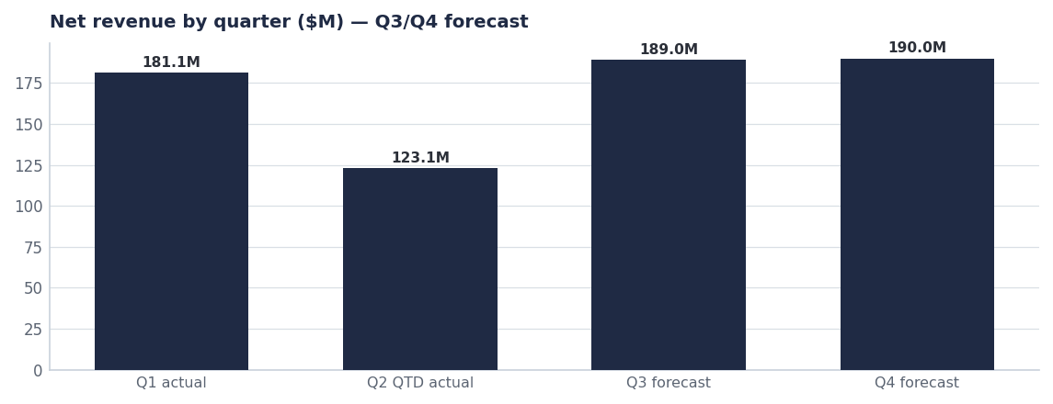
THE SHAPE
H2 carries a modest sequential build
— Q3 ($189M forecast) is the Pack Refresh pipeline quarter — shipment-led, with consumption following in Q4.
— Q4 ($190M forecast) adds full ProteinPeak distribution and the HoneyNest Birthday Cake LTO, less the three discontinued SKUs.
— Neither quarter assumes a Louisiana share recovery beyond the ~35 bps already measured in Q2.
— Downside case is $369M if the Pack Refresh slips a quarter; upside $389M if Walmart protein distribution lands early.
Source: plan_vs_actual (Q1/Q2 actuals); Q3/Q4 are forecasts built off the May run-rate.
Internal · Confidential — Acme Corp synthetic demo data. Fictional; not for real decision-making.
H2 FY26 reforecast · 3

Slide 5
LEDGER
Risks and opportunities behind the H2 number
Item | Type | H2 $ impact | Probability | Owner
Pack Refresh on-shelf Aug 15 as planned | Opportunity | +$6.0M | High | Cory Whitman
Walmart ProteinPeak full-line authorisation | Opportunity | +$4.5M | Medium | Marcus Boudreaux
Retail-media reallocation ($700K, 2.2× LA ROI) | Opportunity | +$1.6M | High | Tasha Brooks
Larksfield 14g line takes protein share | Risk | −$3.5M | Medium | Sage Park
Louisiana recovery stalls at 3.0% share | Risk | −$2.5M | Medium | Marcus Boudreaux
Pack Refresh slips to Q4 | Risk | −$6.0M | Low | Cory Whitman
H-E-B Cinnamon Twist delist (risk score 0.80) | Risk | −$1.8M | Medium | Marcus Boudreaux
Net risk-adjusted position | Net | −$1.4M | — | Finance
Source: seed_innovation_pipeline, seed_competitor_launches, seed_heb_cinnamon_twist_delist_risk, seed_retail_media_spend_q1_2026. Dollar impacts are planning estimates.
Internal · Confidential — Acme Corp synthetic demo data. Fictional; not for real decision-making.
H2 FY26 reforecast · 4

Slide 6
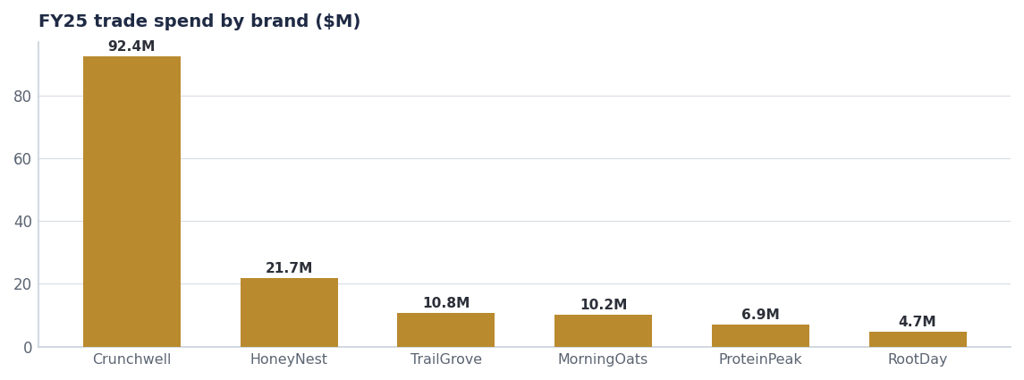
TRADE & CASH
The H2 trade calendar is where the flexibility sits
Lever | H2 effect
Rebuild Q4 Crunchwell events at lower depth | ≈$2.1M spend, index 0.52 → 0.58
Shift two Kids Sweet events to LTO support | ≈$0.6M reallocated
Fund LA recovery leg from national contingency | $0.9M, 2.2× ROI
Hold ProteinPeak trade rate at ~12.9% | Protects launch margin
Net H2 trade spend | ≈$71M, flat to plan
Source: seed_trade_spend_fy25, seed_trade_promo_events_q1_2026. H2 figures are planning estimates.
Internal · Confidential — Acme Corp synthetic demo data. Fictional; not for real decision-making.
H2 FY26 reforecast · 5

Slide 7
DECISIONS
What the reforecast needs to be real
# | Action | Owner | When
1 | Set the H2 reforecast at $379M and hold the FY26 full-year commitment | CFO / Finance | July 2026
2 | Release the $700K retail-media reallocation now, not at the FY27 planning cycle | Tasha Brooks | By Aug 1
3 | Confirm Pack Refresh Aug 15 with a named slip-trigger and a Q4 fallback plan | Cory Whitman | By Jul 15
4 | Take a Cinnamon Twist recovery plan to H-E-B before the Sep 15 review | Marcus Boudreaux | By Sep 1
Internal · Confidential — Acme Corp synthetic demo data. Fictional; not for real decision-making.
H2 FY26 reforecast · 6

Slide 8
THE ONE THING
Hold the year. Move the money.
$379M in H2 is achievable off the May run-rate.
Three opportunities are worth more than the three biggest risks.
Both live decisions are ours, not the market's.
Internal · Confidential — Acme Corp synthetic demo data. Fictional; not for real decision-making.

