Slide 1
REVENUE GROWTH MANAGEMENT
Price, Pack and Promotion Architecture
Where our net revenue actually leaks, and the FY27 price-pack architecture that stops it
RGM Lead with Trade Finance · reviewed with the CFO · July 2026
Internal management presentation · Internal · Confidential — synthetic demo data

Slide 2
AGENDA
What this deck covers
01
The leak, sized
05
Pack architecture
02
Trade spend by brand
06
The FY27 guardrails
03
Promotion effectiveness
07
What changes on Monday
04
Price elasticity by SKU
Internal · Confidential — Acme Corp synthetic demo data. Fictional; not for real decision-making.
FY26–27 RGM · 1

Slide 3
THE HEADLINE
Where the net revenue goes
Acme spends $147M a year on trade at a portfolio incrementality index of 0.51 — meaning roughly half of promoted volume would have happened anyway. Crunchwell is the concentration: heaviest spend, deepest discounts, most elastic SKUs. The FY27 architecture trades event frequency for event quality and puts a floor under everyday price.
$147M
0.51
FY25 TRADE SPEND
PORTFOLIO INCREMENTALITY INDEX
— Crunchwell carries $92.4M of the total at 24.4% average depth and an index of 0.57 — better than the portfolio average, but on a base so large that the absolute waste is the biggest single number in the P&L outside COGS.
— Q1 FY26 ran 43 events, $11.6M of spend, $10.9M incremental at an average modelled lift of 14.3% and an index of 0.52.
— The most elastic SKUs are the Mega packs — Crunchwell Original Mega 18oz at -2.12 at Rouses. They respond to price, which is exactly why they get promoted, and exactly why the base erodes.
— FY27 architecture: fewer, deeper, better-timed events; a defended everyday price ladder; and one new pack size to reset the value equation without cutting price.
24.4%
0.60
CRUNCHWELL AVERAGE DEPTH
FY27 INDEX TARGET
Internal · Confidential — Acme Corp synthetic demo data. Fictional; not for real decision-making.
FY26–27 RGM · 2

Slide 4
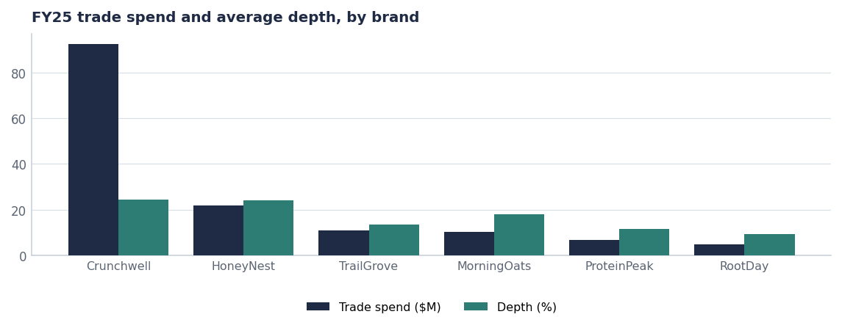
THE SPEND
Two brands account for three quarters of it
Brand | Spend | Depth | Index | Events
Crunchwell | $92.4M | 24.4% | 0.57 | 162
HoneyNest | $21.7M | 24.2% | 0.51 | 86
TrailGrove | $10.8M | 13.5% | 0.52 | 48
MorningOats | $10.2M | 17.8% | 0.59 | 42
ProteinPeak | $6.9M | 11.5% | 0.45 | 46
RootDay | $4.7M | 9.5% | 0.43 | 44
Total / average | $146.7M | 16.8% | 0.51 | 428
Source: seed_trade_spend_fy25.
Internal · Confidential — Acme Corp synthetic demo data. Fictional; not for real decision-making.
FY26–27 RGM · 3

Slide 5
EFFECTIVENESS
Not all mechanics are worth running
Event type | Events | Spend | Avg modelled lift | Index
TPR | 19 | $5.2M | 14.4% | 0.50
Endcap | 9 | $1.8M | 12.1% | 0.66
Endcap+TPR | 5 | $1.8M | 19.0% | 0.42
Bundled price | 1 | $0.5M | 18.0% | 0.58
Multi-store TPR | 1 | $0.5M | 14.0% | -0.21
TPR Wave 2 | 1 | $0.4M | 22.0% | 0.58
Roadshow | 2 | $0.4M | 13.5% | 0.68
Bundled | 1 | $0.3M | 19.0% | 0.59
Tactical Injection | 1 | $0.3M | 12.0% | 1.10
SubFee waiver | 1 | $0.3M | 7.0% | 0.18
TPR Recovery | 2 | $0.2M | 10.0% | 0.43
The rule we are adopting
Any mechanic with a modelled incrementality index below 0.45 comes off the calendar unless it is defending a distribution commitment. On the Q1 base that is roughly $2.4M of spend to redeploy.
Source: seed_trade_promo_events_q1_2026, modelled lift and incrementality.
Internal · Confidential — Acme Corp synthetic demo data. Fictional; not for real decision-making.
FY26–27 RGM · 4

Slide 6
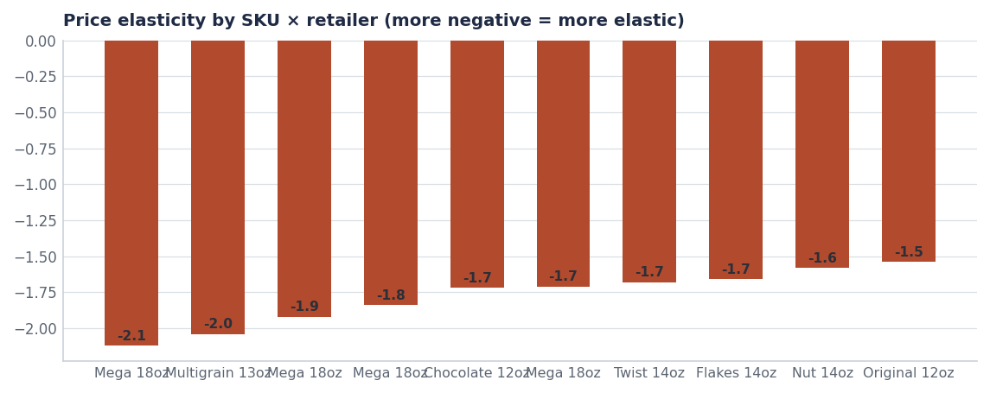
ELASTICITY
The packs we discount hardest are the ones that erode fastest
— Crunchwell Original Mega 18oz at Rouses is the most elastic point in the portfolio at -2.12.
— Rouses and Walmart show the steepest curves — the two banners where Larksfield has been most aggressive on endcaps in Louisiana.
— Implication: deep Mega-pack discounting buys volume at a permanent cost to the reference price. It is the mechanism behind the LA base erosion.
— FY27: Mega discounting capped at 20% off, with feature-and-display weight replacing depth.
Source: seed_sku_elasticity_estimates (last recalibrated per row).
Internal · Confidential — Acme Corp synthetic demo data. Fictional; not for real decision-making.
FY26–27 RGM · 5

Slide 7
ARCHITECTURE
The FY27 price-pack ladder
Pack | Role | Everyday price | Promo policy
Crunchwell 13oz Multigrain | Entry / trial | $4.49 | Max 15% off, 2 events/yr
Crunchwell 14oz hero (post-refresh) | Core volume | $4.49 | Max 20% off, 4 events/yr
Crunchwell 18oz Mega | Value / pantry | $5.49 | Max 20% off, 3 events/yr, no stacking
Crunchwell 36oz Mega Family (2027-Q1) | Value ceiling | $8.99 target | Launch support only, no depth
ProteinPeak 12oz | Premium / growth | $7.49 | Max 10% off, feature-led
ProteinPeak single-serve cup | Convenience | $9.99 | No depth; sampling instead
Source: seeds/skus.csv shelf prices, seed_innovation_pipeline (36oz Mega Family, 2027-Q1). Promo policy is the proposed FY27 guardrail.
Internal · Confidential — Acme Corp synthetic demo data. Fictional; not for real decision-making.
FY26–27 RGM · 6

Slide 8
GUARDRAILS
What changes on Monday
# | Action | Owner | When
1 | Adopt the 0.45 incrementality floor for all new events; existing events reviewed at renewal | RGM Lead / Trade Finance | From Aug 1
2 | Cap Mega-pack depth at 20% and stop depth stacking with retailer funds | Marcus Boudreaux / NAMs | FY27 calendar
3 | Hold ProteinPeak trade rate at ≤13% of gross through the launch year | Sage Park | FY27
4 | Bring the 36oz Mega Family Pack forward into the FY27 innovation gate | Innovation / RGM | Q4 FY26 stage-gate
5 | Report portfolio index monthly alongside revenue in the commercial review | Trade Finance | From August
Internal · Confidential — Acme Corp synthetic demo data. Fictional; not for real decision-making.
FY26–27 RGM · 7

Slide 9
THE ONE THING
Fewer events, better events, defended price.
$147M at 0.51 is the biggest efficiency pool we own.
0.52 → 0.60 is worth roughly 60 bps of EBITDA.
None of it requires a list-price increase.
Internal · Confidential — Acme Corp synthetic demo data. Fictional; not for real decision-making.

