Slide 1
ANNUAL BRAND PLAN · FY2027
Crunchwell FY2027 Brand Plan
Six flat quarters, one diagnosis: we have a relevance problem, not a trust problem
Cory Whitman, Brand Director — Crunchwell · for VP Brand and the CFO · July 2026
Internal management presentation · Internal · Confidential — synthetic demo data

Slide 2
AGENDA
What this deck covers
01
The situation
06
The FY27 plan on a page
02
Diagnosis: relevance, not trust
07
Innovation and pack
03
Who is leaving and who is arriving
08
Measurement
04
Where the money goes today
09
The ask
05
The creative platform recommendation
Internal · Confidential — Acme Corp synthetic demo data. Fictional; not for real decision-making.
Crunchwell FY27 plan · 1

Slide 3
THE HEADLINE
Six quarters flat, and the reason is measurable
Crunchwell has held ~6.0% national value share for six quarters while the category grew and Larksfield's Field & Honey grew 7.4%. The equity tracker says why: Trust and Quality hold, Relevance is down 5.9 points and Modernity is soft. Consumers still believe in Crunchwell — they just do not think it is for them right now. FY27 is a relevance plan, not a value plan.
-5.9 pp
+0.6 pp
RELEVANCE, FY25Q1 → FY26Q2
TRUST OVER THE SAME PERIOD
— The diagnosis is specific. Relevance 68.6 → 62.7 and Modernity 51.0 → 48.8, while Trust holds at ~73 and Quality actually improves. That combination is a brand drifting out of culture, not a brand losing credibility.
— The shopper base is turning over. Loyal-family penetration is eroding; cereal-skipper is growing. We are losing occasions, not preference.
— We spend like a 1990s brand: $48.7M behind Crunchwell with Linear TV the largest line at $30.3M.
— The plan: a relevance platform behind the Aug 2026 Pack Refresh, a media mix shift from TV to CTV/creator/retail media, and a Louisiana-first execution model.
5.97%
-0.11
NATIONAL VALUE SHARE
SOCIAL SENTIMENT 2026
Internal · Confidential — Acme Corp synthetic demo data. Fictional; not for real decision-making.
Crunchwell FY27 plan · 2

Slide 4
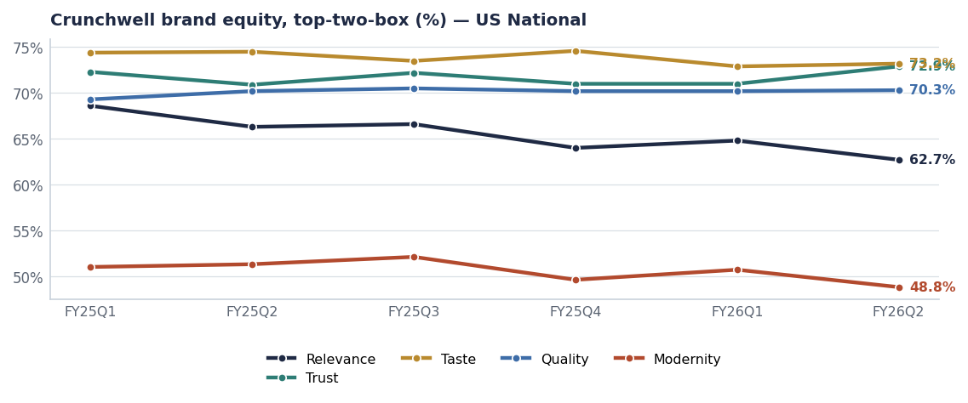
DIAGNOSIS
Trust holds. Relevance is the line that moves.
— Relevance 68.6 → 62.7 across six waves — the steepest decline of any attribute we track.
— Trust 72.3 → 72.9 and Quality 69.3 → 70.3 — the franchise assets are intact.
— Modernity at 48.8 is the lowest attribute in the set and the one the Pack Refresh addresses directly.
— Social confirms it: Crunchwell sentiment runs negative at −0.11 on 316 mentions, against ProteinPeak at +0.44.
Source: brand_equity_quarterly (Kantar-shape), social_mentions 2026.
Internal · Confidential — Acme Corp synthetic demo data. Fictional; not for real decision-making.
Crunchwell FY27 plan · 3

Slide 5
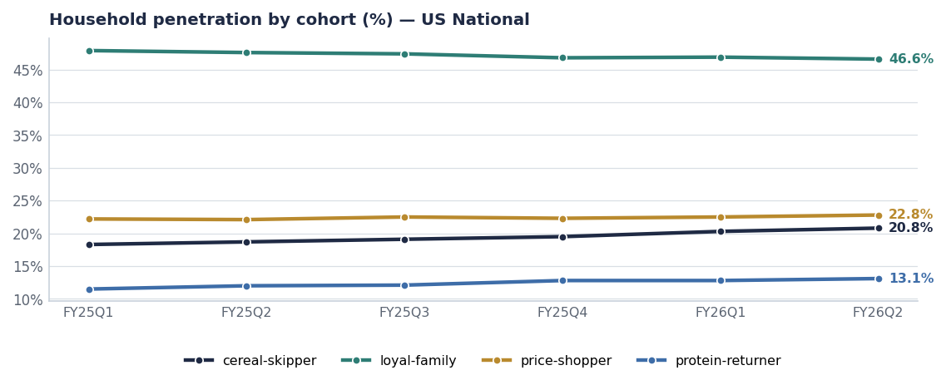
THE SHOPPER
The base is turning over underneath a flat share number
Cohort | FY25Q1 | FY26Q2 | Read
loyal-family | 47.9% | 46.6% | Eroding — the core
cereal-skipper | 18.3% | 20.8% | Growing — occasions lost
protein-returner | 11.5% | 13.1% | Growing — ProteinPeak's pool
price-shopper | 22.2% | 22.8% | Flat — not a value problem
Source: kantar_worldpanel_cohort, US-NAT.
Internal · Confidential — Acme Corp synthetic demo data. Fictional; not for real decision-making.
Crunchwell FY27 plan · 4

Slide 6
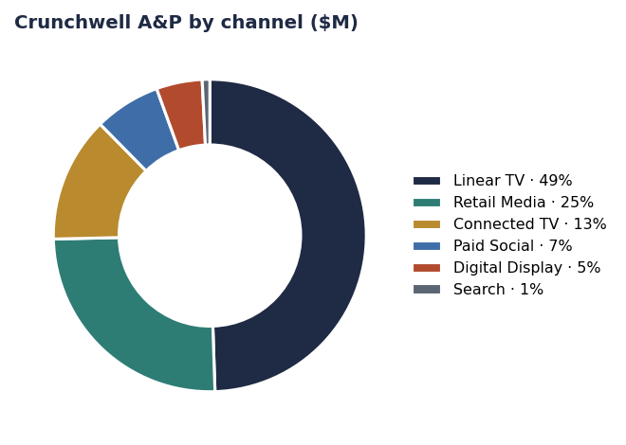
THE MONEY
A media mix built for a brand that was still relevant
— Linear TV is the largest line — reach against a shrinking cereal occasion.
— Retail media is second and is the only line with a modelled ratio above 1.0 at Walmart Connect.
— Creator and CTV are underweight relative to ProteinPeak, which is the brand in the house that is actually growing.
— FY27 recommendation: hold total A&P, move roughly a third of the TV line into CTV, creator and retail media — with the LA DMA weighted at 2.2× national ROI.
Source: seed_marketing_spend (Crunchwell), seed_retail_media_spend_q1_2026.
Internal · Confidential — Acme Corp synthetic demo data. Fictional; not for real decision-making.
Crunchwell FY27 plan · 5

Slide 7
PLATFORM
The creative platform recommendation
"MADE FOR THE MORNING YOU ACTUALLY HAVE"
WHY NOT THE ALTERNATIVES
— Reframes Crunchwell from a nostalgic family brand to a brand that fits a compressed, chaotic weekday morning.
— Targets Relevance and Modernity directly, without touching Trust or Taste.
— Lands with the Pack Refresh (Aug 15 2026) so the visual change and the message change arrive together.
— Executes creator-first in the South, where the share loss is concentrated.
— "Value" platform: rejected — price-shopper penetration is flat at ~24%; this is not a value problem.
— "Heritage" platform: rejected — Trust is already at 72.9; we would be spending against an asset we already own.
— "Health" platform: rejected — that is ProteinPeak's and TrailGrove's ground, and we would cannibalise the growth brands.
— "Kids" platform: rejected — the Kids Sweet segment is −2.8% and the mom-guilt trend runs 0.68.
Source: brand_equity_quarterly, kantar_worldpanel_cohort, seed_macro_trends, seed_category_market_size.
Internal · Confidential — Acme Corp synthetic demo data. Fictional; not for real decision-making.
Crunchwell FY27 plan · 6

Slide 8
THE PLAN
Crunchwell FY2027 on a page
Pillar | What we do | Investment | Success measure
Relevance platform | New creative platform + Pack Refresh launch, creator-first in the South | ≈$18M A&P | Relevance 62.7 → 65.5 by FY27Q4
Pack Refresh | Hero SKUs re-skinned, on shelf Aug 15 2026 | $28M year-1 revenue target | Modernity 48.8 → 52
Louisiana recovery | Facing restoration, targeted trade, LA retail-media injection | ≈$2.4M | LA share 3.0% → 4.5%
Trade reset | Depth capped at 20%, event count down, index up | −$4M net spend | Index 0.57 → 0.62
Innovation | Mega Family 36oz (2027-Q1), Maiz Crunch concept (2027-Q1) | Stage-gate funded | Two concepts through Stage-4
Source: seed_innovation_pipeline, seed_marketing_spend, seed_geographies. FY27 figures are plan targets.
Internal · Confidential — Acme Corp synthetic demo data. Fictional; not for real decision-making.
Crunchwell FY27 plan · 7

Slide 9
THE ASK
What we need signed off
# | Action | Owner | When
1 | Approve the relevance platform and kill the value-platform option | VP Brand | By Jul 15
2 | Approve the A&P mix shift out of Linear TV into CTV, creator and retail media | VP Brand / CFO | FY27 planning
3 | Fund the Louisiana recovery leg at ≈$2.4M inside the existing envelope | CFO | By Aug 1
4 | Hold Pack Refresh at Aug 15 with weekly stage-gate reporting | Cory Whitman | From Jul 15
5 | Add Relevance and Modernity to the brand scorecard as reported KPIs | Nina Ortega / Insights | FY27Q1
Internal · Confidential — Acme Corp synthetic demo data. Fictional; not for real decision-making.
Crunchwell FY27 plan · 8

Slide 10
THE ONE THING
Trusted is not the same as wanted.
Relevance is down 5.9 points; Trust is up 0.6.
The platform, the pack and the media mix all move against relevance.
Louisiana is where we prove it works.
Internal · Confidential — Acme Corp synthetic demo data. Fictional; not for real decision-making.

