Slide 1
THREE-YEAR TURNAROUND · STEERCO COMMITMENT
Crunchwell FY27–FY29 Turnaround
What we are committing to, in what order, and the gates at which the committee can stop us
Cory Whitman with Finance and Supply Chain · SteerCo, July 2026
Internal management presentation · Internal · Confidential — synthetic demo data

Slide 2
AGENDA
What this deck covers
01
The commitment
06
Year 2 — rebuild relevance
02
Where we are today
07
Year 3 — grow again
03
The geography of the problem
08
Gates and stop conditions
04
Three-year sequence
09
The ask
05
Year 1 — stabilise
Internal · Confidential — Acme Corp synthetic demo data. Fictional; not for real decision-making.
Crunchwell turnaround · 1

Slide 3
THE HEADLINE
A staged commitment, not a promise of growth
Crunchwell is $312M of FY25 revenue running −5.7 to −6.0% to plan every month of FY26, with a 340 bps hole in Louisiana and a five-point relevance decline nationally. The commitment is not a return to growth in FY27. It is stabilisation in FY27, relevance recovery in FY28, and growth in FY29 — with a hard gate at the end of each year.
-5.8%
4.16%
FY26 AVERAGE VARIANCE TO PLAN
LOUISIANA VALUE SHARE
— Year 1 (FY27): stabilise. Hold revenue at ≈$318M, get Louisiana above 4.5%, land the Pack Refresh, cap trade depth. No growth commitment.
— Year 2 (FY28): rebuild relevance. Relevance to 65+, Modernity to 52, Mega Family Pack in market, Maiz Crunch through Stage-4.
— Year 3 (FY29): grow. +2% revenue growth with trade rate down from 25.6% to 22% of gross.
— Stop conditions are explicit. If the Year-1 gate fails, the committee reallocates Crunchwell A&P to ProteinPeak and TrailGrove rather than funding Year 2.
62.7
$318M
RELEVANCE TOP-TWO-BOX
FY27 REVENUE COMMITMENT
Internal · Confidential — Acme Corp synthetic demo data. Fictional; not for real decision-making.
Crunchwell turnaround · 2

Slide 4
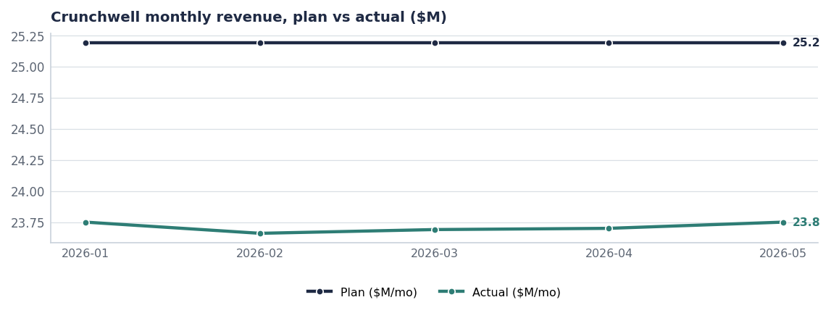
TODAY
A consistent, structural gap — not a bad month
— Every month of FY26 lands between -6.0% and -5.7% against a flat $25.19M monthly plan.
— Consistency is the diagnosis: this is base erosion, not promotional timing.
— Louisiana explains roughly a third of the absolute gap; the rest is national relevance decay.
— The Pack Refresh is the only structural change landing inside FY26.
Source: plan_vs_actual, Crunchwell, 2026-01 to 2026-05.
Internal · Confidential — Acme Corp synthetic demo data. Fictional; not for real decision-making.
Crunchwell turnaround · 3

Slide 5
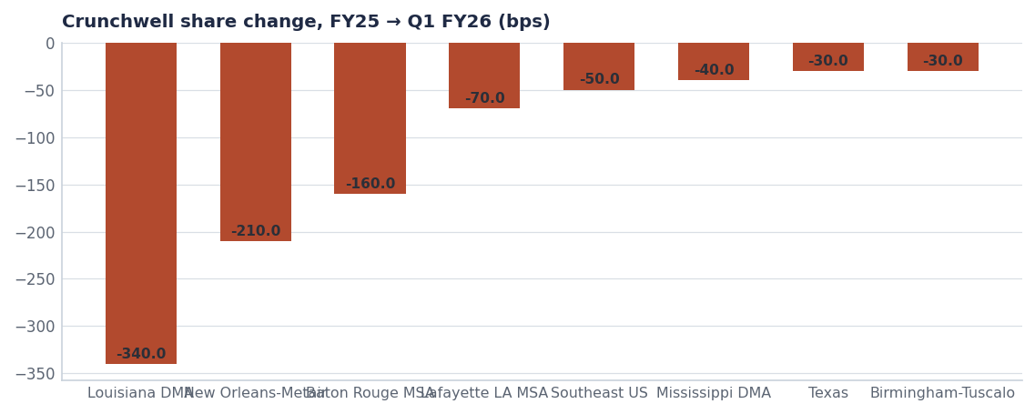
GEOGRAPHY
Three battlefields, two leading indicators
Market | FY25 | Q1 FY26 | Δ bps | Tier
Louisiana DMA | 6.4% | 3.0% | -340 | Battlefield
New Orleans-Metairie M | 5.1% | 3.0% | -210 | Battlefield
Baton Rouge MSA | 5.8% | 4.2% | -160 | Battlefield
Lafayette LA MSA | 6.2% | 5.5% | -70 | Watch
Southeast US | 4.9% | 4.4% | -50 | Under-indexed
Mississippi DMA | 5.3% | 4.9% | -40 | Watch
Texas | 6.3% | 6.0% | -30 | Mid-strong
Source: seed_geographies.
Internal · Confidential — Acme Corp synthetic demo data. Fictional; not for real decision-making.
Crunchwell turnaround · 4

Slide 6
SEQUENCE
Three years, three different jobs
Year | Job | Revenue commitment | Lead measures | Gate
FY27 | Stabilise | $318M (+1.9% on FY25 actual) | LA share ≥4.5%; Pack Refresh 90% ACV; trade index ≥0.60 | Q4 FY27 SteerCo
FY28 | Rebuild relevance | $326M (+2.5%) | Relevance ≥65; Modernity ≥52; Mega Family in market | Q4 FY28 SteerCo
FY29 | Grow | $336M (+3.1%) | Trade rate ≤22% of gross; two new SKUs at scale | FY30 planning
Revenue commitments are targets; FY27 matches the AOP brand build (Report 14). Base = FY25 actual from seeds/skus.csv.
Internal · Confidential — Acme Corp synthetic demo data. Fictional; not for real decision-making.
Crunchwell turnaround · 5

Slide 7
YEAR 1
What happens in FY2027
THE FOUR WORKSTREAMS
WHAT WE ARE EXPLICITLY NOT DOING
— Pack Refresh — hero SKUs on shelf Aug 15 2026, $28M year-1 revenue target, confidence 0.82.
— Louisiana — facing restoration at Walmart (6 → 8 on Mega), targeted Rouses trade, LA retail-media injection at 2.2× national ROI.
— Relevance platform — new creative platform launches with the pack.
— Trade reset — Mega depth capped at 20%, event count down ~15%, index to 0.60.
— Not cutting list price. Elasticity on Mega packs (−1.84 to −2.12) means price cuts buy volume and lose the reference price.
— Not adding Kids Sweet innovation — the segment is −2.8%.
— Not chasing protein with Crunchwell branding; that is ProteinPeak's job.
— Not defending every DMA. Northeast under-indexing stays under-indexed in FY27.
Source: seed_innovation_pipeline, seed_sku_elasticity_estimates, seed_walmart_endcap_audit_la, seed_category_market_size.
Internal · Confidential — Acme Corp synthetic demo data. Fictional; not for real decision-making.
Crunchwell turnaround · 6

Slide 8
GATES
The stop conditions, agreed up front
Risk | Impact if it lands | Mitigation | Owner
LA share below 4.0% at Q4 FY27 | Year-1 gate fails | Reallocate LA trade and media to ProteinPeak/TrailGrove; hold Crunchwell at maintenance A&P | SteerCo
Pack Refresh ACV below 80% by Q4 FY27 | Distribution thesis fails | Renegotiate at Q1 FY28 line reviews before further pack investment | Marcus Boudreaux
Relevance still below 63 at Q4 FY28 | Platform fails | Stop the platform, move to a harvest plan on Crunchwell | VP Brand
Trade index below 0.55 at Q4 FY27 | Efficiency thesis fails | Trade Finance takes calendar control from the NAM team | CFO / RGM Lead
Source: agreed SteerCo stop conditions; measures from syndicated_weekly, sku_authorization, brand_equity_quarterly, seed_trade_promo_events_q1_2026.
Internal · Confidential — Acme Corp synthetic demo data. Fictional; not for real decision-making.
Crunchwell turnaround · 7

Slide 9
THE ASK
What the SteerCo signs today
# | Action | Owner | When
1 | Approve the three-year staged commitment with FY27 as a stabilisation year | SteerCo | July 2026
2 | Approve the four Year-1 workstreams and their owners | Cory Whitman | July 2026
3 | Agree the four stop conditions and the consequence of each | SteerCo / CFO | July 2026
4 | Report the four Year-1 lead measures monthly, not quarterly | Cory Whitman | From August
Internal · Confidential — Acme Corp synthetic demo data. Fictional; not for real decision-making.
Crunchwell turnaround · 8

Slide 10
THE ONE THING
Stabilise, then earn the right to grow.
FY27 is a stabilisation commitment: $318M and Louisiana above 4.5%.
The gates are agreed now, while everyone is calm.
If Year 1 fails, the money moves.
Internal · Confidential — Acme Corp synthetic demo data. Fictional; not for real decision-making.

