Slide 1
ANNUAL BRAND PLAN · FY2027 + THREE-YEAR ROADMAP
ProteinPeak FY2027 Brand Plan
The fastest-growing thing we own, in the fastest-growing pocket of the category — and what it needs to keep compounding
Sage Park, Brand Director — ProteinPeak · July 2026
Internal management presentation · Internal · Confidential — synthetic demo data

Slide 2
AGENDA
What this deck covers
01
The opportunity
06
Three-year roadmap
02
Where the launch landed
07
Competitive response
03
Source of volume
08
Measurement
04
The retailer problem
09
The ask
05
FY27 plan
Internal · Confidential — Acme Corp synthetic demo data. Fictional; not for real decision-making.
ProteinPeak FY27 plan · 1

Slide 3
THE HEADLINE
A brand with a tailwind and a distribution gap
Wellness Protein grew +18.3% to $3M in FY25 and is running +18.6% in Q2 FY26. Acme's share of it moved 7.6% → 8.4% on the April 20 launch. ProteinPeak is the only brand in the house with a structural tailwind. The FY27 plan is about distribution, not demand — we are under-distributed at the two largest retailers in America.
+18.6%
8.4%
WELLNESS PROTEIN GROWTH, Q2 QTD
ACME SHARE OF SEGMENT
— The launch worked. ProteinPeak went from −25.4% to plan in Q1 (pre-launch) to -6.1% in May, with trial at 110–113% of plan at Target.
— 53% of volume is new to Acme — 32% cannibalisation and 15% competitive switching. That is a healthy launch profile for a line extension.
— Target over-indexes hard: Acme holds 18.4% of Wellness Protein at Target versus 5.2% at Walmart. Same product, same price, different shelf.
— Larksfield answered on May 12 with a 14g protein line extension. Our response is Chocolate Almond (64% top-two-box) into the Q4 line reviews, not a price move.
53%
+0.44
LAUNCH VOLUME NEW TO BRAND
SOCIAL SENTIMENT
Internal · Confidential — Acme Corp synthetic demo data. Fictional; not for real decision-making.
ProteinPeak FY27 plan · 2

Slide 4
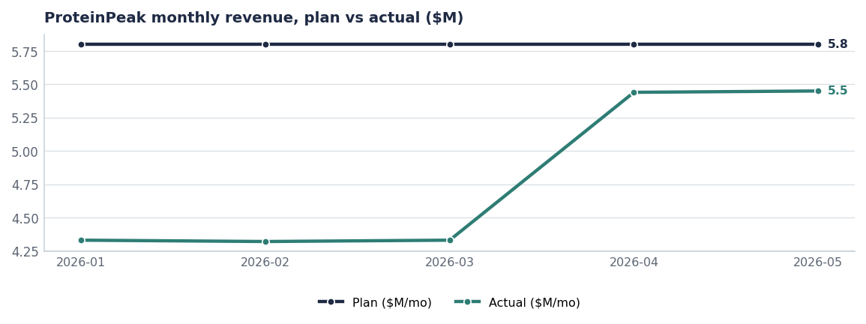
THE LAUNCH
The trough was planned; the recovery is real
— Q1 ran ~$4.33M/month against a $5.80M plan — the pre-launch pipeline draw-down, by design.
— April and May ran ~$5.44M — a 6% gap to plan, closing.
— Week-2 repeat is 1.2× the Berry Crunch archive, the cleanest signal that the product delivers on the claim.
— Velocity tells the retailer story: 17.5 units/store/week at Target versus 9.2 at the Walmart pilot.
Source: plan_vs_actual (ProteinPeak), seed_proteinpeak_q2_launch.
Internal · Confidential — Acme Corp synthetic demo data. Fictional; not for real decision-making.
ProteinPeak FY27 plan · 3

Slide 5
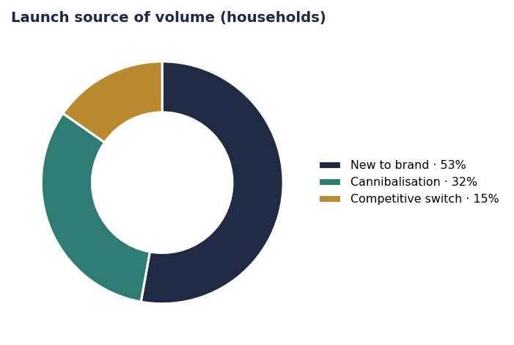
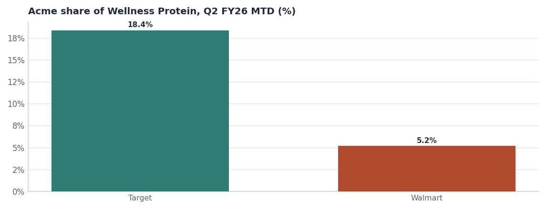
THE READ
Healthy volume mix; unhealthy retailer spread
18.4% at Target versus 5.2% at Walmart — a distribution and merchandising gap, not a demand gap.
53% new-to-brand, 32% cannibalisation of PP001–PP003, 15% taken from competitors.
Source: household_transactions (PP005/PP006 switch analysis), seed_category_market_size retailer cuts.
Internal · Confidential — Acme Corp synthetic demo data. Fictional; not for real decision-making.
ProteinPeak FY27 plan · 4

Slide 6
THE LINE
Six SKUs, two of them four months old
SKU | Shelf price | National ACV | FY25 revenue | Status
Vanilla Almond Original | $7.49 | 54% | $25.0M | Active
Chocolate Hazelnut | $7.49 | 42% | $11.5M | Active
Single-Serve Cups | $9.99 | 18% | $6.3M | Active
Berry Crunch | $7.49 | 28% | $5.2M | Active
Cinnamon Crunch | $7.49 | 38% | launch | Active-Launch-Q2
Cocoa Almond | $7.49 | 28% | launch | Active-Launch-Q2
The distribution ask
Cinnamon Crunch sits at 38% ACV and Cocoa Almond at 28% four months after launch. Getting both to 55% — Vanilla Almond's level — is worth more than any media dollar we could spend in FY27.
Source: seeds/skus.csv.
Internal · Confidential — Acme Corp synthetic demo data. Fictional; not for real decision-making.
ProteinPeak FY27 plan · 5

Slide 7
FY27 PLAN
ProteinPeak FY2027 on a page
Pillar | What we do | Investment | Success measure
Distribution | Full-line authorisation at Walmart and Kroger; Costco club pack | Trade + line-review support | PP005/PP006 ACV ≥55%
Innovation | Chocolate Almond launch (Q4 FY26 line reviews, Q1 FY27 shelf) | Stage-gate funded | Top-two-box ≥55% held; 8pp substitution gate
Creator-led media | Athlete-anchored creator programme, whitelisted into paid social and Roundel | ≈$9M A&P | Sentiment ≥+0.40; earned reach vs protein-curious
Retail media | Weight to Walmart Connect (ratio 1.20) and Kroger Precision (0.77) | ≈$6.5M | Blended modelled ratio ≥1.0
Price discipline | Hold $7.49; max 10% off, feature-led, no depth stacking | − | Trade rate ≤13% of gross
Source: seed_marketing_spend, seed_retail_media_spend_q1_2026, seed_concept_test_chocolate_almond, seed_trade_spend_fy25. FY27 figures are targets.
Internal · Confidential — Acme Corp synthetic demo data. Fictional; not for real decision-making.
ProteinPeak FY27 plan · 6

Slide 8
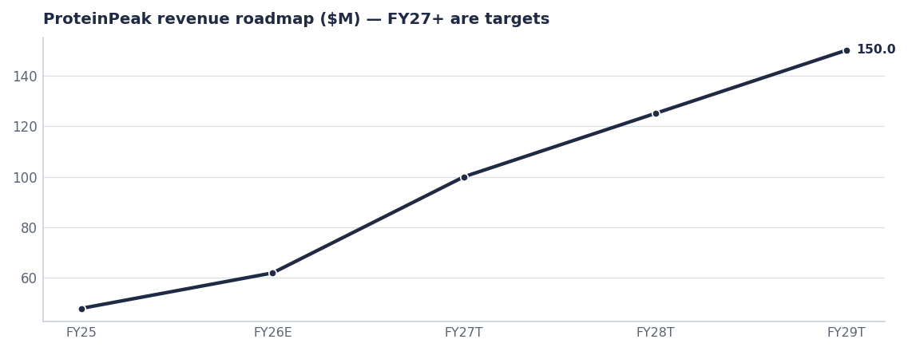
ROADMAP
$48M to $150M in four years
— FY26 ($62M est.): two new SKUs at partial distribution.
— FY27 ($100M target): full distribution at Walmart and Kroger, Chocolate Almond in market. This is the AOP commitment (Report 14).
— FY28 ($125M target): ProteinPeak Bars 12g (Stage-1, 2028-Q2) opens the $2.96B granola-bar segment.
— FY29 ($150M target): 12–14 SKUs, mid-teens share of a $1.45B segment.
Source: seed_innovation_pipeline (PP bars, Stage-1), seed_category_market_size. FY27–FY29 are targets.
Internal · Confidential — Acme Corp synthetic demo data. Fictional; not for real decision-making.
ProteinPeak FY27 plan · 7

Slide 9
THE ASK
What ProteinPeak needs from the business
# | Action | Owner | When
1 | Put ProteinPeak full-line authorisation on the Walmart August line-review agenda | Marcus Boudreaux | Aug line review
2 | Approve Chocolate Almond for the Q4 FY26 Walmart and Target line reviews | Innovation SteerCo | Aug 5
3 | Weight FY27 retail media to Walmart Connect and Kroger Precision, away from Amazon | Tasha Brooks / Hugo Lin | FY27 planning
4 | Hold the $7.49 price and the 10% depth cap through the launch year | Sage Park | FY27
5 | Add velocity by retailer to the monthly brand scorecard | Sage Park | From August
Internal · Confidential — Acme Corp synthetic demo data. Fictional; not for real decision-making.
ProteinPeak FY27 plan · 8

Slide 10
THE ONE THING
The demand is proven. The shelf is the constraint.
53% of launch volume is new to Acme.
18.4% share at Target versus 5.2% at Walmart.
FY27 is a distribution plan with a media programme attached.
Internal · Confidential — Acme Corp synthetic demo data. Fictional; not for real decision-making.

