Slide 1
INNOVATION STEERCO · STAGE GATE
ProteinPeak Chocolate Almond — Concept Test Read
Does the Q3 line extension clear the action standard and the cannibalisation gate?
Maya Chen, Senior Insights Analyst · for the innovation SteerCo, Aug 5 2026
Internal management presentation · Internal · Confidential — synthetic demo data

Slide 2
AGENDA
What this deck covers
01
The decision
05
Cannibalisation gate
02
Method and sample
06
Competitive context
03
Topline result
07
Recommendation and next steps
04
Cohort read
Internal · Confidential — Acme Corp synthetic demo data. Fictional; not for real decision-making.
Choc Almond gate · 1

Slide 3
THE HEADLINE
Both gates clear
Chocolate Almond scores 64% top-two-box against a 55% action standard — 6pp above the launch-SKU pretest and 11pp above the five-year cereal-innovation benchmark. Substitutional cannibalisation against the launch SKUs is 8pp against a 12pp SteerCo gate. Both gates clear. The recommendation is to take it to the Q4 Walmart and Target line reviews.
64%
55%
TOP-TWO-BOX
ACTION STANDARD
— Sample: n=1000, fielded 2026-06-22 to 2026-07-11, standard Acme cereal-innovation monadic design.
— Cohort strength is where the news is: protein-curious at 71% top-two-box with a 3.06/5 purchase-intent mean; lapsed-cereal at 66%.
— Current-Crunchwell buyers score 52% — below the standard, which is the right answer: this SKU is not built to convert the family-cereal base.
— Cannibalisation splits cleanly: 22% overlap with the launch SKUs, 14pp additive, 8pp substitutional. Against Crunchwell it is negligible at 2pp.
8pp
12pp
SUBSTITUTIONAL CANNIBALISATION
STEERCO GATE
Internal · Confidential — Acme Corp synthetic demo data. Fictional; not for real decision-making.
Choc Almond gate · 2

Slide 4
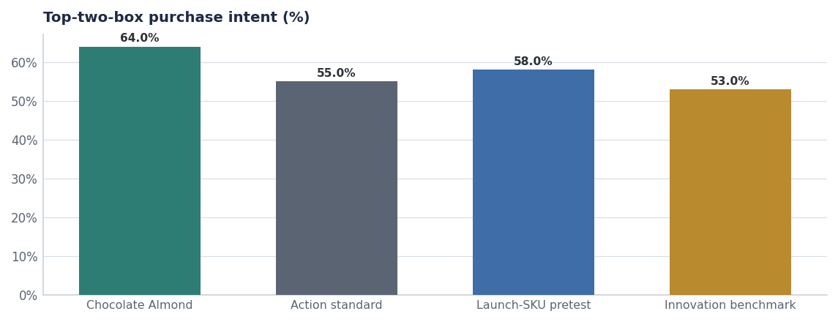
TOPLINE
Clears the standard with room
— 64% top-two-box against a 55% standard.
— 6pp better than the SKUs that just launched — and those are performing at 110–113% of trial plan at Target.
— 11pp above the five-year innovation benchmark puts this in the top quartile of concepts we have tested.
— Chocolate as a breakfast preference runs +14pp in the protein-curious cohort (U&A, April 2026) — the concept is riding a real preference, not a novelty score.
Source: seed_concept_test_chocolate_almond, seed_ua_study_2026q2_reference.
Internal · Confidential — Acme Corp synthetic demo data. Fictional; not for real decision-making.
Choc Almond gate · 3

Slide 5
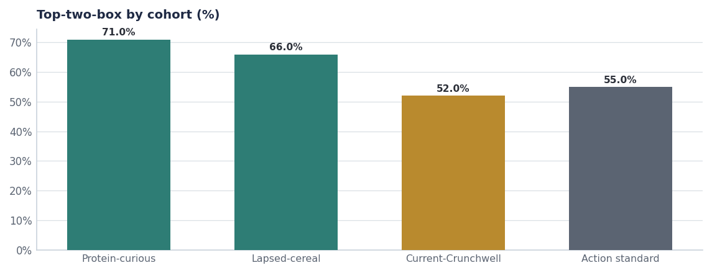
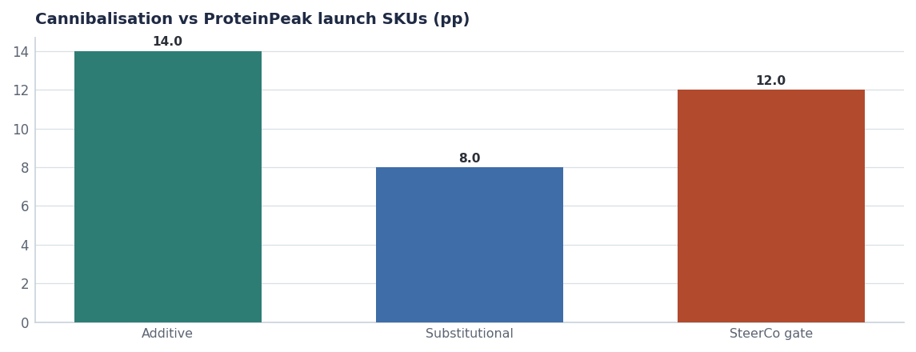
THE GATES
Cohort strength and a cannibalisation result inside the gate
Protein-curious 71% and lapsed-cereal 66% both clear; current-Crunchwell 52% does not, and should not.
22% overlap decomposes to 14pp additive and 8pp substitutional against a 12pp gate. Versus Crunchwell: 6% overlap, 2pp substitutional.
Source: seed_concept_test_chocolate_almond.
Internal · Confidential — Acme Corp synthetic demo data. Fictional; not for real decision-making.
Choc Almond gate · 4

Slide 6
CONTEXT
The competitive window is open now
Brand | SKU | Launch | Claim | Buzz d30
Crunchwell | CR009-PROPOSED | 2026-08-15 00:00:00 | New look. Same Crunchwell you love. | 0.45
Field & Honey | LF-FH-14P | 2026-05-12 00:00:00 | 14g protein per serving, made with whole gra | 0.84
ProteinPeak | PP005 | 2026-04-20 00:00:00 | 12g protein. Real cinnamon. 8g sugar. | 0.84
ProteinPeak | PP006 | 2026-04-20 00:00:00 | 12g protein. Cocoa + almond duo. | 0.62
Cheerios | GM-CHPB-12 | 2026-04-06 00:00:00 | Real peanut butter | 0.74
Field & Honey | LF-FHL-14 | 2026-03-30 00:00:00 | Limited edition spring lemon | 0.36
Why the timing matters
Larksfield launched a 14g protein extension on May 12 2026 and is escalating on both the protein and Louisiana fronts. A Q1 FY27 Chocolate Almond shelf date requires the Q4 FY26 line reviews. Missing them costs us two quarters.
Source: seed_competitor_launches.
Internal · Confidential — Acme Corp synthetic demo data. Fictional; not for real decision-making.
Choc Almond gate · 5

Slide 7
RECOMMENDATION
Take it forward
# | Action | Owner | When
1 | Approve Chocolate Almond to Stage-4 Pre-Launch | Innovation SteerCo | Aug 5 2026
2 | Include Chocolate Almond in the Q4 FY26 Walmart and Target line reviews | Marcus Boudreaux / Soo-jin Lee | Q4 FY26
3 | Hold the 12pp substitution gate as a post-launch measure, re-read at week 13 | Maya Chen | Q1 FY27 + 13 weeks
4 | Brief creator and retail-media plans off the protein-curious cohort, not the general population | Sage Park / Hugo Lin | By Sep 15
Internal · Confidential — Acme Corp synthetic demo data. Fictional; not for real decision-making.
Choc Almond gate · 6

Slide 8
THE ONE THING
Clears the standard, clears the gate, and the window is open.
64% top-two-box against a 55% standard.
8pp substitutional against a 12pp gate.
Q4 line reviews are the decision point, not the concept.
Internal · Confidential — Acme Corp synthetic demo data. Fictional; not for real decision-making.

