Slide 1
PORTFOLIO DECISION
HoneyNest and the Kids Sweet Question
A well-run brand inside a structurally declining segment — harvest, reposition, or invest?
HoneyNest Brand Manager with Insights and Finance · July 2026
Internal management presentation · Internal · Confidential — synthetic demo data

Slide 2
AGENDA
What this deck covers
01
The question
05
Three options
02
Brand performance
06
The recommendation
03
Segment reality
07
What it means for the pipeline
04
Where the trade money goes
08
The ask
Internal · Confidential — Acme Corp synthetic demo data. Fictional; not for real decision-making.
HoneyNest decision · 1

Slide 3
THE HEADLINE
A well-run brand in the wrong room
HoneyNest is running -1.1% to plan — one of the best-executed brands in the portfolio — inside a segment that shrank from $3M to $3M (-2.8%). Good brand management inside a bad segment produces exactly this: on-plan performance and no future. The recommendation is a managed harvest with one repositioning bet, not continued investment at current levels.
-1.1%
-2.8%
FY26 VARIANCE TO PLAN
KIDS SWEET SEGMENT GROWTH
— HoneyNest delivers. -1.1% average variance to plan across FY26 — better than every brand except RootDay.
— The segment does not. Kids Sweet is $3M and -2.8% YoY, with the mom-guilt trend running at 0.68 strength and trending down for kids' cereal.
— We spend $21.7M of trade at 24.2% depth for an index of 0.51 — buying volume in a segment that is leaving.
— Three SKUs are already on the FY26 discontinue list (Granola Crunch, Cookie Dough) and the pipeline holds only an LTO.
$21.7M
0.51
FY25 TRADE SPEND
TRADE INCREMENTALITY INDEX
Internal · Confidential — Acme Corp synthetic demo data. Fictional; not for real decision-making.
HoneyNest decision · 2

Slide 4
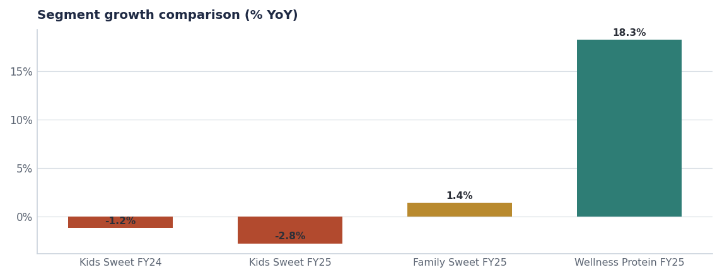
THE SEGMENT
This is not a cycle — it is a structural decline
— Kids Sweet: $3M → $3M. Two consecutive years of decline.
— Mom-guilt trend at 0.68 strength, direction down for kids' cereal — a permissioning problem, not a taste problem.
— Low-sugar pressure at 0.72 compounds it: the segment's core benefit is the thing parents are trying to avoid.
— Meanwhile Wellness Protein grew +18.3%. The same shelf space and the same trade dollars are worth far more one segment over.
Source: seed_category_market_size, seed_macro_trends.
Internal · Confidential — Acme Corp synthetic demo data. Fictional; not for real decision-making.
HoneyNest decision · 3

Slide 5
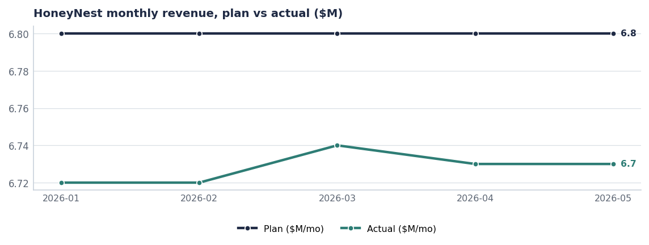
THE BRAND
Execution is not the problem
Measure | HoneyNest | Portfolio
FY26 variance to plan | -1.1% | −5.3% (Q1 total)
Trade spend | $21.7M | $147M
Trade depth | 24.2% | 16.8%
Incrementality index | 0.51 | 0.51
Segment growth | -2.8% | +1.3% (RTE total)
Source: plan_vs_actual, seed_trade_spend_fy25, seed_category_market_size.
Internal · Confidential — Acme Corp synthetic demo data. Fictional; not for real decision-making.
HoneyNest decision · 4

Slide 6
OPTIONS
Three ways to play it
Option | What it means | FY27–FY29 revenue | Investment | Verdict
A · Invest | Fund a kids-cereal relaunch with new mascot and media | $92M → $96M → $99M | ≈$12M incremental A&P | Reject
B · Harvest | Hold distribution, cut A&P to maintenance, run LTOs only, cut trade depth | $92M → $88M → $84M | ≈$1M A&P | Recommend
C · Reposition | Move HoneyNest into Family Wholegrain with a whole-grain-plus line | $92M → $94M → $97M | ≈$5M + R&D | Recommend as a bet inside B
Why not Option A
Funding a relaunch into a −2.8% segment against a 0.68-strength mom-guilt trend spends FY27 growth money on the least favourable structural position in the portfolio. The same $12M behind ProteinPeak distribution returns more.
Revenue paths are planning estimates. Source: seed_category_market_size, seed_innovation_pipeline, seed_macro_trends.
Internal · Confidential — Acme Corp synthetic demo data. Fictional; not for real decision-making.
HoneyNest decision · 5

Slide 7
PIPELINE
What HoneyNest has in the tank
Concept | Stage | Planned launch | Year-1 revenue | Status
HoneyNest Birthday Cake LTO | Stage-4 Pre-Launch | 2026-Q4 | $2.4M | On-Track
HoneyNest Plus Whole Grain - Heart Hea | Stage-1 Idea | 2028-Q1 | $4.0M | Pre-Stage-Gate
HoneyNest Granola Crunch - Discontinue | Stage-Final Discontinue | 2026-Q3 | — | Confirmed-Discontinue
HoneyNest Cookie Dough - Discontinue | Stage-Final Discontinue | 2026-Q3 | — | Confirmed-Discontinue
Source: seeds/innovation_pipeline.csv.
Internal · Confidential — Acme Corp synthetic demo data. Fictional; not for real decision-making.
HoneyNest decision · 6

Slide 8
THE ASK
Decide the role, then fund it
# | Action | Owner | When
1 | Adopt Option B — managed harvest — as HoneyNest's portfolio role from FY27 | VP Brand / CFO | FY27 planning
2 | Fund the Option C whole-grain repositioning as a single Stage-2 concept, not a relaunch | Innovation SteerCo | Q4 FY26 gate
3 | Confirm the Q3 FY26 discontinuation of Granola Crunch and Cookie Dough | HoneyNest BM / Supply Chain | Q3 FY26
4 | Redirect ≈$8M of HoneyNest trade and A&P to ProteinPeak distribution and TrailGrove | CFO / RGM Lead | FY27 planning
5 | Keep the Birthday Cake LTO as the one active innovation in FY27 | HoneyNest BM | Q4 FY26
Internal · Confidential — Acme Corp synthetic demo data. Fictional; not for real decision-making.
HoneyNest decision · 7

Slide 9
THE ONE THING
Manage it well, but stop paying for growth it cannot deliver.
HoneyNest is executing at −1.1% to plan in a −2.8% segment.
Harvest, with one repositioning bet.
$8M moves to where the category is growing.
Internal · Confidential — Acme Corp synthetic demo data. Fictional; not for real decision-making.

