Slide 1
PORTFOLIO GROWTH PLAN · FY2027
TrailGrove and RootDay — The Under-Funded Upside
Two brands sitting in double-digit-growth segments with single-digit investment behind them
TrailGrove and RootDay brand teams with Category Insights · July 2026
Internal management presentation · Internal · Confidential — synthetic demo data

Slide 2
AGENDA
What this deck covers
01
The under-funded case
05
Investment gap
02
TrailGrove today
06
FY27 plan for both
03
RootDay today
07
Innovation pipeline
04
Segment tailwinds
08
The ask
Internal · Confidential — Acme Corp synthetic demo data. Fictional; not for real decision-making.
BFY growth FY27 · 1

Slide 3
THE HEADLINE
Two brands doing more with less
TrailGrove (-1.6% to plan) and RootDay (-0.3% to plan) are the two most on-plan brands in the house. They sit in granola (+3.3%) and oat milk (+18.8%) — and together they receive less A&P than Crunchwell spends on Linear TV alone. The FY27 recommendation is a modest, distribution-weighted investment increase funded from HoneyNest and Crunchwell TV.
+18.8%
-0.3%
OAT MILK SEGMENT GROWTH
ROOTDAY VARIANCE TO PLAN
— RootDay is the best-performing brand in the portfolio at -0.3% to plan, in a $3M segment growing +18.8%. Acme holds 3.8% of it.
— TrailGrove is $152M and -1.6% to plan in granola, an $3M segment growing +1.3% where we already hold 5.7% share.
— Neither has an investment problem we created deliberately — they were simply never the priority. That is the cheapest thing to fix in the FY27 plan.
— Sentiment is with us: Oatly runs +0.20 and MorningOats +0.10, while Crunchwell sits at −0.11. Better-for-you is where consumer conversation is positive.
-1.6%
+9.8%
TRAILGROVE VARIANCE TO PLAN
SINGLE-SERVE CUPS GROWTH
Internal · Confidential — Acme Corp synthetic demo data. Fictional; not for real decision-making.
BFY growth FY27 · 2

Slide 4
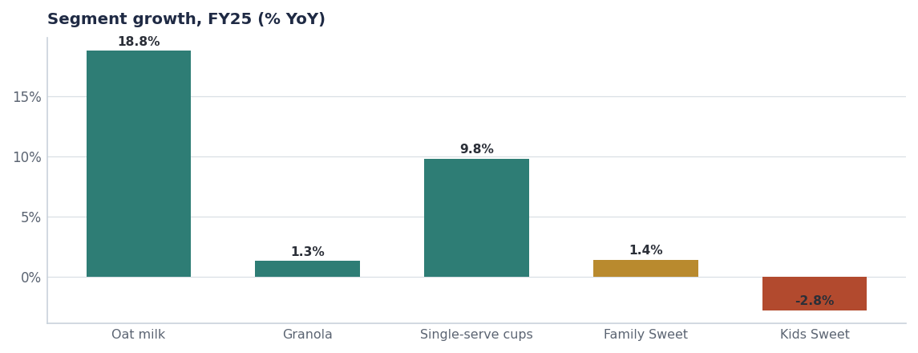
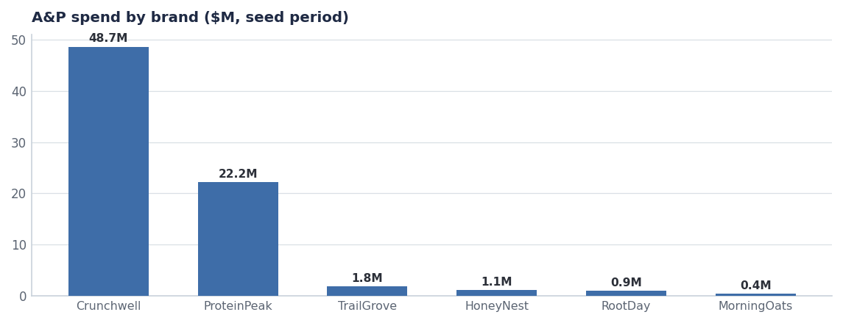
THE GAP
The growth is in one chart; the money is in the other
Oat milk, granola and single-serve cups all grow mid-to-high single digits or better.
Crunchwell and ProteinPeak take the overwhelming majority of A&P. TrailGrove and RootDay are rounding errors.
Source: seed_category_market_size, seed_marketing_spend.
Internal · Confidential — Acme Corp synthetic demo data. Fictional; not for real decision-making.
BFY growth FY27 · 3

Slide 5
TODAY
Where the two brands actually are
Measure | TrailGrove | RootDay
FY25 revenue | $152.0M | $62.0M
SKUs | 10 | 8
FY26 variance to plan | -1.6% | -0.3%
Home segment | Granola ($3M, +1.3%) | Oat milk ($3M, +18.8%)
Acme share of segment | 5.7% | 3.8%
Trade spend FY25 | $10.8M | $4.7M
Trade depth | 13.5% | 9.5%
The structural point
RootDay holds 3.8% of a segment growing 18.8%, on 9.5% trade depth. That is the most efficient share position in the portfolio and the one with the most headroom. It is also the least funded.
Source: seeds/skus.csv, plan_vs_actual, seed_trade_spend_fy25, seed_category_market_size.
Internal · Confidential — Acme Corp synthetic demo data. Fictional; not for real decision-making.
BFY growth FY27 · 4

Slide 6
PIPELINE
What is already in the tank for both brands
Concept | Brand | Stage | Planned launch | Year-1
RootDay Single-Serve Carton 8oz | RootDay | Stage-3 Prototype | 2027-Q2 | $4.5M
RootDay Coffee Creamer 16oz | RootDay | Stage-2 Concept | 2027-Q3 | $3.8M
TrailGrove Bites - Yogurt Coated | TrailGrove | Stage-2 Concept | 2027-Q2 | $3.6M
RootDay Yogurt Smoothie | RootDay | Stage-1 Idea | 2028-Q3 | $6.0M
TrailGrove Trail Mix Hispanic Format - M | TrailGrove | Stage-2 Concept | 2027-Q2 | $2.4M
RootDay Half-Gallon - Non-Refrigerated | RootDay | Stage-1 Idea | 2028-Q2 | $5.5M
TrailGrove Granola Single-Serve Cups | TrailGrove | Stage-2 Concept | 2027-Q4 | $2.9M
RootDay Coconut Blend - Discontinue | RootDay | Stage-Final Discontinue | 2026-Q3 | —
Source: seeds/innovation_pipeline.csv.
Internal · Confidential — Acme Corp synthetic demo data. Fictional; not for real decision-making.
BFY growth FY27 · 5

Slide 7
FY27 PLAN
Distribution first, innovation second
TRAILGROVE FY27
ROOTDAY FY27
— Distribution build in granola and bars — the cheapest incremental volume in the house.
— Bites Yogurt-Coated (Stage-2) into the Q4 FY26 gate for a FY28 launch.
— Social-led media at ≈$4M, no linear TV.
— Hold trade depth at 13.5%; grow on distribution, not discount.
— FY27 target: $162M (+6.6% on FY25).
— Single-Serve Carton (Stage-3, on-hold) reactivated for the gym-bag occasion.
— Coffee Creamer (Stage-2) — oat creamer is genuine whitespace against Califia and Silk.
— Barista positioning behind the oat-milk barista trend (0.84 strength).
— Discontinue Coconut Blend in Q3 FY26 as planned.
— FY27 target: $74M (+19.4% on FY25).
Source: seeds/innovation_pipeline.csv, seed_macro_trends. FY27 targets are plan.
Internal · Confidential — Acme Corp synthetic demo data. Fictional; not for real decision-making.
BFY growth FY27 · 6

Slide 8
THE ASK
A small amount of money, in the right place
# | Action | Owner | When
1 | Approve ≈$6M incremental FY27 investment across TrailGrove and RootDay, funded from HoneyNest harvest and Crunchwell TV | CFO / VP Brand | FY27 planning
2 | Reactivate the RootDay Single-Serve Carton concept from On-Hold | Innovation SteerCo | Q4 FY26 gate
3 | Take TrailGrove granola and bar distribution gaps into the Q4 line reviews | Marcus Boudreaux / Priya Raman | Q4 FY26
4 | Report both brands' segment share monthly — today neither is on the scorecard | Category Insights | From August
Internal · Confidential — Acme Corp synthetic demo data. Fictional; not for real decision-making.
BFY growth FY27 · 7

Slide 9
THE ONE THING
The cheapest growth in the portfolio is the growth we are not funding.
Two brands, two double-digit-growth segments, minimal investment.
≈$6M redirected, not new money.
$236M FY27 combined target between them.
Internal · Confidential — Acme Corp synthetic demo data. Fictional; not for real decision-making.

