Slide 1
S&OP / IBP EXECUTIVE REVIEW
Q2 FY2026 Integrated Business Planning Review
Demand, supply and financial plans reconciled to one number for Q3 and Q4
S&OP Lead with Demand Planning, Supply Chain and FP&A · July 2026
Internal management presentation · Internal · Confidential — synthetic demo data

Slide 2
AGENDA
What this deck covers
01
The consensus number
05
Reconciliation and gaps
02
Demand review
06
Management decisions required
03
Supply review
07
Actions
04
Product / innovation review
Internal · Confidential — Acme Corp synthetic demo data. Fictional; not for real decision-making.
Q2 FY26 S&OP · 1

Slide 3
THE HEADLINE
One number, agreed across three functions
The Q2 cycle closes with demand, supply and finance aligned on an H2 number of $379M — $3M below original plan and built off the May actual of $61.6M. The two constraints in the cycle are Pack Refresh changeover capacity in August and ProteinPeak line capacity if Walmart authorises the full line. Neither is a demand problem.
-3.4%
94.7%
Q2 QTD DEMAND VS PLAN
FILL RATE, LATEST MONTH
— Demand: unconstrained forecast is $384M for H2; the consensus number is $379M after supply and phasing constraints.
— Supply: fill rate has fully recovered from the November 2025 storm event and is running at normal service levels.
— Product: the Pack Refresh (Aug 15) is the gating item — changeover consumes line capacity in weeks 33–35.
— Gap to plan is $3M, held as a management risk rather than closed with promotional volume.
93.9%
$379M
ON-TIME IN FULL
CONSENSUS H2 NUMBER
Internal · Confidential — Acme Corp synthetic demo data. Fictional; not for real decision-making.
Q2 FY26 S&OP · 2

Slide 4
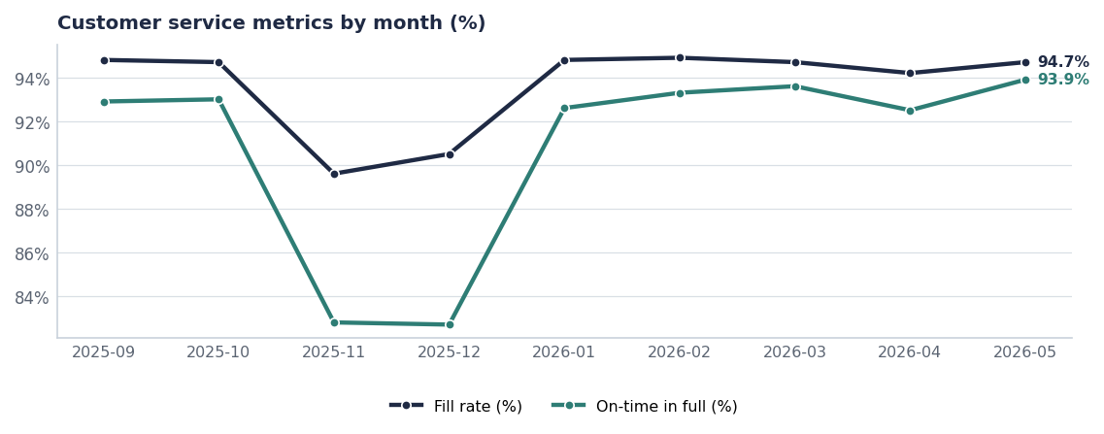
SUPPLY
Service has fully recovered from the storm event
— November 2025 is the Hurricane Tonya trough — fill fell to ~52% on storm-cut lines at the Houston, Thibodaux and Tyler DCs.
— Latest month runs 94.7% fill and 93.9% OTIF — normal service.
— The lesson stands (see the after-action review, Report 73): our recovery took two quarters and cost roughly 12% of the Louisiana share decline.
— Q3 watch item: Pack Refresh changeover in weeks 33–35 tightens Battle Creek line availability.
Source: shipments (Fill_Rate_Pct, On_Time_Pct), monthly averages.
Internal · Confidential — Acme Corp synthetic demo data. Fictional; not for real decision-making.
Q2 FY26 S&OP · 3

Slide 5
CUT ANALYSIS
Where units are lost between order and shipment
Cut reason | Units cut | Avg fill on those lines | Order lines
No cut | 490.9K | 94.9% | 14,665
Storm | 192.8K | 53.7% | 450
Production_Lag | 17.7K | 83.6% | 127
Quality_Hold | 10.1K | 83.0% | 76
Launch_Allocation | 6.6K | 83.4% | 74
Launch allocation is now the second-largest cut reason
Launch_Allocation cuts are a choice, not a failure — we deliberately short base SKUs to protect launch fill. It needs to be visible in the demand plan rather than showing up as a service miss.
Source: shipments, order lines since October 2025.
Internal · Confidential — Acme Corp synthetic demo data. Fictional; not for real decision-making.
Q2 FY26 S&OP · 4

Slide 6
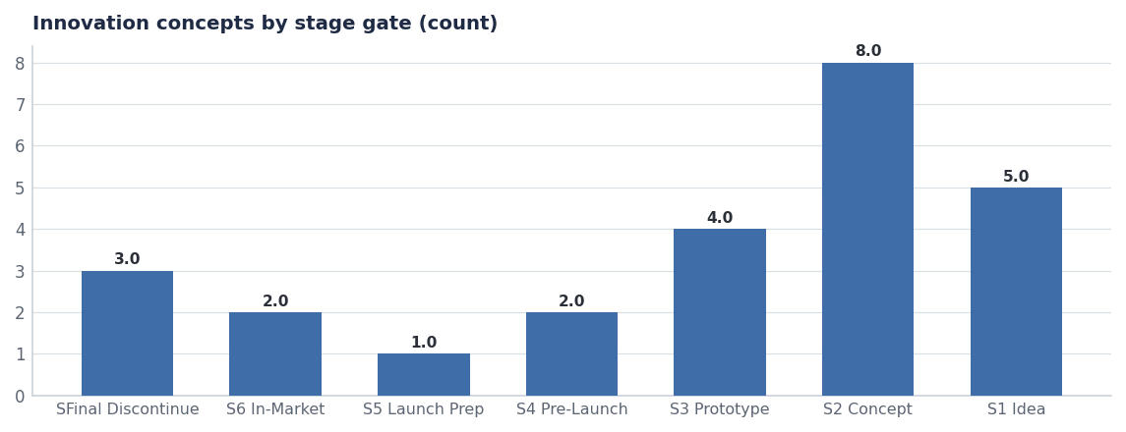
PRODUCT REVIEW
Three launches inside the planning horizon
Concept | Brand | Launch | Year-1 | Status
Crunchwell Pack Refresh - Hero SKU | Crunchwell | 2026-08-15 | $28.0M | On-Track
ProteinPeak Cinnamon Crunch | ProteinPeak | 2026-04-20 | $14.0M | Live-Q2-2026
ProteinPeak Cocoa Almond | ProteinPeak | 2026-04-20 | $10.0M | Live-Q2-2026
HoneyNest Birthday Cake LTO | HoneyNest | 2026-Q4 | $2.4M | On-Track
MorningOats Cup Pumpkin Spice LTO | MorningOats | 2026-Q3 | $1.8M | On-Track
Source: seeds/innovation_pipeline.csv, Stage-4 to Stage-6.
Internal · Confidential — Acme Corp synthetic demo data. Fictional; not for real decision-making.
Q2 FY26 S&OP · 5

Slide 7
RECONCILIATION
From unconstrained demand to the consensus number
Step | H2 $M | Owner | Note
Unconstrained demand forecast | 384.0 | Demand Planning | Statistical + brand overlay
Less: Pack Refresh changeover phasing | −2.5 | Supply Chain | Weeks 33–35 line capacity
Less: ProteinPeak allocation at Walmart | −1.5 | Supply Chain | Only if full line authorised early
Less: HoneyNest discontinuations | −1.6 | Brand | Granola Crunch, Cookie Dough
Plus: retail-media reallocation upside | +0.6 | Tasha Brooks | LA injection at 2.2x ROI
Consensus H2 number | 379.0 | S&OP | Signed off this cycle
Reconciliation is a planning artefact; base actuals from plan_vs_actual.
Internal · Confidential — Acme Corp synthetic demo data. Fictional; not for real decision-making.
Q2 FY26 S&OP · 6

Slide 8
DECISIONS
What the executive team needs to settle
# | Action | Owner | When
1 | Approve the $379M consensus H2 number and carry the $3M gap as management risk | CFO / S&OP | July cycle
2 | Protect Pack Refresh changeover capacity in weeks 33–35 ahead of base SKU fill | VP Supply Chain | By Aug 1
3 | Pre-agree the ProteinPeak allocation rule if Walmart authorises the full line early | Supply Chain / Sage Park | By Aug 15
4 | Make Launch_Allocation cuts a visible line in the demand plan, not a service miss | Demand Planning | Next cycle
Internal · Confidential — Acme Corp synthetic demo data. Fictional; not for real decision-making.
Q2 FY26 S&OP · 7

Slide 9
THE ONE THING
One number. Two constraints. Both ours to manage.
$379M consensus for H2, $3M below plan.
Service is fully recovered; capacity is the live constraint.
The gap is held, not promoted away.
Internal · Confidential — Acme Corp synthetic demo data. Fictional; not for real decision-making.

