Slide 1
SUPPLY CHAIN & CUSTOMER SERVICE
Q2 FY2026 Service Review
Fill, OTIF, on-shelf availability and what the storm taught us about recovery speed
VP Supply Chain with Customer Logistics · July 2026
Internal management presentation · Internal · Confidential — synthetic demo data

Slide 2
AGENDA
What this deck covers
01
Service scorecard
05
On-shelf availability
02
The storm and the recovery curve
06
The Rouses problem
03
DC-level performance
07
Q3 risks
04
Cut reasons
08
Actions
Internal · Confidential — Acme Corp synthetic demo data. Fictional; not for real decision-making.
Q2 FY26 supply chain · 1

Slide 3
THE HEADLINE
Warehouse fixed. Shelf not fixed.
Service is back to normal: 94.7% fill and 93.9% OTIF in the latest month, against the ~52% storm trough in November 2025. The residual problem is not warehouse fill — it is on-shelf availability at specific Louisiana doors, where OSA in the high 50s and low 60s persists months after supply recovered. That is an execution problem, not a supply problem.
94.7%
93.9%
FILL RATE
ON-TIME IN FULL
— Warehouse service is fixed. Fill and OTIF are at pre-storm levels across every DC.
— Store-level availability is not. 7 audited Rouses doors sit below 70% OSA on Crunchwell Original Mega, with up to 21 out-of-stock days in Q1.
— Every low-OSA door has a Larksfield endcap. Empty shelf plus competitor display is how a supply event becomes a share event.
— Q3 constraint: the Pack Refresh changeover in weeks 33–35, which we are protecting at the cost of base-SKU fill.
58%
21
WORST ROUSES DOOR OSA
OOS DAYS, WORST DOOR, Q1
Internal · Confidential — Acme Corp synthetic demo data. Fictional; not for real decision-making.
Q2 FY26 supply chain · 2

Slide 4
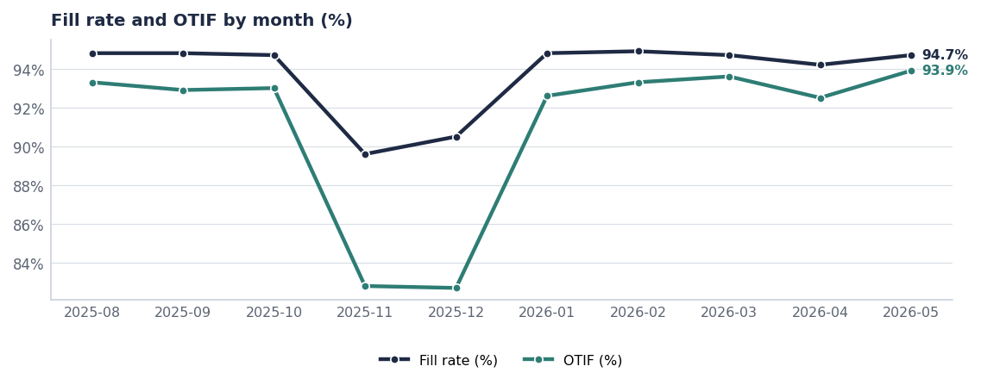
THE CURVE
A two-quarter recovery from a two-week event
The November trough is Hurricane Tonya. The shape of the recovery — not the depth of the trough — is the thing worth fixing.
Source: shipments, monthly averages of Fill_Rate_Pct and On_Time_Pct.
Internal · Confidential — Acme Corp synthetic demo data. Fictional; not for real decision-making.
Q2 FY26 supply chain · 3

Slide 5
BY DC
Lowest-performing retailer DCs, calendar 2026
Retailer DC | Fill | OTIF | Order lines
Costco Chicago DC | 94.1% | 94.0% | 184
Brookshire's Tyler DC | 94.2% | 91.5% | 176
Walmart Chicago DC | 94.3% | 93.9% | 197
CVS Indianapolis DC | 94.4% | 93.7% | 239
Wegmans Pottsville DC | 94.4% | 91.4% | 163
Target Houston DC | 94.4% | 94.5% | 218
Publix Atlanta DC | 94.4% | 94.1% | 205
Winn-Dixie Hammond DC | 94.4% | 91.8% | 184
Source: shipments, 2026 year-to-date, ranked by fill rate ascending.
Internal · Confidential — Acme Corp synthetic demo data. Fictional; not for real decision-making.
Q2 FY26 supply chain · 4

Slide 6
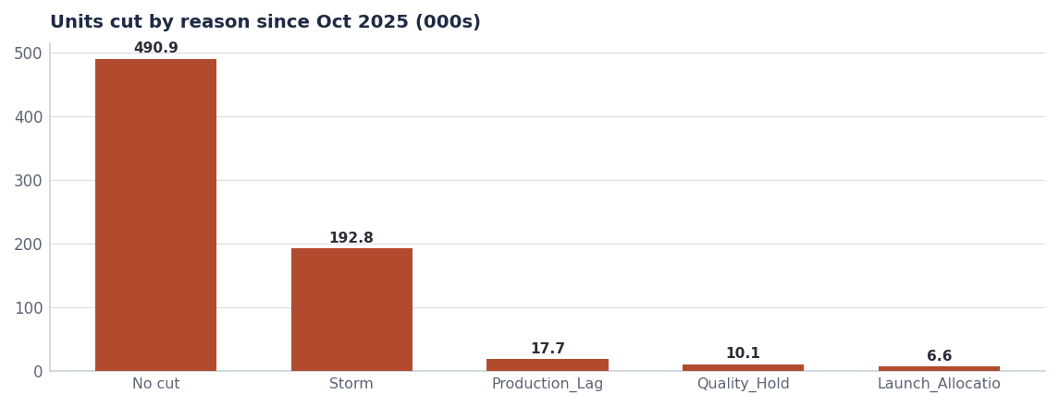
CUT REASONS
Storm, production lag and quality hold — in that order
Cut reason | Units cut | Fill on those lines
No cut | 490.9K | 94.9%
Storm | 192.8K | 53.7%
Production_Lag | 17.7K | 83.6%
Quality_Hold | 10.1K | 83.0%
Launch_Allocation | 6.6K | 83.4%
Source: shipments, Cut_Reason.
Internal · Confidential — Acme Corp synthetic demo data. Fictional; not for real decision-making.
Q2 FY26 supply chain · 5

Slide 7
ON SHELF
Banner-level OSA and planogram compliance, 2026
Banner | OSA | Planogram compliance | Avg facings
Target | 96.5% | 95.8% | 5.59
Sprouts | 96.9% | 95.8% | 5.67
Walmart.com | 97.0% | 95.8% | 5.63
Kroger | 97.0% | 95.7% | 5.96
Whole Foods | 97.0% | 95.9% | 5.18
Walmart | 97.0% | 95.8% | 4.81
Amazon | 97.0% | 95.7% | 5.16
Target.com | 97.1% | 95.8% | 5.80
Averages hide the problem
Banner averages sit in the mid-90s. The Louisiana door-level audit shows OSA in the 58–70% range on the exact SKUs losing share. Store-level, not banner-level, is the unit of management here.
Source: perfect_store, 2026 year-to-date.
Internal · Confidential — Acme Corp synthetic demo data. Fictional; not for real decision-making.
Q2 FY26 supply chain · 6

Slide 8
THE ROUSES PROBLEM
Door-level audit: empty shelf next to a competitor endcap
SKU | City | OSA | Q1 OOS days | Promo lift | Larksfield endcap
Crunchwell Original Mega | Baton Rouge | 58% | 21 | 10% | Y
Crunchwell Original Mega | Houma | 60% | 19 | 11% | Y
Crunchwell Original Mega | Thibodaux | 62% | 18 | 12% | Y
Crunchwell Original Mega | Baton Rouge | 64% | 16 | 11% | Y
Crunchwell Original Mega | Metairie | 66% | 15 | 13% | Y
Crunchwell Original Mega | Slidell | 67% | 14 | 13% | Y
Crunchwell Original Mega | Lafayette | 69% | 12 | 14% | Y
Crunchwell Original Mega | New Orleans | 71% | 11 | 15% | Y
Crunchwell Original Mega | Rouses-LA-Total | 73% | 11 | 15% | Y
Source: seed_rouses_oos_by_door, audited doors.
Internal · Confidential — Acme Corp synthetic demo data. Fictional; not for real decision-making.
Q2 FY26 supply chain · 7

Slide 9
Q3 RISKS
What could break service in the back half
Risk | Impact if it lands | Mitigation | Owner
Pack Refresh changeover, weeks 33–35 | Base-SKU fill dips 3–5 points for two weeks | Pre-build hero SKUs in week 31–32; communicate to top-10 customers in advance | VP Supply Chain
ProteinPeak full-line authorisation at Walmart | Launch allocation cuts spread to base protein SKUs | Pre-agreed allocation rule with the brand team; capacity booked | Supply Chain / Sage Park
Louisiana store execution does not improve | Recovery plan under-delivers even with supply fixed | Weekly door-level OSA reporting; third-party merchandising in the 14 worst doors | Marcus Boudreaux
2026 hurricane season | Repeat of the November 2025 pattern | Pre-positioned inventory at Houston and Tyler from week 32; alternate DC routing agreed | VP Supply Chain
Source: shipments, seed_rouses_oos_by_door, seed_innovation_pipeline.
Internal · Confidential — Acme Corp synthetic demo data. Fictional; not for real decision-making.
Q2 FY26 supply chain · 8

Slide 10
ACTIONS
Four things out of this review
# | Action | Owner | When
1 | Fund third-party merchandising in the 14 worst Louisiana doors for 12 weeks | Marcus Boudreaux | From Aug 1
2 | Pre-build Pack Refresh hero SKUs in weeks 31–32 to protect base fill | VP Supply Chain | By Jul 31
3 | Move OSA reporting from banner to door level for the top-100 Acme volume stores | Customer Logistics | By Sep 1
4 | Pre-position Louisiana inventory ahead of the 2026 hurricane season | VP Supply Chain | By Aug 15
Internal · Confidential — Acme Corp synthetic demo data. Fictional; not for real decision-making.
Q2 FY26 supply chain · 9

Slide 11
THE ONE THING
The warehouse is fixed. The shelf is where the money is.
Fill and OTIF are back to normal service levels.
Fourteen Louisiana doors are still below 70% OSA.
Every one of them has a Larksfield endcap.
Internal · Confidential — Acme Corp synthetic demo data. Fictional; not for real decision-making.

