Slide 1
TRADE PROMOTION EFFECTIVENESS
H1 FY2026 Post-Event Analysis
43 events, $11.6M of spend, and the question of how much of the lift we actually bought
RGM with Trade Finance · for the commercial review · July 2026
Internal management presentation · Internal · Confidential — synthetic demo data

Slide 2
AGENDA
What this deck covers
01
The headline
05
The best and worst events
02
By retailer
06
What we stop doing
03
By brand
07
Actions
04
By mechanic
Internal · Confidential — Acme Corp synthetic demo data. Fictional; not for real decision-making.
H1 FY26 trade PEA · 1

Slide 3
THE HEADLINE
Half the volume we bought was already ours
Q1 FY2026 ran 43 promoted events costing $11.6M and generating $10.9M of modelled incremental revenue at an average lift of 14.3% and an incrementality index of 0.52. An index of 0.52 means roughly half of the volume we paid to move would have moved anyway. The spread between our best and worst mechanics is wide enough that fixing the mix — not cutting the budget — is the answer.
43
$11.6M
EVENTS IN THE QUARTER
TRADE SPEND
$10.9M
0.52
— The portfolio index is 0.52. Best-in-class for this category is 0.65–0.70; we have a full 15 points of headroom.
— Average modelled lift is 14.3% — respectable on the surface, but lift and incrementality are different questions, and only the second one is worth paying for.
— Crunchwell carries $8.5M of the quarter's spend — the concentration risk and the biggest single opportunity.
— The recommendation is a 0.45 index floor on new events, which reallocates roughly $2.4M a quarter into mechanics that work.
MODELLED INCREMENTAL REVENUE
AVERAGE INCREMENTALITY INDEX
Internal · Confidential — Acme Corp synthetic demo data. Fictional; not for real decision-making.
H1 FY26 trade PEA · 2

Slide 4
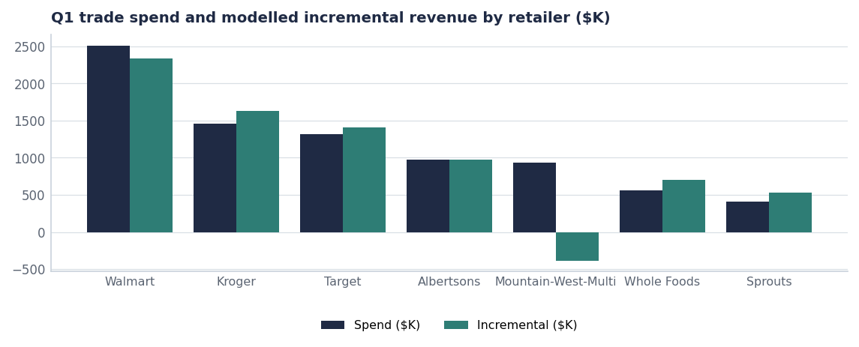
BY RETAILER
Where the money goes and what it returns
Retailer | Events | Spend | Incr. | Index
Walmart | 3 | $2.5M | $2.3M | 0.57
Kroger | 3 | $1.5M | $1.6M | 0.57
Target | 4 | $1.3M | $1.4M | 0.62
Albertsons | 4 | $1.0M | $1.0M | 0.54
Mountain-West-Multi | 3 | $0.9M | $-0.4M | -0.18
Whole Foods | 3 | $0.6M | $0.7M | 0.68
Sprouts | 3 | $0.4M | $0.5M | 0.65
Sams Club | 1 | $0.3M | $0.3M | 0.59
Source: seed_trade_promo_events_q1_2026.
Internal · Confidential — Acme Corp synthetic demo data. Fictional; not for real decision-making.
H1 FY26 trade PEA · 3

Slide 5
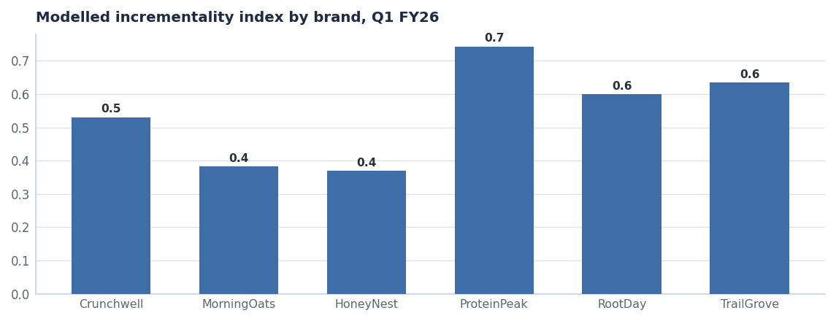
BY BRAND
The lean promoters are the efficient ones
— ProteinPeak promotes least and converts best — trade rate ~12.9% of gross against Crunchwell's ~25.6%.
— Crunchwell's index is respectable on a huge base, which is why the absolute waste is concentrated there.
— HoneyNest is the worst combination: heavy depth in a declining segment (see the portfolio decision, Report 50).
— Rule of thumb from this quarter: every 5 points of average depth costs roughly 0.04 of index.
Source: seed_trade_promo_events_q1_2026, seed_trade_spend_fy25.
Internal · Confidential — Acme Corp synthetic demo data. Fictional; not for real decision-making.
H1 FY26 trade PEA · 4

Slide 6
BY MECHANIC
Not every mechanic earns its place on the calendar
Mechanic | Events | Spend | Avg lift | Index | Call
2.99 14oz | 5 | $3.7M | 25.4% | 0.57 | Keep
$0.50 off | 5 | $1.5M | 15.4% | 0.41 | Stop
$0.40 off | 5 | $0.9M | 11.8% | 0.38 | Stop
$0.45 off | 6 | $0.8M | 12.5% | 0.54 | Keep
Display + sample | 3 | $0.6M | 12.0% | 0.72 | Keep
Display + price | 4 | $0.6M | 13.2% | 0.60 | Keep
Display only | 2 | $0.6M | 10.0% | 0.67 | Keep
Buy 2 save $1 | 1 | $0.5M | 18.0% | 0.58 | Keep
All other mechanics (10) | 12 | $2.5M | 12.9% | 0.54 | Keep
The 0.45 floor
Applying a 0.45 index floor to the Q1 calendar would have removed the lowest-returning mechanics and freed roughly $2.4M for feature-and-display weight, which indexes higher on every brand we run it on.
Source: seed_trade_promo_events_q1_2026, grouped by mechanic.
Internal · Confidential — Acme Corp synthetic demo data. Fictional; not for real decision-making.
H1 FY26 trade PEA · 5

Slide 7
EXTREMES
The five best and five worst events of the quarter
BEST FIVE (BY INDEX)
WORST FIVE (BY INDEX)
— Crunchwell at Multi-retailer-LA — $0.55 off 14oz, 15% off, index 1.10
— ProteinPeak at Whole Foods — Display + sample, 0% off, index 0.78
— ProteinPeak at Sprouts — Display + sample, 0% off, index 0.74
— ProteinPeak at Target — Display only, 0% off, index 0.71
— Crunchwell at Costco — Bundle 4-pack, 12% off, index 0.71
— Crunchwell at Mountain-West-Multi — $0.50 off, 18% off, index -0.21
— HoneyNest at Mountain-West-Multi — $0.40 off, 12% off, index -0.18
— MorningOats at Mountain-West-Multi — $0.50 off + display, 14% off, index -0.15
— Crunchwell at Amazon — Subscribe-and-save first, 0% off, index 0.18
— Crunchwell at Rouses — Multigrain 12% off, 12% off, index 0.41
Source: seed_trade_promo_events_q1_2026, ranked by modelled incrementality index.
Internal · Confidential — Acme Corp synthetic demo data. Fictional; not for real decision-making.
H1 FY26 trade PEA · 6

Slide 8
ACTIONS
What changes in the Q3 and Q4 calendar
# | Action | Owner | When
1 | Adopt a 0.45 modelled-incrementality floor for all new events | RGM Lead / Trade Finance | From Aug 1
2 | Reallocate the freed ~$2.4M/quarter into feature-and-display weight, not depth | NAM team | Q3–Q4 calendar
3 | Cap Crunchwell Mega depth at 20% and stop depth stacking with retailer funds | Marcus Boudreaux | Q3 calendar
4 | Cut HoneyNest promoted events in line with the harvest decision (Report 50) | HoneyNest BM | FY27 calendar
5 | Report index alongside spend in the monthly commercial review | Trade Finance | From August
Internal · Confidential — Acme Corp synthetic demo data. Fictional; not for real decision-making.
H1 FY26 trade PEA · 7

Slide 9
THE ONE THING
An index of 0.52 is the cheapest money in the plan.
43 events, $11.6M, $10.9M modelled incremental.
0.45 floor frees ~$2.4M a quarter without cutting the budget.
Fewer, better events — starting with the Q3 calendar.
Internal · Confidential — Acme Corp synthetic demo data. Fictional; not for real decision-making.

