Slide 1
MARKETING MIX & MEDIA EFFECTIVENESS
H1 FY2026 Media Read
What the mix model and the retail-media incrementality work say we should stop, start and shift
Hugo Lin, Director — Performance Marketing, with the CMO · July 2026
Internal management presentation · Internal · Confidential — synthetic demo data

Slide 2
AGENDA
What this deck covers
01
The headline
05
Two brands, two mixes
02
Spend by period and brand
06
Creator and social signal
03
Retail-media incrementality
07
The H2 reallocation
04
Platform-reported versus modelled
08
Actions
Internal · Confidential — Acme Corp synthetic demo data. Fictional; not for real decision-making.
H1 FY26 media read · 1

Slide 3
THE HEADLINE
The average is fine. The distribution is not.
Q1 retail media spent $4.2M and returned $2.73M of modelled incremental revenue — $0.65 per dollar. The average hides everything that matters: Walmart Connect returns 1.20 while Amazon Ads returns 0.40 on more than twice the spend. The recommendation is a $700K in-quarter reallocation and a structural mix shift for FY27.
$0.65
1.20
MODELLED INCREMENTAL PER $1
BEST PLATFORM RATIO
— Amazon Ads is $2.4M of the $4.2M at a modelled ratio of 0.40. It is the single largest efficiency leak we have.
— Platform-reported ROAS is not the measure. Amazon reports positive ROAS on the same spend our incrementality model marks as substantially cannibalised.
— Crunchwell and ProteinPeak run opposite mixes — TV-led versus creator-led — and the creator-led brand is the one growing.
— Social sentiment tracks the mix: ProteinPeak +0.44 versus Crunchwell -0.11.
0.40
$700K
WORST PLATFORM RATIO
RECOMMENDED REALLOCATION
Internal · Confidential — Acme Corp synthetic demo data. Fictional; not for real decision-making.
H1 FY26 media read · 2

Slide 4
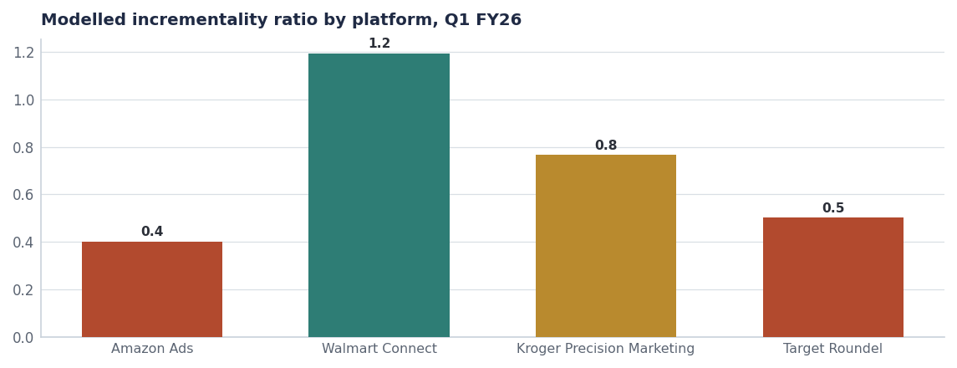
INCREMENTALITY
Two platforms are subsidising two others
Platform | Spend | Modelled incr. | Reported ROAS | Modelled ratio
Amazon Ads | $2.4M | $0.98M | 1.12 | 0.40
Walmart Connect | $1.0M | $1.21M | 2.06 | 1.20
Kroger Precision Marketing | $0.4M | $0.32M | 1.43 | 0.77
Target Roundel | $0.4M | $0.22M | 1.16 | 0.50
Total | $4.2M | $2.73M | 1.44 | 0.65
Source: seed_retail_media_spend_q1_2026. Modelled ratio governs decisions; platform-reported ROAS is shown for contrast.
Internal · Confidential — Acme Corp synthetic demo data. Fictional; not for real decision-making.
H1 FY26 media read · 3

Slide 5
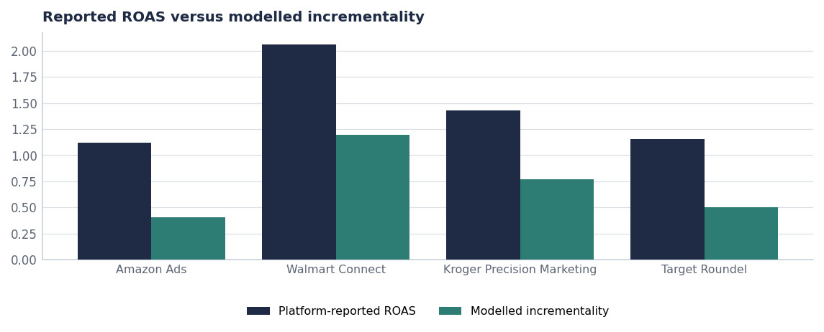
THE GAP
Why we govern on modelled incrementality
— Every platform reports a better number than the model produces. That is expected — platform attribution counts conversions the model attributes to base.
— Amazon has the widest gap: reported 1.12 against modelled 0.40.
— Walmart Connect is the narrowest gap and the only platform above 1.0 on the modelled measure.
— Governance rule: budget decisions use modelled incrementality; platform dashboards are for in-flight optimisation only (see Report 75).
Source: seed_retail_media_spend_q1_2026.
Internal · Confidential — Acme Corp synthetic demo data. Fictional; not for real decision-making.
H1 FY26 media read · 4

Slide 6
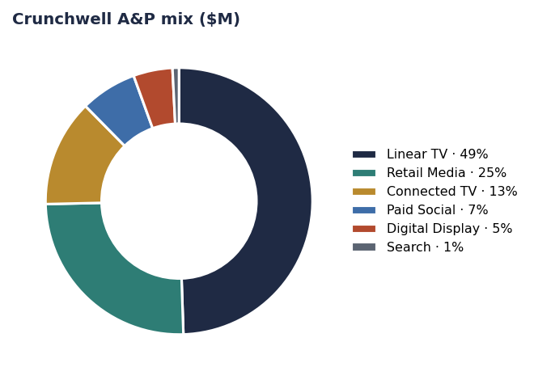
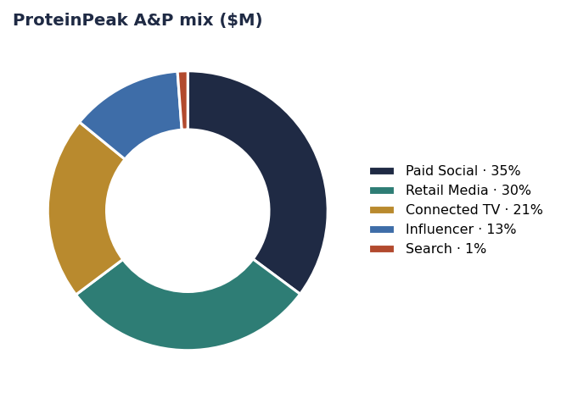
TWO MIXES
The growing brand and the flat brand spend differently
Crunchwell: $48.7M, Linear-TV-led. Reach against a shrinking occasion.
ProteinPeak: $22.2M, paid-social and creator-led with retail media close behind.
Source: seed_marketing_spend by brand and channel.
Internal · Confidential — Acme Corp synthetic demo data. Fictional; not for real decision-making.
H1 FY26 media read · 5

Slide 7
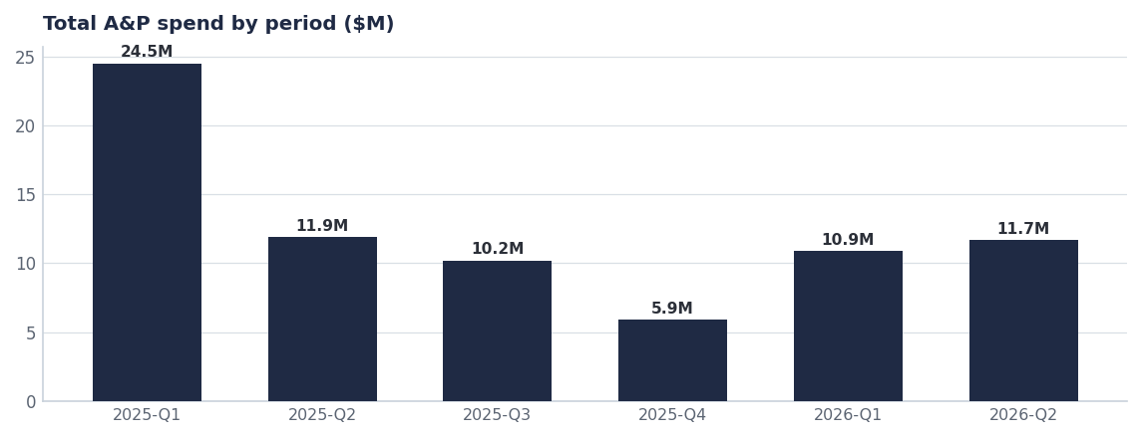
PHASING
Spend is lumpy in a category that is bought weekly
Period | A&P $M
2025-Q1 | $24.5M
2025-Q2 | $11.9M
2025-Q3 | $10.2M
2025-Q4 | $5.9M
2026-Q1 | $10.9M
2026-Q2 | $11.7M
Source: seed_marketing_spend, by period.
Internal · Confidential — Acme Corp synthetic demo data. Fictional; not for real decision-making.
H1 FY26 media read · 6

Slide 8
THE MOVE
The H2 reallocation, platform by platform
Platform | Q1 spend | H2 recommendation | Rationale
Amazon Ads | $2.4M | −$700K | Ratio 0.40; largest leak in the plan
Walmart Connect | $1.0M | +$350K | Ratio 1.20; the only platform above 1.0
Kroger Precision | $0.4M | +$200K | Ratio 0.77 and improving
Louisiana injection (cross-platform) | — | +$150K | 2.2x portfolio ROI on the LA recovery leg
Net | $4.2M | $0 | Reallocation, not incremental budget
Source: seed_retail_media_spend_q1_2026; H2 figures are the recommended plan.
Internal · Confidential — Acme Corp synthetic demo data. Fictional; not for real decision-making.
H1 FY26 media read · 7

Slide 9
ACTIONS
What we are asking for
# | Action | Owner | When
1 | Approve the $700K reallocation out of Amazon Ads | CFO / Tasha Brooks | By Aug 1
2 | Adopt modelled incrementality as the single budget-governing metric | Hugo Lin / Tasha Brooks | From Aug 1
3 | Shift a third of Crunchwell's Linear TV line into CTV, creator and retail media in FY27 | CMO / Cory Whitman | FY27 planning
4 | Smooth A&P phasing to match weekly category purchase behaviour | Hugo Lin | FY27 planning
5 | Re-read incrementality at week 8 and week 13 post-reallocation | Hugo Lin | Q4 FY26
Internal · Confidential — Acme Corp synthetic demo data. Fictional; not for real decision-making.
H1 FY26 media read · 8

Slide 10
THE ONE THING
Stop paying the platform that reports best and delivers least.
$0.65 per dollar blended, 0.40 at Amazon, 1.20 at Walmart.
$700K moves now; the Crunchwell mix shift moves in FY27.
One metric governs: modelled incrementality.
Internal · Confidential — Acme Corp synthetic demo data. Fictional; not for real decision-making.

