Slide 1
BRAND EQUITY & CONSUMER HEALTH
Q2 FY2026 Tracker Read
Six waves of equity data across the portfolio, and the one attribute that explains the Crunchwell problem
Nina Ortega, VP Consumer Insights · July 2026
Internal management presentation · Internal · Confidential — synthetic demo data

Slide 2
AGENDA
What this deck covers
01
What the tracker is telling us
06
NPS and awareness
02
Crunchwell national
07
Social sentiment
03
Crunchwell Louisiana
08
Cohort penetration
04
ProteinPeak
09
Implications
05
Competitive: Field & Honey
Internal · Confidential — Acme Corp synthetic demo data. Fictional; not for real decision-making.
Q2 FY26 equity tracker · 1

Slide 3
THE HEADLINE
One finding matters more than the rest
Across six waves, Crunchwell's Relevance fell from 68.6 to 62.7 while Trust rose from 72.3 to 72.9. That is the single most important finding in the tracker: the brand is credible and increasingly irrelevant. ProteinPeak shows the opposite profile, and Field & Honey is gaining on both.
-5.9 pp
+0.6 pp
CRUNCHWELL RELEVANCE
CRUNCHWELL TRUST
— Relevance, not Trust. Every diagnostic points the same way: consumers believe in Crunchwell and do not think it is for them.
— Modernity at 48.8 is the weakest attribute in the set. The Pack Refresh is the direct intervention.
— Louisiana is worse than national on every attribute — Relevance at 58.6 versus 62.7 nationally.
— ProteinPeak's profile is inverted: Relevance 76.2 and Modernity 79.0, both above Crunchwell.
6.5
82%
NPS, LATEST WAVE
AIDED AWARENESS
Internal · Confidential — Acme Corp synthetic demo data. Fictional; not for real decision-making.
Q2 FY26 equity tracker · 2

Slide 4
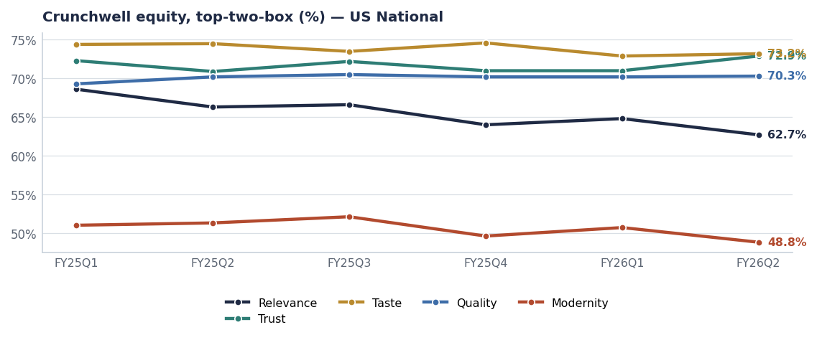
CRUNCHWELL
Six waves, five attributes, one problem
Attribute | FY25Q1 | FY26Q2 | Δ pp
Relevance | 68.6 | 62.7 | -5.9
Trust | 72.3 | 72.9 | +0.6
Taste | 74.4 | 73.2 | -1.2
Quality | 69.3 | 70.3 | +1.0
Modernity | 51.0 | 48.8 | -2.2
Source: brand_equity_quarterly, Crunchwell US-NAT.
Internal · Confidential — Acme Corp synthetic demo data. Fictional; not for real decision-making.
Q2 FY26 equity tracker · 3

Slide 5
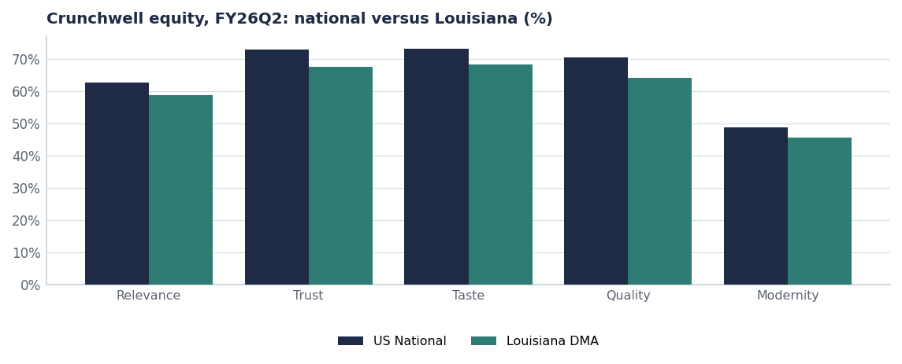
LOUISIANA
The share loss shows up in the equity data too
— Relevance 58.6 in Louisiana against 62.7 nationally.
— Trust holds locally at 67.4 — the franchise is not damaged, the presence is.
— Reading it with the distribution data: eight weeks of empty shelf next to a Larksfield endcap is a relevance event as much as an availability event.
— Implication for the recovery plan: facings and OSA first, then message. Message into an empty shelf is wasted.
Source: brand_equity_quarterly (LA-DMA vs US-NAT), seed_rouses_oos_by_door.
Internal · Confidential — Acme Corp synthetic demo data. Fictional; not for real decision-making.
Q2 FY26 equity tracker · 4

Slide 6
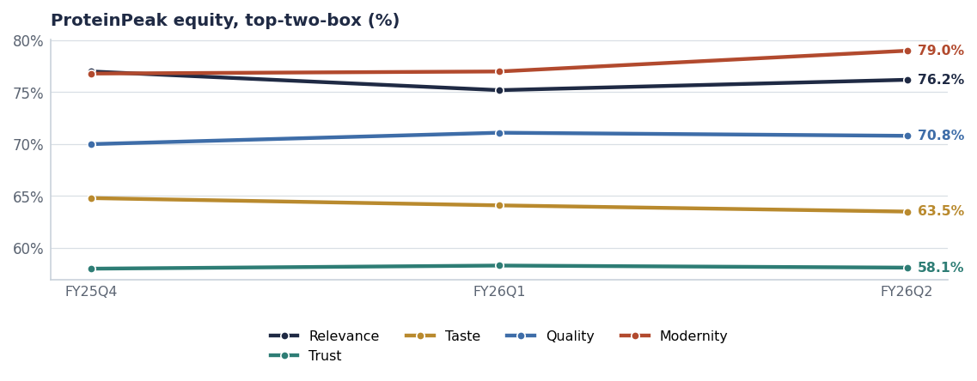
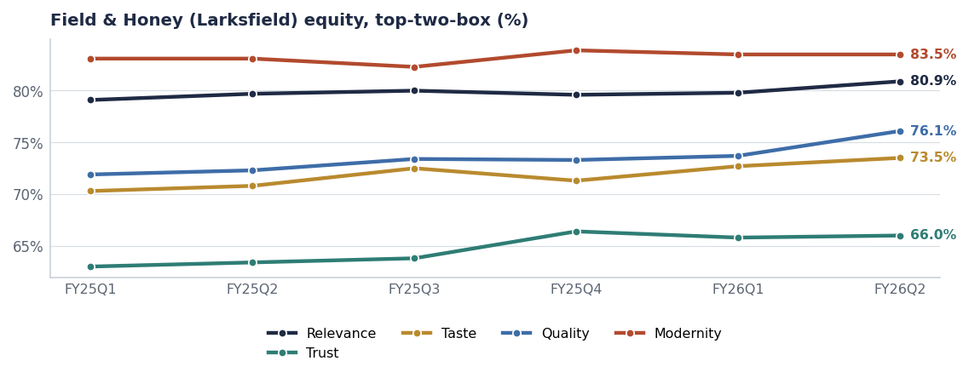
THE CONTRAST
One brand building, one competitor building faster
ProteinPeak: Relevance 76.2, Modernity 79.0 — the profile of a brand people want to be seen buying.
Field & Honey: Relevance 80.9 and rising. The aggressor is winning the attribute we are losing.
Source: brand_equity_quarterly.
Internal · Confidential — Acme Corp synthetic demo data. Fictional; not for real decision-making.
Q2 FY26 equity tracker · 5

Slide 7
CONSUMER HEALTH
NPS, awareness, taste and price sensitivity by wave
Wave | NPS | Aided awareness | Taste (1–5) | Price sensitivity (1–5)
2024Q1 | 6.47 | 81.8% | 3.59 | 3.51
2024Q2 | 6.40 | 82.9% | 3.59 | 3.50
2024Q3 | 6.47 | 83.3% | 3.52 | 3.52
2024Q4 | 6.41 | 82.6% | 3.59 | 3.60
2025Q1 | 6.41 | 81.3% | 3.57 | 3.50
2025Q2 | 6.53 | 82.5% | 3.64 | 3.55
2025Q3 | 6.44 | 82.4% | 3.57 | 3.45
2025Q4 | 6.43 | 81.8% | 3.59 | 3.54
2026Q1 | 6.51 | 81.8% | 3.62 | 3.49
2026Q2 | 6.54 | 81.9% | 3.57 | 3.53
Awareness is not the problem
Aided awareness runs around 82% and NPS is flat at about 6.5. Price sensitivity is stable. We are not short of awareness, affection or affordability — we are short of relevance.
Source: brand_health (n=16,500 responses across waves).
Internal · Confidential — Acme Corp synthetic demo data. Fictional; not for real decision-making.
Q2 FY26 equity tracker · 6

Slide 8
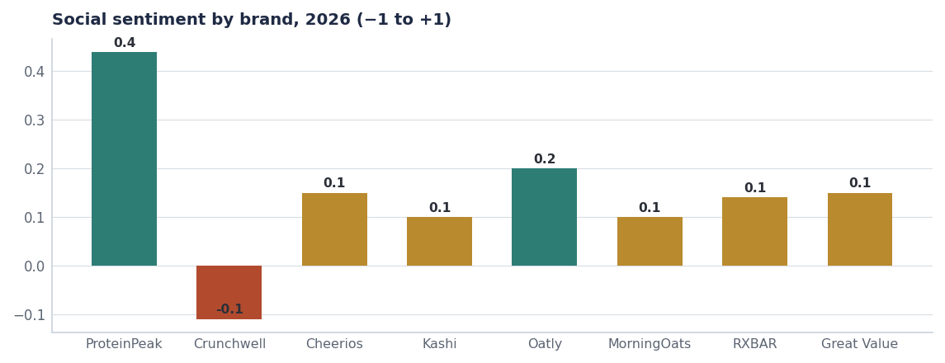
SOCIAL
Conversation confirms the tracker
Brand | Mentions | Sentiment | Reach
ProteinPeak | 496 | +0.44 | 562.1M
Crunchwell | 316 | -0.11 | 269.3M
Cheerios | 201 | +0.15 | 243.9M
Kashi | 191 | +0.10 | 199.7M
Oatly | 184 | +0.20 | 205.6M
MorningOats | 183 | +0.10 | 180.1M
RXBAR | 182 | +0.14 | 199.1M
Great Value | 180 | +0.15 | 198.4M
Source: social_mentions, calendar 2026.
Internal · Confidential — Acme Corp synthetic demo data. Fictional; not for real decision-making.
Q2 FY26 equity tracker · 7

Slide 9
IMPLICATIONS
What the insights team is asking the business to do
# | Action | Owner | When
1 | Adopt Relevance and Modernity as reported KPIs on the Crunchwell scorecard | Nina Ortega / Cory Whitman | FY27Q1
2 | Sequence the Louisiana recovery as availability first, message second | Marcus Boudreaux | From Aug 1
3 | Brief the FY27 Crunchwell platform against Relevance, not Trust or value | Cory Whitman | By Jul 15
4 | Add Field & Honey to the standing competitive tracker read | Comp Intel | Q3 FY26
5 | Recut the tracker by the four Kantar cohorts each wave, not just nationally | Jordan Hsu | Next wave
Internal · Confidential — Acme Corp synthetic demo data. Fictional; not for real decision-making.
Q2 FY26 equity tracker · 8

Slide 10
THE ONE THING
Trusted, liked, affordable — and not for me.
Relevance −5.9 pp; Trust +0.6 pp.
Louisiana is worse on every attribute except Trust.
The Pack Refresh and the platform both aim at the right target.
Internal · Confidential — Acme Corp synthetic demo data. Fictional; not for real decision-making.

