Slide 1
CATEGORY STATE OF THE BUSINESS
Q3 FY2026 Category Read
Three data sources, three answers, one reconciliation — and the consumer narrative for the back half
Nina Ortega, VP Consumer Insights · executive committee, July 22 2026
Internal management presentation · Internal · Confidential — synthetic demo data

Slide 2
AGENDA
What this deck covers
01
The reconciliation problem
05
Cohort dynamics
02
Category size and growth
06
Macro trends
03
Segment winners and losers
07
The consumer narrative
04
Acme share by instrument
08
What it means for FY27
Internal · Confidential — Acme Corp synthetic demo data. Fictional; not for real decision-making.
Q3 FY26 category SOB · 1

Slide 3
THE HEADLINE
The reconciliation is the read
The category is growing slowly and unevenly: RTE Cereal total US is up about 1.4% in Q2 QTD while Wellness Protein is up +18.6%. Our three instruments — syndicated retail measurement, household panel and internal POS — disagree on the level of Acme's share by up to two points, and reconciling them is most of the analytical work. The direction, though, is unanimous.
+1.4%
+18.6%
RTE TOTAL US GROWTH, Q2 QTD
WELLNESS PROTEIN GROWTH
— Three instruments, three answers. Syndicated value share reads Acme at 8.09%; the category database reads 5.7%; internal POS reads differently again. Each is right on its own definition.
— The Louisiana category itself is shrinking at -2.8% — roughly a fifth of our local share story is the pond, not the fish.
— Cohort dynamics are the real narrative: cereal-skipper households are growing and loyal-family is eroding. We are losing breakfast occasions, not brand preference.
— GLP-1 sits at 0.81 trend strength with a downward volume direction — the most important structural item on this page.
-2.8%
8.09%
LOUISIANA CATEGORY GROWTH
ACME SHARE, SYNDICATED
Internal · Confidential — Acme Corp synthetic demo data. Fictional; not for real decision-making.
Q3 FY26 category SOB · 2

Slide 4
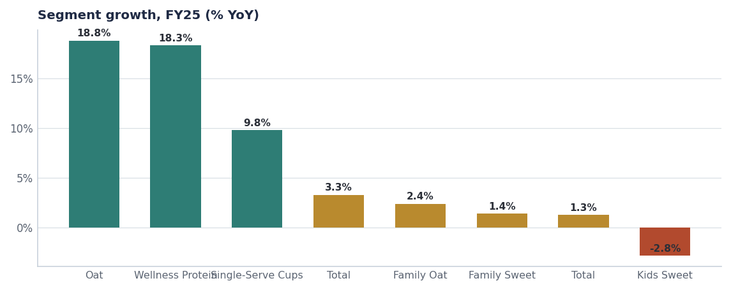
THE CATEGORY
Growth is concentrated in three pockets
Segment | Category | Size | Growth | Acme share
Oat | Plant-Based Milk | $1,640M | +18.8% | 3.8%
Wellness Protein | RTE Cereal | $840M | +18.3% | 7.6%
Single-Serve Cups | Hot Cereal | $560M | +9.8% | 7.0%
Total | Granola | $1,880M | +3.3% | 8.6%
Family Oat | RTE Cereal | $1,680M | +2.4% | 7.4%
Family Sweet | RTE Cereal | $2,860M | +1.4% | 5.9%
Total | RTE Cereal | $8,350M | +1.3% | 5.7%
Kids Sweet | RTE Cereal | $1,410M | -2.8% | 5.1%
Source: seed_category_market_size, FY2025 US National.
Internal · Confidential — Acme Corp synthetic demo data. Fictional; not for real decision-making.
Q3 FY26 category SOB · 3

Slide 5
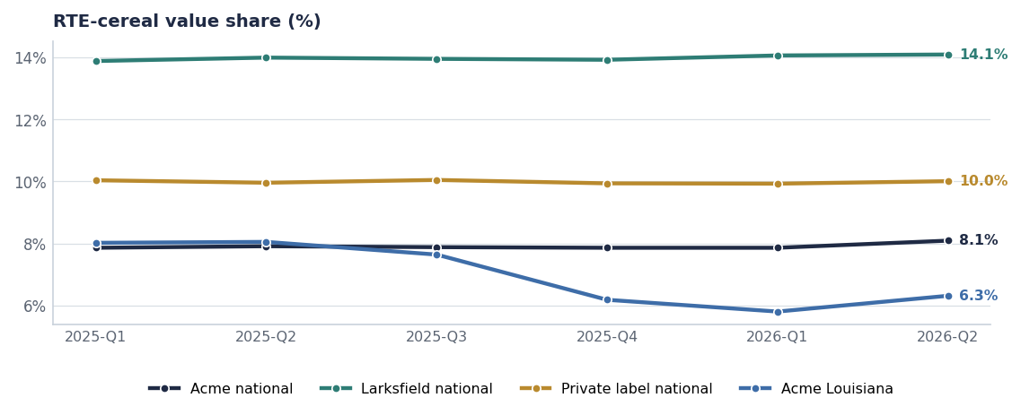
SHARE
Nationally stable, locally broken
— Acme national holds at 8.09% across six quarters — stability, not growth.
— Larksfield at 14.10% and still the share gainer nationally.
— Private label at 10.01% is flat — this is not a trade-down story.
— Acme Louisiana at 6.31% after bottoming at 5.80% — the recovery has started but is a long way from done.
Source: syndicated_weekly, RTE Cereal, quarterly averages.
Internal · Confidential — Acme Corp synthetic demo data. Fictional; not for real decision-making.
Q3 FY26 category SOB · 4

Slide 6
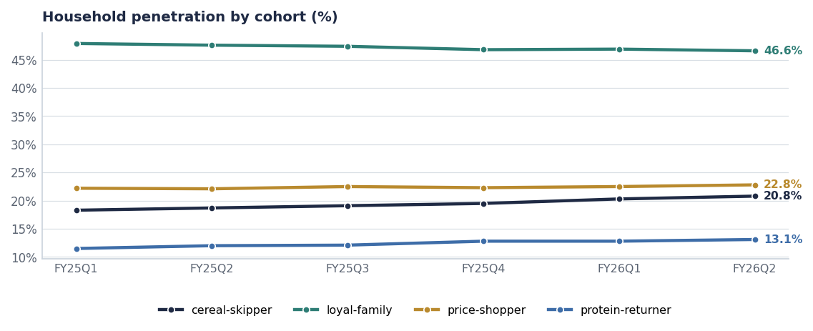
THE CONSUMER
Occasions, not preference
Cohort | FY25Q1 | FY26Q2 | Direction
cereal-skipper | 18.3% | 20.8% | Growing
loyal-family | 47.9% | 46.6% | Eroding
price-shopper | 22.2% | 22.8% | Growing
protein-returner | 11.5% | 13.1% | Growing
Source: kantar_worldpanel_cohort, US-NAT.
Internal · Confidential — Acme Corp synthetic demo data. Fictional; not for real decision-making.
Q3 FY26 category SOB · 5

Slide 7
MACRO
Nine trends, ranked by strength
Trend | Strength | Phase | Direction | Categories
High-protein cereal | 0.92 | Growth | Up | RTE Cereal
TikTok Shop grocery | 0.86 | Emerging | Up | All Categories
Plant-based milk barista | 0.84 | Growth | Up | Plant-Based Milk
Cinnamon flavor renaissance | 0.81 | Growth | Up | RTE Cereal+Granola
GLP-1 / Ozempic appetite shift | 0.81 | Growth | Down (volume impact) | RTE Cereal+Bar+Hot Cereal
Sustainable packaging | 0.74 | Growth | Up | All Categories
Limited-time offers (LTO) acceleration | 0.74 | Growth | Up | RTE Cereal+Granola+Bar
Wellness-Hero pillar consolidation | 0.74 | Growth | Up | RTE Cereal+Bar+Plant-Based
On-the-go single-serve breakfast | 0.72 | Growth | Up | RTE Cereal+Hot Cereal
The one to plan against
GLP-1 appetite shift at 0.81 strength with a downward volume direction is the trend most likely to change the shape of the category by FY29. It argues for smaller packs, higher protein and premium price-per-serving — all three of which are in the FY27 plan.
Source: seed_macro_trends, ranked by strength.
Internal · Confidential — Acme Corp synthetic demo data. Fictional; not for real decision-making.
Q3 FY26 category SOB · 6

Slide 8
NARRATIVE
The consumer story for the back half
WHAT IS TRUE
WHAT IT MEANS FOR FY27
— Breakfast is being skipped, not switched — cereal-skipper penetration is up 2.5 points.
— Protein is the permission structure for the occasion to come back.
— Chocolate and cinnamon are the flavour cues with momentum (0.81 cinnamon trend).
— Value-seeking is stable; this is not a recession story.
— Kids' cereal is structurally pressured by parent guilt, not by price.
— Fund protein and single-serve; both answer the occasion problem directly.
— Reposition Crunchwell on relevance, not on value or heritage.
— Harvest Kids Sweet rather than relaunching it.
— Plan pack architecture for smaller portions and higher price-per-serving.
— Treat Louisiana as an execution recovery, not a consumer-preference problem.
Source: kantar_worldpanel_cohort, seed_macro_trends, seed_category_market_size, brand_equity_quarterly.
Internal · Confidential — Acme Corp synthetic demo data. Fictional; not for real decision-making.
Q3 FY26 category SOB · 7

Slide 9
ACTIONS
What the executive committee is asked to take from this
# | Action | Owner | When
1 | Adopt the occasion-loss narrative as the FY27 planning frame | Executive committee | FY27 planning
2 | Publish one reconciled share number per brand per month with the instrument named | Nina Ortega / Jordan Hsu | From August
3 | Fund protein and single-serve ahead of family-size volume in FY27 | VP Brand / CFO | FY27 planning
4 | Add a GLP-1 sensitivity to the FY27–FY29 long-range plan | Strategy / FP&A | Q4 FY26
5 | Recut the tracker and panel by cohort every wave | Jordan Hsu | Next wave
Internal · Confidential — Acme Corp synthetic demo data. Fictional; not for real decision-making.
Q3 FY26 category SOB · 8

Slide 10
THE ONE THING
People are not switching away from us. They are skipping breakfast.
Cereal-skipper households up 2.5 points in six quarters.
Protein and single-serve are the answers we already own.
One reconciled share number, published monthly.
Internal · Confidential — Acme Corp synthetic demo data. Fictional; not for real decision-making.

