Slide 1
DIAGNOSTIC & RECOVERY PLAN
Crunchwell Louisiana — What Happened and What We Do About It
Five hypotheses, one attribution, and a three-leg recovery plan with named owners
Jordan Hsu (diagnostic) with Marcus Boudreaux (recovery) · July 2026
Internal management presentation · Internal · Confidential — synthetic demo data

Slide 2
AGENDA
What this deck covers
01
The number
06
Five hypotheses, one attribution
02
National versus Louisiana
07
The three-leg recovery plan
03
Channel and distribution
08
Leading indicators to watch
04
The Walmart shelf audit
09
The ask
05
The Rouses door audit
Internal · Confidential — Acme Corp synthetic demo data. Fictional; not for real decision-making.
LA diagnostic · 1

Slide 3
THE HEADLINE
340 basis points, five causes, one dominant one
Crunchwell's Louisiana share fell from about 6.4% at the Mass/Grocery peak to 3.0% in Q1 FY2026 — 340 basis points — against a flat national trend. The value-weighted all-channel cut reads milder (6.10% to 3.97%) in the same direction. Root cause is now attributed across five hypotheses, with the September 2025 Walmart modular reset accounting for roughly 55% of it. The recovery plan has three legs and is funded.
−340 bps
55%
CANONICAL PEAK-TO-TROUGH
ATTRIBUTED TO THE WALMART RESET
58%
2.2x
— The signal existed before the alarm. Q4 2025 was already down; the quarter-level read was three months ahead of the escalation.
— Louisiana share bottomed at 3.97% in 2026-Q1 and has recovered to 4.16% — roughly a third of the loss, no more.
— Attribution: Walmart facing reset ~55%, Larksfield promo intensity ~20%, Hurricane Tonya supply ~12%, private label ~8%, Hispanic-shopper mix ~5%.
— The category shrank too — Louisiana RTE is −2.8% — so roughly a fifth of the story is the pond, not the fish.
WORST DOOR OSA
ROI ON THE LA MEDIA LEG
Internal · Confidential — Acme Corp synthetic demo data. Fictional; not for real decision-making.
LA diagnostic · 2

Slide 4
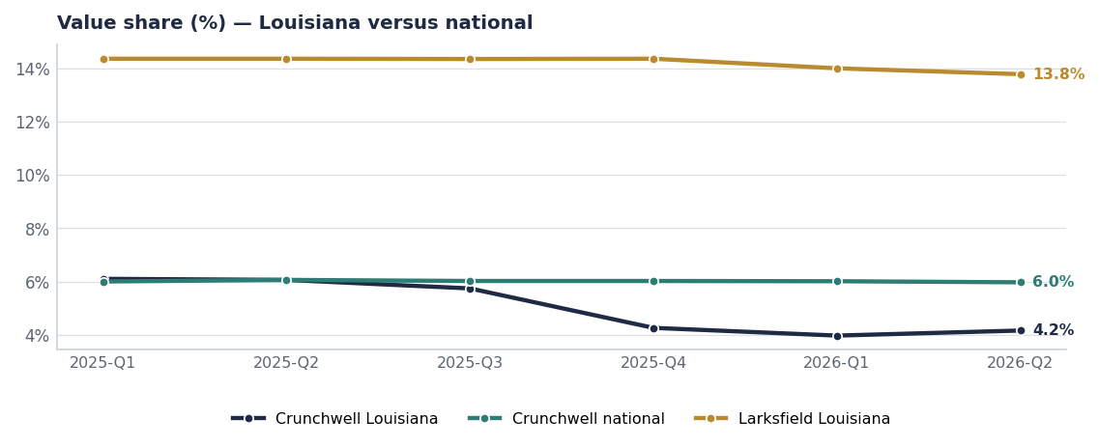
THE NUMBER
A local break against a flat national line
— Crunchwell Louisiana 6.10% → 3.97% → 4.16%.
— National held at about 5.97% through the same period — this is not a franchise problem.
— Larksfield held roughly 14.2% locally while taking our displaced volume through endcap presence rather than share-of-shelf gains.
— The canonical headline is the Mass/Grocery peak-to-trough: 6.4% → 3.0%. Both cuts are shown so the numbers reconcile across documents.
Source: syndicated_weekly (LA-DMA vs ex-LA), docs/louisiana-decline.md canonical headline.
Internal · Confidential — Acme Corp synthetic demo data. Fictional; not for real decision-making.
LA diagnostic · 3

Slide 5
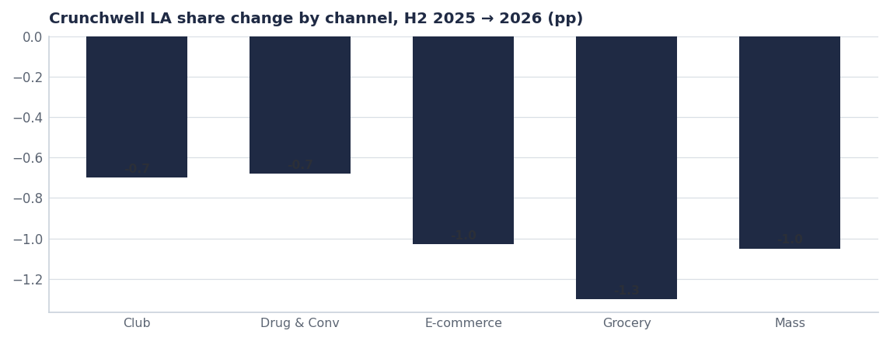
CHANNEL & SHELF
Grocery and E-commerce fell hardest; facings fell with them
Quarter | ACV | TDP | Avg facings | Promo share
2025-Q3 | 83.6% | 82 | 5.37 | 31.0%
2025-Q4 | 84.7% | 81 | 5.48 | 29.3%
2026-Q1 | 83.6% | 82 | 5.42 | 31.1%
2026-Q2 | 83.6% | 83 | 5.28 | 28.6%
Source: syndicated_weekly, LA-DMA, RTE Cereal.
Internal · Confidential — Acme Corp synthetic demo data. Fictional; not for real decision-making.
LA diagnostic · 4

Slide 6
WALMART AUDIT
The shelf tells the story better than the share number does
City | Stores | Larksfield endcaps | Acme endcaps | CW Mega facings | F&H facings | Mega OOS
Baton Rouge | 14 | 2.57 | 0.14 | 4.57 | 5.64 | 29%
Burbank | 8 | 2.50 | 0.38 | 4.50 | 5.63 | 25%
Lafayette | 5 | 2.40 | 0.00 | 4.00 | 6.00 | 0%
Slidell | 4 | 2.00 | 0.00 | 4.00 | 6.00 | 0%
Shreveport | 4 | 2.25 | 0.00 | 4.00 | 6.00 | 0%
Monroe | 3 | 2.00 | 0.00 | 4.00 | 6.00 | 0%
Alexandria | 3 | 2.00 | 0.00 | 4.00 | 6.00 | 0%
Lake Charles | 3 | 2.67 | 0.00 | 4.00 | 6.00 | 0%
All other LA cities (9) | 18 | 2.41 | 0.00 | 4.00 | 6.00 | 0%
The mechanism, in one line
Larksfield averages more than two endcaps per store to Acme's fraction of one, and Field & Honey holds more facings than Crunchwell Mega in every audited city. The reset did not just cut our facings — it handed the display to the competitor.
Source: seed_walmart_endcap_audit_la, 62 audited stores.
Internal · Confidential — Acme Corp synthetic demo data. Fictional; not for real decision-making.
LA diagnostic · 5

Slide 7
ROUSES AUDIT
Fifteen doors, and the pattern is the same in all of them
SKU | City | OSA | Q1 OOS days | Promo response | Larksfield endcap
Crunchwell Original Mega | Baton Rouge | 58% | 21 | 10% | Y
Crunchwell Original Mega | Houma | 60% | 19 | 11% | Y
Crunchwell Original Mega | Thibodaux | 62% | 18 | 12% | Y
Crunchwell Original Mega | Baton Rouge | 64% | 16 | 11% | Y
Crunchwell Original Mega | Metairie | 66% | 15 | 13% | Y
Crunchwell Original Mega | Slidell | 67% | 14 | 13% | Y
Crunchwell Original Mega | Lafayette | 69% | 12 | 14% | Y
Crunchwell Original Mega | New Orleans | 71% | 11 | 15% | Y
Source: seed_rouses_oos_by_door.
Internal · Confidential — Acme Corp synthetic demo data. Fictional; not for real decision-making.
LA diagnostic · 6

Slide 8
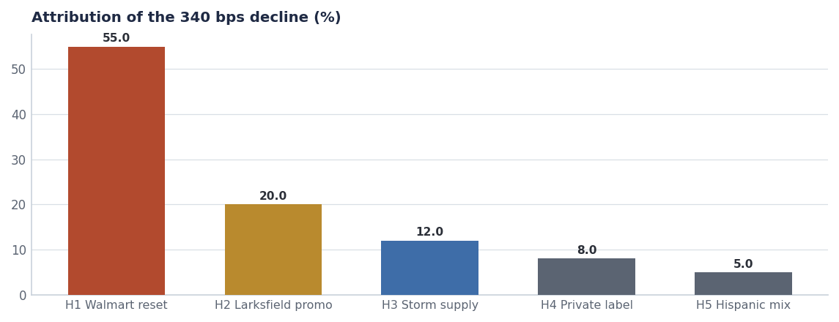
ATTRIBUTION
Five hypotheses tested, one dominant cause
— H1 — Walmart modular reset (Sep 2025): Crunchwell Mega cut from 8 facings to 6. The largest single driver at ~55%.
— H2 — Larksfield promo intensity at Rouses: ~20%, and the endcap audit shows the mechanism.
— H3 — Hurricane Tonya supply: ~12%. Houston-DC fill fell to about 52% and OSA has still not fully recovered at door level.
— H4/H5 — private label and Hispanic-shopper mix: ~8% and ~5%. Both real, both slow-moving; neither can explain an eight-week break.
Source: seed_walmart_endcap_audit_la, seed_rouses_oos_by_door, shipments, syndicated_weekly, seed_geographies.
Internal · Confidential — Acme Corp synthetic demo data. Fictional; not for real decision-making.
LA diagnostic · 7

Slide 9
RECOVERY PLAN
Three legs, named owners, measurable in 12 weeks
Leg | What we do | Investment | Owner | 12-week measure
1 · Shelf | Restore Crunchwell Mega to 8 facings at Walmart LA; win one endcap per supercenter | Line-review ask | Marcus Boudreaux | Facings ≥7.5 avg; 1+ endcap
2 · Availability | Third-party merchandising in the 14 worst doors; Rouses OSA recovery programme | ≈$0.4M | Customer Logistics | OSA ≥90% in audited doors
3 · Demand | LA retail-media injection plus targeted Rouses trade at capped depth | ≈$1.1M | Tasha Brooks / NAM | LA share ≥4.0%
Source: recovery plan as funded; ROI on the media leg is 2.2x portfolio average per seed_retail_media_spend_q1_2026.
Internal · Confidential — Acme Corp synthetic demo data. Fictional; not for real decision-making.
LA diagnostic · 8

Slide 10
EARLY WARNING
Birmingham and Memphis are the next two dominoes
Market | FY25 | Q1 FY26 | Δ bps | Tier
Louisiana DMA | 6.4% | 3.0% | -340 | Battlefield
New Orleans-Metairie MSA | 5.1% | 3.0% | -210 | Battlefield
Baton Rouge MSA | 5.8% | 4.2% | -160 | Battlefield
Lafayette LA MSA | 6.2% | 5.5% | -70 | Watch
Southeast US | 4.9% | 4.4% | -50 | Under-indexed an
Mississippi DMA | 5.3% | 4.9% | -40 | Watch
Texas | 6.3% | 6.0% | -30 | Mid-strong
Birmingham-Tuscaloosa-An | 5.7% | 5.4% | -30 | Leading-indicato
Do not wait for the alarm again
Birmingham (−30 bps) and Memphis (−30 bps) show the same early pattern Louisiana showed in Q4 2025. Weekly facing and OSA monitoring in both DMAs costs almost nothing and buys a quarter of warning.
Source: seed_geographies.
Internal · Confidential — Acme Corp synthetic demo data. Fictional; not for real decision-making.
LA diagnostic · 9

Slide 11
THE ASK
What we need agreed today
# | Action | Owner | When
1 | Take the facing restoration (6 → 8 on Mega) into the Walmart August line review as a non-negotiable | Marcus Boudreaux | Aug line review
2 | Fund third-party merchandising in the 14 worst doors for 12 weeks | Customer Logistics | From Aug 1
3 | Release the LA retail-media injection at 2.2x portfolio ROI | Tasha Brooks | By Aug 1
4 | Stand up weekly facing and OSA monitoring in Birmingham and Memphis | Jordan Hsu / Marcus Boudreaux | By Aug 15
5 | Re-read share, facings and OSA at week 12 and decide whether leg 3 scales | Jordan Hsu | Late October
Internal · Confidential — Acme Corp synthetic demo data. Fictional; not for real decision-making.
LA diagnostic · 10

Slide 12
THE ONE THING
We lost the shelf, then we lost the shopper.
340 bps, and 55% of it was a facing decision we did not contest.
Three legs: shelf, availability, demand — in that order.
Birmingham and Memphis are showing the same pattern now.
Internal · Confidential — Acme Corp synthetic demo data. Fictional; not for real decision-making.

