Slide 1
JOINT BUSINESS PLAN · FY2027
Walmart FY2027 Joint Business Plan
Category growth, the modular ask, and the protein gap we need to close together
Marcus Boudreaux, Director Sales South, with the Walmart team · August 2026
Internal management presentation · Internal · Confidential — synthetic demo data

Slide 2
AGENDA
What this deck covers
01
The partnership today
06
Our FY27 proposal
02
Where we are against plan
07
Innovation calendar
03
The protein gap
08
The joint scorecard
04
The Louisiana modular issue
09
The asks
05
Trade productivity
Internal · Confidential — Acme Corp synthetic demo data. Fictional; not for real decision-making.
Walmart FY27 JBP · 1

Slide 3
THE HEADLINE
Two fixes and one growth story
Walmart is $184M of Acme revenue at 21.4% ACV weight — our largest customer by a factor of two. Q1 ran -5.3% to plan, in line with the portfolio. Two things need fixing jointly in FY27: our Wellness Protein position at Walmart (5.2% share against 18.4% at Target on the same items), and the Louisiana modular that cut Crunchwell Mega facings.
$184M
21.4%
ACME REVENUE AT WALMART
ACV WEIGHT
— The protein gap is the growth story. Same products, same price, 18.4% share at Target versus 5.2% here. Closing half of it is worth roughly $9M of retail sales.
— The Louisiana modular cost both of us. Crunchwell Mega went from 8 facings to 6 in the September 2025 reset; category dollars in the DMA are down 2.8%.
— Trade productivity: 3 Q1 events, $2.5M of spend at an index of 0.57. We are proposing fewer, deeper, better-timed events for FY27.
— Back-to-school works here: $9.7M of incremental category dollars in the 2025 window at 41.6% kids-household cereal share — the highest of any retailer.
5.2%
18.4%
ACME WELLNESS PROTEIN SHARE AT WALMART
THE SAME NUMBER AT TARGET
Internal · Confidential — Acme Corp synthetic demo data. Fictional; not for real decision-making.
Walmart FY27 JBP · 2

Slide 4
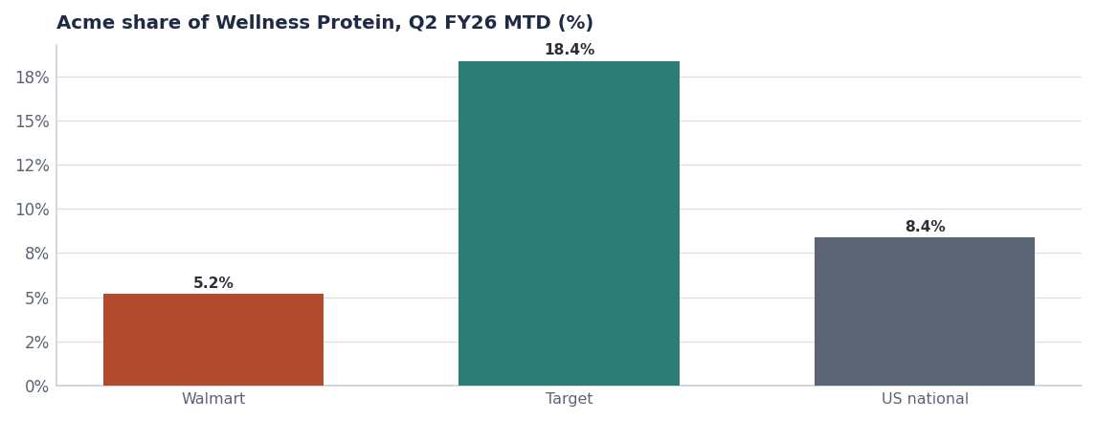
THE GAP
The same items perform three times better one retailer over
— 5.2% at Walmart against 18.4% at Target. Identical assortment, identical shelf price.
— Walmart's Wellness Protein segment grew +12.0% — the demand is here; the assortment and the merchandising are not.
— ProteinPeak velocity is 9.2 units/store/week here versus 17.5 at Target with an endcap and Roundel support.
— The ask is assortment plus one merchandising event, not price.
Source: seed_category_market_size retailer cuts, seed_proteinpeak_q2_launch velocities.
Internal · Confidential — Acme Corp synthetic demo data. Fictional; not for real decision-making.
Walmart FY27 JBP · 3

Slide 5
THE MODULAR
What the September reset did in Louisiana
City | Stores audited | Crunchwell Mega facings | Field & Honey facings | Larksfield endcaps | Mega OOS
Baton Rouge | 14 | 4.57 | 5.64 | 2.57 | 29%
Burbank | 8 | 4.50 | 5.63 | 2.50 | 25%
Lafayette | 5 | 4.00 | 6.00 | 2.40 | 0%
Shreveport | 4 | 4.00 | 6.00 | 2.25 | 0%
Slidell | 4 | 4.00 | 6.00 | 2.00 | 0%
Lake Charles | 3 | 4.00 | 6.00 | 2.67 | 0%
Metairie | 3 | 4.00 | 6.00 | 2.00 | 0%
Monroe | 3 | 4.00 | 6.00 | 2.00 | 0%
All other LA cities (9) | 18 | 4.00 | 6.00 | 2.41 | 0%
The joint case
Louisiana RTE category dollars are down 2.8% and Crunchwell share is down 340 bps. Restoring Mega to 8 facings and one endcap per supercenter rebuilds category dollars, not just our share — which is why we are bringing it as a joint ask rather than a supplier complaint.
Source: seed_walmart_endcap_audit_la, seed_category_market_size (Louisiana DMA).
Internal · Confidential — Acme Corp synthetic demo data. Fictional; not for real decision-making.
Walmart FY27 JBP · 4

Slide 6
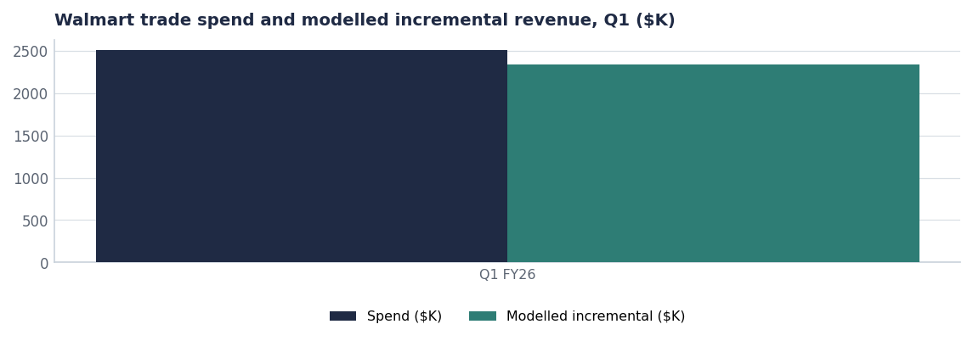
TRADE
Fewer, better events in FY27
Measure | Q1 FY26 | FY27 proposal
Events | 3 | −15%
Spend | $2.5M | Flat
Average depth | 29.5% (FY25 Crunchwell) | ≤20% on Mega
Incrementality index | 0.57 | ≥0.60
Feature-and-display weight | Baseline | +30%
Source: seed_trade_promo_events_q1_2026, seed_trade_spend_fy25. FY27 column is the proposal.
Internal · Confidential — Acme Corp synthetic demo data. Fictional; not for real decision-making.
Walmart FY27 JBP · 5

Slide 7
FY27 PROPOSAL
What we bring and what we ask
WHAT ACME BRINGS
WHAT WE ASK WALMART FOR
— ProteinPeak full-line support: endcap creative, sampling and Walmart Connect weight at the ratio-1.20 platform.
— Crunchwell Pack Refresh (Aug 15 2026) with modular-ready planograms and pre-built inventory.
— Chocolate Almond as a Q1 FY27 exclusive-window opportunity.
— Trade calendar rebuilt to a 0.60 incrementality floor — fewer, better events.
— Back-to-school programme scaled to the 41.6% kids-household share this account owns.
— Crunchwell Mega restored to 8 facings in the Louisiana DMA modular.
— One endcap per Louisiana supercenter in two windows.
— Full ProteinPeak line authorisation, including Cinnamon Crunch and Cocoa Almond.
— Joint OSA programme for the 14 lowest-performing Louisiana doors.
— Early visibility of the FY27 modular calendar so we can pre-build.
Source: seed_walmart_endcap_audit_la, seed_innovation_pipeline, seed_numerator_bts_occasion_2025, seed_retail_media_spend_q1_2026.
Internal · Confidential — Acme Corp synthetic demo data. Fictional; not for real decision-making.
Walmart FY27 JBP · 6

Slide 8
SCORECARD
The joint measures we will review quarterly
Measure | Today | FY27 target | Owner
Acme revenue at Walmart | $184M | $196M | Marcus Boudreaux
Acme Wellness Protein share | 5.2% | ≥9% | Sage Park
Crunchwell Mega facings, LA DMA | 4.1 | 8.0 | Walmart merchandising
Louisiana Crunchwell share | 3.0% | ≥4.5% | Joint
Trade incrementality index | 0.57 | ≥0.60 | Trade Finance
OSA, 14 focus doors | 74% (proxy) | ≥90% | Joint
Source: seed_retailers, seed_category_market_size, seed_walmart_endcap_audit_la, seed_trade_promo_events_q1_2026. Targets are the FY27 proposal.
Internal · Confidential — Acme Corp synthetic demo data. Fictional; not for real decision-making.
Walmart FY27 JBP · 7

Slide 9
THE ASKS
Five decisions for the August line review
# | Action | Owner | When
1 | Restore Crunchwell Mega to 8 facings in the Louisiana modular | Walmart merchandising | Aug line review
2 | Authorise the full ProteinPeak line including PP005 and PP006 | Walmart buying | Aug line review
3 | Agree one endcap per Louisiana supercenter across two windows | Joint | Q3–Q4 FY26
4 | Approve the FY27 trade calendar at a 0.60 incrementality floor | Joint | Sep 2026
5 | Stand up the joint OSA programme in the 14 focus doors | Joint | From Aug 15
Internal · Confidential — Acme Corp synthetic demo data. Fictional; not for real decision-making.
Walmart FY27 JBP · 8

Slide 10
THE ONE THING
Same products, three times the share one retailer over.
18.4% at Target versus 5.2% here.
Eight facings on Mega rebuilds category dollars in Louisiana, not just our share.
Fewer, better trade events on both sides of the table.
Internal · Confidential — Acme Corp synthetic demo data. Fictional; not for real decision-making.

