Slide 1
SHOPPER PROGRAMME & JBP · FY2027
Target Back-to-School 2026 and the FY27 Plan
Three brands, one window, and the retailer where our growth engine over-indexes
Wes Okafor, Senior Manager — Shopper Marketing, with Soo-jin Lee (Target NAM) · July 2026
Internal management presentation · Internal · Confidential — synthetic demo data

Slide 2
AGENDA
What this deck covers
01
Why Target matters more than its size
05
Media and Roundel plan
02
The back-to-school window
06
Measurement
03
Three brands on one programme
07
FY27 JBP frame
04
The protein over-index
08
The asks
Internal · Confidential — Acme Corp synthetic demo data. Fictional; not for real decision-making.
Target BTS + FY27 · 1

Slide 3
THE HEADLINE
The account where our growth engine already works
Target is $68M of Acme revenue — third largest — but it is where our growth engine works best: Acme holds 18.4% of Wellness Protein here against 5.2% at Walmart. The back-to-school window (July 13 to August 23) is the largest shopper occasion of the year in this account, worth $14.4M of incremental category dollars in 2025 with a protein-curious cohort overlap of 64.7% — the highest of any retailer.
18.4%
$14.4M
ACME WELLNESS PROTEIN SHARE AT TARGET
BTS INCREMENTAL CATEGORY $, 2025
64.7%
-5.3%
— Target is the proof case for ProteinPeak. Trial ran 110–113% of plan and velocity hit 17.5 units/store/week on the April endcap — nearly double the Walmart pilot.
— The BTS window is protein-shaped here. 64.7% overlap with the protein-curious cohort against 41.1% at Walmart, where the window is kids-shaped.
— Three brands, one programme: ProteinPeak (protein-curious), TrailGrove (lunchbox occasion) and MorningOats single-serve cups (dorm and commuter).
— Asset deadline drives everything — circular, Roundel and in-store creative lock roughly three weeks before the window opens.
PROTEIN-CURIOUS COHORT OVERLAP
Q1 REVENUE VS PLAN AT TARGET
Internal · Confidential — Acme Corp synthetic demo data. Fictional; not for real decision-making.
Target BTS + FY27 · 2

Slide 4
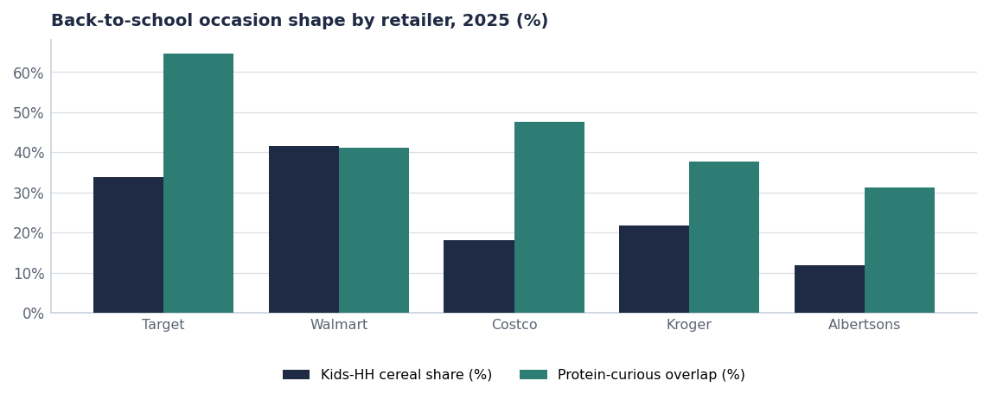
THE WINDOW
Same season, different shopper, different programme
Retailer | Kids-HH share | Protein overlap | Incremental $
Target | 33.7% | 64.7% | $14.4M
Walmart | 41.6% | 41.1% | $9.7M
Costco | 18.0% | 47.6% | $4.2M
Kroger | 21.8% | 37.6% | $4.2M
Albertsons | 11.9% | 31.2% | $4.1M
Source: seed_numerator_bts_occasion_2025.
Internal · Confidential — Acme Corp synthetic demo data. Fictional; not for real decision-making.
Target BTS + FY27 · 3

Slide 5
THE PROGRAMME
Three brands, three occasions, one window
Brand | Occasion | Mechanic | Roundel weight | Success measure
ProteinPeak | Protein-curious adult breakfast | Endcap + sampling, no price discount | 45% | Trial index ≥110; repeat ≥1.1x
TrailGrove | Lunchbox and after-school | Feature + multi-buy at capped depth | 30% | Units/store/week +15% vs LY
MorningOats cups | Dorm, commuter, single-serve | Circular feature + Target Circle offer | 25% | Segment share +50 bps
What we are not doing
No deep price discounting on ProteinPeak. The launch data says this shopper responds to display and sampling, not to depth — and a discount here trains a premium buyer to wait for promotions.
Source: seed_numerator_bts_occasion_2025, seed_proteinpeak_q2_launch, seed_trade_spend_fy25.
Internal · Confidential — Acme Corp synthetic demo data. Fictional; not for real decision-making.
Target BTS + FY27 · 4

Slide 6
THE PRECEDENT
What the April launch window looked like at Target
SKU | Retailer | Event type | Start | End
ProteinPeak Cinnamon Crunch 12oz | Target | Launch + Endcap | 2026-04-20 00:00:00 | 2026-04-20 00:00:00
ProteinPeak Cocoa Almond 12oz | Target | Launch + Endcap | 2026-04-20 00:00:00 | 2026-04-20 00:00:00
ProteinPeak Cinnamon Crunch 12oz | Target | Endcap (4-wk) | 2026-04-20 00:00:00 | 2026-05-17 00:00:00
ProteinPeak Cocoa Almond 12oz | Target | Endcap (4-wk) | 2026-04-20 00:00:00 | 2026-05-17 00:00:00
ProteinPeak Cinnamon Crunch 12oz | Target | Creator Drop | 2026-04-20 00:00:00 | 2026-04-20 00:00:00
Source: seed_proteinpeak_q2_launch.
Internal · Confidential — Acme Corp synthetic demo data. Fictional; not for real decision-making.
Target BTS + FY27 · 5

Slide 7
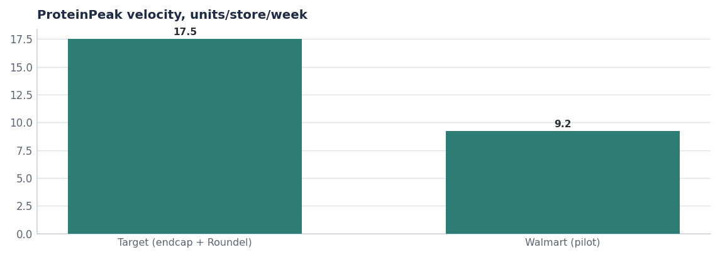
WHY IT WORKS HERE
Display plus retail media, not price
— 17.5 units/store/week at Target against 9.2 at the Walmart pilot on the same items at the same price.
— The difference is the endcap and Roundel support, not assortment depth.
— Target Circle membership overlap is high in the BTS cohort, which makes Roundel audience targeting unusually efficient in this window.
— Read-across: the BTS programme should replicate the April structure — display plus targeted media plus sampling.
Source: seed_proteinpeak_q2_launch, seed_numerator_bts_occasion_2025.
Internal · Confidential — Acme Corp synthetic demo data. Fictional; not for real decision-making.
Target BTS + FY27 · 6

Slide 8
FY27 FRAME
Beyond the window
WHAT ACME COMMITS FOR FY27
WHAT WE ASK TARGET FOR
— Grow Acme revenue at Target from $68M toward $76M.
— Chocolate Almond into the Q1 FY27 assortment following the Q4 line review.
— Roundel investment weighted to the protein-curious and BTS audiences.
— Crunchwell Pack Refresh planograms ready for the FY27 reset.
— No incremental depth on ProteinPeak; growth from display and distribution.
— BTS endcap for ProteinPeak in the July 13 to August 23 window.
— Circular feature for TrailGrove and MorningOats cups in weeks 30 and 33.
— Chocolate Almond authorisation at the Q4 FY26 line review.
— Shelf-space parity for the ProteinPeak line at the FY27 reset.
— Joint post-window read on trial, repeat and incremental category dollars.
Source: seed_retailers, seed_innovation_pipeline, seed_concept_test_chocolate_almond.
Internal · Confidential — Acme Corp synthetic demo data. Fictional; not for real decision-making.
Target BTS + FY27 · 7

Slide 9
THE ASKS
What has to be agreed and by when
# | Action | Owner | When
1 | Confirm the BTS endcap and circular positions | Soo-jin Lee / Target buying | By Jun 12 (asset lock)
2 | Lock creative and Roundel audiences for all three brands | Wes Okafor / Hugo Lin | By Jul 1
3 | Authorise Chocolate Almond at the Q4 FY26 line review | Target buying | Q4 FY26
4 | Agree the joint post-window measurement plan | Wes Okafor | By Jul 1
5 | Read trial, repeat and incremental dollars at window close | Wes Okafor / Maya Chen | Sep 2026
Internal · Confidential — Acme Corp synthetic demo data. Fictional; not for real decision-making.
Target BTS + FY27 · 8

Slide 10
THE ONE THING
The window is protein-shaped here. Build for that.
64.7% protein-curious overlap — the highest of any retailer.
Display, sampling and Roundel — no depth on a premium item.
$14.4M of incremental category dollars is the prize.
Internal · Confidential — Acme Corp synthetic demo data. Fictional; not for real decision-making.

