Slide 1
Indoor Positioning System
Presented by
Group-09

Slide 2
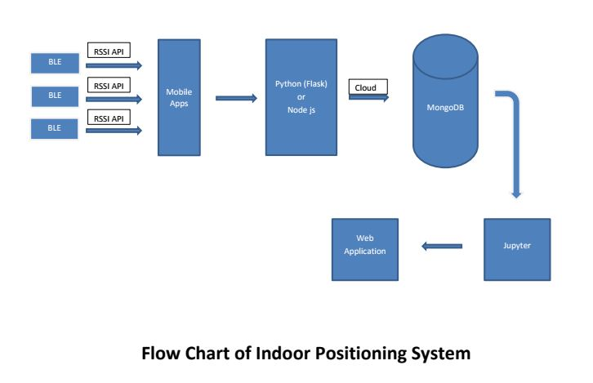

Slide 3
Progress
Circuit simulation is completed
.Set communication between BLE(HM-10) and build in Android apps.
.Data can be stored in MongoDB from Sensors.
.Generating graphs by JUPITAR NOOTBOOK using Plotly.
.Web application is progressing.

Slide 4
Problems:
Need at least 3 pieces of HM-10 BLE and relevant equipment's.
Need support for Android apps development.

