Slide 1
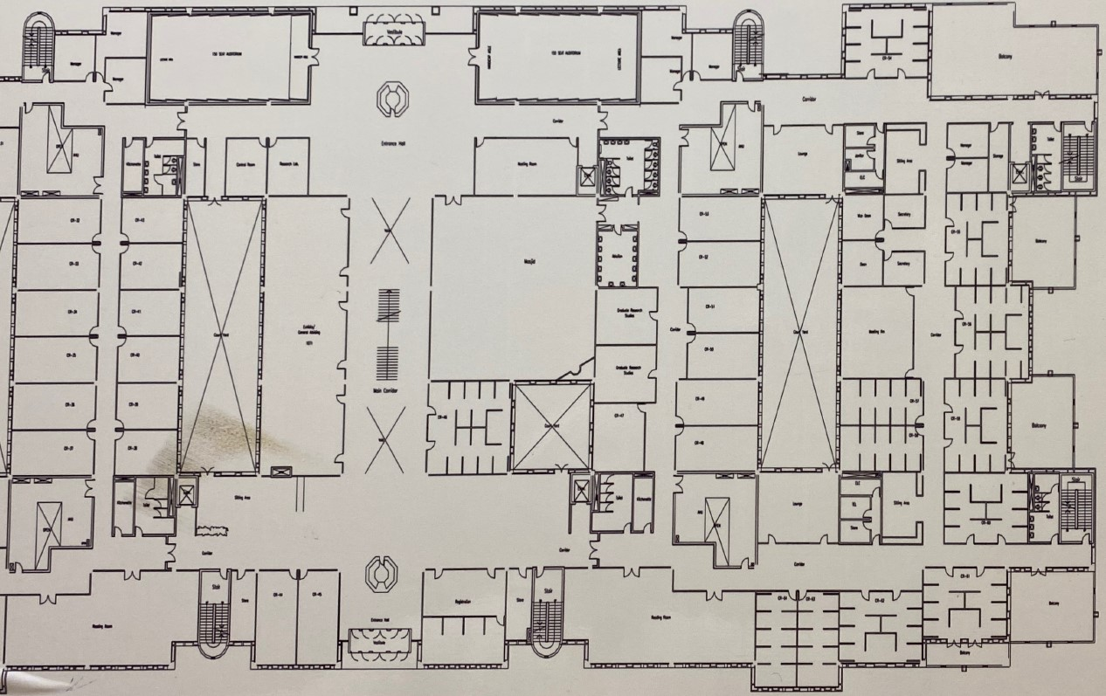
Site2- King Saud University, College Of Computer And Information Science

Slide 2
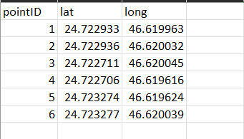
Coordinates of points on the map
Site2- King Saud University, College Of Computer And Information Science
The previous 6 points information on map after Georeferencing

Slide 3
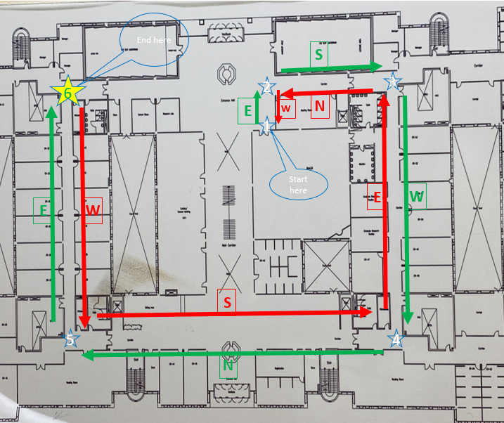
1-2 _E 1-3 _E_S 1-4 _E_S_W 1-5 _E_S_W_N) 1-6 _E_S_W_N_E)
2-3 _S 2-4 _S_W 2-5 _S_W_N 2-6 _S_W_N_E_
3-4 _W 3-5 _W_N 3-6 _W_N_E
4-5 _N 4-6 _N_E
5-6 _E
wb6-5 _W wb6-4 _W_S wb6-3 _W_S_E wb6-2 _W_S_E_N wb6-1 _W_S_E_N_W
wb5-4 _S wb5-3 _S_E wb5-2 _S_E_N) wb5-1 _S_E_N_W)
wb4-3_E wb4-2_E_N wb4-1_E_N_W
wb2-1_W wb3-2_N wb3-1_N_W
wb3-2_N
walkForward (wf) = 6
walkBackword (wb) = 5
Stop = 6
17 cases

Slide 4
احداثيات النقاط على الطبيعة (الخريطة)

