Slide 1


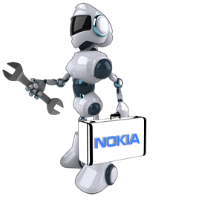

’S
- Sudhagar Nagarajan (Sun)
- Gogulakrishnan Thiyagarajan (Gogs)

Slide 2
What’s BuddyBot?
It’s a virtual agent which is available in every employee’s buddy list on communicator.

Slide 3
Goals
It avoids human presence for the majority of the services provided by IT and Support.
Reduces customer wait time.
Entire or part of IT and Support can be put in self-service mode in order to maintain the best customer experience.

Slide 4
BuddyBot Services
It provides following services:
    IT Services
    Hosted Services
    Information Services

Slide 5
BuddyBot Services
IT services
  It promptly responds to most of the IT service requirements without putting the customers in queue.
  For example:
        Creating new user account
        Reset password
        Providing sudo access
        Creating tickets and etc.

Slide 6
BuddyBot Services
Hosted Services
  It provides most of the services provided by Hosted Services.
  For example:
        Running SQL queries on CERT/PROD environments
        Tagging the devices
        Scheduling policies
        Restarting managed nodes and etc.

Slide 7
BuddyBot Services
Information Services
- It provides helpful information that any employee may require.
  For example:
        Whom to contact for desk phone issue?
        What’s the support desk phone number?
        What’s the URL for Nokia’s training portal?
        What’s the URL for time sheet? and etc.

Slide 8
Technologies/API’s used
Facebook Messenger API
Node.JS
  Express module
  Request module
  Body-Parser module and etc.
Java
  Jersey API
  JSch API

Slide 9






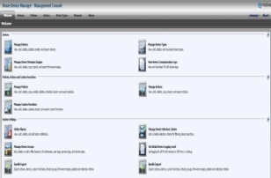









Current Deployment Architecture
BuddyBot App
Hey
Callback
Hi
Heroku
{JSON}
HDM
NBI
ssh
BuddyBot
Services
ssh

Slide 10


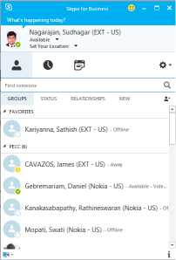
Actual Deployment Architecture
Callback
HDM
NBI
BuddyBot
App
ssh
{JSON}
BuddyBot
Services
ssh

Slide 11
Demo

Slide 12
Q&A

Slide 13
Thank You

