Slide 1

Notes:
"John has added short shell commands for his own day-to-day workflow: selecting
candidates, launching calculations, and inspecting jobs and output files."

Slide 2
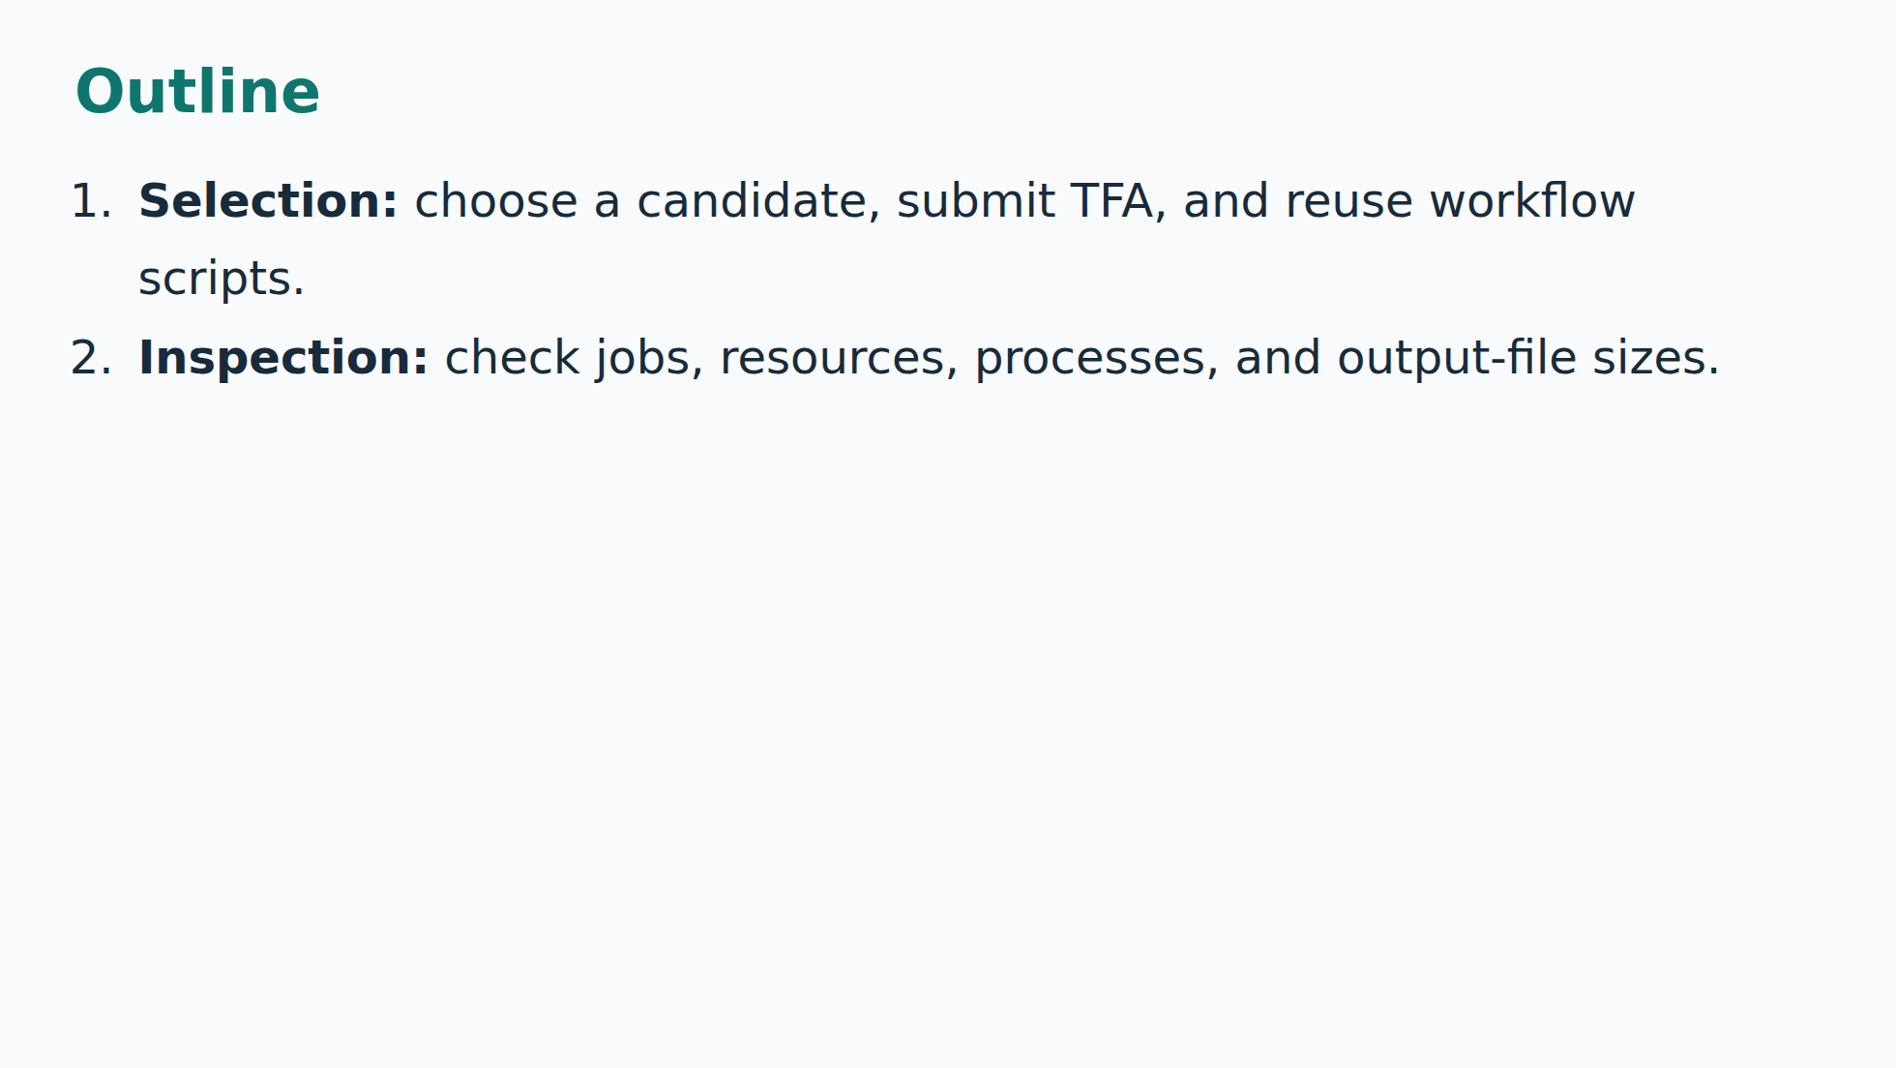
Notes:
"We will start with candidate selection and submission, show how these helpers
fit around existing scripts, then check jobs and output-file sizes."

Slide 3
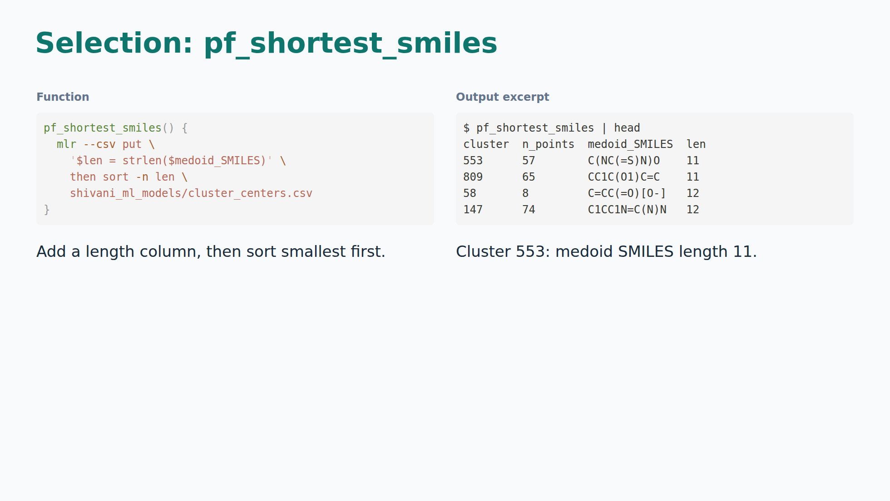
Notes:
"John is improving his own ergonomics for running the existing
workflow. This helper puts shorter candidate structures first, so it is easy
to pick a starting case. Here that is cluster 553."
SMILES length is a selection heuristic, not a runtime prediction.
Selected columns and rows retain the supplied values.

Slide 4
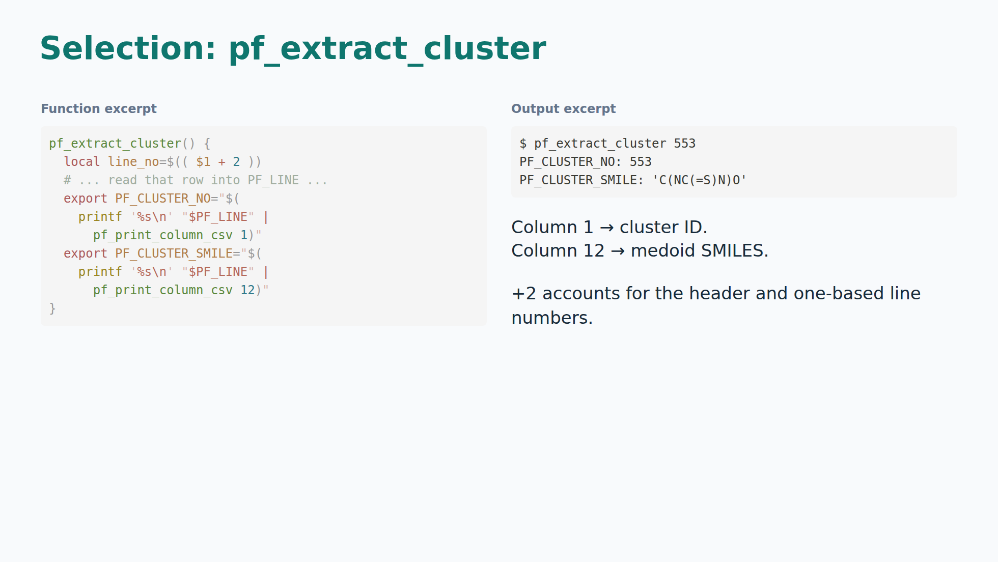
Notes:
"The next helper remembers the selected candidate's ID and
structure. John can reuse them in the next command instead of copying a long
CSV row by hand."
pf_print_line uses awk NR == n; pf_print_column_csv uses awk -F','. This is a
row-index lookup, not a search for a cluster ID, and assumes the CSV layout.

Slide 5
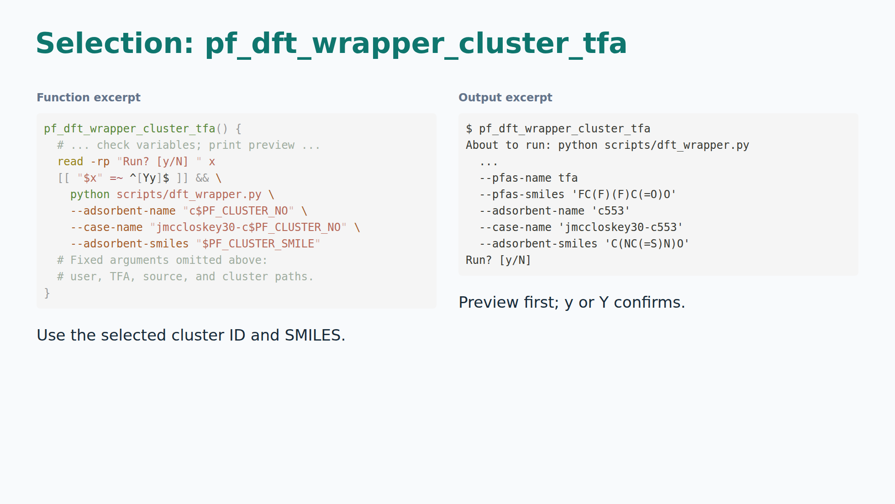
Notes:
"This fills in the candidate and TFA inputs, then shows the command
before running it. It saves typing and gives John a quick check before saying
yes. The following slides show his running jobs."
This explanatory excerpt omits fixed arguments and is not a replacement for
the real function. The full version passes --submit-if-missing and fixed
user/source/root/workflow/PFAS options. This capture does not show a response
or job receipt, so it alone does not prove submission.

Slide 6
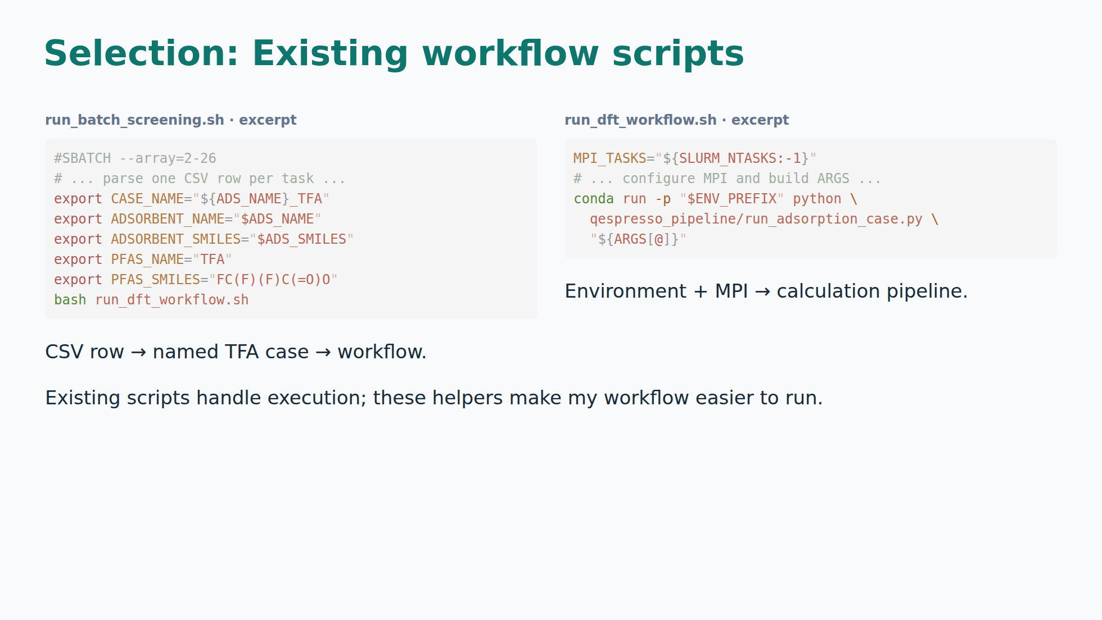
Notes:
"Some of this repeats existing tooling. Batch screening already
selects candidates, and the workflow script runs the calculations. John's
focus is his own ergonomics: less typing, easier checks, and better visibility
into jobs and storage. These helpers sit around the existing workflow."
Batch input is simple_adsorbents.csv, not the medoid CSV, so candidate libraries
differ. The array has 25 tasks, each requesting 4 MPI tasks and 192G memory;
that is RAM, not a disk-storage allowance. Actual directives take precedence
over stale comments mentioning 100 rows and 64G. It uses Python csv.reader,
which is more robust than the aliases' awk comma splitting. The aliases also
call the existing dft_wrapper.py and shared workflow rather than implementing
the DFT pipeline again. No claim that these scripts already inspect file sizes.

Slide 7
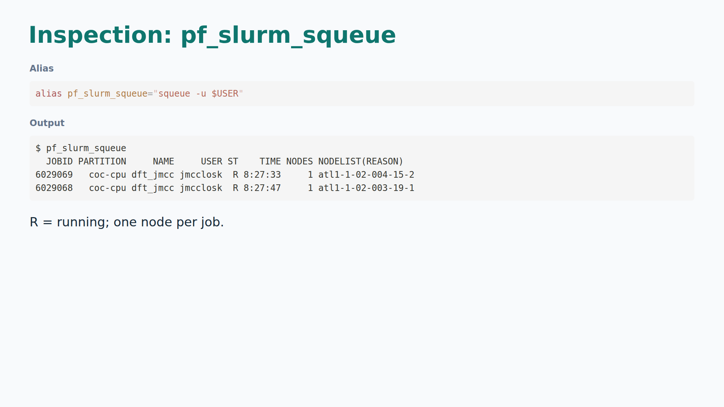
Notes:
"One short command shows John's jobs. Both are running on one
node each, for about eight and a half hours."
Historical user-supplied snapshot, not a fresh cluster query.

Slide 8
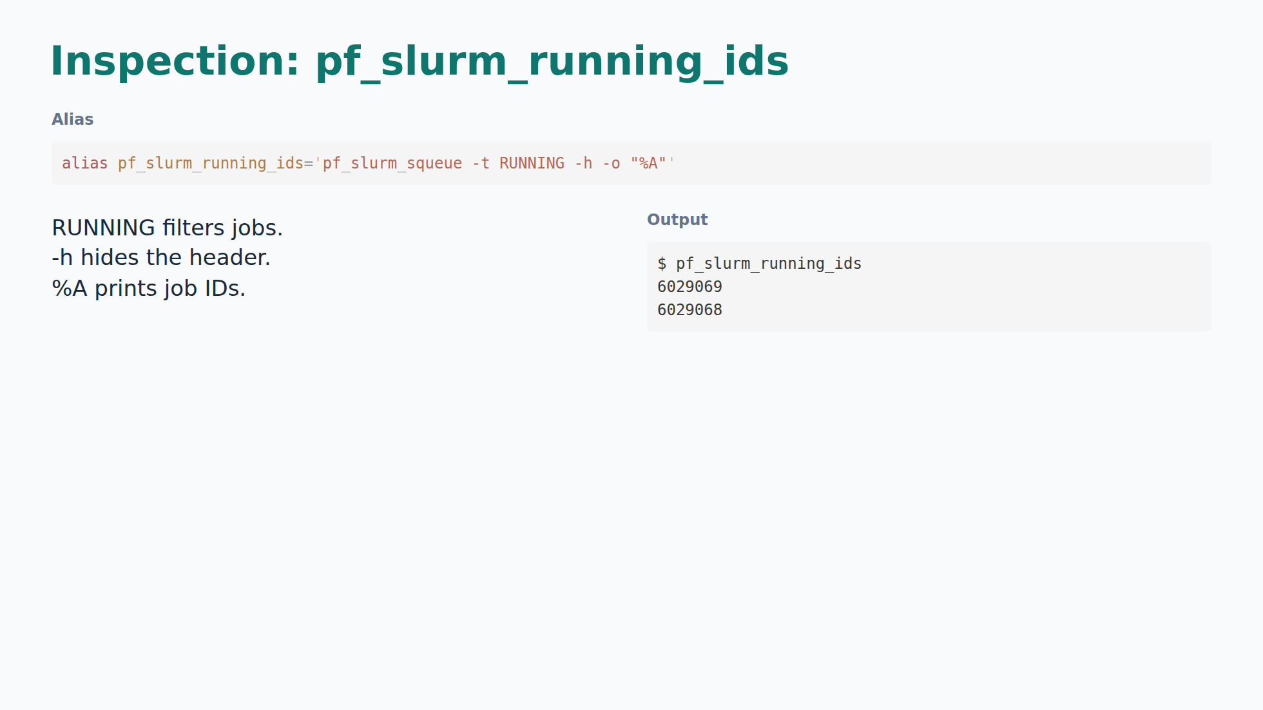
Notes:
"This returns just the running job numbers. Other helpers can use
that list automatically, saving another copy-and-paste step."

Slide 9
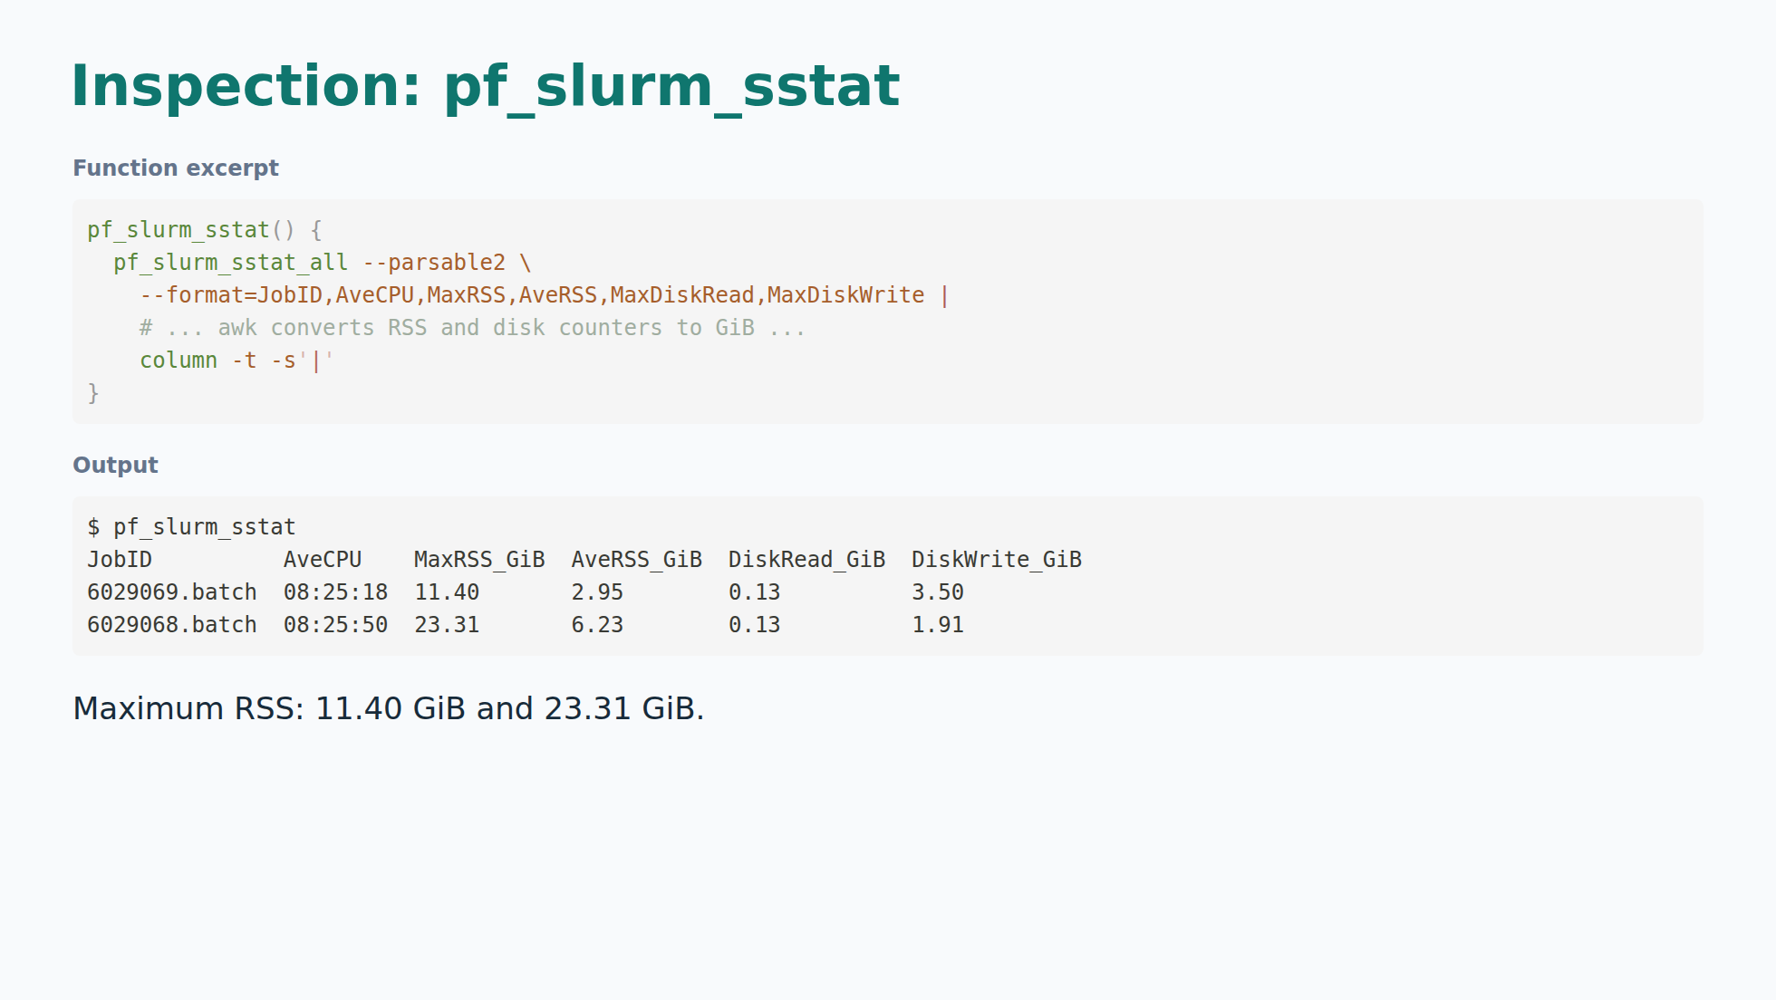
Notes:
"This makes memory and disk activity easier to read. The second
job reports about twice the maximum memory use. John can quickly see which
run deserves closer inspection."
pf_slurm_sstat_all appends .batch to IDs, joins with commas, and calls sstat.
The omitted awk strips K from RSS and divides by 1048576, divides disk counters
by 1073741824, relabels headers, and formats two decimal places. This excerpt
is not runnable. AveCPU is CPU time, not elapsed time; MaxRSS is not allocation
memory. Disk columns are maximum task counters, not summed job I/O.

Slide 10
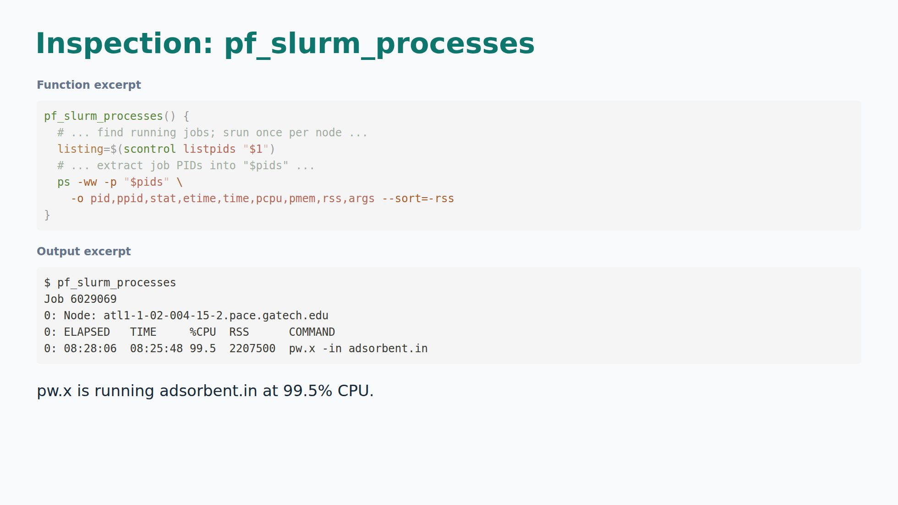
Notes:
"This shows the actual calculation inside the job. The adsorbent
calculation is still using about one CPU. It is a useful activity check;
John still needs the calculation output to confirm a finished result."
The excerpt shows the original inner commands without their outer context.
Original srun uses --overlap --exact --immediate=10 with one task/CPU per node
and --label. Output retains exact supplied values for selected fields, omitting
PID, PPID, STAT, %MEM, other processes, and Slurm prolog lines. Parent command
shows jmccloskey30-c553, mpirun -np 1, and --skip-pfas. Not runnable as shown.

Slide 11
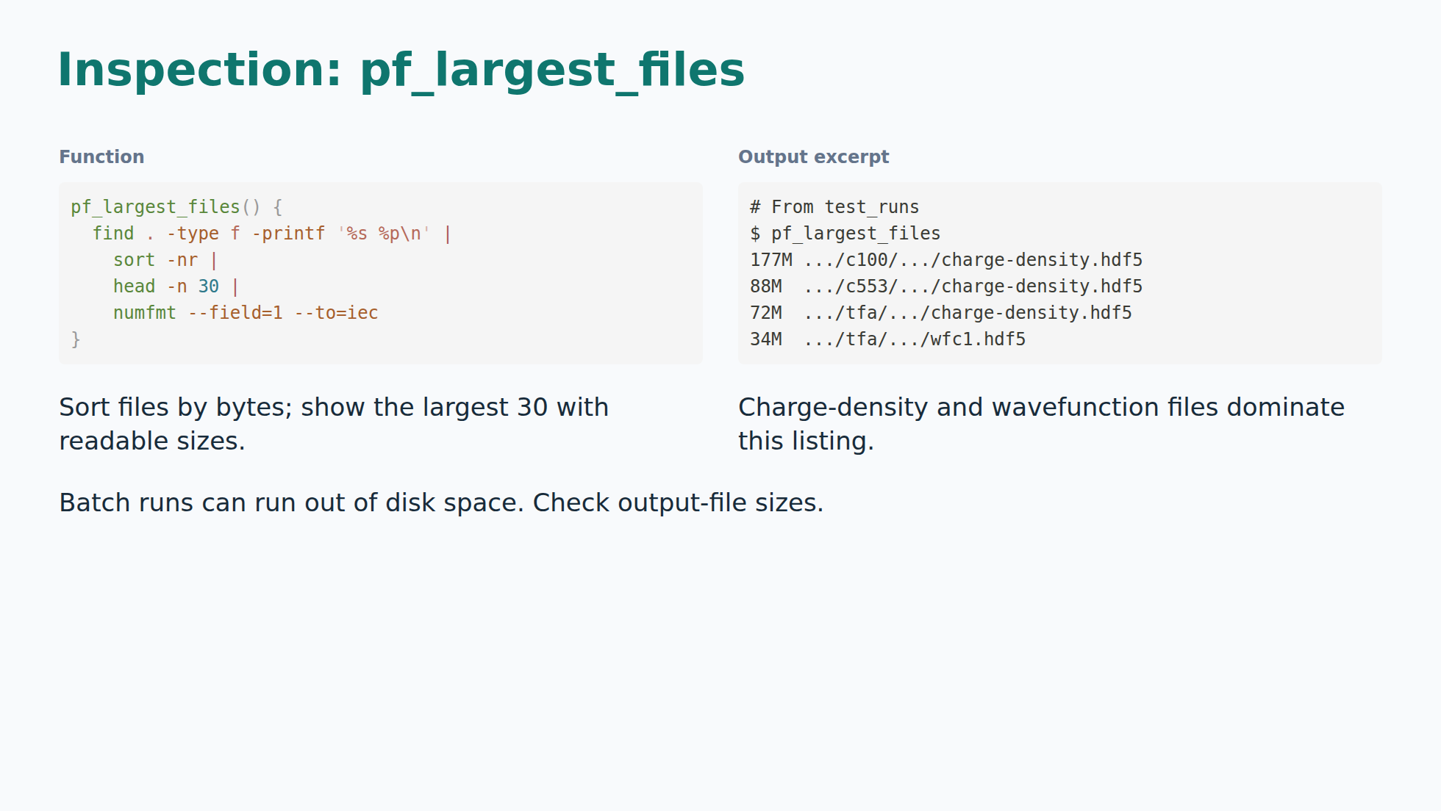
Notes:
"The biggest files here are calculation artifacts.
Checking output sizes matters: many batch cases multiply these artifacts and
can run out of space. We already have a disk-quota failure in a sample log."
Full paths are under compounds/adsorbents/c100/Outputs/adsorbent.save,
compounds/adsorbents/c553/Outputs/adsorbent.save, and
compounds/pfas/tfa/Outputs/pfas.save. First four supplied entries shown.
Source of quota failure: scripts/sample_logs/simple_screen_5898218_9.out.
Largest files alone are not a quota or total-storage measurement.
Do not infer that c100 belongs to job 6029068 from these separate logs.

