Slide 1


Slide 2

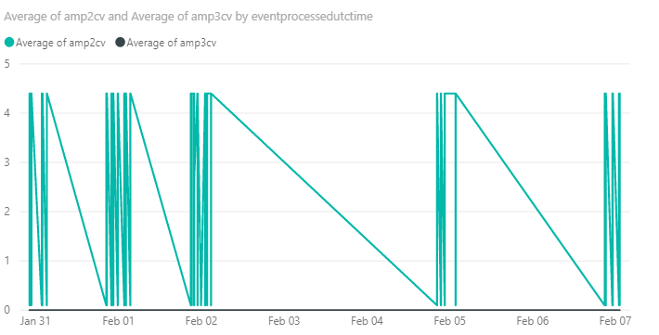
Goal
Notes:
Goal:
To turn MQTT data coming from the sensors into a more visual representation using Azure.

Slide 3
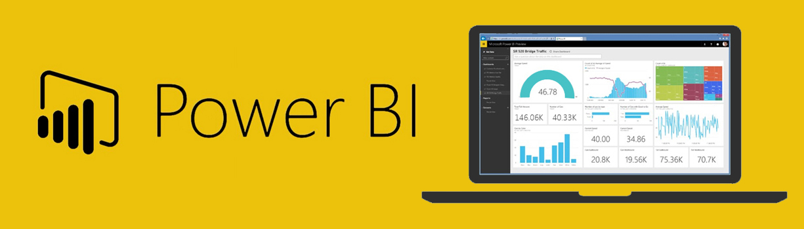
Data Visualisation
Notes:
Azure Power BI
A business analytics service
Provides live dashboards and interactive historical reports for monitoring services

Slide 4
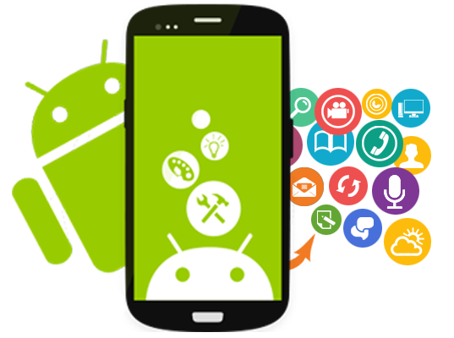
Mobile App
Notes:
After choosing Power BI
Searched up if they have an API suitable for mobile applications - YES
Decided to create a mobile application - specifically Android because Harry specialises in native Android development and Paul owns an Android device
Also, by creating a mobile application specifically for GetUnified, it allows multiple users to use GetUnified’s app without creating a Power BI account for each user. Gives GetUnified more freedom in terms of adding own functionality, etc.

Slide 5
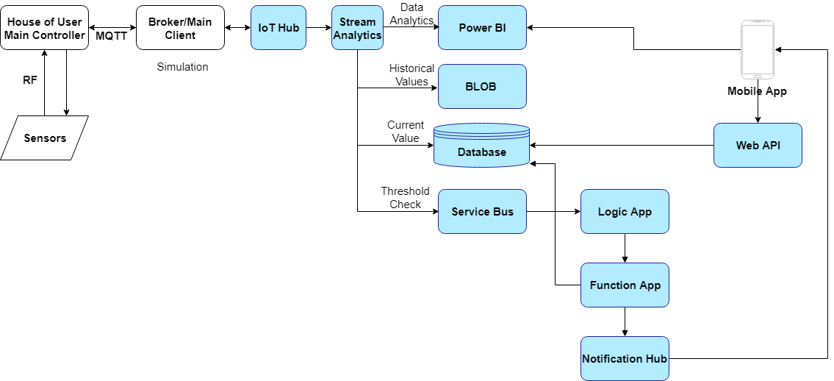
MQTT Data to Mobile App
Notes:
Next, we needed to figure out how to send the MQTT data to the Android app using Azure.
Here, you can see our system architecture diagram. Boxes in blue are Azure services.
Main idea - get sensor data to mobile app
Initial solution: main client would be a UWP app running on a Raspberry Pi.
Had technical difficulties with the MQTT stream so decided to use a console app simulator.
Console app will work the same way as the UWP app - but need to use UWP for RPi because of compatibility.
IoT Hub
A bi-directional channel that lets devices talk to the cloud and vice versa.
Kind of like an entry point to the cloud from the devices’ perspective.
Only saves data for 7 days temporarily.
Stream Analytics
For real-time analytics and querying of data coming in from IoT Hub
Chose 4 outputs for data:
Power BI - data analytics
BLOB - to store historical values
stored in yyyy/mm/dd format
each JSON file will store all the data for all the sensors - can distinguish sensors using topic which is included in the messages (MAC address + sensor ID)
Database
The current value of each sensor is updated at a certain interval e.g. 10 secs (can be adjusted)
Service bus queue - allows more data processing using logic apps
Logic App - triggered by service bus
Function app - for more data processing
Checks the database if the current value of the sensor meets a certain threshold
If yes, calls Notification Hub to send a push notification to the mobile app and also sends an email to the owner (for today, I’ll act as the owner because this is my laptop)
Mobile app + Web Api -> Harry
Calls Power BI to view historical data using reports.
Still adjusting UI of Power BI report
Calls the Web API to:
Obtain current value (automatically refreshes after a certain amount of time)
Allows threshold limits to be set (e.g. maximum and minimum value for getting push notifications).
Ask if there’s any questions. Else, pass to Leo to talk about his part, then Li, then Harry.
After Harry’s part -> Demo (next slide)

Slide 6
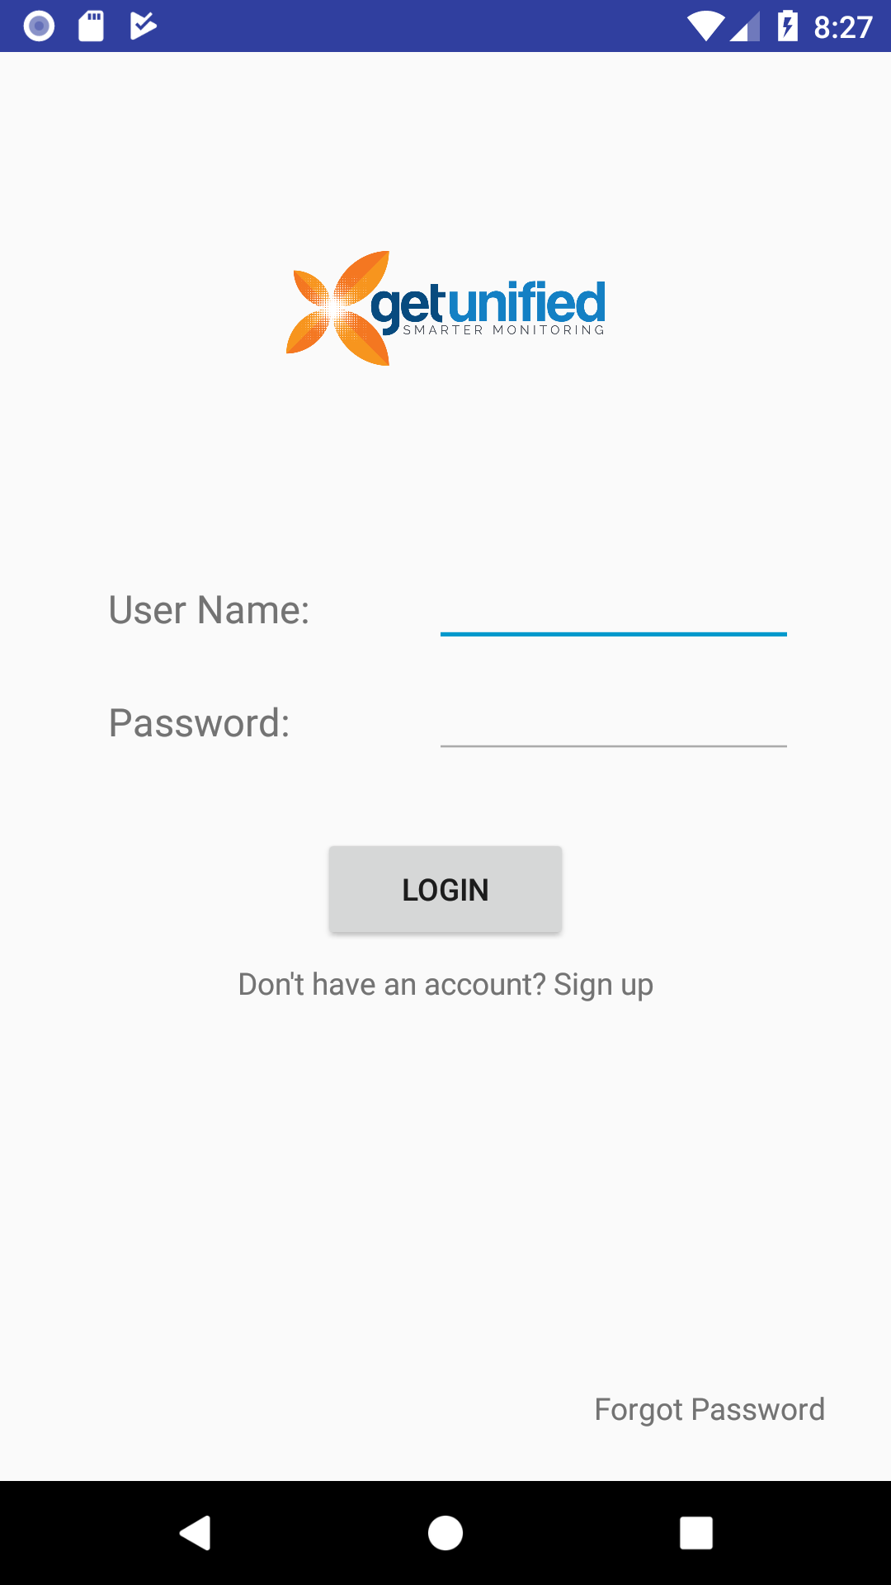
GetUnified App Demo

Slide 7
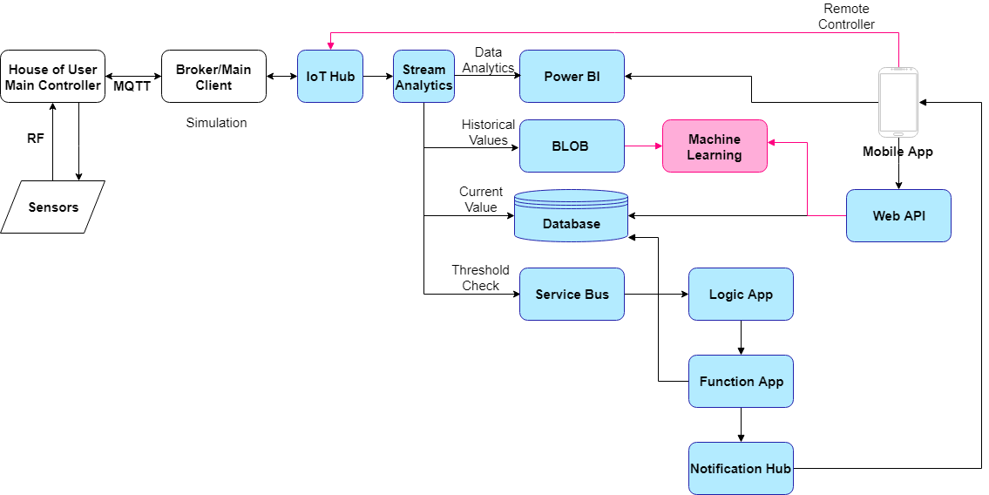
Next Phase
Notes:
Next phase
Add remote controller functionality
Turn on/off sensors
Azure Machine Learning
Already have data from BLOB
Need to gather a couple weeks worth of data then do some machine learning
Identify patterns in data
Suggest some predictive maintenance (e.g. when to order a new LPG bottle, more water, etc.)

Slide 8
Thank you!
Questions?

