Slide 1

getvariant.com
Variant Overview
1/9
© Variant, Inc.

Slide 2
Problem Statement
getvariant.com
S3_{green}
S3.1_{green}
S1_{blue}
S2_{blue}
S1
S2
S3
S2_{red.A}
S3_{red.A}
S2_{red.B}
Control: present experience, basis for statistical inference.
Experiences are bags of states. In Web world a state is roughly a page.
An experiment may have multiple variant experiences.
A state may be instrumented by many tests — multivariate instrumentation.
Experience may vary arbitrarily: state change, deletion or addition.
2/9
© Variant, Inc.

Slide 3


The Artless State-of-the-Art
getvariant.com
Experiment data
Experiment meta data
Very limited variance: only top 10% of the stack is instrumentable.
Unactualized experiment metadata.
Practically impossible to use operational data in test targeting.
Likewise, very hard to correlate experiment data with the operational data.
Implementation is entirely throwaway code.
Takes advantage of organizational dysfunction where Marketing does its own dev work behind engineers’ backs.
Productization risk.
Runtime Service API
Config & Analysis Webapp
Service JS Library
Marketing +
Content Management
Browser
HTML/CSS/JavaScript
Server
Java/Ruby/Python
Development +
Configuration Management
Operational data
3/9
© Variant, Inc.

Slide 4
Overall Architecture
getvariant.com
Browser
HTML/CSS/JavaScript
Variant
JS Library
Runtime Service API
Config & Analysis Webapp
Server
Java/Ruby/Python
Variant
Java Library
Experiment data
Experiment meta data
Operational data
Full stack integration: any new experience can be instrumented as an RCT against the current experience.
Fully actualized experiment metadata based on a novel RCT model.
Experience implementation is 100% reusable for eventual productization: low risk.
Complete separation between experience implementation and experiment instrumentation.
Complete real time integration between operational data and experiment data.
4/9
© Variant, Inc.

Slide 5
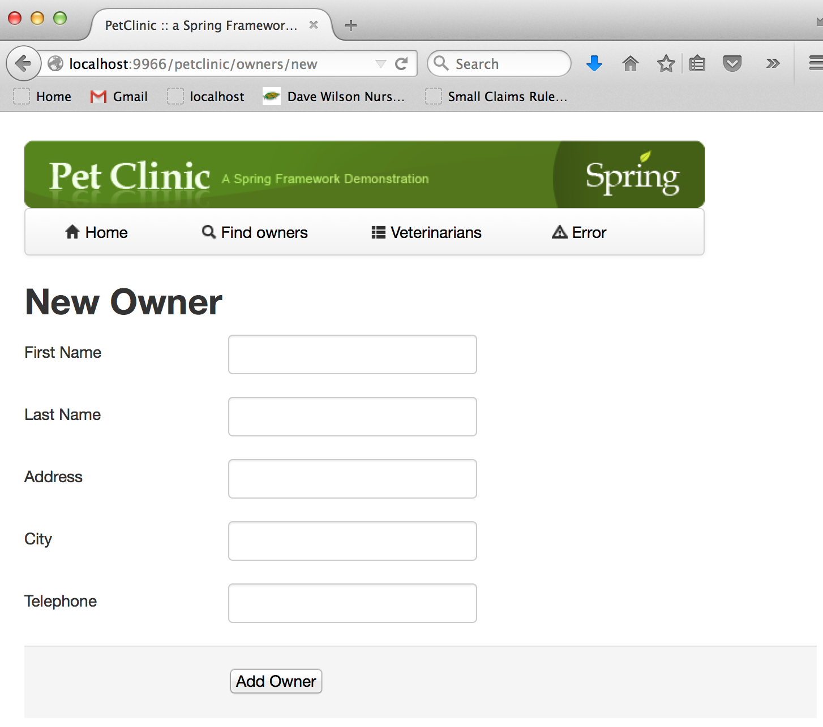
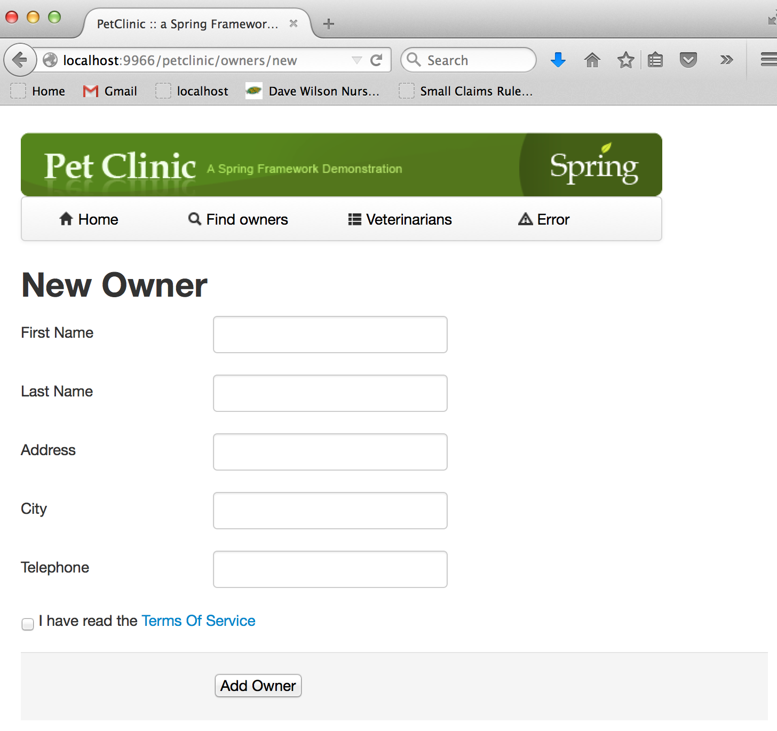
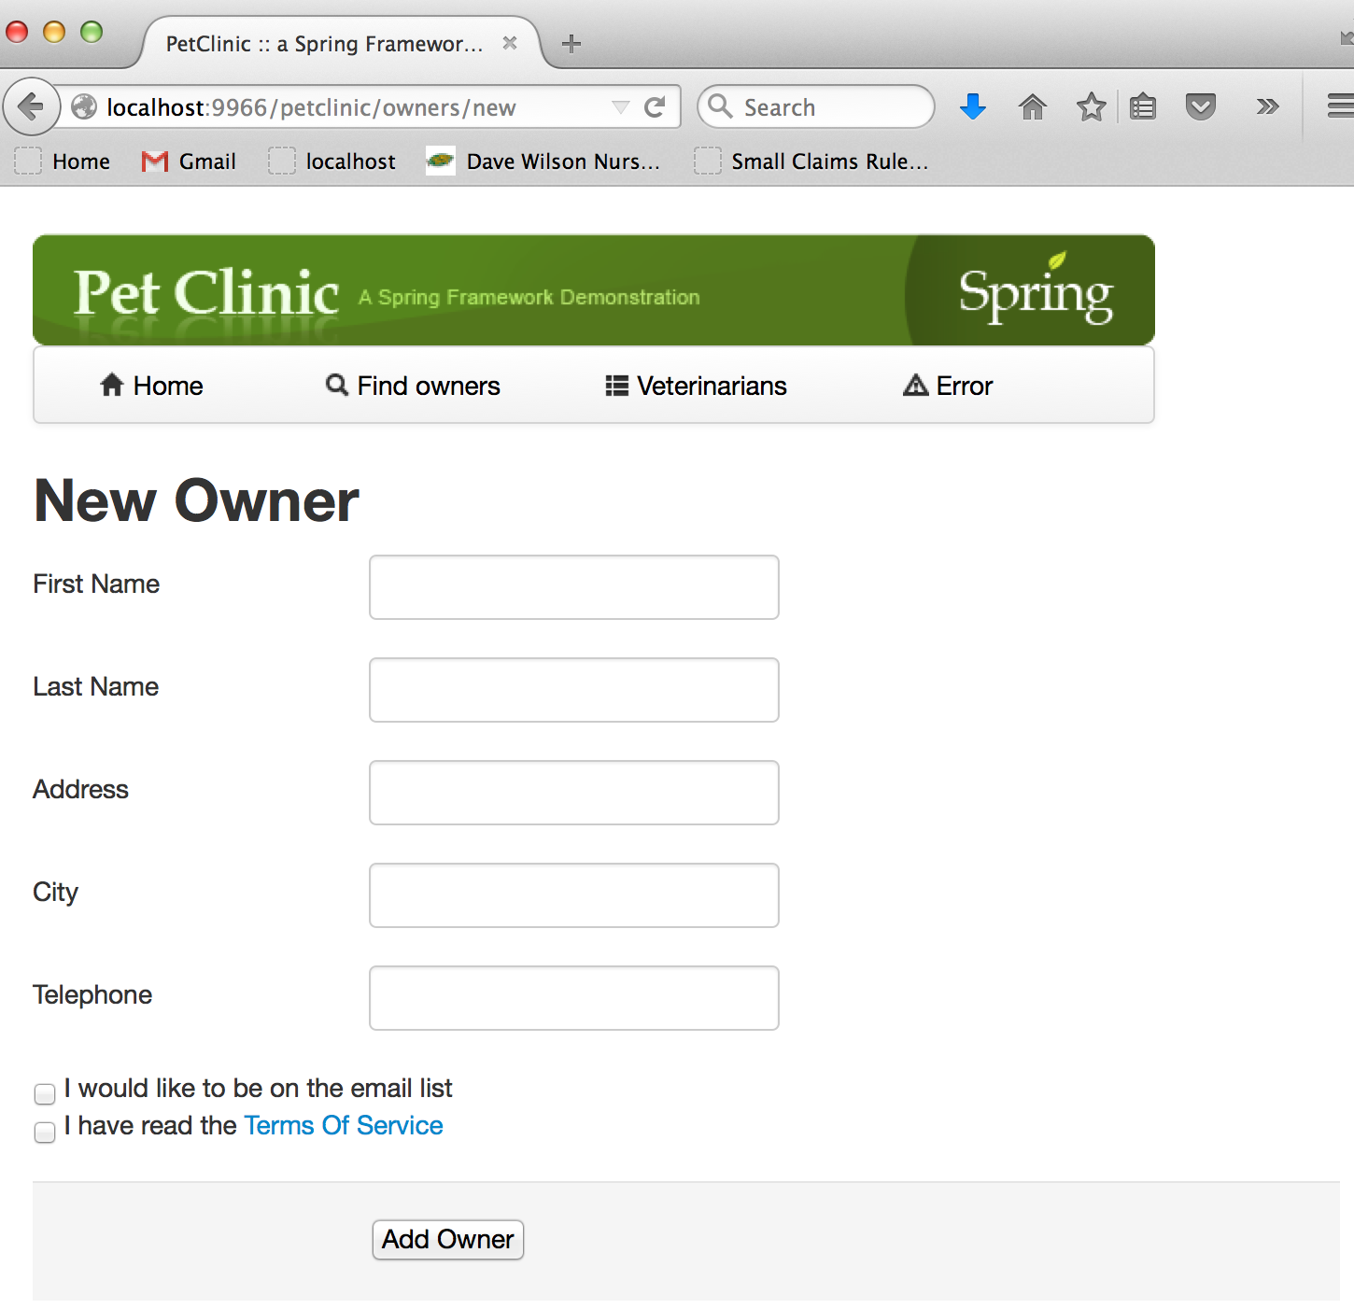
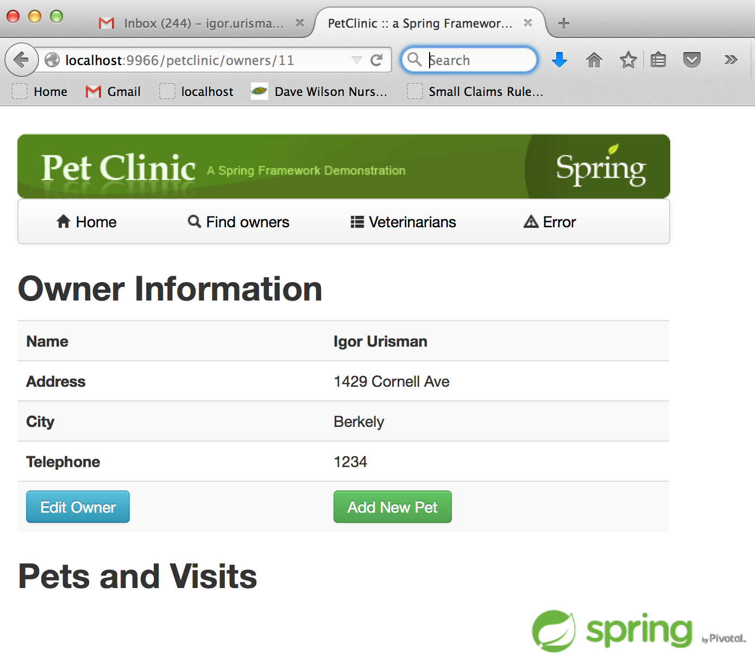
Sample Experiment
getvariant.com
One page test with 3 experiences:
outOfTheBox (control)
tosBox (variant)
tos&MailBox (variant)
5/9
© Variant, Inc.

Slide 6
Sample Experiment Schema
getvariant.com
{
'states':[
{ 'name':'newOwner',
’parameters': {
'path':'/petclinic/owners/new'
}
},
{ 'name':'ownerDetail',
’parameters': {
'path':'/petclinic/owners/~\\d+/'
}
}
],
'tests':[
{
'name':'NewOwnerTest',
'experiences':[
{
'name':'outOfTheBox',
'weight':8,
'isControl':true
},
{
'name':'tosCheckbox',
'weight':1
},
{
'name':'tos&mailCheckbox',
'weight':1
}
],
'onStates':[
{
'stateRef':'newOwner',
'variants':[
{
'experienceRef': 'tosCheckbox',
'parameters': {
'path':'/owners/new/variant/newOwnerTest.tosCheckbox'
}
},
{
'experienceRef': 'tos&mailCheckbox',
’parameters': {
'path':'/owners/new/variant/newOwnerTest.tosAndMailCheckbox'
}
}
]
},
{
'stateRef':'ownerDetail',
'isNonvariant': true
}
]
}
]
}
Schema Concepts
States & Tests.
Test Experiences. One must be control.
OnStates element ties Tests to States — basic instrumentation block.
Nonvariant instrumentation allows a view that is not a part of the test to be tracked as if it were.
Advanced path matching.
6/9
© Variant, Inc.

Slide 7
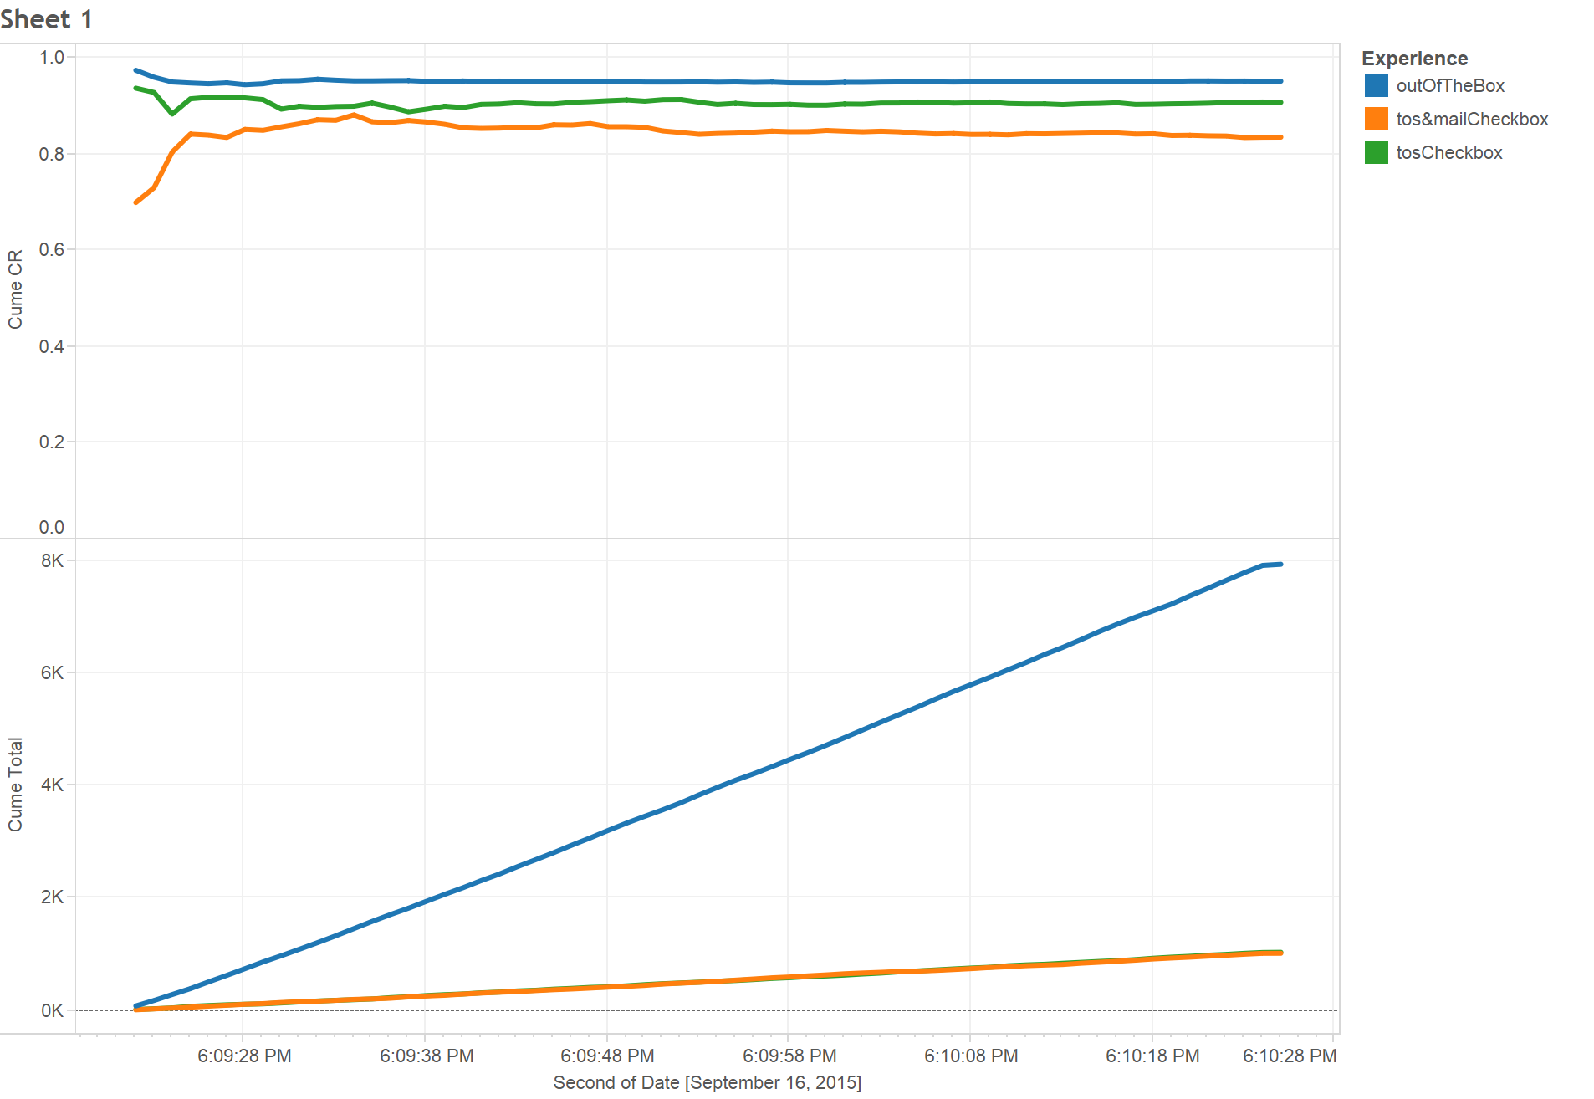
Sample Experiment Output
getvariant.com
7/9
© Variant, Inc.

Slide 8
Multi-variance
getvariant.com
S3_{green}
S3.1_{green}
Blue and Green tests are disjoint: they do not have any pages in common. Can be targeted independently.
Red test is multivariate with both Blue and Green tests: they have pages in common.
Two options: do nothing (disjoint multi-variance) or define the hybrid variants (real or covariant multi-variance).
S1_{blue}
S2_{blue}
S1
S2
S3
S2_{red.A}
S3_{red.A}
S2_{red.B}
Red Test
S2
S2_{red.A}
S2_{red.B}
Blue Test
S2_{blue}
8/9
© Variant, Inc.

Slide 9
Recap Of Main Features
getvariant.com
Novel RCT model.
Complete support for true multi-variance.
Full stack instrumentation (vertical consistency).
Consistent instrumentation of any interactive application: Web, native mobile, call center, etc. (horizontal consistency).
Two integration modes: compilation time & run time.
(Well) beyond optimization: Application Growth Management.
9/9
© Variant, Inc.

